Slide 1
Operating Systems
  Lecture 2
  Interrupt & Syscall
  IIIS & CS
  Tsinghua University
Acknowledgement:
materials from Dr. Zhang Yong Guang in MSRA,
And from http://williamstallings.com/OS/OS5e.html , http://www.os-book.com

Slide 2

Outline
Interrupts & Exceptions
  Background
  Interrupt v.s. Exception
  Interrupt Process Mechanism
  Nested Execution
Syscall
  Concept of System Calls
  System Call Implementation
  Difference between routine call and system call
System boot

Slide 3
Background
kernel is trusted third-party that runs the machine
Only the kernel can execute privileged instructions
How can a user program change to the kernel address space?
How can the kernel transfer to a user address space?
What happens when a device attached to the computer needs attention?
System Call
Device Interrupt

Slide 4
Background
  System Call (aka: Trap from user program )
  a system call invoked by a user program
  Exception (from ill program)
  an illegal instruction or other kind of bad processor state (memory fault, etc.).
  Interrupt (from device)
  timer/net interrupt from different hardware device.

Slide 5
Kernel Entry and Exit
Library Code
exceptions
(error traps)
System Call Interface
trap
Kernel
30h
system
call
table
boot
trap /
interrupt
table
scheduler
IPI: inter-
processor
interrupt
device
dialog
interrupt
page faults
Devices

Slide 6
Interrupts vs Exceptions
Hardware support for getting CPUs attention
  Often transfers from user/kernel to kernel mode
    Nested interrupts are possible; interrupt can occur while an interrupt handler is already executing (in kernel mode)
  Asynchronous: device or timer generated hardware event
    Unrelated to currently executing process
  Synchronous: immediate result of last instruction
    Often represents a hardware error condition
Intel terminology and hardware
  Irqs, vectors, IDT, gates, PIC, APIC
Interrupt handling: data structures, flow of control
Delayed Handlers: softirqs, tasklets, bottom halves

Slide 7
Interrupts vs Exceptions
Similar to context switch (but lighter weight)
  Hardware saves a small amount of context on stack
  Includes interrupted instruction if restart needed
  Execution resumes with special “iret” instruction
Structure: top and bottom halves
  Top-half: do minimum work and return
  Bottom-half: deferred processing
Handler code executed in response
  Possible to temporarily mask interrupts
  Handlers need not be reentrant
  But other interrupts can occur, causing nesting

Slide 8
Interrupt Process Mechanism
An interrupt is an internal or external event that forces a hardware call to a function called an interrupt service routine.
  Interrupt Enable Flag must be set [CPU initialization]
    Internal or external event forces interrupt flag to be set
    Event forces routine at interrupt vector to be called
hardware

Slide 9
Interrupt Process Mechanism
software
  Processor state must be preserved [compiler]
  Interrupt service routine (ISR) must process data [os developer’s code]
  Interrupt flag must be cleared [os developer’s code]
  Processor state must be restored [compiler]

Slide 10
Nested Execution
Interrupts can be interrupted
  By different interrupts; handlers need not be reentrant
  No notion of priority in Linux
  Small portions execute with interrupts disabled
  Interrupts remain pending until acked by CPU
Exceptions can be interrupted
  By interrupts (devices needing service)
Exceptions can nest two levels deep
  Exceptions indicate coding error
  Exception code (kernel code) shouldn’t have bugs
  Page fault is possible (trying to touch user data)

Slide 11
Outline
Interrupts & Exceptions
  Background
  Interrupt v.s. Exception
  Interrupt Process Mechanism
  Nested Execution
Syscall
  Concept of System Calls
  System Call Implementation
  Difference between routine call and system call
System boot

Slide 12
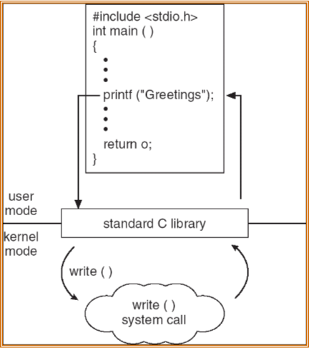
Standard C Library Example
  C program invoking printf() library call, which calls write() system call

Slide 13
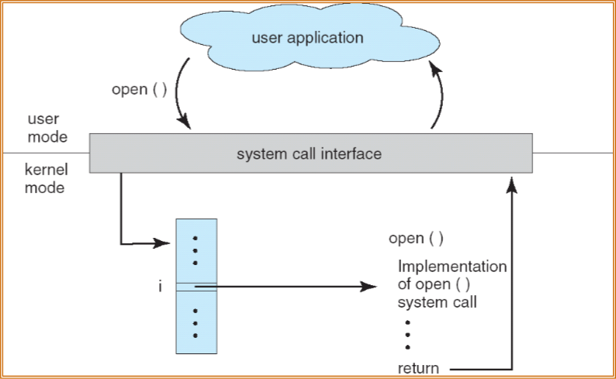
API – System Call – OS Relationship

Slide 14
System Calls
Programming interface to the services provided by the OS
Typically written in a high-level language (C or C++)
Mostly accessed by programs via a high-level Application Program Interface (API) rather than direct system call use
Three most common APIs
  Win32 API for Windows
  POSIX API for POSIX-based systems (including virtually all versions of UNIX, Linux, and Mac OS X)
  Java API for the Java virtual machine (JVM)

Slide 15
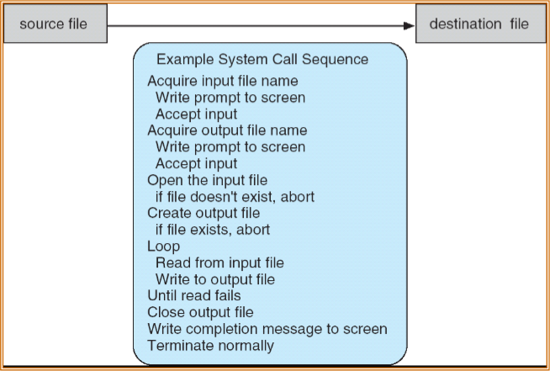
Example of System Calls
// System call numbers
#define SYS_fork 1
#define SYS_exit 2
#define SYS_wait 3
#define SYS_pipe 4
#define SYS_write 5
#define SYS_read 6
#define SYS_close 7
#define SYS_kill 8
#define SYS_exec 9
#define SYS_open 10
#define SYS_mknod 11
#define SYS_unlink 12
#define SYS_fstat 13
#define SYS_link 14
#define SYS_mkdir 15
#define SYS_chdir 16
#define SYS_dup 17
#define SYS_getpid 18
#define SYS_sbrk 19
#define SYS_sleep 20
#define SYS_procmem 21
  System call sequence to copy the contents of one file to another file

Slide 16
Example of user-level syscall API
  Consider read() function in ucore—a function for reading from a file
    in user/libs/file.h: int read(int fd, void * buf, int length)
  A description of the parameters passed to read()
    int fd—the file to be read
    void * buf—a buffer where the data will be read into and written from
    int length—the number of bytes to be read into the buffer
    int return_value: the number of bytes that readed
  Example
    in sfs_filetest1.c: ret = read(fd, data, len);

Slide 17
Example of user-level syscall API
    in sfs_filetest1.c: ret=read(fd,data,len);
……
8029a1: 8b 45 10 mov 0x10(%ebp),%eax
8029a4: 89 44 24 08 mov %eax,0x8(%esp)
8029a8: 8b 45 0c mov 0xc(%ebp),%eax
8029ab: 89 44 24 04 mov %eax,0x4(%esp)
8029af: 8b 45 08 mov 0x8(%ebp),%eax
8029b2: 89 04 24 mov %eax,(%esp)
8029b5: e8 33 d8 ff ff call 8001ed <read>
syscall(int num, ...) {
...
asm volatile (
"int %1;"
: "=a" (ret)
: "i" (T_SYSCALL),
"a" (num),
"d" (a[0]),
"c" (a[1]),
"b" (a[2]),
"D" (a[3]),
"S" (a[4])
: "cc", "memory");
return ret;

Slide 18
System Call Implementation
  Typically, a number associated with each system call
    System-call interface maintains a table indexed according to these numbers
  The system call interface invokes intended system call in OS kernel and returns status of the system call and any return values
  The caller need know nothing about how the system call is implemented
    Just needs to obey API and understand what OS will do as a result call
    Most details of OS interface hidden from programmer by API
      Managed by run-time support library (set of functions built into libraries included with compiler)

Slide 19
Steps in Making a System Call
alltraps(): in kern/trap/trapentry.S
trap(): tf->trapno == T_SYSCALL , in kern/trap/trap.c
syscall(): tf->tf_regs.reg_eax ==SYS_read, in /kern/syscall/syscall.c
sys_read(): get fd, buf, length from tf->sp, in kern/syscall/syscall.c
sysfile_read(): read file content, in kern/fs/sysfile.c
trapret(): in kern/trap/trapentry.S
There are 6 important steps in making the system call read (fd, buffer, length)

Slide 20
System Call Parameter Passing
  Often, more information is required than simply identity of desired system call
    Exact type and amount of information vary according to OS and call
  Three general methods used to pass parameters to the OS
    Simplest: pass the parameters in registers
      In some cases, may be more parameters than registers
    Parameters stored in a block, or table, in memory, and address of block passed as a parameter in a register
      This approach taken by Linux and Solaris
    Parameters placed, or pushed, onto the stack by the program and popped off the stack by the operating system (ucore methord)
    Block and stack methods do not limit the number or length of parameters being passed

Slide 21
Difference between routine call and system call
int or trap are used for system call
  Ring level and stack are switched during system call
call or jmp are used for routine call
  No stack switch during routine call
Reference: http://www.intel.com/products/processor/manuals/index.htm

Slide 22
Cost of Crossing the “Kernel Barrier”
more than a procedure call
less than a context switch
costs:
  vectoring mechanism
  establishing kernel stack
  validating parameters
  kernel mapped to user address space?
    updating page map permissions
  kernel in a separate address space?
    reloading page maps
    invalidating cache, TLB

Slide 23
Outline
Interrupts & Exceptions
  Background
  Interrupt v.s. Exception
  Interrupt Process Mechanism
  Nested Execution
Syscall
  Concept of System Calls
  System Call Implementation
  Difference between routine call and system call
System boot

Slide 24
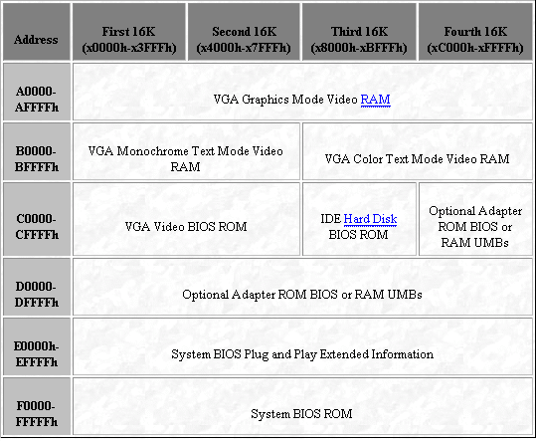
Memory Map at Power up
FREE SPACE
0x100000
1MB
MAPPED TO
ROM
0x0A0000
FREE SPACE
640KB
0x000000

Slide 25
ROM shadowing
The address space occupied by BIOS Roms is not available as useful RAM.
BIOS can make use of this RAM to shadow its ROM.
Write protects this shadowed RAM, disables ROM.

Slide 26
Start up Sequence
CS:IP = 0xf000:fff0.
Starts in real mode.
  16 bit mode.
  IP = 16 bit offset
  CS = Segment offset in 16 byte units.
  i.e PC = 16*CS+IP
  Max: 1MB of address space.
  A20 pain from the past.

Slide 27
Start up Sequence
POST(Power on self test)
Looks for video card and executes its BIOS.
Looks for other option ROMS e.g IDE disk.
Does more system inventory e.g COM ports, setting hard disk params.
Plug and play support.
Sets up IDT and the interrupt service routines

Slide 28
BIOS contd…
Looks for bootable media.
Loads Boot sector(512 bytes) of the media at 0x7c00 .
Jumps to CS:IP = 0000:7c00 with DL=drive id of bootable drive.
BIOS data area from 0x0000 to 0x7c00.
(Contains IDT,ISR’s and data).

Slide 29
BIOS system calls
BIOS provides low level I/O routines through interrupts.
Main services are:
  INT 15h: Get memory map.
  INT 13h: Disk I/O interrupts.
  INT 19h: Bootstrap loader.

Slide 30
Memory Map at this stage
0x00100000 (1MB)
BIOS ROM
VGA
0xA0000 (640KB)
FREE
SPACE
BOOT
SECTOR
0x7C00
BIOS DATA
0x0000

Slide 31
Switches processor into 32-bit mode
# Switch from real to protected mode, using a bootstrap GDT
# and segment translation that makes virtual addresses
# identical to physical addresses, so that the
# effective memory map does not change during the switch.
lgdt gdtdesc
movl %cr0, %eax
orl $CR0_PE_ON, %eax
movl %eax, %cr0
# Jump to next instruction, but in 32-bit code segment.
# Switches processor into 32-bit mode.
ljmp $PROT_MODE_CSEG, $protcseg
.code32 # Assemble for 32-bit mode

Slide 32
This week’s Work
Finish lab #1
  Deadline: March 07, 2014

