Slide 1
Operating Systems
Lecture 5
Virtual Memory Management: Page Fault
Department of Computer Science & Technology
Tsinghua University

Slide 2
Review
Computer Arch/Memory Hierarchy
Address Space & Address Generation
Contiguous Memory Allocation
Dynamic Allocation of Partitions
Non-Contiguous Memory Allocation
Segmentation
Paging
Page Table
Paged Segmentation Model

Slide 3
Outline
Virtual Memory & Principle of Locality
Address Translation for VM
Method of Virtual Memory
Page Fault Handling
Mechanisms for Implementing VM
Virtual Memory Performance
Notes:
基本思路：把一部分不常用的内容放到外存中；
问题：
1)外存比内存慢，为什么可以把部分地址空间放到外存，系统不慢反而快？
2)如果要访问的地址空间不在内存，操作系统需要如何处理？
3)放在外存的地址空间可能在什么地方？对换区、可执行文件、库；
4)如果可以把一部分地址空间放在内存，哪些地址空间放在内存？如何动态调整这些放在内存中的地址空间？算法的近似实现：精度与速度的折中。
5)如何预测未来近期会访问哪些地址空间？
6)有哪些因素会影响这个预测？
7)性能问题：如果好访问的地址空间在外存，性能下降。如何在空间和速度间进行折中？

Slide 4
Memory Management Goals
Support multiprogramming
Provide the abstraction of address space
Enforce isolation and protection
Enable new programming models like shared memory
Manage memory resource and use them efficiently
Utilize the memory hierarchy
Better resource allocation algorithms

Slide 5
Method of Virtual Memory
Virtual memory – separation of user logical memory from physical memory.
Only part of the program needs to be in memory for execution.
Logical address space can therefore be much larger than physical address space.
Allows address spaces to be shared by several processes.
Allows for more efficient process creation.
Virtual memory can be implemented via:
Demand paging
Demand segmentation

Slide 6
Characteristics of Paging and Segmentation
Memory references are dynamically translated into physical addresses at run time
a process may be swapped in and out of main memory such that it occupies different regions
A process may be broken up into pieces (pages or segments) that do not need to be located contiguously in main memory
Hence: all pieces of a process do not need to be loaded in main memory during execution
computation may proceed for some time if the next instruction to be fetch (or the next data to be accessed) is in a piece located in main memory

Slide 7
Principle of Locality
Program and data references within a process tend to cluster
Only a few pieces of a process will be needed over a short period of time
Possible to make intelligent guesses about which pieces will be needed in the future
This suggests that virtual memory may work efficiently
Temporal locality
Spatial locality
Branch locality
Notes:
时间局部性：一条指令的一次执行和下次执行，一个数据的一次访问和下次访问都集中在一个较短时期内；
空间局部性：当前指令和邻近的几条指令，当前访问的数据和邻近的数据都集中在一个较小区域内。
局部性原理的具体体现
程序在执行时，大部分是顺序执行的指令，少部分是转移和过程调用指令。
过程调用的嵌套深度一般不超过5，因此执行的范围不超过这组嵌套的过程。
程序中存在相当多的循环结构，它们由少量指令组成，而被多次执行。
程序中存在相当多对一定数据结构的操作，如数组操作，往往局限在较小范围内。
http://en.wikipedia.org/wiki/Locality_of_reference
Branch locality: if there are only few amount of possible alternatives for the prospective part of the path in the spatial-temporal coordinate space. This is the case when an instruction loop has a simple structure, or the possible outcome of a small system of conditional branching instructions is restricted to a small set of possibilities. Branch locality is typically not a spatial locality since the few possibilities can be located far away from each other.

Slide 8
Outline
Virtual Memory & Principle of Locality
Address Translation for VM
Method of Virtual Memory
Page Fault Handling
Mechanisms for Implementing VM
Virtual Memory Performance
Notes:
基本思路：把一部分不常用的内容放到外存中；
问题：
1)外存比内存慢，为什么可以把部分地址空间放到外存，系统不慢反而快？
2)如果要访问的地址空间不在内存，操作系统需要如何处理？
3)放在外存的地址空间可能在什么地方？对换区、可执行文件、库；
4)如果可以把一部分地址空间放在内存，哪些地址空间放在内存？如何动态调整这些放在内存中的地址空间？算法的近似实现：精度与速度的折中。
5)如何预测未来近期会访问哪些地址空间？
6)有哪些因素会影响这个预测？
7)性能问题：如果好访问的地址空间在外存，性能下降。如何在空间和速度间进行折中？

Slide 9
Support Needed for Virtual Memory
Hardware
must support paging and/or segmentation
Operating system
must be able to management the movement of pages and/or segments between secondary memory and main memory

Slide 10
Paging for VM
Program
P
A page table maps logical pages to physical frames
(f,o)
CPU
MMU
P’s
Logical
Address
Space
p
o
f
o
Physical
Memory
20
10
9
1
16
10
9
1
Logical
Addresses
(p,o)
Physical
Addresses
f
MEMORY
EXCEPTION
p
invalid
PTBR
Page Table
Notes:
We need something to tell use where in physical memory pages are located.
— All computer science problems are solved by adding a level of indirection!
Virtual to physical mappings are done through a mapping table called a page table.
— A page table is just a (per-process) data structure maintained inside the operating system.
— The mapping between pages and frames is arbitrary. Any pages can (in principle) appear in any page frame.
Lots of issues here.
— How to determine which entries in the page table are valid at any one time.
— Aren’t page tables huge? (How wide are they? How tall are they?)

Slide 11
Address Translation for VM
Mapping from logical address space to physical memory space
MM: L->P
Each process has its own mapping
How memory management achieves isolation?
Each concurrent process is mapped to disjointed physical space
How to support sharing (e.g., shared libraries)?
Shared segment (or page) of two or more processes is mapped to the same physical address
If translation fails: memory exception

Slide 12
Shared Page
(p,o)
2
fn = 2
f n= 0
57
fn = 3
fn = 1
f n= 1
1
A’s
Page Table
B’s
Page Table
jmp(p,o)
0
Physical Memory

Slide 13
Memory Exceptions
Must be dealt with in all memory models
Memory access issues in MMU
When do memory exceptions happen?
Contiguous Allocation: address out-of-bound (LIMIT)
Segmentation: address out-of-bound
Segmentation: segmentation number doesn’t exist
Paging: page not mapped to a frame
What happens when there is memory exception?
MMU will raise the exception line in CPU
CPU will jump to the corresponding exception handler (an kernel subroutine pre-registered to this exception type)
Now up to the handler to do what is necessary (like kill the process, or do something else)

Slide 14
Outline
Virtual Memory & Principle of Locality
Address Translation for VM
Method of Virtual Memory
Page Fault Handling
Mechanisms for Implementing VM
Virtual Memory Performance
Notes:
基本思路：把一部分不常用的内容放到外存中；
问题：
1)外存比内存慢，为什么可以把部分地址空间放到外存，系统不慢反而快？
2)如果要访问的地址空间不在内存，操作系统需要如何处理？
3)放在外存的地址空间可能在什么地方？对换区、可执行文件、库；
4)如果可以把一部分地址空间放在内存，哪些地址空间放在内存？如何动态调整这些放在内存中的地址空间？算法的近似实现：精度与速度的折中。
5)如何预测未来近期会访问哪些地址空间？
6)有哪些因素会影响这个预测？
7)性能问题：如果好访问的地址空间在外存，性能下降。如何在空间和速度间进行折中？

Slide 15
Virtual Memory
Problem: how can one support running programs that requires more memory than the computer’s physical main memory?
The concept of virtual memory
Process views memory by logical (virtual) address space
Only part of the logical address space needs to be in main memory at a given time
Other parts may be in secondary storage (e.g., disk)
The resident place may change dynamically (on-demand)
Secondary storage can be viewed as an “extension” of physical memory
Abstraction: “infinite” amount of main memory!

Slide 16
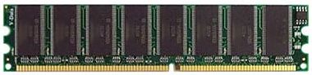

Virtual Memory Concept
Operating System
OS abstraction: Address Space
P1
P2
P3
Kernel
0
2³²
0
2³²
0
2³²
0
2³²
0
m
M>>m
Cache
MMU
Hardware

Slide 17
Demand Paging: a Mechanism for VM
Based on the Paging model
Some pages are mapped to frames in main memory
Some pages are not (but in secondary storage)
Page table entry has a flag (resident bit) to denote which case
If CPU needs to access an address in a page that is not in main memory, the whole page should be loaded in memory first
Demand paging memory management
OS should maintain the mapping and know where each page is stored in secondary storage

Slide 18
Outline
Virtual Memory & Principle of Locality
Address Translation for VM
Method of Virtual Memory
Page Fault Handling
Mechanisms for Implementing VM
Virtual Memory Performance
Notes:
基本思路：把一部分不常用的内容放到外存中；
问题：
1)外存比内存慢，为什么可以把部分地址空间放到外存，系统不慢反而快？
2)如果要访问的地址空间不在内存，操作系统需要如何处理？
3)放在外存的地址空间可能在什么地方？对换区、可执行文件、库；
4)如果可以把一部分地址空间放在内存，哪些地址空间放在内存？如何动态调整这些放在内存中的地址空间？算法的近似实现：精度与速度的折中。
5)如何预测未来近期会访问哪些地址空间？
6)有哪些因素会影响这个预测？
7)性能问题：如果好访问的地址空间在外存，性能下降。如何在空间和速度间进行折中？

Slide 19
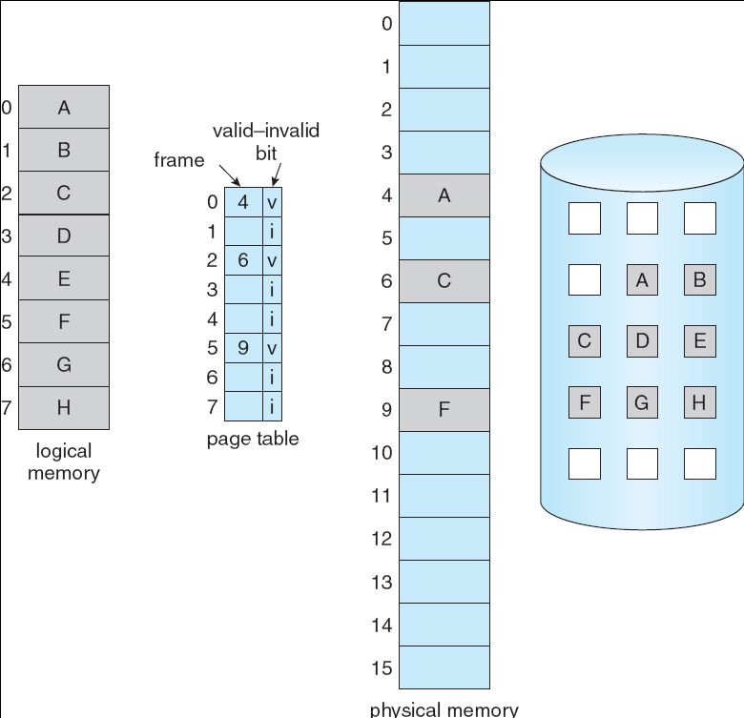
Resident Bit in Page Table
A valid/invalid bit in the page table entry
If page is mapped to a frame in main memory, the page is resident (or the entry is “valid”)
MMU translates as usual
Otherwise: the entry is invalid.

Slide 20
What if a Page is not in Main Memory
Demand paging
If CPU access an address of a page that is not in memory
OS must load the page from secondary storage into a frame in main memory (before CPU can access the page)
Step 1: find a frame for this page
Most likely there is not free frame
Find a frame in use and replace the content
Involve replacement policy (which page to replace)
May involve writing content to secondary storage
Step 2: load the content of the page
Update the page table with new mapping (Page->Frame)
CPU can now access the page
Q: How does OS know?

Slide 21
Paging Hardware Checking Resident Bit
CPU
MEMORY
EXCEPTION:
PAGE FAULT
MMU
p
o
f
o
if bit is
“invalid”
20
10
9
1
16
10
9
1
Logical
Addresses
Physical
Addresses
PTBR
+
0
1
0
f
p
Page Table

Slide 22
Page Fault Handling
CPU jumps to the exception handler (an OS kernel subroutine pre-registered to page fault exception)
Check if it is really a valid/legal location in logical address space
If not, send memory fault signal or abort process
Pick a page/frame to swap out (may involve write I/O)
Request a read I/O for the missing page (secondary storage)
Block the process and put in waiting state (why?)
Call scheduler (to schedule other processes)
In interrupt handler (upon above I/O finishes)
Maps the missing page into memory (i.e., update the page table)
Resume the faulting process (put to ready state)

Slide 23
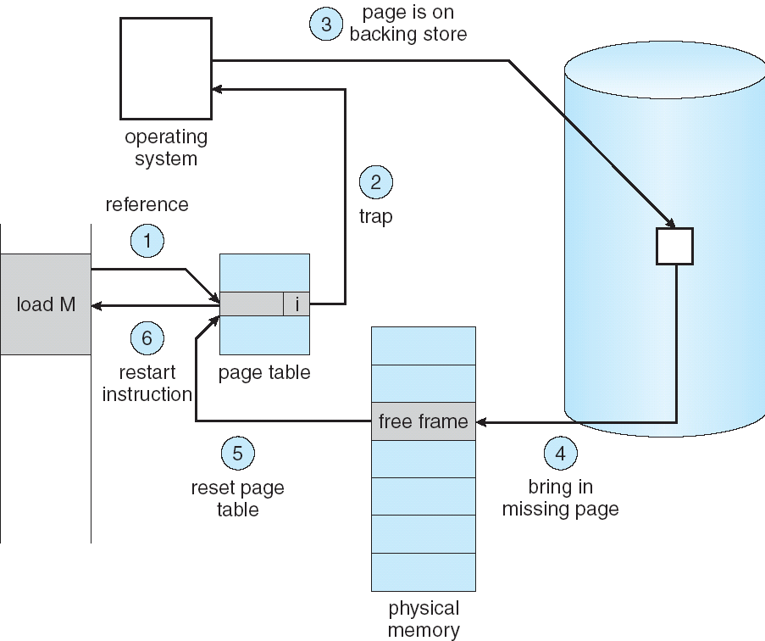
Page Fault Handling

Slide 24
Outline
Virtual Memory & Principle of Locality
Address Translation for VM
Method of Virtual Memory
Page Fault Handling
Mechanisms for Implementing VM
Virtual Memory Performance
Notes:
基本思路：把一部分不常用的内容放到外存中；
问题：
1)外存比内存慢，为什么可以把部分地址空间放到外存，系统不慢反而快？
2)如果要访问的地址空间不在内存，操作系统需要如何处理？
3)放在外存的地址空间可能在什么地方？对换区、可执行文件、库；
4)如果可以把一部分地址空间放在内存，哪些地址空间放在内存？如何动态调整这些放在内存中的地址空间？算法的近似实现：精度与速度的折中。
5)如何预测未来近期会访问哪些地址空间？
6)有哪些因素会影响这个预测？
7)性能问题：如果好访问的地址空间在外存，性能下降。如何在空间和速度间进行折中？

Slide 25
Outline
Principle of Locality & Address Translation
Virtual Memory
Mechanisms for Implementing VM
Dirty Bit
Backing Store
Virtual Memory Performance
Local Page Replacement
Global Page Replacement
Belady Phenomenon

Slide 26
Mechanisms for Implementing VM
Demand paging
Based on paging
Bring a page into memory only when it is needed
Page fault: mechanism to implement demand paging
Other mechanisms
Demand segmentation
Swapping (of the whole process)
Replacement policy
Selecting which page (or segment, or process) to be replaced

Slide 27
Dirty Bit
Another flag in page table entry
Whether the page has had write access since it is mapped to the main memory
If yes, the page is called a “dirty” page
A dirty page must be written to secondary storage when it is picked for replacement
May slow down the access to a missing page
A pager program may run in the background and periodically “clean” the dirty pages in memory
According to some strategy

Slide 28
Backing Store
Where to keep the unmapped pages?
Must be easy to identify the pages in secondary storage
Swap space (partition or file): specially formatted for storing the unmapped pages
The concept of backing store
A page (in virtual address space) can be mapped to a location in a file (in secondary storage)
Code segment: mapped to the executable binary file
Dynamically loaded shared library segment: mapped to the dynamically loaded library file
Other segment: may be implicitly mapped to swap file

Slide 29
Outline
Virtual Memory & Principle of Locality
Address Translation for VM
Method of Virtual Memory
Page Fault Handling
Mechanisms for Implementing VM
Virtual Memory Performance
Notes:
基本思路：把一部分不常用的内容放到外存中；
问题：
1)外存比内存慢，为什么可以把部分地址空间放到外存，系统不慢反而快？
2)如果要访问的地址空间不在内存，操作系统需要如何处理？
3)放在外存的地址空间可能在什么地方？对换区、可执行文件、库；
4)如果可以把一部分地址空间放在内存，哪些地址空间放在内存？如何动态调整这些放在内存中的地址空间？算法的近似实现：精度与速度的折中。
5)如何预测未来近期会访问哪些地址空间？
6)有哪些因素会影响这个预测？
7)性能问题：如果好访问的地址空间在外存，性能下降。如何在空间和速度间进行折中？

Slide 30
Virtual Memory Performance
To understand the overhead of paging, compute the effective memory access time (EAT)
EAT = memory access time * probability of a page hit +
page fault service time * probability of page fault
Example:
Memory access time: 10 ns
Disk access time: 5 ms
Let p = the probability of a page fault
Let q = the probability of a dirty page
EAT = 10(1–p) + 5,000,000p(1+q) ?
Notes:
Overhead in paging is severe!
— Perform a disk I/O just to reference a memory location?!
20 ns memory — on a 50 MHz bus (old), one transfer takes 20 ns.
To have an EAT within 5% of minimum (20 ns), a memory access can take no more than 20(1+0.05) = 21 ns. Thus solving for p in the EAT formula gives:
21 ns = 20 ns  (1–p) + 25,000,000 ns p
1 = 24,999,980p
p = 0.000,000,04 (0.000,004%)
Less than one fault every 25,000,000 references!
— 1 fault every 500 ms.
If we achieve no more than one fault every 25M references then paging slows us down by at most 5%.
— Is this fault rate reasonable?

Slide 31
Recap of Virtual Memory Management
Key concept: Demand paging
Load pages into memory only when a page fault occurs
Issues:
Placement strategies
Place pages anywhere – no placement policy required
Replacement strategies
What to do when there exist more jobs than can fit in memory
Load control strategies
Determining how many jobs can be in memory at one time
Long-term scheduling
Notes:
Although we didn’t deal with these issues explicitly, they all apply to the partitioning schemes we looked at previously.
Note on load control:
— Load control in the small (when to load pages), and
— Load control in the large (when to load processes).
The latter is the same as medium/long-term scheduling.

Slide 32
System Design Exercise
Many computer architecture maintain 4 bits per TLB entries: resident, used, dirty, read-only
Will raise exception if write access to read-only page
Suggest how you can do that in OS

Slide 33
Q&A

