Slide 1
Introduction to Database File (tdb)
Part 1
CompuTherm, LLC, Madison, Wisconsin, USA http://www.computherm.com
June 2015

Slide 2
Element
Element Zn HCP_A3 65.39 5656.7 41.631 !
keyword
structure
H₂₉₈
end of definition
element name
atomic weight
(g/mol)
S₂₉₈
Note
Pandat has a built-in table of atomic weights of elements.
If a compound (e.g., Al2O3) is defined as an element, its atomic weight has to be specified in the definition.
Pandat does not use structure, H₂₉₈ and S₂₉₈ in current version.

Slide 3
Function
Function GHCPAl 298.15 5481-1.8*T+GHSERAl; 6000 N !
keyword
temperature range
temperature range
end of definition
function name
function expression
end of function
$G_{Al}^{HCP}=$5481-1.8T +$G_{Al}^{HSER}\left( J/mol\right) (298.15K≤T≤6000K)$

Slide 4
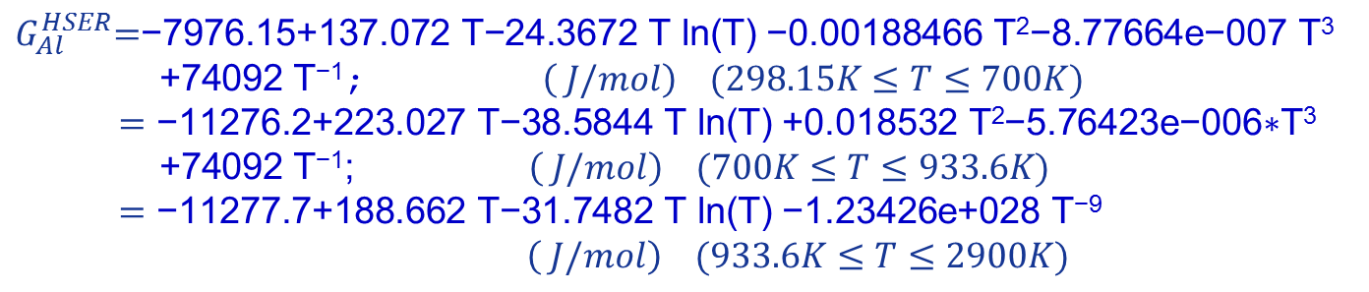
Function (multiple ranges)
function name
keyword
range 1
Function GHSERAl 298.15 -7976.15+137.072*T-24.3672*T*ln(T)
-0.00188466*T**2-8.77664e-007*T**3+74092*T**(-1); 700 Y
-11276.2+223.027*T-38.5844*T*ln(T)
+0.018532*T**2-5.76423e-006*T**3+74092*T**(-1); 933.6 Y
-11277.7+188.662*T-31.7482*T*ln(T)
-1.23426e+028*T**(-9); 2900 N !
range 2
continued
range 3
temperature range
$G_{Al}^{HSER}\text{=}\text{−7976.15+137.072} \text{T}\text{−24.3672 }\text{T} \text{ln}\text{(}\text{T}\text{)}$ $\text{−0.00188466} \text{T}\text{2}\text{−8.77664}\text{e}\text{−007} \text{T}\text{3}$
$\text{+74092} \text{T}\text{−1}\text{;} \left( J/mol\right) (298.15K≤T≤700K)$
$=\text{−11276.2+223.027} \text{T}\text{−38.5844 }\text{T} \text{ln}\text{(}\text{T}\text{)}$ $\text{+0.018532} \text{T}\text{2}\text{−5.76423}\text{e}\text{−006∗}\text{T}\text{3}$
$\text{+}\text{74092} \text{T}\text{−1}\text{;} \left( J/mol\right) (700K≤T≤933.6K)$
$=\text{−11277.7+188.662} \text{T}\text{−31.7482 }\text{T} \text{ln}\text{(}\text{T}\text{)}$ $\text{−1.23426}\text{e}\text{+028 }\text{T}\text{−9}$
$\left( J/mol\right) (933.6K≤T≤2900K)$

Slide 5
Type Defintion
Type_Definition a GES A_P_D FCC_A1 Magnetic -3 0.28!
keyword
keyword
phase name
f
data-type code
p
property
append
phase
description
p : the fraction of the magnetic enthalpy absorbed above the critical temperature, depends on the structure
P(BCC_A2) = 0.40
P(!BCC_A2) = 0.28
f : a magnetic factor for Tc<0 and Bmag<0
if (Tc<0) then Tc/f → Tc and Bmag/f → Bmag

Slide 6
Species
Species Al2O3 Al2O3 !
keyword
definition
species
name
Species CuO Cu1O1 !
keyword
definition
species
name

Slide 7
Phase
Phase Liquid % 1 1 !
keyword
number of
sublattices
phase
name
sublattice size

Slide 8
Constituent
Constituent Liquid :Al,Mg,Zn:!
keyword
constituents on sublattice
phase
name

Slide 9

Parameter
Phase Liquid % 1 1 !
Constituent Liquid :Al,Mg,Zn:!
Parameter G(Liquid,Al;0) 298.15 +GLIQAl; 3000 N !
keyword
Phase name
function
power index
of interaction
type
constituent
$x_{Al}$ $G_{Al}^{Liquid,0}$
where
$G_{Al}^{Liquid,0}=$GLIQAl$\left( J/mol\right) (298.15K≤T≤3000K)$

Slide 10

Parameter
Phase Liquid % 1 1 !
Constituent Liquid :Al,Mg,Zn:!
Parameter G(Liquid,Al,Zn;1) 298.15 -810+0.471*T; 6000 N !
keyword
Phase name
function
power index
of interaction
type
constituents
$$x_{Al}x_{Zn}{(x_{Al}{−x}_{Zn})}^{1} L_{Al,Zn}^{Liquid,1}$$
where
$L_{Al,Zn}^{Liquid,1}=$-810+0.471*T $\left( J/mol\right) (298.15K≤T≤6000K)$

Slide 11
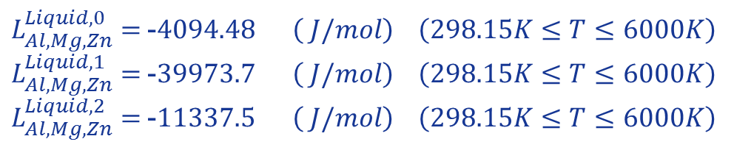
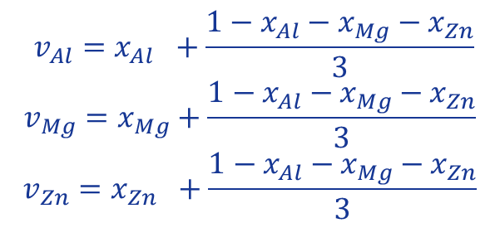
Parameter
Parameter G(Liquid,Al,Mg,Zn;0) 298.15 -4094.48; 6000 N !
Parameter G(Liquid,Al,Mg,Zn;1) 298.15 -39973.7; 6000 N !
Parameter G(Liquid,Al,Mg,Zn;2) 298.15 -11337.5; 6000 N !
$x_{Al}x_{Mg}x_{Zn}$($v_{Al}L_{Al,Mg,Zn}^{Liquid,0}+v_{Mg}L_{Al,Mg,Zn}^{Liquid,1}+v_{Zn}L_{Al,Mg,Zn}^{Liquid,2}$)
where
$$v_{Al}=x_{Al} +\frac{1−x_{Al}−x_{Mg}−x_{Zn}}{3}$$
$$v_{Mg}=x_{Mg}+\frac{1−x_{Al}−x_{Mg}−x_{Zn}}{3}$$
$$v_{Zn}=x_{Zn} +\frac{1−x_{Al}−x_{Mg}−x_{Zn}}{3}$$
and
$L_{Al,Mg,Zn}^{Liquid,0}=$-$4094.48 \left( J/mol\right) \left(298.15K≤T≤6000K\right)$
$L_{Al,Mg,Zn}^{Liquid,1}=$-$39973.7 \left( J/mol\right) \left(298.15K≤T≤6000K\right)$
$L_{Al,Mg,Zn}^{Liquid,2}=$-$11337.5 \left( J/mol\right) \left(298.15K≤T≤6000K\right)$

Slide 12
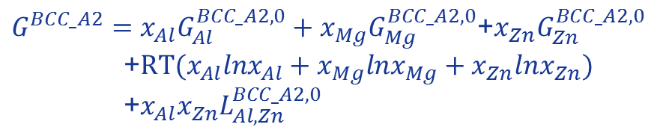
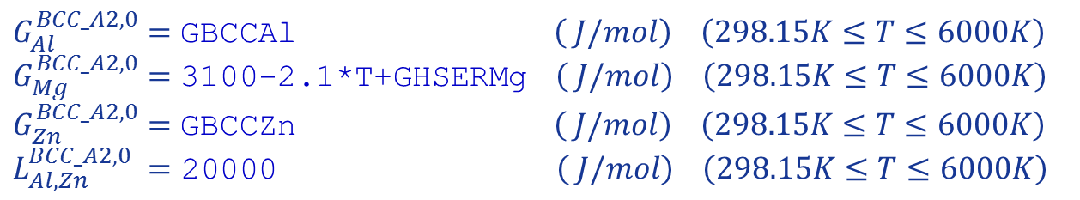
Parameter
Phase BCC_A2 %c 1 1 !
Constituent BCC_A2 :Al,Mg,Zn:!
Parameter G(BCC_A2,Al;0) 298.15 +GBCCAl; 6000 N !
Parameter G(BCC_A2,Mg;0) 298.15 3100-2.1*T+GHSERMg; 6000 N !
Parameter G(BCC_A2,Zn;0) 298.15 +GBCCZn; 6000 N !
Parameter G(BCC_A2,Al,Zn;0) 298.15 20000; 6000 N !
$G^{BCC_A2}=x_{Al}G_{Al}^{BCC_A2,0}+x_{Mg}G_{Mg}^{BCC_A2,0}$+$x_{Zn}G_{Zn}^{BCC_A2,0}$
+$RT(x_{Al}lnx_{Al}+x_{Mg}lnx_{Mg}+x_{Zn}lnx_{Zn})$
+$x_{Al}x_{Zn}L_{Al,Zn}^{BCC_A2,0}$
where
$$G_{Al}^{BCC_A2,0}=\text{GBCCAl} \left( J/mol\right) \left(298.15K≤T≤6000K\right)$$
$$G_{Mg}^{BCC_A2,0}=\text{3100−2.1∗}\text{T}\text{+}\text{GHSERMg} \left( J/mol\right) \left(298.15K≤T≤6000K\right)$$
$$G_{Zn}^{BCC_A2,0}=\text{GBCC}\text{Zn} \left( J/mol\right) \left(298.15K≤T≤6000K\right)$$
$$L_{Al,Zn}^{BCC_A2,0} =\text{20000} \left( J/mol\right) \left(298.15K≤T≤6000K\right)$$

Slide 13
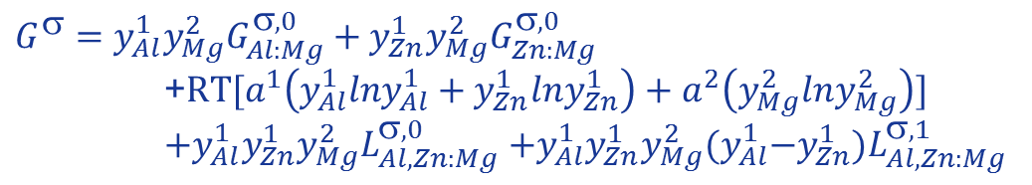
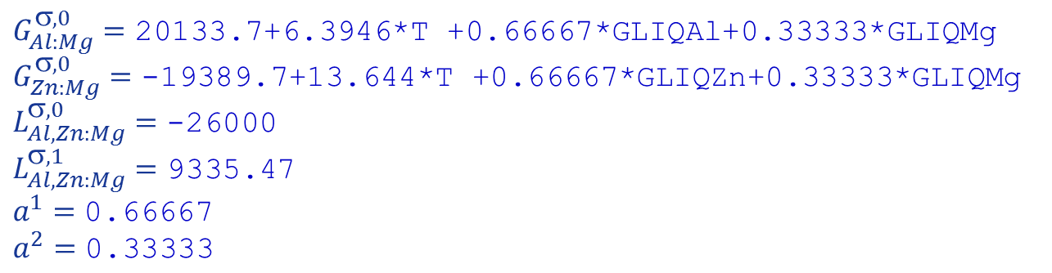
Parameter
Phase SIGMA % 2 0.66667 0.33333 !
Constituent SIGMA :Al,Zn:Mg:!
Parameter G(SIGMA,Al:Mg;0) 298.15 20133.7+6.3946*T +0.66667*GLIQAl+0.33333*GLIQMg; 3000 N !
Parameter G(SIGMA,Zn:Mg;0) 298.15 -19389.7+13.644*T +0.66667*GLIQZn+0.33333*GLIQMg; 3000 N !
Parameter G(SIGMA,Al,Zn:Mg;0) 298.15 -26000; 3000 N !
Parameter G(SIGMA,Al,Zn:Mg;1) 298.15 9335.47; 3000 N !
$$G^{}=y_{Al}^{1}y_{Mg}^{2}G_{Al:Mg}^{,0}+y_{Zn}^{1}y_{Mg}^{2}G_{Zn:Mg}^{,0}$$
+$RT[a^{1}\left(y_{Al}^{1}lny_{Al}^{1}+y_{Zn}^{1}lny_{Zn}^{1}\right)+a^{2}\left(y_{Mg}^{2}lny_{Mg}^{2}\right)]$
$+y_{Al}^{1}y_{Zn}^{1}y_{Mg}^{2}L_{Al,Zn:Mg}^{,0}$ $+y_{Al}^{1}y_{Zn}^{1}y_{Mg}^{2}(y_{Al}^{1}{−y}_{Zn}^{1})L_{Al,Zn:Mg}^{,1}$
where
$$G_{Al:Mg}^{σ,0}=\text{20133.7+6.3946∗}\text{T}\text{ +0.66667∗}\text{GLIQAl}\text{+0.33333∗}\text{GLIQMg}$$
$$G_{Zn:Mg}^{σ,0}=\text{−19389.7+13.644∗}\text{T}\text{ +0.66667∗}\text{GLIQZn}\text{+0.33333∗}\text{GLIQMg}$$
$$L_{Al,Zn:Mg}^{σ,0}=\text{−26000}$$
$$L_{Al,Zn:Mg}^{σ,1}=\text{9335.47}$$
$$a^{1}=\text{0.66667}$$
$$a^{2}=\text{0.33333}$$

Slide 14
For any questions and comments, contact CompuTherm by email:
info@computherm.com

