Slide 1
Singapore Job Analytics
A dashboard for jobseekers and career switchers
10-minute project presentation
Dataset-driven view of demand, salary, accessibility, and skill signals

Slide 2
1. Why This Project Matters
The dashboard is built around career decisions, not just data exploration.
Core audience
Decision it supports
Singapore-based jobseekers
Career switchers comparing pathways
Students or fresh graduates planning first roles
Which sectors are hiring?
Which roles are accessible?
What salary range can I expect?
Which visible skill signals appear in job titles?
Main question: Which roles and skillsets should I consider to improve employability?

Slide 3
2. Data Foundation
The CSV turns advertised job postings into measurable career signals.
Processed postings
Period
Categories
Career tracks
1,036,725
Mar 2023 to May 2024
43
9
Important fields used in the dashboard
title: advertised position or role name
category: industry or job-function area
salary and experience: market expectation and accessibility
applications and views: rough interest or competition signals
position level and title keywords: seniority, career track, and visible skill signals
A job title is specific; a category gives the wider labour-market context.

Slide 4
3. From Raw CSV to Dashboard Metrics
The analysis converts posting fields into jobseeker-friendly views.
Raw postings
→
Clean & classify
→
Aggregate metrics
→
Interactive filters
Primary category is extracted from the category list.
Role family is classified from title keywords.
Seniority is inferred from position level, title, and minimum experience.
Skillsets are title-based signals, such as SQL, Python, Excel, Java, sales, or analytics.

Slide 5
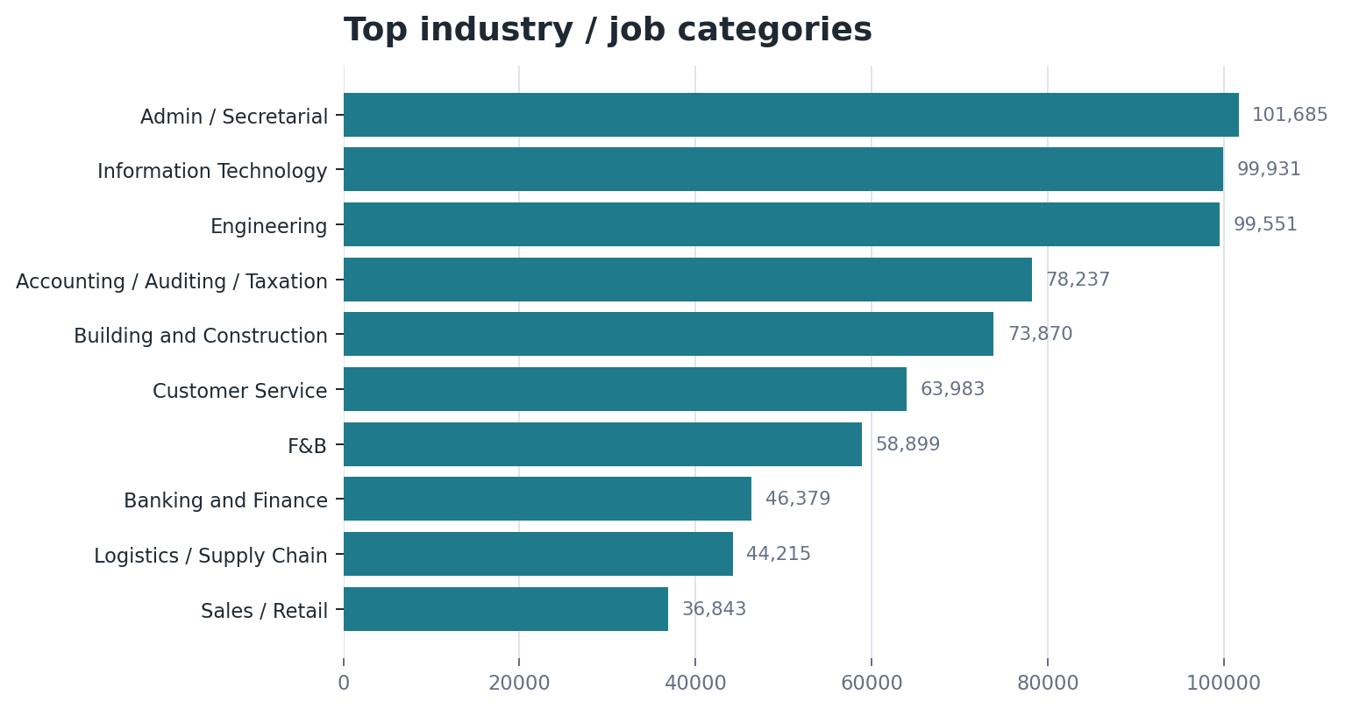
4. Market Demand by Category
Categories show the broad sectors and functions with the most advertised activity.
How to interpret this
High count means more advertised openings.
Categories help jobseekers compare broad career areas.
A role can appear across sectors, so category and title should be analysed together.
Jobseeker takeaway: start with active sectors, then inspect the actual titles inside them.

Slide 6
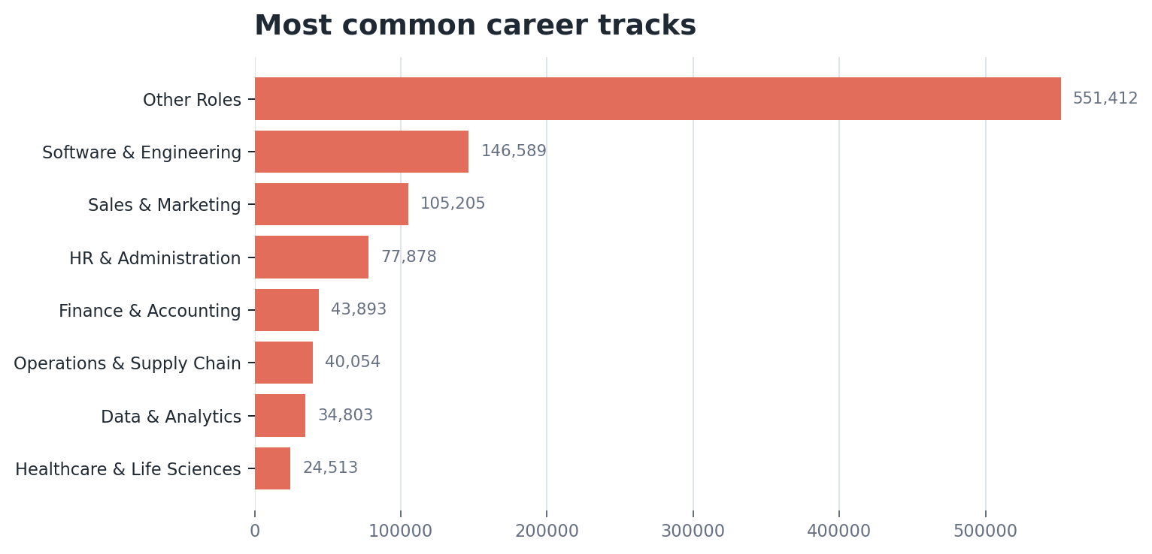
5. Role Families Translate Titles into Career Tracks
Job titles are messy, so the dashboard groups them into clearer pathways.
Why this matters
Titles answer: What job is advertised?
Role families answer: What career track does it belong to?
This helps users discover alternative titles they may not have searched for.
Example: analyst, data analyst, BI analyst, and reporting analyst can be viewed as related pathways.

Slide 7
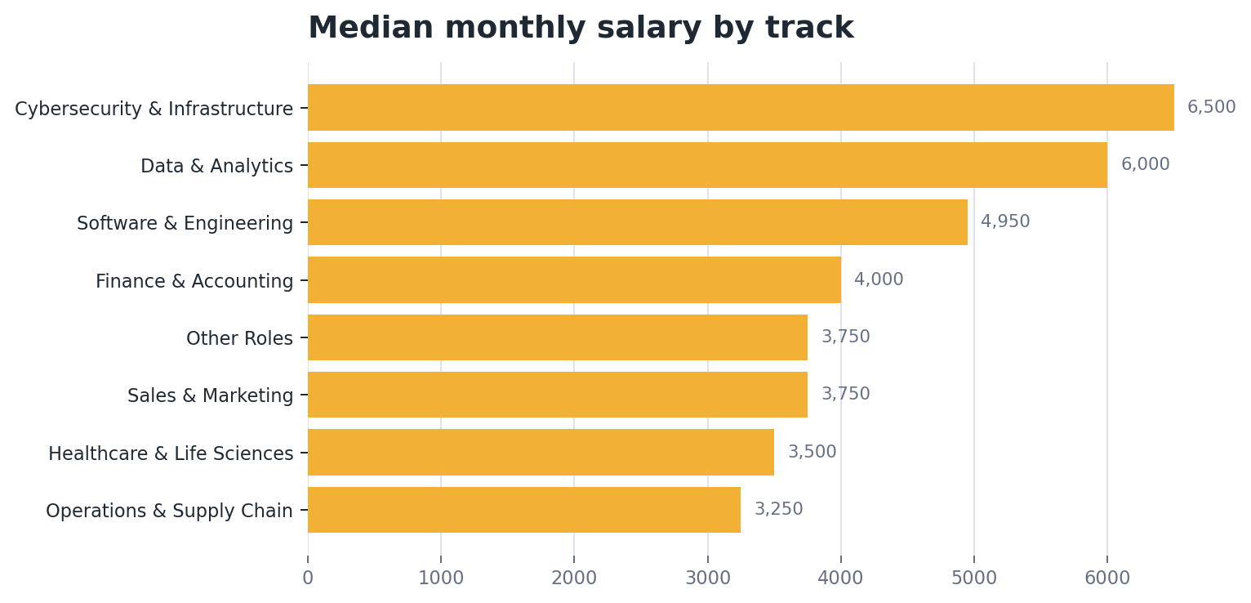
6. Salary and Accessibility
Salary becomes more useful when combined with experience and seniority.
Median monthly salary
S$3,850
Median required experience
2.0 yrs
A high-paying role may not be realistic for an entry-level switcher.
A moderate salary with low experience requirements may be a better first target.

Slide 8
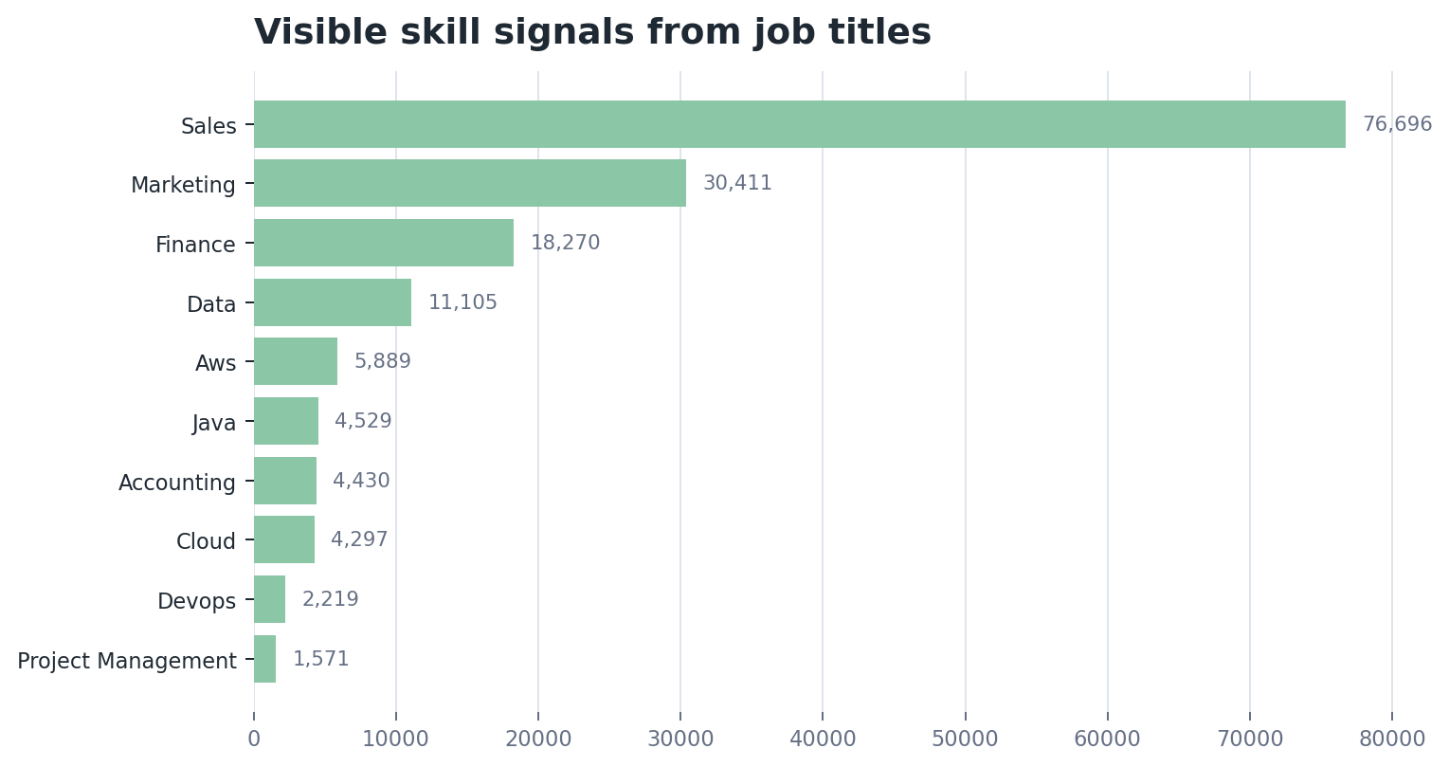
7. Skillset Signals
The dashboard can suggest visible skill signals, but it cannot fully replace job descriptions.
What this can say
Skills visible in job titles can highlight role direction.
Examples include SQL, Python, Excel, Java, sales, finance, and analytics.
Important limitation
The CSV does not include full job descriptions.
So skill counts are signals, not complete skill requirements.

Slide 9
8. Who Else Benefits?
The same dataset can support different dashboard designs for different decisions.
Training providers
Course planning
High-demand role families, visible skill signals, salary outcomes
Employers / HR
Hiring competitiveness
Salary benchmark, applications, views, similar postings
Policy teams
Labour-market planning
Sector demand, entry-level access, high-demand/low-application gaps
Career coaches
Guidance conversations
Alternative titles, accessible roles, salary and competition signals
Design principle: each audience needs different metrics because each audience has a different decision to make.

Slide 10
9. Conclusion and Next Steps
The dashboard is useful now, and stronger with richer job-description data.
What the project delivers
Recommended improvements
Career exploration by sector, role family, seniority, salary, and experience
Job explorer for comparing real advertised positions
Title-based skill signals for early career planning
Add full job descriptions for stronger skill extraction
Map role titles to a formal skills taxonomy
Track trends over time and separate active vs closed postings
Add role pathway recommendations for career switchers
Final message: the dashboard helps users move from “What jobs exist?” to “Which career direction should I explore next?”

