Slide 1




How they blame: Comparison between AI and human across cultures
Shuang Zoe Wang, The Education University of Hong Kong
Emma E. Buchtel, The Education University of Hong Kong

Slide 2
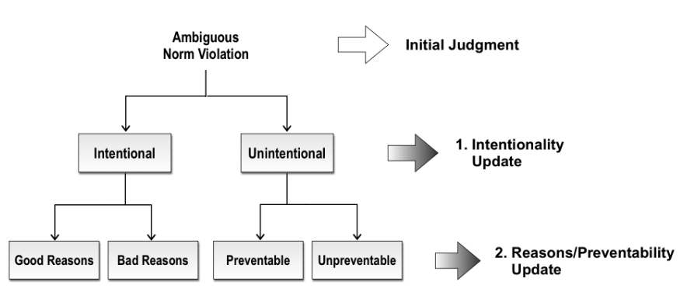
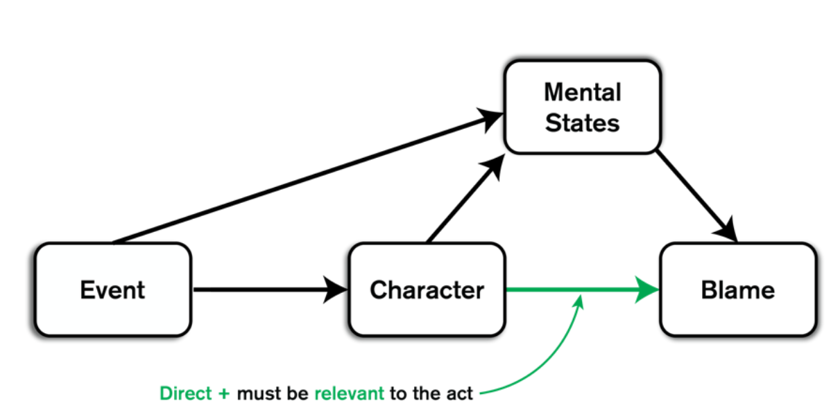
The path model of blame
Socially shaped blame judgment
Inaccurate blame → additional costs like retaliation and damaged ingroup relationships → need warrants to prove that the judgment is justified and correct.
Intentionality, Reasons, Preventability
Cultural differences in morality definition
Harmful: “Someone stuck a pin into a child’s palm”
Budaode: “Someone didn't offer to help his mother carry her bags of groceries”
Figure 1. The Path Model of Blame (Monroe & Malle, 2018)
Question 1: Are existing factors enough to explain the blame judgment across cultures?
Figure 2. Two-Channel Model (Murray et al., 2024)

Slide 3
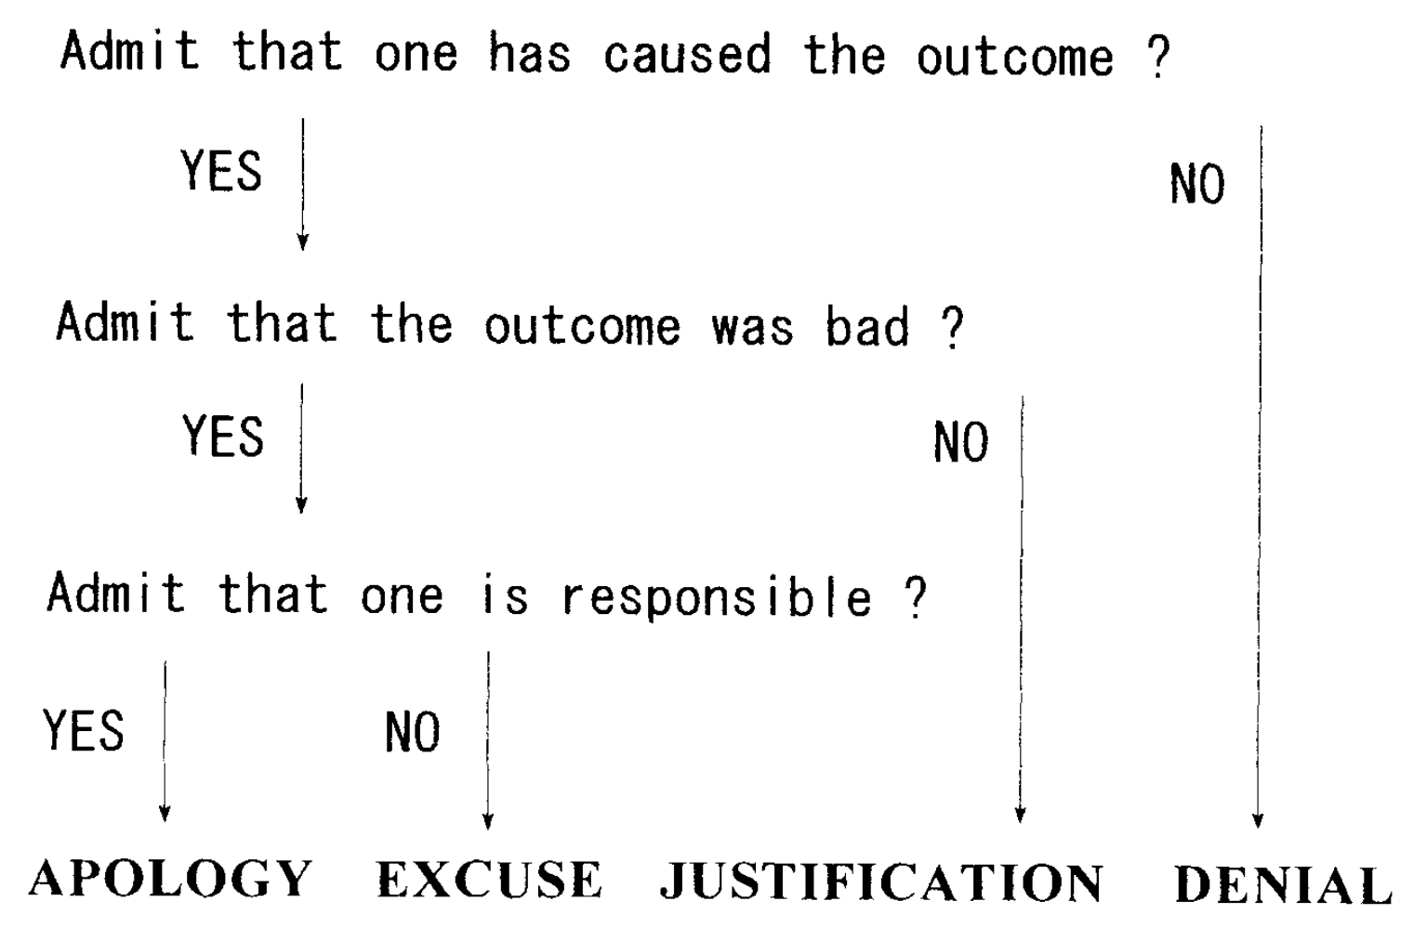
New factors?
After violating norms, people will create statements to explain the unexpected or unwanted behaviors, which are called accounts (Gill, 2000).
Cultural differences in the preference for accounts: More collectivistic cultures like Japan rely more on apologies and excuses than Americans (Itoi et al., 1996)
Figure 3. The classification system of accounts (Itoi et al., 1996)
Question 2: Will new factors affect the blame judgment, especially for budaode behaviors?

Slide 4
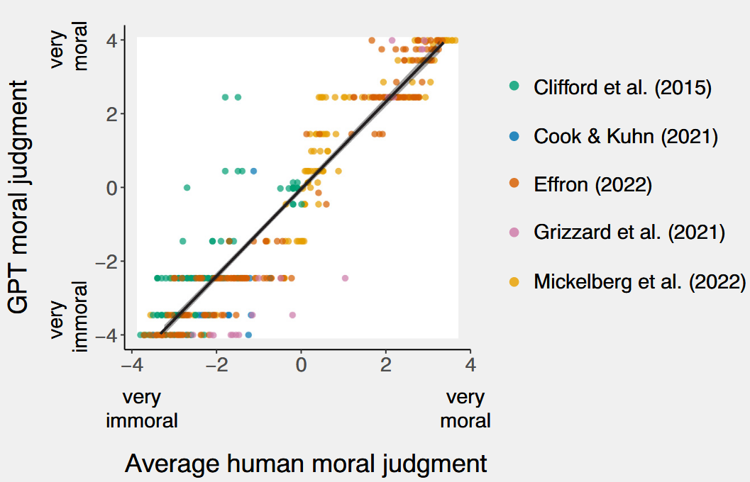
Blame in AI
AI helps us to study Human beings
Understanding the behavior of AI, specifically LLM, can better assist human decision-making (Meng, 2024).
The moral judgments of GPT-3.5 were extremely well aligned with human moral judgments (Dillion et al., 2023).
Comparing the moral judgments of humans versus GPT (Dillion et al., 2023)

Slide 5

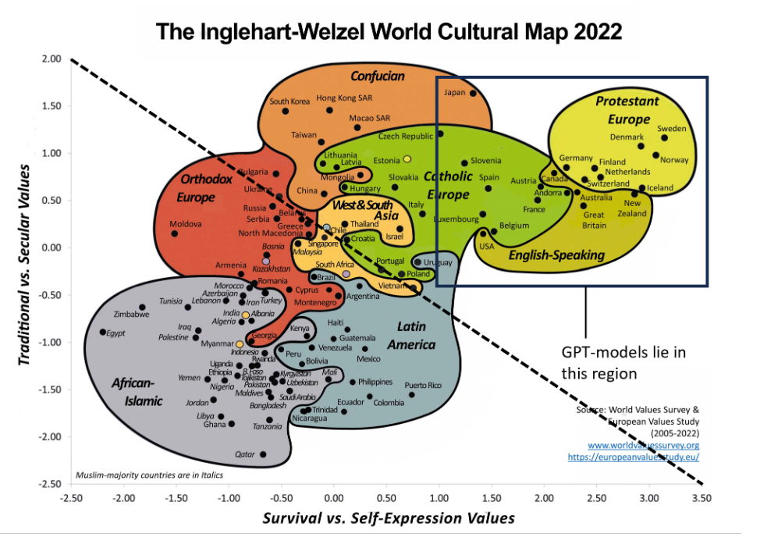
Example: Social robot as teachers to judge student’s immoral behaviors
Blame in AI
Human findings to improve AI and Human alignment
The importance of AI & Human alignment
Cultural bias in AI
Training data dominated by Western corpora → Biased value, more similar to Western cultures (Yao et al., 2025).
LLMs reflect culturally situated biases rather than a universal ethical framework (Segerer, 2025).
Prompt language affects LLM responses (Lu et al., 2025; Cao et al., 2023).
Question 3: Will AI participants and human participants show similar mechanism for blame judgment?
A representation of current LLMs with the world-cultural map (Rao et al., 2023)

Slide 6
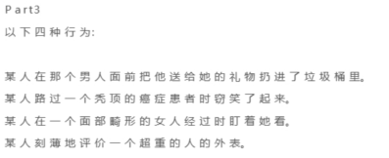
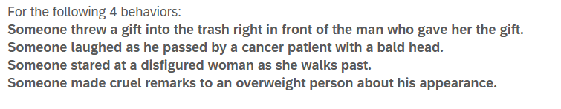
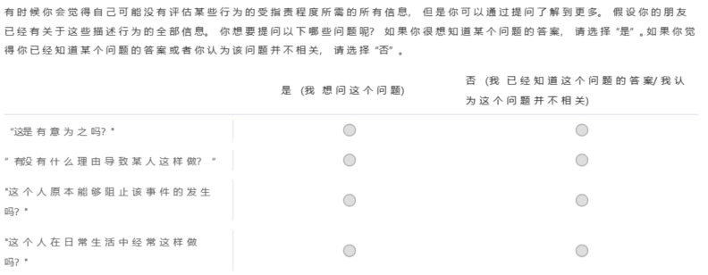
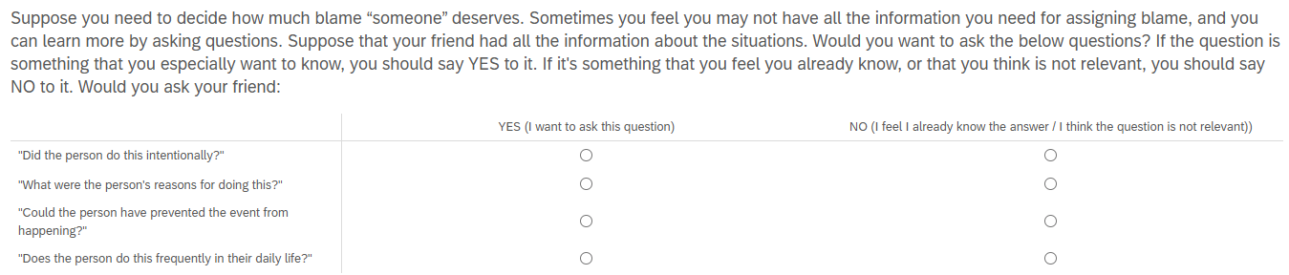
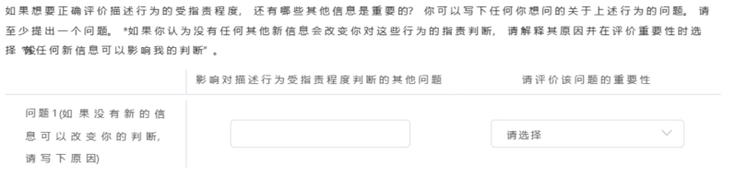
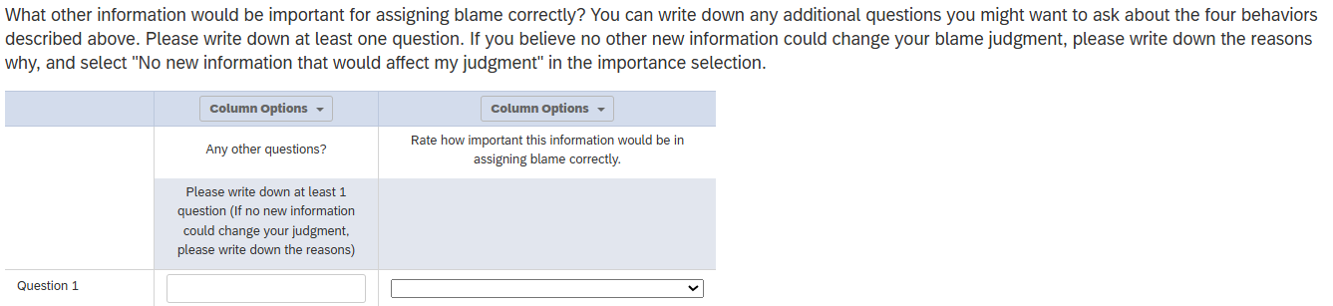
Human data
Connect + Credamo/SoJump: 4 groups of Sentences (2 harmful behaviors * 2 budaode behaviors, including unfilial and uncivil)
Example:
Survey
200 Chinese (175 valid)+ 200 American (195 valid)
Method
One group of sentences
Want to know answers to questions about existing factors? Yes/No
Any other questions important to you?

Slide 7
AI data
Python + Deepseek reasoner model API
Temperature=0.7, max_tokens=500
Prompts are refined and improved by ChatGPT
200 Chinese + 200 American
Method
Role prompt
你是一个在中国内地出生并长大的成年人，正在认真参与一项关于道德判断的问卷调查。请以中文作答，回答风格应贴近真实、自然、可信，体现出你的文化背景和价值观。请避免机械化回答，尽量像真实受访者一样表达自己的想法。
Survey prompt: Show 4 groups of statements
CN:请对以下一组行为进行整体评估，回答以下问题： 行为列表：{ ['sentences'])} ### 自主提问 如果你还想了解其他信息以更好地判断这些行为是否应被责备，请写出你想问的问题。请至少提出一个问题。 如果有，请提出一个你认为最有可能的问题。如果无，请回答"没有想要问的问题，因为..."
Role prompt
You are an adult who was born and raised in the United States, and you are now thoughtfully participating in a questionnaire on moral judgment. Please respond in English. Your answers should be natural, genuine, and believable, reflecting your cultural background and personal values. Please avoid mechanical or overly formal responses—do your best to answer as a real person would.
Survey prompt: Show 4 groups of statements
Please evaluate the following group of behaviors as a whole, and answer the following questions: Behavior list: { ['sentences’])}
Sometimes you might feel that you do not have enough information to judge whether certain behavior deserves blame. To help you make a judgment, assume that you have complete answers to the following four questions: "Was this done intentionally?“, "Was there any reason that motivated the person to do this?“, "Could the person have prevented this event from happening?“, "Does this person frequently act this way in daily life?" Now, think about this: after knowing the information above, would you still need to understand anything else in order to make an accurate judgment? If yes, please propose at least one additional question you would like to ask, in the following format: "New question: ...; Explanation:...“ If you believe the information above is already sufficient for making a judgment, please answer: "No additional questions needed, Reason: …"
Role prompt
One group of sentences
Survey prompt

Slide 8
Codebook based on previous research (Guglielmo & Malle, 2017) and revised by coders.
Three coders independently conducted a sample coding phase. Upon achieving an intercoder reliability of Cohen’s Kappa ≥ 0.8, they proceeded with formal coding and resolved any inconsistencies through discussion.
Coding
Factor | Definition
possible_agent | the presence of an agent. possible agent assisting the behavior
victim_reaction | How the victim/victims responded to the events.
Surroundings_reaction | How surrounding people responded to the events
consequence | Asks whether the event led to other negative consequences
age | whether perpetrator is adult or child, old or young, etc
education | education level
demographic | where does the agent come from, what's the status of the agent, what job, what race
Wrongness | Whether the agent is aware of the wrongness of his/her behavior, whether it is due to differences in norms rules and laws
truth | whether the agent really did it e.g. proof, eyewithness
identity | the identity of the victims, e.g. minority group, good/bad person
method | whether the perpetrator did it in a cruel way
punishment | whether the agent has been punished
intentional | whether a person/group caused the event intentionally/accidentally/by accident
Enough | 1) no (just no more questions). 2)enough (the existing questions can cover) 3)obvious: the behaviors are obviously wrong/immoral 4)other reasons: not sever, not a big deal etc.
frequency | Whether agent has caused (or typically causes) similar events
Character | The agent's Character, personality, and moral Character in dailylife
incapacitating | whether the agent did the action out of free will, or whether they were forced to do so, whether they have the ability to understand the norms, whether they can control their behaviors
awareness | Whether the agent aware of the consequences that his/her behavior will cause
preventability | whether the agent was able to prevent the event from happening
reason | agent’s reasons for bringing about the event, or whether the agent was justified in doing so
relationship | The relationship between the perpetrator and the victim e.g. what's their relationship, do they know each other,
RelationshipQuality | good/bad relationship, close/distant relationship
Apology | Whether agent admitted to causing the event or accepted responsibility/blame for it, whether agent felt remorse for the behavior, whether the agent apologized to the victims, whether the agent made amends for his/her behavior in any way, whether the agent will correct the behavior
history | whether the agent used to be victims of similar events
context | the context\situation where the agent did the action
 | General or distal experience that may influence the current behavior: Life experience, childhood experience etc. *Not immediate cause of the behaviors
FamilyUpbring | 家庭教育，观念如何形成，家教， teach, upbringing

Slide 9
Study 1：Blame factors for human data
Top 10 factors in each category in each culture

Slide 10
Budaode
Harmful
Behavior Category | Culture | Existing | Existing+ Enough
Harm | US | 46.482 | 70.603
Budaode | US | 33.333 | 61.026
Budaode | CN | 38.208 | 46.934
Harm | CN | 40.612 | 46.735
Culture | Top 10 Factors | Percentage
US | Enough | 27.692
US | Reason | 15.641
US | Relationship Quality | 11.538
US | Wrongness | 6.923
US | Experience | 4.871
US | Incapacitating | 4.359
US | Awareness | 3.590
US | Uncodable | 3.077
US | Apology | 2.821
US | Character | 2.821
CN | Reason | 15.094
CN | Awareness | 10.142
CN | Apology | 9.198
CN | Enough | 8.726
CN | Consequence | 6.840
CN | Wrongness | 6.604
CN | Relationship Quality | 5.189
CN | Family Upbring | 4.717
CN | Frequency | 4.717
CN | Uncodable | 3.302
No more questions needed
Culture | Factor | % (Top 10)
US | Enough | 24.121
US | Reason | 21.608
US | Incapacitating | 17.085
US | Frequency | 3.769
US | Apology | 3.518
US | Age | 3.015
US | Context | 2.764
US | Awareness | 2.513
US | Consequence | 2.513
US | Experience | 2.261
CN | Reason | 16.939
CN | Incapacitating | 12.653
CN | Apology | 11.633
CN | Awareness | 7.551
CN | Consequence | 6.735
CN | Enough | 6.122
CN | Character | 4.490
CN | Context | 4.286
CN | Frequency | 3.469
CN | Uncodable | 3.265
Existing factors from the model, including Denial Event, Intentionality, Preventability, Reason
Existing factors had higher percentages for US (even for budaode behaviors) than CN
US rely more on existing factors for harmful than budaode
Only slight difference in percentage of existing factors for the two groups in CN
Apology is an important new factor for all groups but the percentage in CN is much higher than that in US
Notes:
US Existing Factor + Enough = 61.026%
CN Existing Factor + Enough = 46.934%

Slide 11
Compare Apology with Other Top 10 Factors across Cultures
We used Bayesian multinomial logistic regression models to test how Culture influence the probability of asking questions of each factor compared with that of asking information about apology.

Slide 12
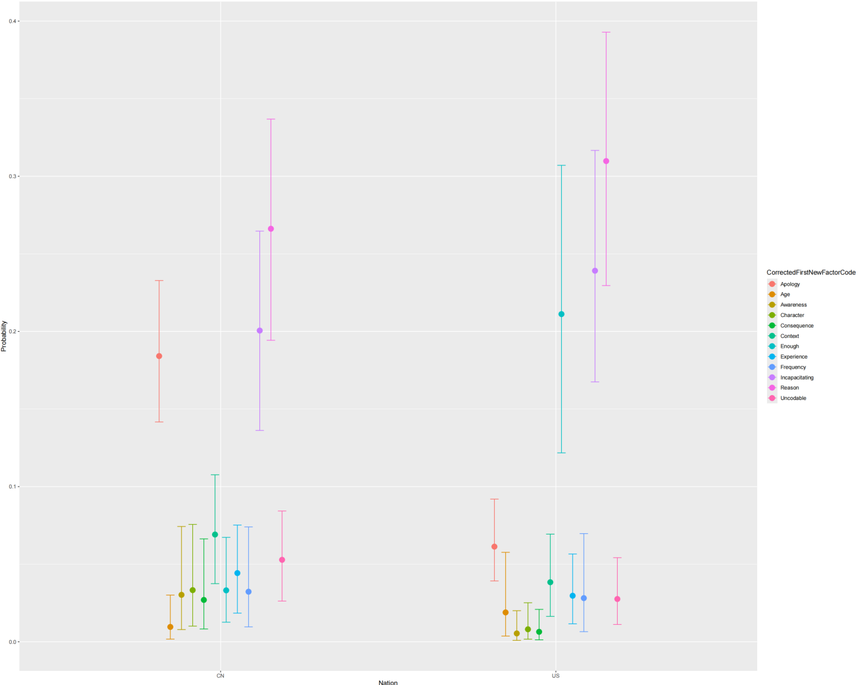
Harm Human Data
For Chinese, when comparing apology to other factors:
the Chinese are less likely to ask questions about
Age
Awareness
Character
Context
Enough
Consequence
Experience
Frequency
The probability of asking questions about apology is similar to that of questions about:
Incapacitating (+)
Reason (+)
Compared to Chinese, US participants have a higher probability to ask questions about……than questions about apology:
Enough
Age
Incapacitating
Reason
When comparing US and CN, no significant differences when asking following questions than apology questions:
Awareness
Character
Consequence
Context
Experience
Frequency
The predicted probability
Apology still important
Existing factors also important
Rely more on existing factors

Slide 13
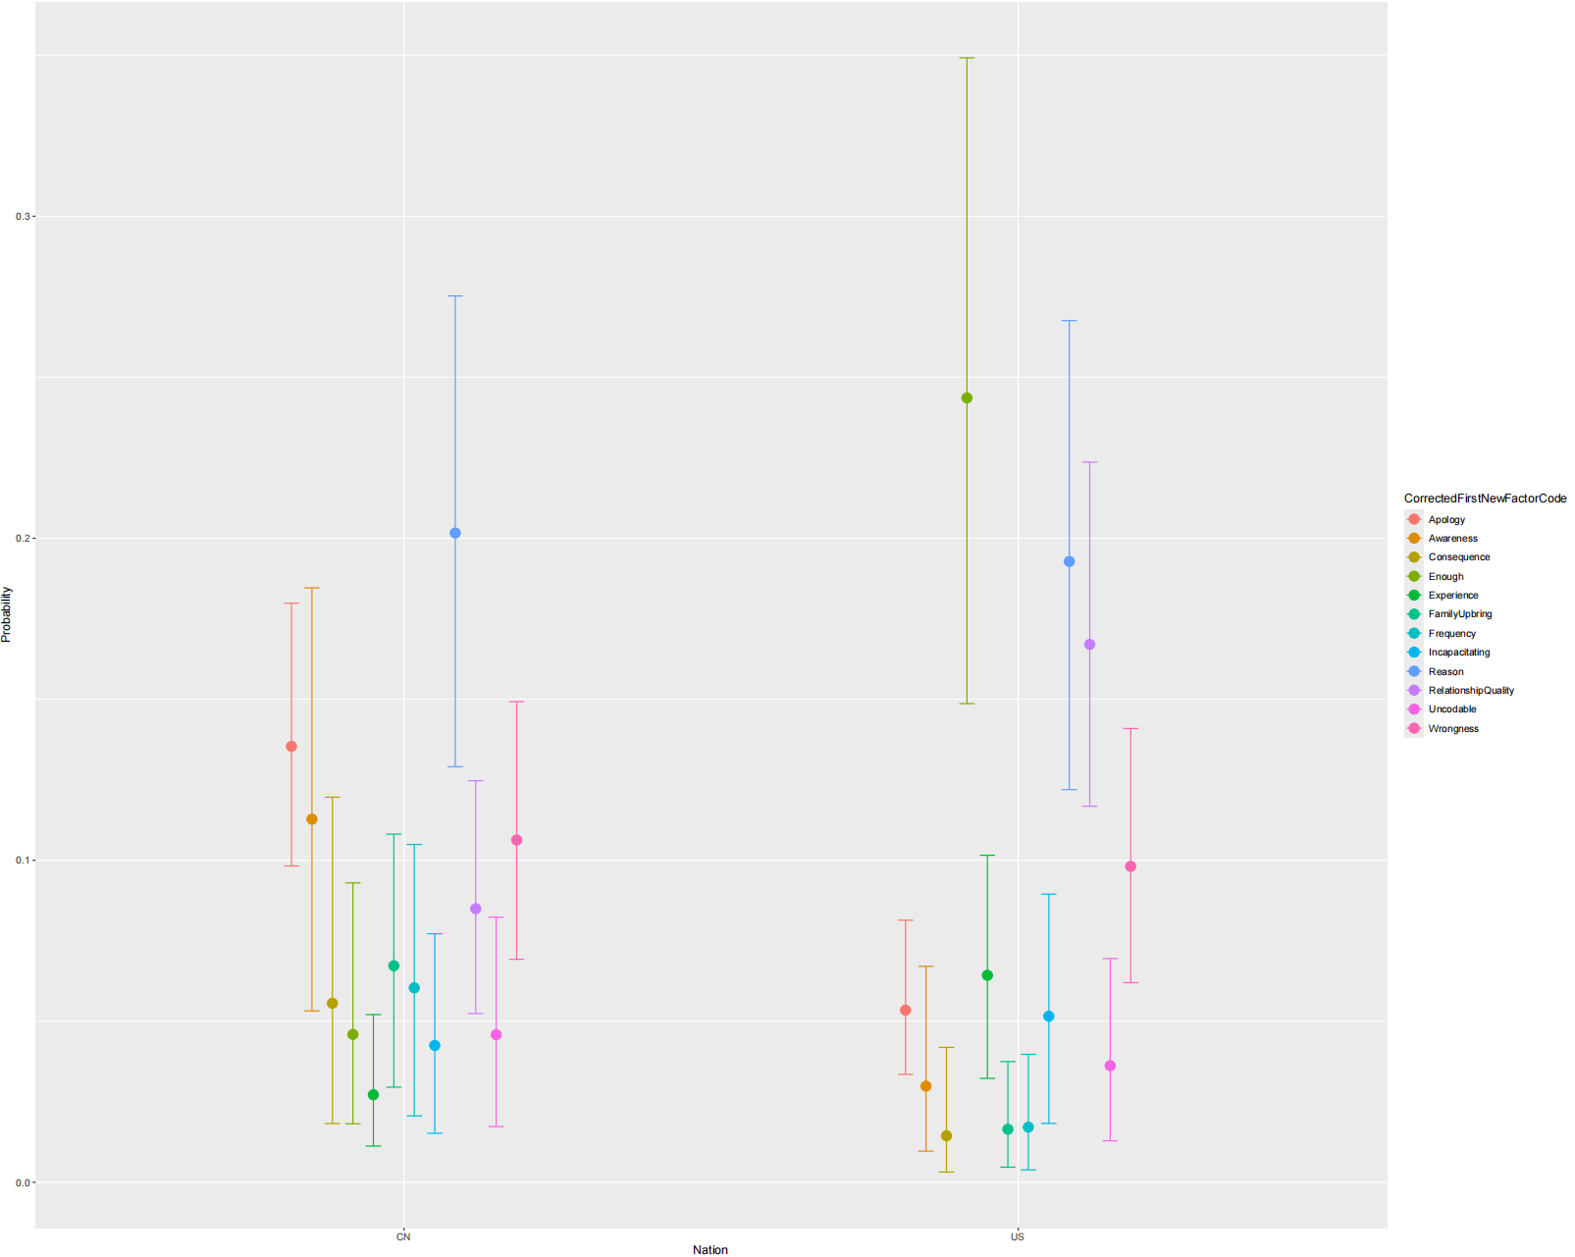
Budaode Human Data
The predicted probability
For budaode behaviors, the existing factors do not differ significantly from those in other topics, especially in the Chinese sample, compared to harmful behaviors.
For Chinese, when comparing apology to other factors:
the Chinese are less likely to ask questions about
Consequence
Experience
Family Upbringing
Frequency
Incapacitating
Enough
The probability of asking questions about apology is similar to that of questions about:
Reason (+), wrongness (-), awareness (-)
Relationship quality (-)
Compared to Chinese, US participants have a higher probability to ask questions about……than questions about apology:
Enough
Experience
Incapacitating
Reason
Relationship quality
Wrongness
When comparing US and CN, no significant differences when asking following questions than apology questions:
Awareness
Consequence
Family upbringing
frequency
CN: Apology still very important. Reason is the only one slightly higher than apology, though not statistically significant.
US: Rely more on Existing Factors than apology but also focus on experience and relationship quality

Slide 14
Study 2：Compare AI & Human

Slide 15
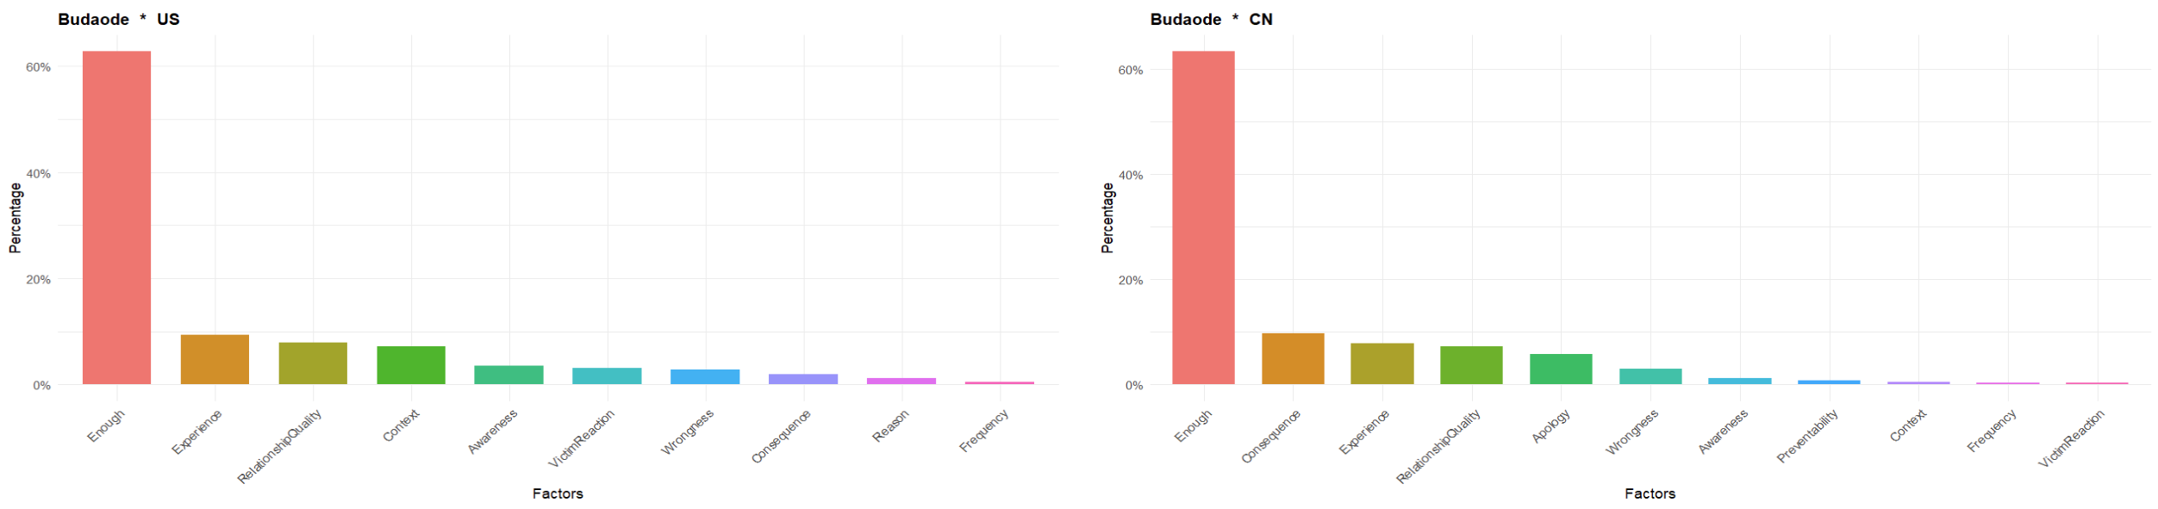
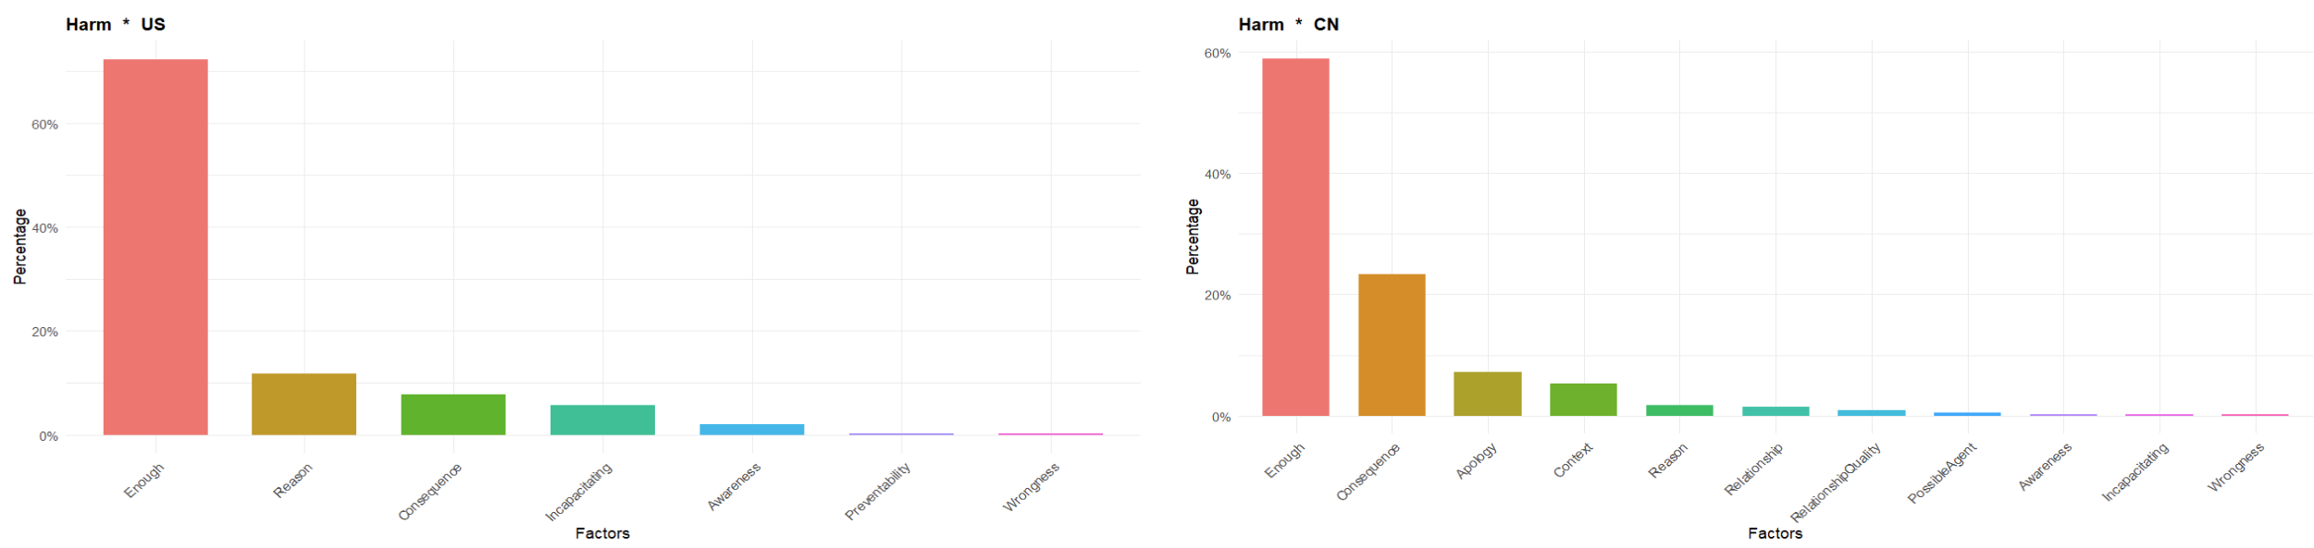
“No New Factor” + Existing factor: US 70.23% > CN 68.34%
AI * Budaode
Apology disappeared
The answers are highly focused on existing factors
Apology still important
“No New Factor” + Existing factor: US 92.25 % > CN 61.33 %
AI * Harm
No new factor
The answers are highly focused on existing factors
Consequence and Apology are still top 2 new factors.
US
CN

Slide 16
AI had higher percentages than human
AI US rely more on existing factors than AI CN
AI US harmful > AI US budaode
Smaller differences in AI CN
Culture | AI/Human | Behavior Category | Existing+Enough | Sum
US | AI | Harm | 92.25 | 92.25
US | AI | Budaode | 70.23 | 70.23
US | Human | Harm | 70.603 | 70.603
US | Human | Budaode | 61.026 | 61.026
CN | AI | Harm | 61.33 | 61.33
CN | AI | Budaode | 68.34 | 68.34
CN | Human | Harm | 46.735 | 46.735
CN | Human | Budaode | 46.934 | 46.934
AI participants replicated the tendency of relying on existing factors in human participants (US > CN, US harmful > US budaode, slighter differences in CN)
AI amplified the tendency (AI > Human)

Slide 17
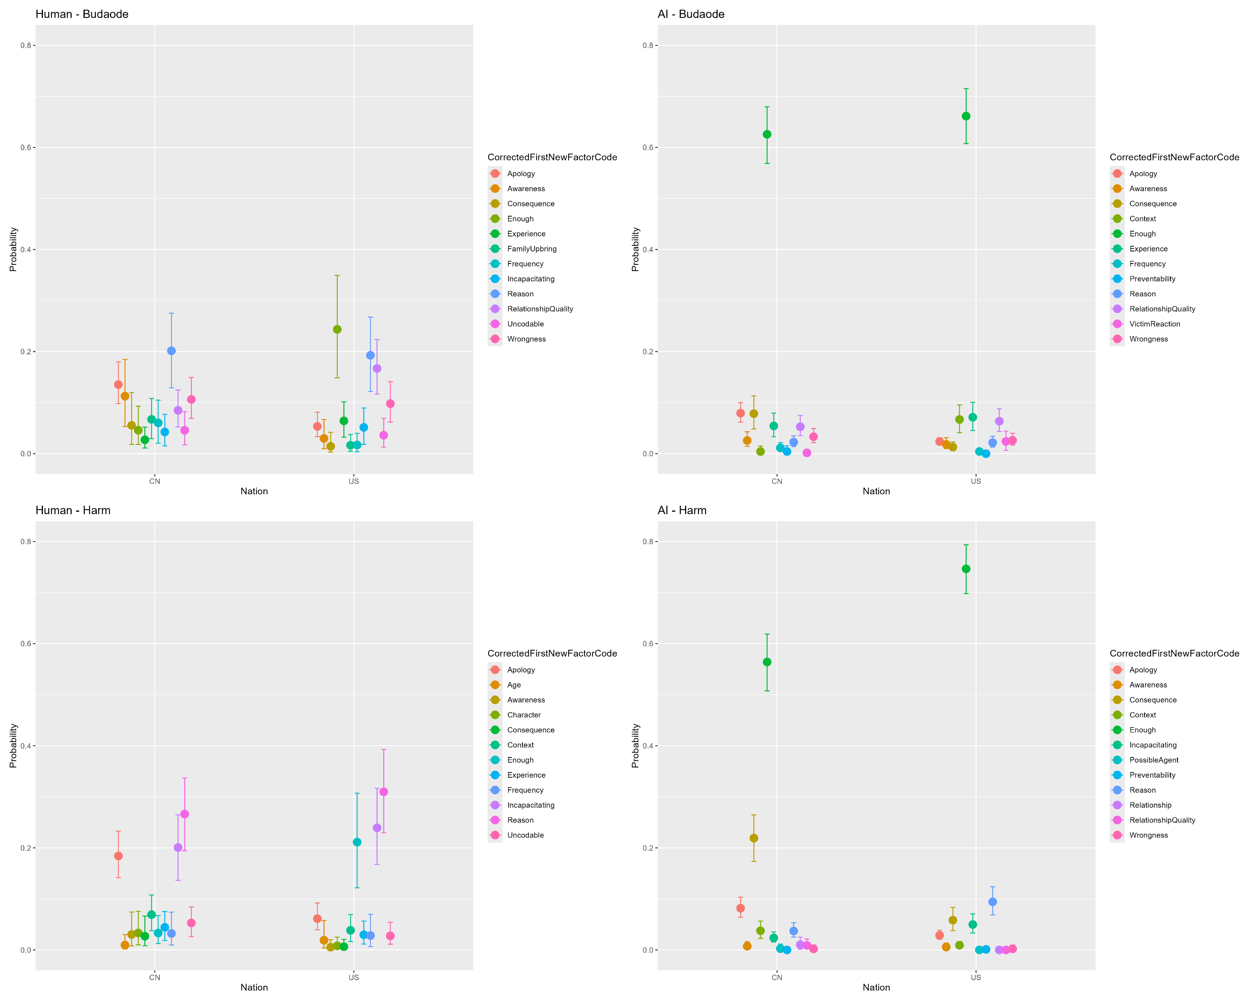
Bayesian multinomial logistic regression models
Y axis: The predicted probability
Error bar: 95% credible intervals
Gap between enough and other factors
The predicted probability
Conformist bias?
the learning probability of a cultural variant increasing with its frequency (e.g., a practice performed by 60% of the population is learned by observers 90% of the time).
Notes:
the predicted probability of each outcome category of the response variable (CorrectedFirstNewFactorCode). This probability, ranging from 0 to 1, indicates the model’s estimated likelihood that a particular category occurs given the Nation
Represent the uncertainty or variability around the predicted probabilities, typically shown as 95% credible intervals. These intervals indicate the range within which the true predicted probability is likely to fall with high confidence, reflecting the model’s uncertainty in its estimates.
conformist bias, which is formally defined as the learning probability of a cultural variant increasing with its frequency (e.g., a practice of a cultural variant increasing with its frequency (e.g., a practice performed by 60% of the population is learned by observers 90% of the time). Existing psychological findings on conformity may or may notreflect fre

Slide 18
Conclusions and Discussion
The path model of blame—originally developed in Western contexts—appears to align more closely with blame judgments in the U.S. sample, particularly for harmful behaviors.
AI in both cultural contexts showed an even greater dependence on existing factors, suggesting that AI rely more heavily on the established path model when assigning blame, especially for harmful behaviors.

Slide 19
Conclusions and Discussion
Cultural differences were also evident in the emphasis on Apology: Chinese participants placed more importance on this factor than U.S. participants.
Chinese AI participants mirrored their human counterparts by emphasizing Apology, whereas U.S. AI participants did not.

Slide 20
Conclusions and Discussion
Apology and moral judgment:
Apology can facilitate moral repair by rebuilding trust (Yuan Bo, 2017). The trust-repairing effect of an apology will be even stronger if regret is expressed in the apology (Kox et al., 2021).
Guilt and regret work as explicit signals suggesting that the offender has not thoroughly gone through such negative moral change and thus could reduce the corruption and change the observer’s blame judgment as a result (Anderson et al., 2024).
Cultural differences:
Apology has a greater influence in repairing trust for Japanese than for Americans (Maddux et al., 2011).
More collectivistic cultures like Japan rely more on apologies and excuses than Americans (Itoi et al., 1996)

Slide 21
Implications and future directions
Current study unveiled the cultural differences in how people assign their blame judgment, indicating the importance of considering culturally specific factors when applying the path model of blame.
Current study only used DeepSeek as AI participants. Future research will include not only more Chinese-oriented LLMs like DeepSeek but also will use other LLMs with potential cultural orientations like GPT, GigaChat etc. Besides, the sample size is limited in current study. In future studies, we will consider create more samples to better understand the blame mechanism and its cultural differences in LLM.

Slide 22
Thank You!

Slide 23
Q & A

