Slide 1
Efficient Abstract Interpretation via Selective Widening
Jiawei Wang*, Xiao Cheng*, Yulei Sui
School of Computer Science and Engineering
University of New South Wales, Australia
Notes:
Good afternoon everyone. Today I’m going to present our paper, Efficient Abstract Interpretation via Selective Widening, joint work with Xiao and Yulei.
In this paper, we propose a selective widening strategy guided by value-flow analysis, reducing time consumption while preserving precision.

Slide 2

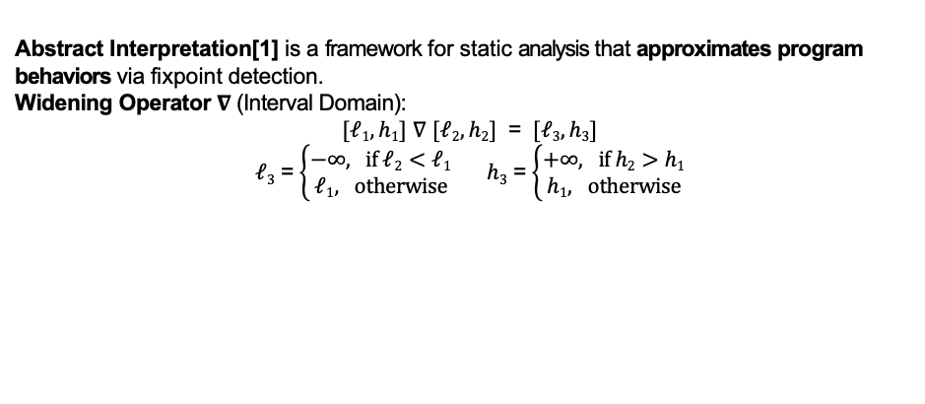
Background: Abstract Interpretation & Widening
Abstract Interpretation[1] is a framework for static analysis that approximates program behaviors via fixpoint detection.
Widening Operator $∇$ (Interval Domain):
$[ℓ1, h1]$ $∇$ $[ℓ2, h2]$ = $[ℓ3, h3]$
$ℓ3$ = $\left\{\begin{aligned}−∞, if ℓ2<ℓ1 \\ ℓ1, otherwise\end{aligned}\right.$ $h3$ = $\left\{\begin{aligned}+∞, if h2>h1 \\ h1, otherwise\end{aligned}\right.$
Widening Example:
State-wise widening strategy (IKOS[2] Clam[3])
Fixpoint reached, apply 10 widens
[1] P. Cousot and R. Cousot, ”Abstract interpretation: a unified lattice model for static analysis of programs by construction or approximation of fixpoints,” POPL, 1977.
[2] D. Gopan, T. Reps, and M. Sagiv, ”IKOS: A Framework for Sound Static Analysis of C and C++ Programs,” CAV, 2011.
[3] E. Albert, P. Kafle, and G. Puebla, ”Clam: A Static Analyzer for C Programs Based on Abstract Interpretation,” CAV, 2020.
Notes:
Abstract interpretation is a framework for static analysis to infer over-approximate program behaviors.
The widening operation plays a key role here. we put the definition for interval widening. According to this definition. The value could extend to infinity in one step. So the widening helps the analysis to reach the fixpoint and terminate quickly, and safely over-approximating the program’s behaviour.
The problem is , in real-world programming, we find large amount of redundant widenings that result in computational overhead.
(Animation 1)
Example – loop l3/l6 – current loc l3 – trace 5 variables – l3: cmp stmt – analyse every instruction inside the loop during the iteration, in the first 3 iter value grow - in order to reach the fixpoint earlier – apply widen btw 2 traces – 5 interval in one trace – one widening operation is for one interval pair --so 5 widening. -> some extend to infinity. – compare to previous trace , not equivilant, not fixpoint – analyze one more loop iteration
(Animation 2)
widen again – stablises – equivilant to previous one – fixpoint – termination.
(Animation 3)
we call it state-wise widening strategy. 10 widenings are performed under state-wise strategy. Because the size of widening ties to the whole program size, state-wise strategy results in redundant widening in every loop. Of course, State-wise strategy can ensure the soundness, bu accumulated redundant widening operations waste a significant amount of time.

Slide 3
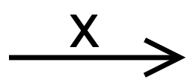



Background: Abstract Interpretation & Widening
CSA: Cross Domain Sparse Abstract Interpretation [1]
Inter-procedural value flow graph(IVFG): def-use chain graph
Node: x@$ℓ1$ means x defined at $ℓ1$
Edge: represents a def-use relation about variable x
Widen Set: 4 variables defined in the cycle ($ℓ3$- $ℓ6$) : $ℓ3$, x@$ℓ4$, y@$ℓ5$, z@$ℓ6$
Fixpoint reached, apply 8 widens
[1] X. Cheng, J. Wang, and Y. Sui, ”CSA: Cross-Domain Sparse Abstract Interpretation for Efficient and Precise Static Analysis,” ICSE, 2024.
Notes:
In another work, CSA or Cross Domain Sparse Abstract Interpretation, uses Inter-procedural Value Flow Graph or IVFG to propagate abstract states along def-use chains.
<Introduce node – introduce edge>
Let's see how CSA handle loops, it perform widening exclusively on CFG-loop defined variables, illustrated in blue circle.
CSA widens all variables inside loop (blue circle)– smaller, 4 vars.
e.g. y @l5 defined inside the loop, k@ l2 is not inside the loop.
(Animation 1) k is removed.
8 widenings – better than state-wise – not efficient - CSA does not fully utilize the potentials of IVFG, it mainly focus on reducing the cost of propagating data-flow fact, instead of loop analysis.

Slide 4

Insight: Value-Flow Cycle & Selective Widening
Some variables seem to be necessary to widen, but get reassigned later, like z@$ℓ6$
Focus on Cyclic value dependencies
x@ ℓ₄, y@ℓ₅
SiftAbs: Our Approach
Fixpoint reached, apply 2 widens
Notes:
Can we do even more selectively other than the CFG-loop defined variables?
Our central idea is simple but powerful: infinite ascending chains don‘t come from control-flow loops themselves, but from cyclic data dependencies within those loops. We call these value-flow cycles.
If we look at y@l5 and x@l4, we would find that the value of y is dependent on x whose value, in turn, relies on y, forming a value-flow cycle as illustrated in the yellow circle.
and the thing is that, the ascending chains of abstract interpretation are essentially related exclusively to the variables residing in these value-flow cycles.
(Animation 1)
In another word, the variables outside the value-flow cycle, such as variable z defined at l6, is not responsible for ascending chain, because its value will always be updated by the value of x, which is in the value-flow cycle.
It is the same regarding the loop guard at l3.
(Animation 2)
We also find that, in the value-flow cycle, only x@l4 contributes to the real widening set.
(Animation 3)
even y@l5 is redundant because it will be re-assigned and propagated through the def-use chain from x@l4 anyway
(Animation 4 5)
so we claim selective widening strategy performs only 2 widenings and preserves the precision

Slide 5
Insight: Value-Flow Cycle & Selective Widening
CSA: Cross Domain Sparse Abstract Interpretation
SiftAbs: Our Approach
Fewer widening operations, while preserving precision
Notes:
(Animation 7 )
since the abstract traces produced by the two different approaches are identical when reaching the fixpoint. At the same time, we reduce the number of widening operations from 8 to 2.

Slide 6
Challenge 1: Spurious Inter-procedural Value-Flow Cycle
Problem: How to remove spurious value-flow cycle
Two cycles in (context insensitive) IVFG: $ℓ8$ and $ℓ1ℓ2ℓ9$
Only $ℓ8$ is a genuine loop cycle while $ℓ1ℓ2ℓ9$ is a spurious one caused by context insensitivity
Spurious cycles lead to higher cost, more widening ($i$@ $ℓ8.$and $x@ℓ1res@ℓ2temp@ℓ9$)
*IVFG: Inter-procedural value flow cycle
Notes:
When it comes to value-flow cycle, naturally we think of cycle detection algorithm, and get this challenge about spurious inter-procedural cycles. In this real-world example, the source code simplified from a computer vision C library is a bit long. at line 1 and 2, we simplify the function trans() which should do some transformation, and
(Animation 1)
You can assume there is a data flow (this dashed arrow) from x at line 1 to the result at line 2. In terms of multi_trans function at line 3 to line 11., we just need to focus on line 8 – line 11 which is a loop with two continuous function calls, this pattern bring about spurious cycle. Why? look at IVFG. Along with two continuous function call, Red and blue edges are call and return edge. 1 and 2 here means the first and second call at l9 and l10.
(Animation 2)
we apply cycle detection. some cycles are real in green circle, but others are spurious in red circle. ->why? src code, continuous function calls, which bring about 2 pairs of call return edges -> two call return edge may mismatch in cycle detection.
(Animation 3, 4, 5)
E.g. call 1 matches return 1, call 2 matches return 2. If call 2 mismatches return 1, this is mismatch to form spurious cycle.
(Animation 6)
Why does this matter? Because the widening set is derived from cycles in the value-flow graph. Our ultimate goal is to make the widening set as small as possible. If we include spurious cycles, the widening set becomes unnecessarily large, of course the redundant widening operations are unnecessarily huge.
One naive solution to resolve it is fully context-sensitive analysis, which guarantees call-return strict matching. But the time complexity is at exponential level due to call return matches in the call chain stack. That’s why we propose a new algorithm to handle spurious cycles efficiently.

Slide 7
Approach 1: Modular Value-Flow Graph (MVFG) Construction
It removes call-return value-flow edge pairs, replaces with shortcut value-flow edges between n@$ℓ3$ and temp@$ℓ9$, temp@$ℓ9$ and d@$ℓ10$,improving analysis efficiency.
The Widening Set of loop $ℓ8\text{−}ℓ11 \text{is} i@ℓ8$ , and spurious cycle is removed.
Notes:
The approach to challenge 1 is modular value flow graph construction.
The algorithm is strightforward. we search this IVFG and get the pairs of call edge and return edge.
(Animation 1)
We simplify the interprocedural data flow by removing the call and return edge pair, and introduce a new shortcut value-flow edges (the green edges).
(Animation 2 and 3)
Okay. this is the final version of Modular value flow graph (or MVFG). There no longer exists spurious cycle, but remains the genuine cycle i at line8.
The widening set of loop l8-l11 is i@l8.

Slide 8
Implementation: Widening variables identification on MVFG
CFG Weak Topological Order(WTO)[1]: $ℓ1ℓ2\text{(}ℓ3ℓ4ℓ5ℓ6\text{)}$ , loop header $ℓ3$
Method: Align CFG execution order with intra/inter-procedural value-flow deps; pick the earliest definition on each value-flow cycle (e.g., x@$ℓ4$).
Widening Var Size: State wise (IKOS, Clam) > Sparse Abs Interpret(CSA) > Selective Widen(SiftAbs)
[1] François Bourdoncle. 1993. Efficient chaotic iteration strategies with widenings. In Formal Methods in Programming and Their
Applications, Dines Bjørner, Manfred Broy, and Igor V. Pottosin (Eds.). Springer Berlin Heidelberg, Berlin, Heidelberg, 128–141.
Notes:
(Animation 1)
Then we assume/ we have got all the genuine cycles. we talk about how our approach works. The analyse order is weak topological order, or WTO on Control flow graph at the right, which has a cycle from line 3 - 6. In this value flow cycle, x at line 4 and y at line 5. We find we can/ pick the earliest definition on each value flow cycle and other elements can be broadcasted from this value. For example, Because Y at line 5 is the successor of x line 4 in control flow order, Y can be broadcasted from X. that’s why we only need to widen X , instead of widening all nodes in this cycles.
(Animation 2)
Then we compare the widening sets among all the approaches, from the whole program in the begining to only one variable in the end.

Slide 9
Evaluation
RQ1 Scalability: Does our approach improve scalability compared to traditional methods? We measure analysis time and accuracy across programs of varying sizes.
Preserve precision, same TP & FP
Reduce 37% runtime due to selective widen
Table: Comparison of tools on open-source projects. The table includes the number of true positives (#TP), false positives (#FP), and analysis time in seconds. The - symbol indicates that the tool did not complete the analysis within the time limit of 4 hours.
Notes:
Then we come to evaluation, we focus on three research questions.
First, scalability . we detected buffer overflow and nullptr deference bug from these projects, from small ones like md5sum to large ones like redis. Two key takeaways: first, our method complete much faster. Second, the number of true positives and false positives remains same to our last work CSA.
So overall, selective widening achieves a big gain in scalability, without hurting accuracy.”

Slide 10
Evaluation
RQ2 Effectiveness: Does selective widening maintain or improve recall and precision? We compare false positive and negative rates with baselines.
Same recall and precision
Table: Comparison of tools using the NIST benchmark, with Recall and Precision in percentages (%).
Notes:
For RQ2, we evaluated recall and precision on the small programs named NIST Juliet Test-Suite benchmarks. In the middle, the results show that selective widening maintains high recall, and achieves precision that is same to the baselines. The bottoms are buffer overflow and nullptr dereference examples, we can detect the vulnerabilities in the loops.

Slide 11
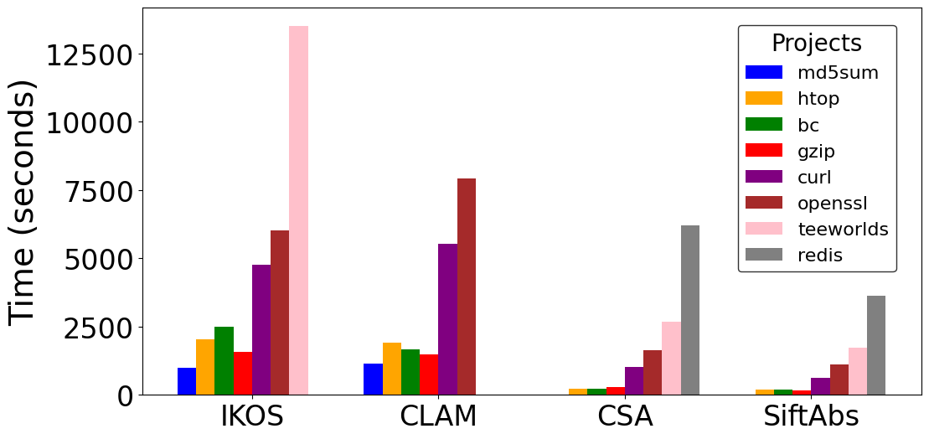
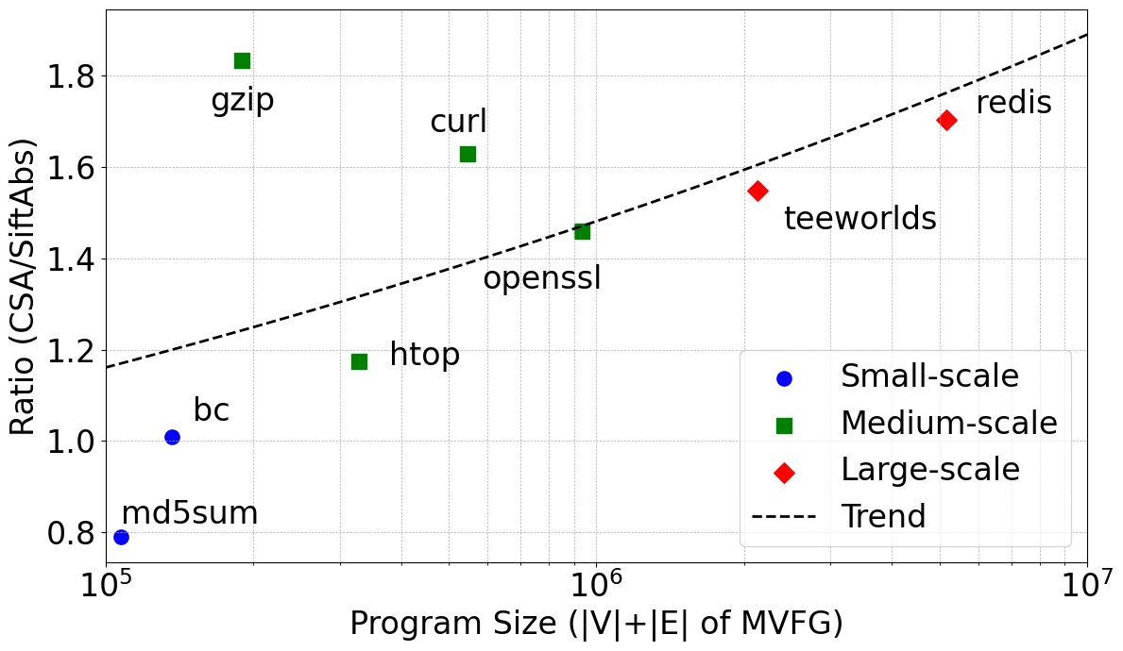
Evaluation
RQ3 Component Analysis: What is the impact of each optimization? We use ablation to quantify the contributions of selective widening and MVFG.
MVFG Construction cause overhead
Speed up ratio grows with program size
Table: Comparison of average widened variables and analysis time for CSA and SiftAbs across projects.
Our approach significantly improve runtime
Figure: Analysis Time
Figure: Speed-up Ratio
Notes:
For RQ3, we break down the impact of each component.
(Action)
The results show that on small programs, the MVFG construction may introduce some overhead, so runtime can even be slightly slower.
(Action)
Like the speed-up ratio at the bottom right, as program size grows, the benefit becomes clear: the number of widened variables drops dramatically, and the speedup grows larger.
So overall, the method scales better as programs get larger, while still preserve precision.

Slide 12
Conclusion
Selective widening guided by value-flow analysis improves efficiency and preserve precision in abstract interpretation.
Modular Value-Flow Graph (MVFG) enables precise cycle detection across procedures.
Our approach reduces computational overhead and maintains analysis accuracy.
Future work: extend to relational domains for even greater precision.
Notes:
To conclude, our work introduces selective widening guided by value-flow analysis, which improves both efficiency and precision in abstract interpretation.
The modular value-flow graph helps us detect cycles more accurately across procedures, avoiding spurious cycles.
Overall, the approach reduces computational overhead while preserving analysis accuracy.
In the future, an exciting direction is to extend this framework to relational domains, which could provide even greater precision.

Slide 13




Thank you
Notes:
Thank you for your listening — I’ll be happy to take questions.

