Slide 1
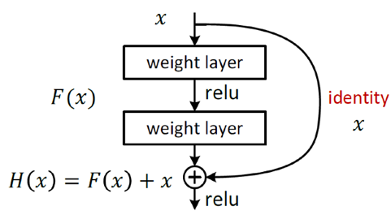
Residual Network
The ResNet referred to the VGG19
ResNet also added residual unit through the short circuit mechanism
The changes between VGG and ResNet are mainly reflected in the fact that ResNet directly uses the convolution of stride=2 to sample and replaces the full connection layer with the global average pool layer.
An important design principle of ResNet is that when the feature map size is reduced by half, the number of feature maps is doubled, which keeps the complexity of the network layer.
Residual learning: a building block.

Slide 2
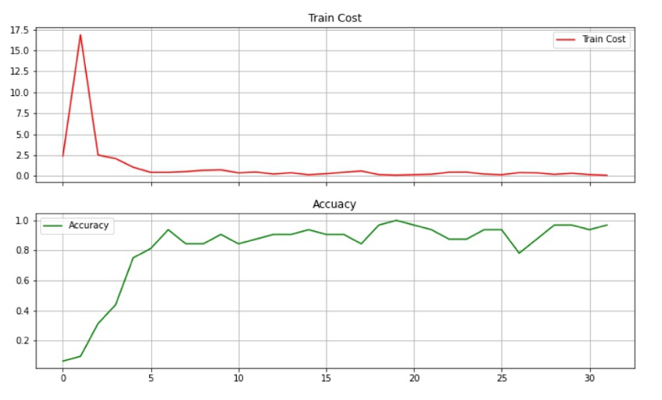
The result of MINIST

Slide 3
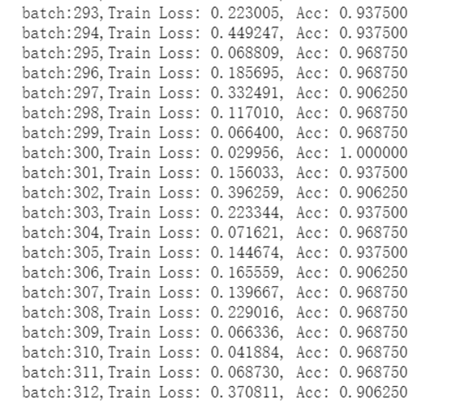
the accuracy can reach 0.906250 at last

Slide 4
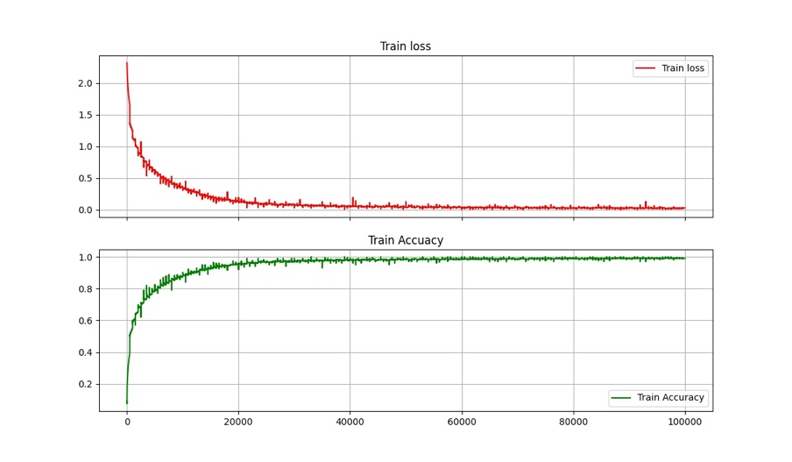
The result of cifar10

Slide 5
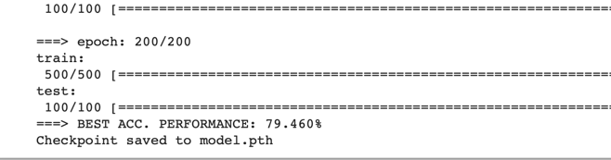
the accuracy can reach 79.460% at last.

Slide 6
Reference
[1] He, Kaiming, et al. “Deep residual learning for image recognition.” Proceedings of the IEEE conference on computer vision and pattern recognition. 2016.

