Slide 1
D-Bus调研
吴西飞
2014年8月19日

Slide 2
目录
D-Bus简介
D-Bus相关工具
D-Bus概念
Process of Method-Call on D-Bus
实例代码
method call and signal emit：libdbus
method call and signal emit：bus-glib
现有接口调用：org.freedesktop.Notification
不同语言之间的dbus通信
dbus-binding：node-dbus go-dbus

Slide 3
D-Bus简介
D-Bus is a system for interprocess communication (IPC). D-Bus is intended for potentially high-resolution same-machine IPC, not primarily for Internet IPC.
low-level D-Bus have been heavily tested in the real world over several years, and are now "set in stone."
IPC还有：Android使用Binder IPC、以及被D-Bus替代的CORBA，Bonobo和DCOP、xml格式的XML-RPC、Window上使用的DCOM (distributed COM)等。
D-Bus建立在socket之上，与socket相比2.5x slower：marshaling、dbus-daemon、security等。

Slide 4
D-Bus简介
D原先是代表桌面“Desktop” 的意思。即用于桌面操作系统的通信总线。典型的桌面都会有多个应用程序在运行，而且，它们经常需要彼此进行通信。
D-Bus is designed for two specific use cases:
系统总线， system bus, system daemon (for events such as "new hardware device added" or "printer queue changed")
会话总线 ，session bus， a per-user-login-session daemon (for general IPC needs among user applications).
Security: the system bus and session bus are separate.

Slide 5
D-Bus简介
D-Bus has several layers:
libdbus allows two applications to connect to each other and exchange messages.
A message bus daemon can route messages from one application to zero or more other applications.
Dbus bindings for particular application frameworks. For example, libdbus-glib and libdbus-qt. dbus-python, Perl, C++, php, .net, ruby, and so on.
libdbus is not primarily designed for application authors to use, it is a basis for binding authors.
Dbus-binding simplify the details of D-Bus programming.

Slide 6
D-Bus简介
There are also some reimplementations of the D-Bus protocol for languages such as C#, Java, and Ruby.
GDBus doesn't uses the libdbus reference implementation. Instead, it relies on GIO streams as transport layer, and has its own implementation for the the D-Bus connection setup and authentication.
Gnome.org: GDBus is going to replaced lib-dbus.
D-Bus参考资料
http://dbus.freedesktop.org/doc/dbus-tutorial.html
http://dbus.freedesktop.org/doc/dbus-specification.html

Slide 7
D-Bus相关工具
D-feet
D-Feet is an easy to use D-Bus debugger.
D-Feet can be used to inspect D-Bus interfaces and names of running programs and invoke methods on those interfaces.
dbus-monitor
dbus-send
dbus-send --session --type=method_call --print-reply --dest=org.ztb.Test /TestObj org.fmddlmyy.Test.Basic.Add int32:100 int32:999

Slide 8
D-Bus概念
Bus Names
When each application connects to the bus daemon, the daemon immediately assigns it a name, called the unique connection name.
Applications may ask to own additional well-known names. For example, you could write a specification to define a name called com.mycompany.TextEditor.
Queued Name Owner
Each bus name has a primary owner; messages sent to the name go to the primary owner.
If the primary owner releases the name, then the first secondary owner in the queue automatically becomes the new owner of the name.

Slide 9
D-Bus概念
Object Paths and Native Objects
Native Object is a object defined in server side, such as java.lang.Object, GObject, Qobject, DBusMessage, depending on the binding language used.
The idea of an object path is that higher-level bindings can name native object instances, and allow remote applications to refer to them.
Methods and Signals (Object members)
Methods are operations that can be invoked on an object, with optional input (aka arguments or "in parameters") and output (aka return values or "out parameters").
Signals are broadcasts from the object to any interested observers of the object; signals may contain a data payload.

Slide 10
D-Bus概念
Interfaces
Think of an interface as a named group of methods and signals, just as it is in GLib or Qt or Java. Interfaces define the type of an object instance.
Most bindings will map these interface names directly to the appropriate programming language construct, for example to Java interfaces or C++ pure virtual classes.
Each object supports one or more interfaces
Interface is important for language binding. It is used for Mapping method calls to native APIs.

Slide 11
D-Bus概念
<?xml version="1.0" encoding="UTF-8" ?>
<node name="/">
<interface name="org.ztb.Test">
<method name="Add">
<arg name="arg0" type="i"/>
<arg name="arg1" type="i"/>
<arg name="ret" type="i" direction="out"/>
</method>
<!-- Mark the signal as exported -->
<signal name="HelloSignal"/>
</interface>
</node>
dbus-binding-tool --prefix=test_object --mode=glib-server --output=example-signal-emitter-glue.h ./example-signal-emitter.xml

Slide 12
D-Bus概念
Messages
Message is the basic unit travelled on bus daemon.
Each message has a header, including fields, and a body, including arguments.
There are 4 message types:Method call, Method return, Signal messages, Error messages.
marshaling and unmarshaling
D-Bus has a type system, in which values of various types can be serialized into a sequence of bytes referred to as the wire format in a standard way.
Converting a value from some other representation into the wire format is called marshaling
converting it back from the wire format is unmarshaling.

Slide 13
D-Bus概念
Proxies
A proxy object is a convenient native object created to represent a remote object in another process.
Proxy proxy = new Proxy(getBusConnection(), "/remote/object/path");
Object returnValue = proxy.MethodName(arg1, arg2);
How to Mapping method calls to native APIs

Slide 14
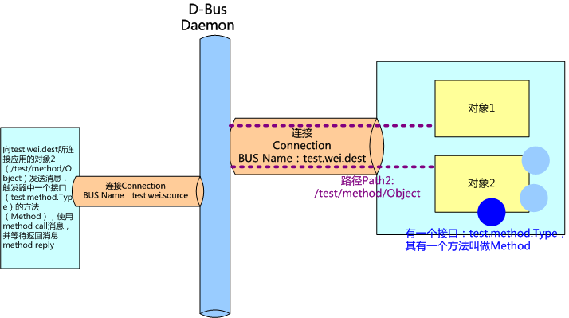
Process of Method-Call on D-Bus
Method call on an object instance
Address -> [Bus Name] -> Path -> Interface -> Method

Slide 15
node-dbus
The node-dbus project is a simple light-weight NodeJS based wrapper over some libdbus api's which enables the developer to:
perform synchronous method-calls on a service provider
perform asynchronous method-calls on a service provider
send signals on the message bus
listen to signals propogated over the message bus
Note that it is not intended to be a full-blown one-to-one mapping of the libdbus api. For that, you might want to look at node-libdbus which is relatively concrete.
https://www.npmjs.org/package/node-dbus
https://github.com/guelfey/go.dbus
https://github.com/agnat/node_libdbus

Slide 16
go.dbus
go.dbus is a simple library that implements native Go client bindings for the D-Bus message bus system.
Features:
Complete native implementation of the D-Bus message protocol
Go-like API (channels for signals / asynchronous method calls, Goroutine-safe connections)
Subpackages that help with the introspection / property interfaces
https://github.com/guelfey/go.dbus

Slide 17
谢谢~
Q&A

