Slide 1
Outline EcoDynamics AI
A framework to Decipher Plant-Pathogen-Microbe Dynamics
Internals
Addressing various challenges with the data
Inferring intricate dynamics between abiotic environments and biotic interactions, encompassing plants, pathogens, and microbes
Extension to multiple species
Using targeted primers for higher resolutions

Slide 2
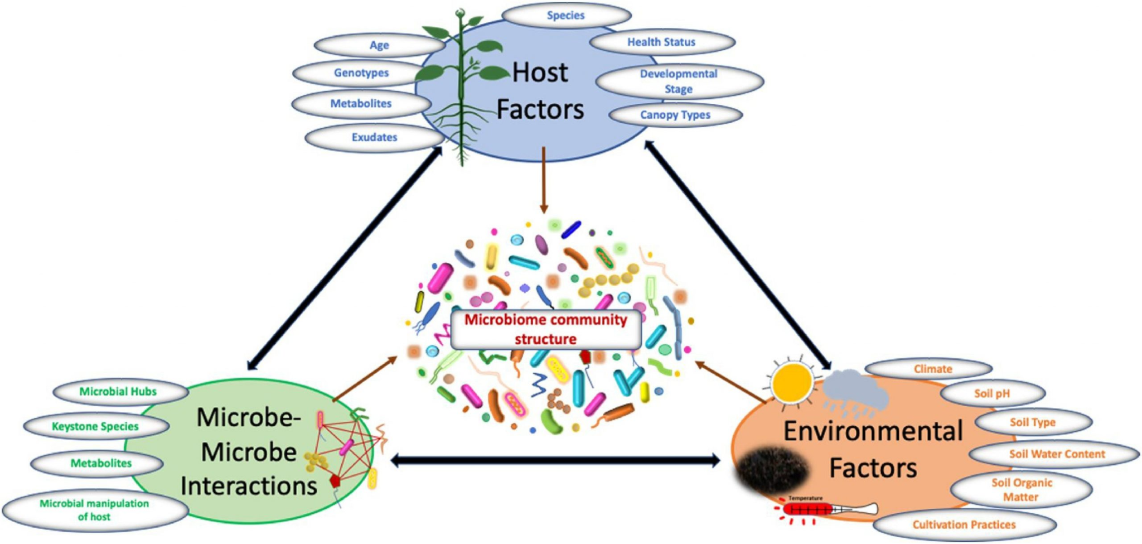
EcoDynamics AI: a framework to
Decipher Plant-Pathogen-Microbe Dynamics
Framework's focus on analyzing and
interpreting the dynamic interactions within ecological systems using artificial intelligence.
Abiotic-Biotic Non-Linear interaction modeler:
comprehensive approach to modeling the interplay between abiotic (non-living environmental) and biotic (living organisms) components.

Slide 3
EcoDynamics AI Framework to Decipher
Plant-Pathogen-Microbe Dynamics
CLR transformation
for Compositional
Data
Define Question,
Select Features,
Select Target Variable, Further Data Processing
Data Processing
(normalization,
Imputation, etc.)
Non-Linear Modeling,
Hyperparam
Optmization
Select most important/highest scores Abiotic and Biotic Factors
Adjust for
Confounding
Infer Factors Signs:
Cooperation/
Competition
Abiotic factors
Biotic factors
Target Variable
(OTU, richness, etc.)

Slide 4
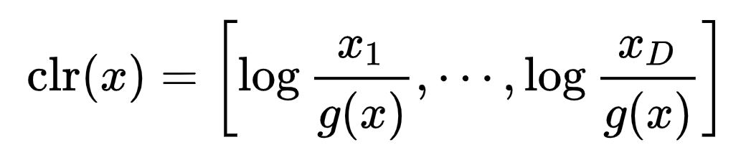
CLR-transformed OTU Data:
Ensure robustness against compositional effects.
CLR Transformation for OTU relative abundance:
to properly handle compositional data.
Ensures data accuracy without compositional bias.
g(x) is the geometric mean of x

Slide 5
EcoDynamics AI Framework to Decipher
Plant-Pathogen-Microbe Dynamics
CLR transformation
for Compositional
Data
Define Question,
Select Features,
Select Target Variable, Further Data Processing
Data Processing
(normalization,
Imputation, etc.)
Non-Linear Modeling,
Hyperparam
Optmization
Select most important/highest scores Abiotic and Biotic Factors
Adjust for
Confounding
Infer Factors Signs:
Cooperation/
Competition
Abiotic factors
Biotic factors
Target Variable
(OTU, richness, etc.)

Slide 6
Addressing the Problem of Confounding - Example
Confounding Factors: Both abiotic and biotic factors influence microbial communities, leading to potential confounding.
Conditional Independence Testing: Implement statistical testing to evaluate whether relationships between variables (e.g., pathogen richness and soil nitrogen) remain after controlling for other factors.
In the context of microbial interactions, a strong relationship may arise simply because both OTUs respond similarly to a third variable (e.g., a shared abiotic condition), not because they directly interact.
E.g. positive relationship can imply cooperation
Soil pH
But this relationship between two microbes could be driven by an abiotic factor such as soil pH. Without controlling for such confounders, it’s difficult to infer if the relationship is true, or simply due to a shared environmental factor.
X
otu_a
otu_b
+

Slide 7
Addressing the Problem of Confounding - Example
Microbes interact with each other and their environment, but observed relationships might not be direct. How do we distinguish if OTU A influences OTU B or if both respond to a shared environmental factor (e.g., soil pH)?
Conditional Independence Testing: isolates direct relationships by controlling for all other variables.
Train a model to predict OTU B abundance using all other variables.
Exclude OTU A and retrain the model.
If model performance drops, the relationship between OTU A and OTU B is direct.
If not, their relationship is likely mediated by other variables.
Soil pH
X
otu_a
otu_b
+

Slide 8
EcoDynamics AI Framework to Decipher
Plant-Pathogen-Microbe Dynamics
CLR transformation
for Compositional
Data
Define Question,
Select Features,
Select Target Variable, Further Data Processing
Data Processing
(normalization,
Imputation, etc.)
Non-Linear Modeling,
Hyperparam
Optmization
Select most important/highest scores Abiotic and Biotic Factors
Adjust for
Confounding
Infer Factors Signs:
Cooperation/
Competition
Abiotic factors
Biotic factors
Target Variable
(OTU, richness, etc.)

Slide 9
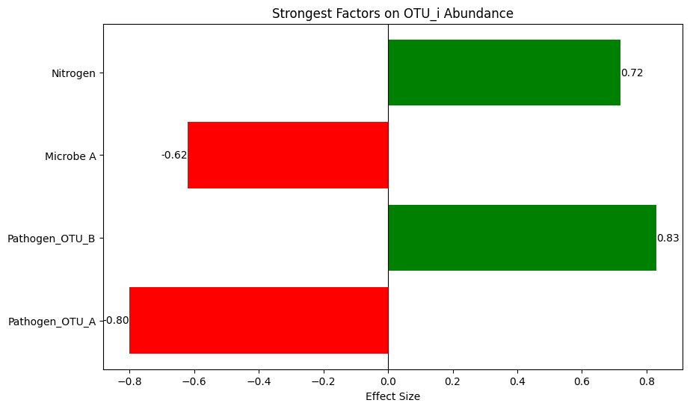
Feature Sign Testing: Cooperation(+) or Competition(-)
Relationships can be competitive (negative) or cooperative (positive). How do we tell if an OTU benefits or competes with another?
Feature Sign Testing reveals the sign of interactions. Approaches:
PDP and ALE plots: Give you a global sense of how predictions change on average as a feature changes—indicating global directionality.
ICE plots: Reveal whether this directionality is consistent across different instances or if it varies in different regions of feature space.
SHAP values (global view): Aggregate local attributions to assess whether a feature tends to push predictions up or down overall.
Local surrogate explanations (LIME): Offer a snapshot of feature directionality in a local neighborhood.
Tree interpreters(tree interpreter package in python): Allow for decomposing a single prediction into feature contributions, which can indicate sign on a case-by-case basis.

Slide 10
EcoDynamics AI: a framework to Decipher
Plant-Pathogen-Microbe Dynamics
CLR transformation
for Compositional
Data
Define Question,
Select Features,
Select Target Variable, Further Data Processing
Data Processing
(normalization,
Imputation, etc.)
Non-Linear Modeling,
Hyperparam
Optmization
Select most important/highest scores Abiotic and Biotic Factors
Adjust for
Confounding
Infer Factors Signs:
Cooperation/
Competition
Abiotic factors
Biotic factors
Target Variable
(OTU, richness, etc.)

Slide 11
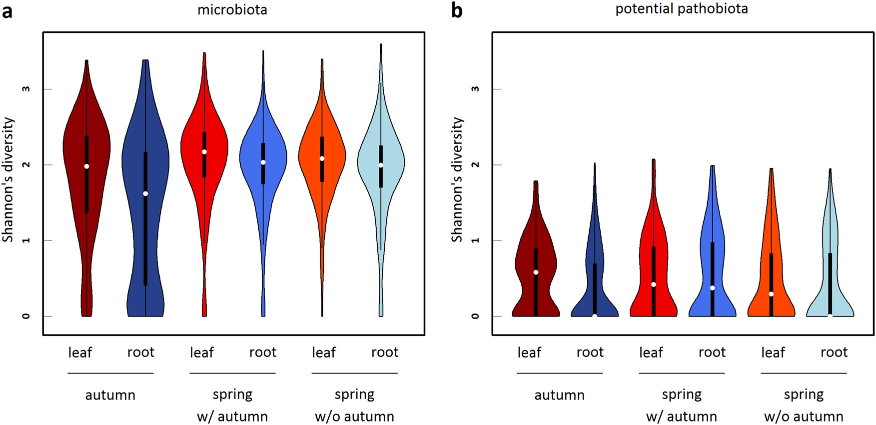
Identifying Key (Abiotic and Biotic) Factors Influencing Microbiota Richness/Shannon with EcoDynamics AI
EcoDynamics AI is a sophisticated non-linear modeling framework designed to analyze complex ecological interactions, integrating diverse data types to model ecological metrics effectively.
Modeling microbiota richness and Shannon diversity
in leaf and root compartments.
Employ EcoDynamics AI to pinpoint the most influential abiotic
and biotic factors affecting microbiota composition.
Combine environmental variables (e.g., soil pH, temperature)
with data on plant companion species.
Determine the strength and direction (positive or negative) of
causal relationships between these factors
and microbial richness and diversity
Changes of Microbiota diversity across seasons

Slide 12
Understanding Abiotic vs. Biotic Contributions -
Modeling Microbiota Richness and Diversity
Selected Abiotic and Biotic Factors
Target Variable(s) for Modeling
Environmental Factors:
Temp
soil PH, …)
Microbiota_leaf_richness/shannon
Microbiota_root_richness/shannon
Biological Factors:
plant companions abundance (plant_OTUs)

Slide 13
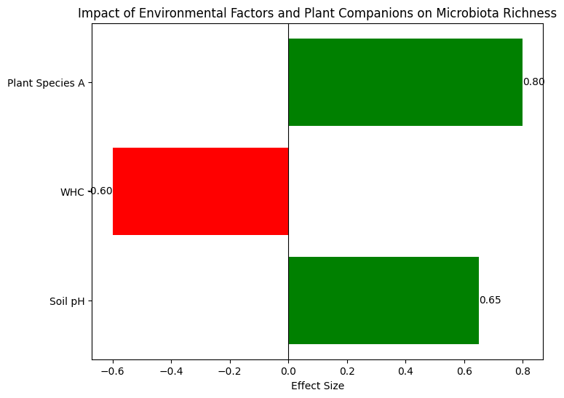
Understanding Abiotic vs. Biotic Contributions -
Modeling Microbiota Richness and Diversity
Selected Abiotic and Biotic Factors
Target Variable(s) for Modeling
Sample Output
Environmental Factors:
Temp
soil PH, …)
Microbiota_leaf_richness/shannon
Microbiota_root_richness/shannon
Biological Factors:
plant companions abundance (plant_OTUs)

Slide 14
Determining Influential (Abiotic and Biotic) Factors on Pathobiota Dynamics Using EcoDynamics AI
EcoDynamics AI is a sophisticated non-linear modeling framework designed to analyze complex ecological interactions, integrating diverse data types to model ecological metrics effectively.
Model Richness and Shannon diversity for pathobiota
in leaf and root compartments.
Combine environmental variables, non-pathogenic microbial
OTU data, and information on plant companion species.
To assess the strength and direction of causality
between these factors and pathogen richness/diversity
Changes of Pathobiota diversity across seasons

Slide 15
Understanding Abiotic vs. Biotic Contributions -
Determining Influential Factors on Pathobiota Dynamics Using EcoDynamics AI
Selected Abiotic and Biotic Factors
Target Variable(s) for Modeling
Pathobiota_leaf_richness/shannon
Pathobiota_root_richness/shannon
Environmental Factors:
Temp
soil PH, …)
Biological Factors:
Non-pathogenic microbial OTU data
plant companions abundance, plant_OTUs

Slide 16
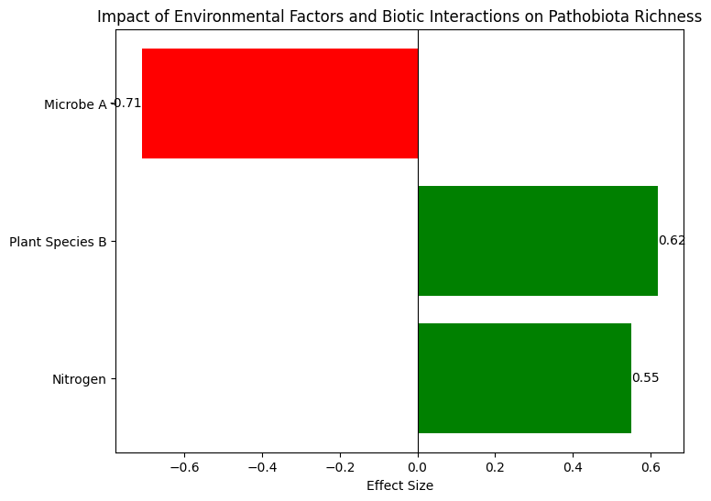
Understanding Abiotic vs. Biotic Contributions -
Determining Influential Factors on Pathobiota Dynamics Using EcoDynamics AI
Selected Abiotic and Biotic Factors
Target Variable(s) for Modeling
Pathobiota_leaf_richness/shannon
Pathobiota_root_richness/shannon
Environmental Factors:
Temp
soil PH, …)
Biological Factors:
Non-pathogenic microbial OTU data
plant companions abundance, plant_OTUs

Slide 17
Expanding EcoDynamics AI to Cardamine hirsuta and Draba verna
We aim to extend this framework to Cardamine hirsuta and Draba verna
Comparative Analysis:
Investigate species-specific plant-microbiome interactions and their ecological implications.
Compare the root and leaf-associated microbiomes of C. hirsuta and D. verna with those of A. thaliana.
Identify core microbiome constituents and assess species-specific microbial associations.
Assess how mutualistic and antagonistic relationships vary among the three species and their implications for ecosystem functioning.
Identify microbial taxa that consistently promote plant health across species.

Slide 18
Linking Individual Microbe/Pathogen with
environmental conditions, plant communities, with other pathogens and the rest of the microbiota
Selected Abiotic and Biotic Predictors
Target Variable(s) for Modeling
Environmental Factors:
Temp
soil PH, …)
Leaf/Root OTU_i
Biological Factors:
plant companions abundance, plant_OTUs
Biological Factors:
Microbial Abundances: include the abundances of all other root and leaf OTUs, excluding OTU_i to avoid multicollinearity.

Slide 19
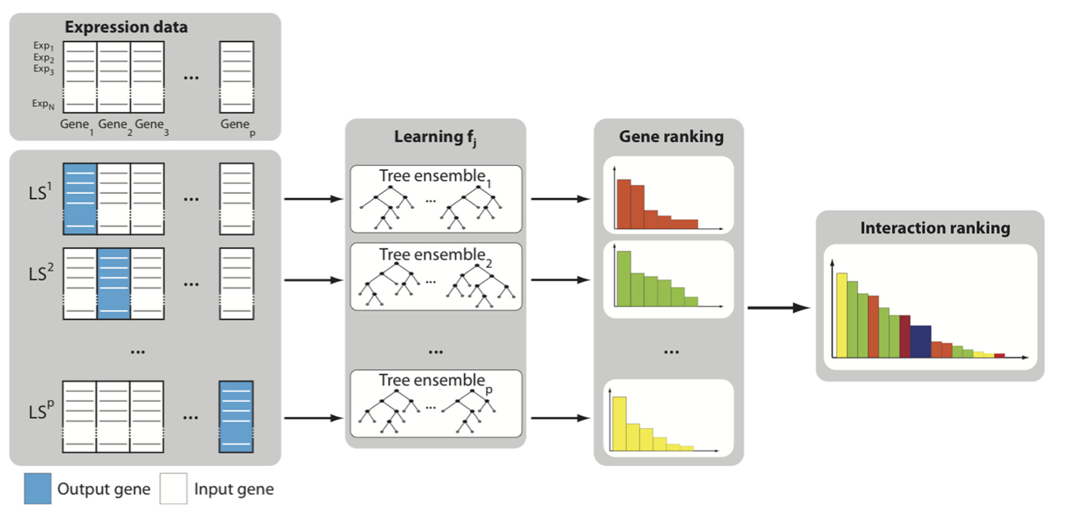
Build OTUs’ models in parallel
Ecological Data
(OTUs, Env, Plant Companions)
Training Data
Popul_1
Popul_2
Popul_N
OTU_1 OTU_2 Temp OTU_p
Factors Ranking
Target
Features

Slide 20
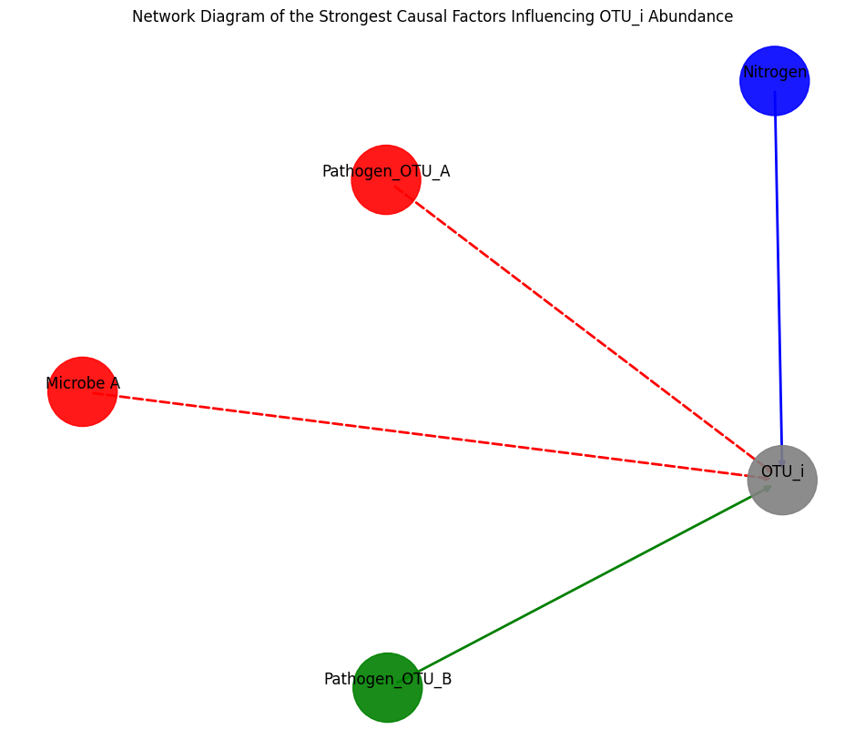
Understanding Abiotic vs. Biotic Contributions
Competition
Cooperation
Notes:
STRONGEST RELATIONSHIPS

