Slide 1
Project Title : Intelligent Delight Management System
UNDER THE GUIDANCE OF
EXTERNAL GUIDE INTERNAL GUIDE
Mr.Meeramehadi Gadamfalli Mr.T.R.Arunkumar
PRESENTED BY
SADHANA SANKPAL
(CA161054)

Slide 2
Contents
Introduction and objective
Literature survey
Hardware and Software requirements
ER-Diagram
Data flow diagram
Data dictionary
Use case diagram
Activity diagram
Testing methodology
Conclusion

Slide 3
INTRODUCTION
IDMS is a client based solution where currently the client hotel is using a manual system to maintain daily hotel activities. When a guest does their reservation, all those details will be maintained in a file. As they maintain this in a file, the hotel has to make effort for securing those files from damaged reasons like fire damage, damage by insects etc. The intelligent delight management system we are going to implement will reduce the disadvantages of the manual based hotel management system. It will maintain reservation details, guest details, room services, staff details, room types, amenity details, these details will store in the database of a system. Using the GUI menus it’s easy to retrieve the data from the database and also it saves the time.
OBJECTIVE
The main objectives of the project are to reduce the overhead in maintaining the information about the Room, booking, Customer Check IN. The objectives is to computerized all the manual work. By the help of this software we can find overall Room, Customer record on the basics of their Customer Name , Room NO. The main aim of our project is to build a user friendly, efficient and robust system that will handle all information related to the Hotel.

Slide 4
LITERATURE SURVEY
Existing system
At present the hotel work is totally based on manual system. When any activity is carried out then, its details will be stored in physical storage like registers. At the time of checkout of customer, calculations of bills are done manually too. Doing all the work manually and storing information on register takes much time and wastes much precious man hours. Manually calculation of bill is also error prone. Sometime we need a records of particular customer to fine this in manual system will make confusion as well as it will take more time to search that information.

Slide 5
Problems in existing system
As they maintained large number of registers for the data storage, unable to find the exact location of particular guest details.
The physical storage takes large space.
Poorly maintained records may exclude some important data while maintaining.
Because of poor data maintenance the mistakes like overcharging, charging of service without use can happen.
Improper communication: Due to improper communication between the staff and customer mistakes can happen by the staff.
Difficult in report generation: Due to improper record keeping mistake may happen at the time of final bill generation.

Slide 6
Proposed system
New software is developed to reduce the problems in existing manual system. With the help of this software application we will task deployed for information collection to a large extends and also can reduce the human made errors during the maintenance of large data. It automates the various daily activities of hotel and task of information collection with the help of database designing. In this proposed system the offers provided by the hotel which will be based on the season will display accordingly. And in existing system if the customer wants to order the food they needs to call the receptionist and order the food but in proposed system there is one android mobile application provided to the customer through which customer can order the food.

Slide 7
Advantages of proposed system
Reduction of number of manual material used for the data storage.
Backup facility provided in case of data loss.
Increased data security.
Better control over business through automation.
The system enables easy and fast access to the guest files.
The system provides better data management facilities.
Reduces the data entry and processing errors.
Reduce the paper use in hotel.

Slide 8
Hardware and Software Requirements
Hardware Requirements :
Processor : Pentium 4 or Above
RAM : 1 GB or Above
HDD : Minimum 30 GB
Device : Smart Android Phone.
Software Requirements :
Operating System : Windows XP or above
IDE : Macromedia Dreamweaver, Android Studio
Designing Tools : HTML, CSS, Bootstraps
Scripting language : JSP, Servlet, java
Server : Tomcat 5.5 and Wamp Server
Back End : MySQL
Web Browser : Google Chrome, Internet Explorer etc

Slide 9
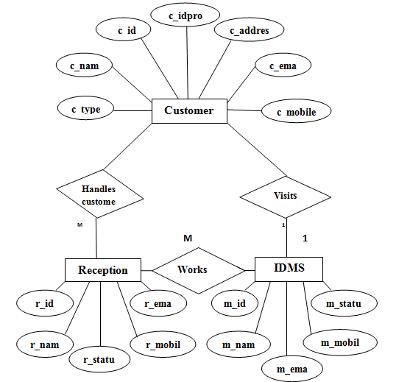
ER-Diagram

Slide 10
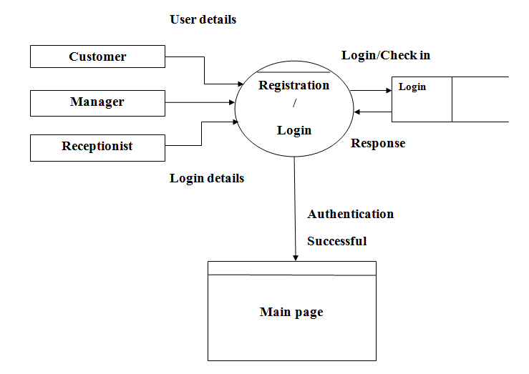
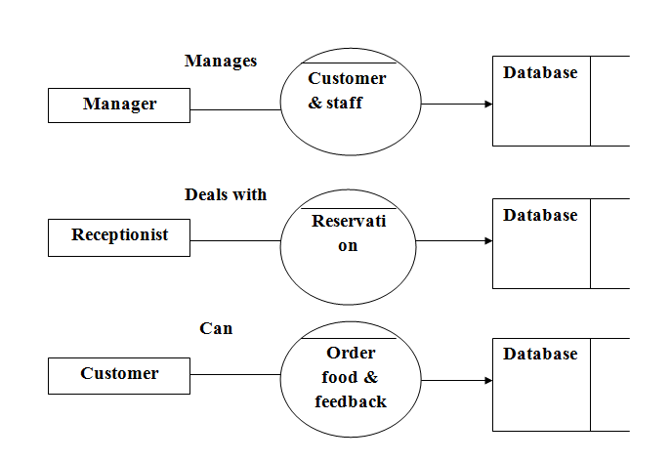
Data Flow Diagram
Zero level DFD
First level DFD

Slide 11
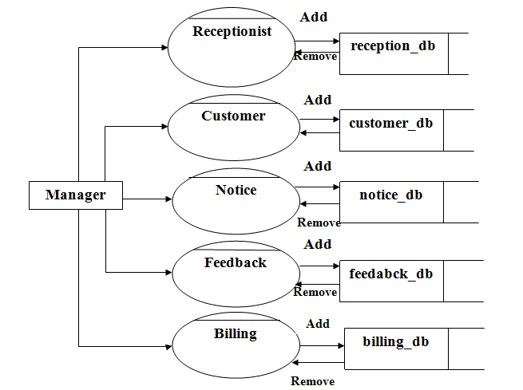
Second level DFD

Slide 12
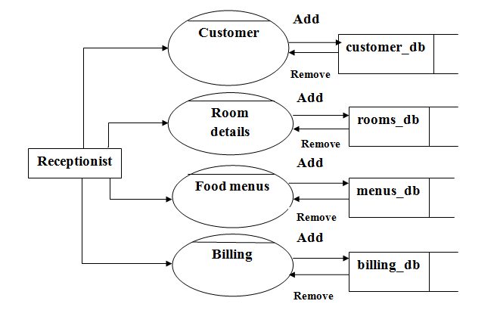
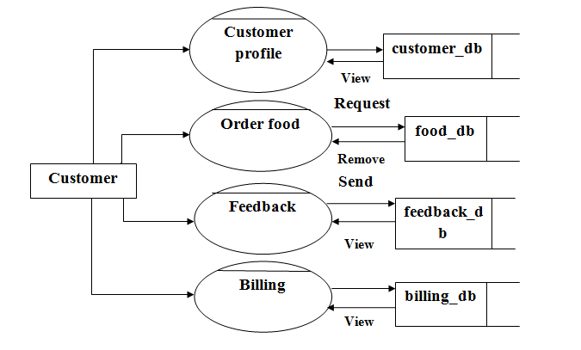
Second level DFD continued…

Slide 13
Data Dictionary
Customer table
c_id | c_name | c_mobileno | c_email | c_address | c_type | c_idproof
int(100) | varchar(100) | varchar(100) | varchar(100) | varchar(100) | varchar(100) | varchar(100)
primary key | - | - | - | - | - | -
Manager table
m_id | m_name | m_mobileno | m_email | m_status
int(100) | varchar(100) | varchar(100) | varchar(100) | varchar(100)
primary key | - | - | - | -

Slide 14
Receptionist table
r_id | r_name | r_mobileno | r_email | r_status
int(100) | varchar(100) | varchar(100) | varchar(100) | varchar(100)
primary key | - | - | - | -
Login table
username | password | type | sec_que | sec_ans | status
varchar(100) | varchar(100) | varchar(100) | varchar(100) | varchar(100) | varchar(100)
- | - | - | - | - | -
Booking details table
b_id | c_id | r_id | b_date | b_from | b_to | b_status
int(100) | int(100) | int(100) | varchar(100) | varchar(100) | varchar(100) | varchar(100)
primary key | foreign key | foreign key | - | - | - | -

Slide 15
Room details table
r_id | r_no | r_type | r_description | r_amenites | rm_price | rm_image | rm_status
int(100) | varchar(100) | varchar(100) | varchar(100) | varchar(100) | varchar(100) | varchar(100) | varchar(100)
primary key | - | - | - | - | - | - | -
Order details table
o_id | c_id | mn_id | o_date | o_status
int(100) | int(100) | int(100) | varchar(100) | varchar(100)
primary key | foreign key | foreign key | - | -
Menu details table
mn_id | mn_name | mn_description | mn_price | mn_image
int(100) | varchar(100) | varchar(100) | varchar(100) | varchar(100)
primary key | - | - | - | -

Slide 16
Amenity details table
a_id | a_name | a_description | a_image
int(100) | varchar(100) | varchar(100) | varchar(100)
primary key | - | - | -
Notice table
n_id | n_from | n_to | n_notice | n_date | n_status
int(100) | varchar(100) | varchar(100) | varchar(100) | varchar(100) | varchar(100)
primary key | - | - | - | - | -

Slide 17
Feedback table
f_id | f_from | f_to | f_feedback | f_date | f_status
int(100) | varchar(100) | varchar(100) | varchar(100) | varchar(100) | varchar(100)
primary key | - | - | - | - | -
Billing details table
bl_id | c_id | t_amount | p_date | b_status
int(100) | varchar(100) | varchar(100) | varchar(100) | varchar(100)
primary key | foreign key | - | - | -

Slide 18
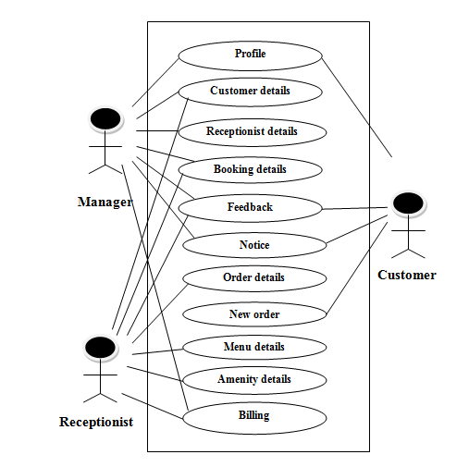
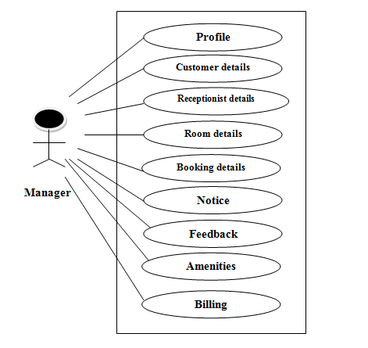
Use case diagrams
System use case diagram
Manager level use case diagram

Slide 19
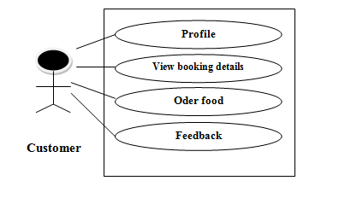
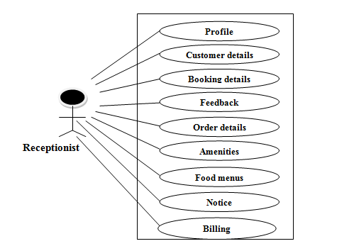
Customer use case diagram
Receptionist use case diagram

Slide 20
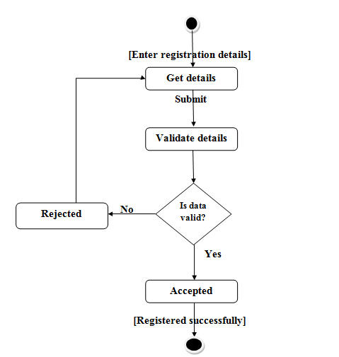
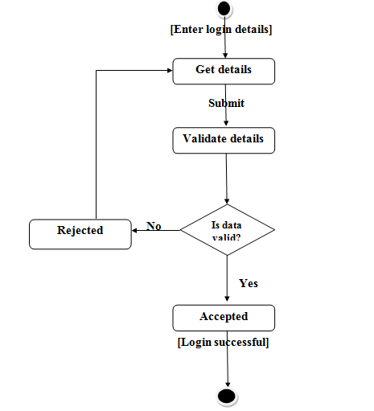
Registration page activity diagram
Login page activity diagram

Slide 21
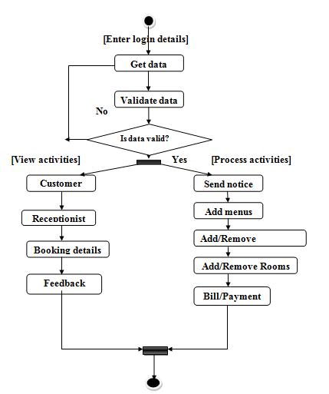
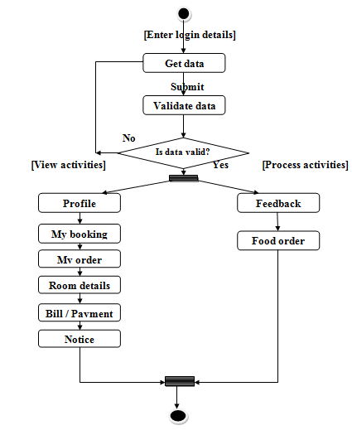
Manager activity diagram
Customer activity diagram

Slide 22
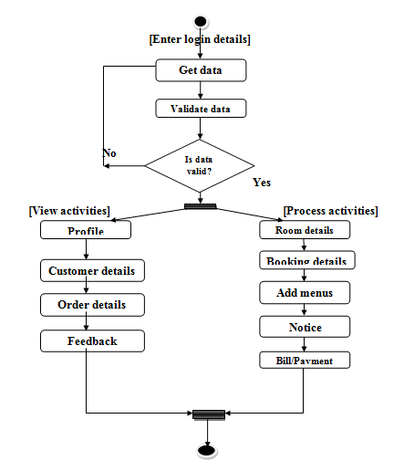
Receptionist activity diagram

Slide 23
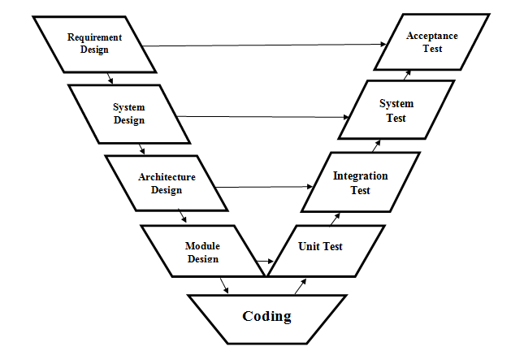
Testing methodology
V-Model:
V-Model it is one of the software development life cycle model, we are using this model for software developing and testing purpose. V-Model is software verification and validation model. The V-Model focuses on a fairly typical waterfall method that follows strict, step-by-step stages. While initial stages are broad design stages, progress proceeds down through more and more granular stages, leading into implementation and coding, and finally back through all testing stages prior to completion of the project.

Slide 24
CONCLUSION AND FUTURE SCOPE
This project has got clear advantage over the manual system. The computerized system is more reliable, efficient and fast and does maximum work within minimum time. It provides comfort and suitability to everyone. Providing maximum facilities and comfort to customers.
FUTURE SCOPE
For the above developed system to function to give more capabilities than the existing, the below features can implement in future.
Multiple system can connected for communication through networking.
The hotel server can be connected to the internet, to have the web site for hotel through which online booking page will be loaded to enable online booking over the internet.
IOT’s can be applied for the future services.
More security will update as the time passes.

Slide 25
Thank you…

