Slide 1
Project Title : Intelligent Delight Management System
UNDER THE GUIDANCE OF
EXTERNAL GUIDE INTERNAL GUIDE
Mr.Meeramehadi Gadamfalli Mr.T.R.Arunkumar
PRESENTED BY
SADHANA SANKPAL
(CA161054)

Slide 2
Introduction
IDMS is a client based solution where currently the client hotel is using a manual system to maintain daily hotel activities. When a guest does their reservation, all those details will be maintained in a file. As they maintain this in a file, the hotel has to make effort for securing those files from damaged reasons like fire damage, damage by insects etc. Also if we want to search for the old reservation details we need to search it manually which takes much time. The intelligent delight management system we are going to implement will reduce the disadvantages of the manual based hotel management system. It will maintain reservation details, guest details, room services, staff details, room types, amenity details, these details will store in the database of a system. Using the GUI menus it’s easy to retrieve the data from the database and also it saves the time.

Slide 3
Objective
The main objectives of the project are to reduce the overhead in maintaining the information about the Room, booking, Customer Check IN. The objectives is to computerized all the manual work. By the help of this software we can find overall Room, Customer record on the basics of their Customer Name , Room NO. The main aim of our project is to build a user friendly, efficient and robust system that will handle all information related to the Hotel.

Slide 4
Literature Survey
Existing system.
Disadvantages of existing system.
Proposed system.
Advantages of proposed system.

Slide 5
EXISTING SYSTEM
At present the hotel work is totally based on manual system. When any activity is carried out then, its details will be stored in physical storage like registers. At the time of checkout of customer, calculations of bills are done manually too. Doing all the work manually and storing information on register takes much time and wastes much precious man hours. Manually calculation of bill is also error prone. Sometime we need a records of particular customer to fine this in manual system will make confusion as well as it will take more time to search that information.

Slide 6
Problems in existing system:
As they maintained large number of registers for the data storage, unable to find the exact location of particular guest details.
The physical storage takes large space.
Poorly maintained records may exclude some important data while maintaining.
Because of poor data maintenance the mistakes like overcharging, charging of service without use can happen.
Improper communication: Due to improper communication between the staff and customer mistakes can happen by the staff.
Difficult in report generation: Due to improper record keeping mistake may happen at the time of final bill generation.

Slide 7
PROPOSED SYSTEM
New software is developed to reduce the problems in existing manual system. With the help of this software application we will task deployed for information collection to a large extends and also can reduce the human made errors during the maintenance of large data. It automates the various daily activities of hotel and task of information collection with the help of database designing. In this proposed system the offers provided by the hotel which will be based on the season will display accordingly. And in existing system if the customer wants to order the food they needs to call the receptionist and order the food but in proposed system there is one android mobile application provided to the customer through which customer can order the food.

Slide 8
Advantages of proposed system :
Reduction of number of manual material used for the data storage.
Backup facility provided in case of data loss.
Increased data security.
Better control over business through automation.
The system enables easy and fast access to the guest files.
The system provides better data management facilities.
Reduces the data entry and processing errors.
Reduce the paper use in hotel.

Slide 9
FEASIBILITY STUDY
A feasibility study evaluates the project’s potential for success; A feasibility study is an analysis used to measure the ability expectation to complete a project successfully including all relevant factors that affects it such as operational, technical and economical. Feasibility study is used to determine positive and negative outcomes of the project.
The key consideration in feasibility study is
Operational feasibility
Technical feasibility
Economical feasibility

Slide 10
Operational Feasibility:
Hotel is ready to use this application software for managing their information and it is acceptable by hotel administration as well as hotel staff.

Slide 11
Technical feasibility
A number of issues we have to consider while doing a technical analysis.
Understand the different technologies involved in the proposed system.
Before commencing the project, we have to be very clear about what are the technologies that are to be required for the development of the new system.
Find out whether the organization currently processes the required technologies.
For this project we have used Dreamweaver as a front-end editor and MySQL as back-end.

Slide 12
Economical feasibility
In this study the cost and benefits of proposed system are compared. The cost of proposed system is less as compared to the maintenance cost in the existing manual system in which more cost involved in maintaining the register, books, files etc. The system also reduces the administrative and other staff to do various jobs that single software can do, so, this system is economically feasible.

Slide 13
TOOLS AND TECHNOLOGIES USED
TOOLS
The tools used in building This project are Android and Dreamweaver. Following sections give a brief description about the tools.
DREAMWEAVER
Dreamweaver is an IDE (integrated development environment). That means it’s a piece of software that combines different tools to make web design and development easier.

Slide 14
ANDROID STUDIO
Android studio is the IDE (Integrated Development Environment), for android application development. It is based on the IntelliJ IDEA, a java integrated development environment for software. To support application development within the android operating system, Android studio uses a Gradle-based build system, emulator, code templates, and Github integration. Every project in android studio has one or more modalities with source code and resource files. These modalities include Android app module, library module, and Google App engine modules.

Slide 15
TECHNOLOGIES
JSP
Java Server Page (JSP) is a technology for controlling the content or appearance of Web pages through the use of servlets, small programs that are specified in the Web page and run on the Web server to modify the Web page before it is sent to the user who requested it.
DATABASE
MySQL

Slide 16
Functional Requirements (Modules):
Administrative
Receptionist
Visitors

Slide 17
Administrative
Monitor cost and expenses to assist in budget preparation.
Admin can manage the customers.
Admin can manage the receptionist.
Monitor the booking details.
Manage the room details, also can add the room details or can remove.
Admin see the feedbacks.
Admin can send notice to staff and customer.
Admin can add new menu or remove menu from menu list.
Admin can add or remove amenities from amenities list.

Slide 18
Receptionist
Monitor day to day hotel activities.
Receptionist can manage the customers.
Monitor the booking details.
Manage the room details, also can add the room details or can remove.
Receptionist sees the feedbacks.
Receptionist can add new menu or remove menu from menu list.
Receptionist can manage the food orders by customers.
Receptionist can add or remove amenities from amenities list.

Slide 19
Visitors/Customers
Customer can view booking details.
Customer can order food.
Customer can make request for emergency.
Customer can give feedback.

Slide 20
Hardware and Software Requirements
Hardware Requirements :
Processor : Pentium 4 or Above
RAM : GB or Above
HDD : Minimum 30 GB
Device : Smart Android Phone.

Slide 21
Hardware and Software Requirements
Software Requirements :
Operating System : Windows XP or above
IDE : Macromedia Dreamweaver, Android Studio
Designing Tools : HTML, CSS, Bootstraps
Server Side Programming language : JSP, Servlet, java
Server : Tomcat 5.5 and Wamp Server
Back End : MySQL
Web Browser : Google Chrome, Internet Explorer etc

Slide 22
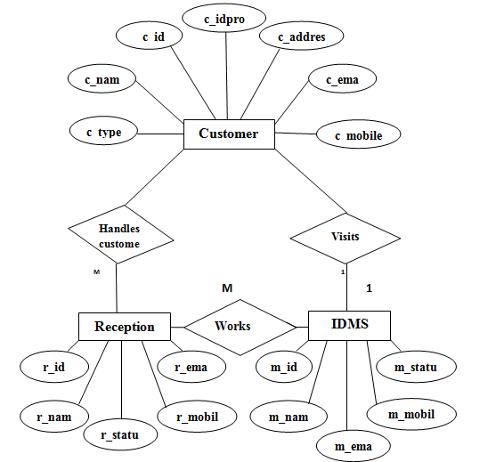
ER-Diagram

Slide 23
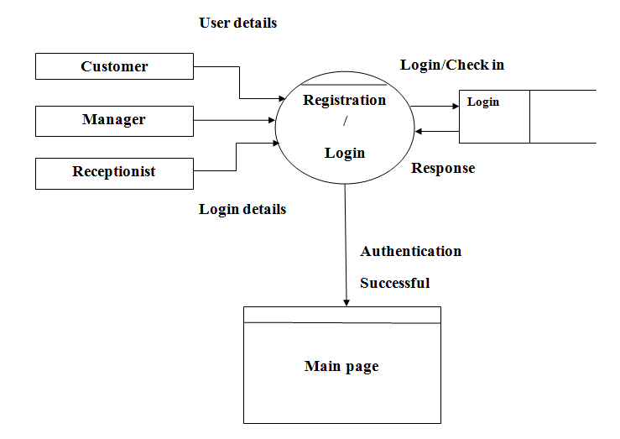
Data Flow Diagram
Zero level DFD

Slide 24
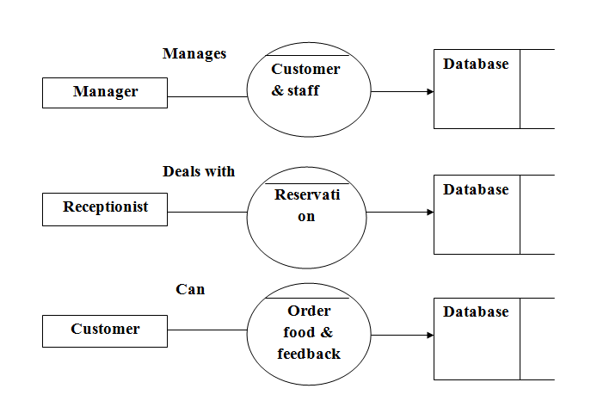
Data Flow Diagram
First level DFD

Slide 25
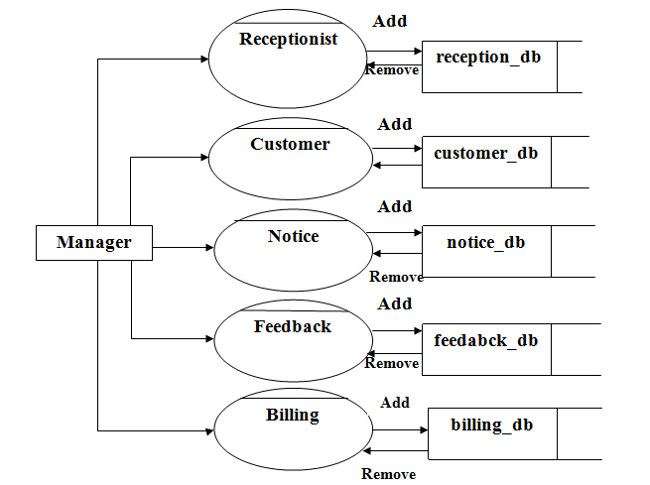
Data Flow Diagram
Second level DFD

Slide 26
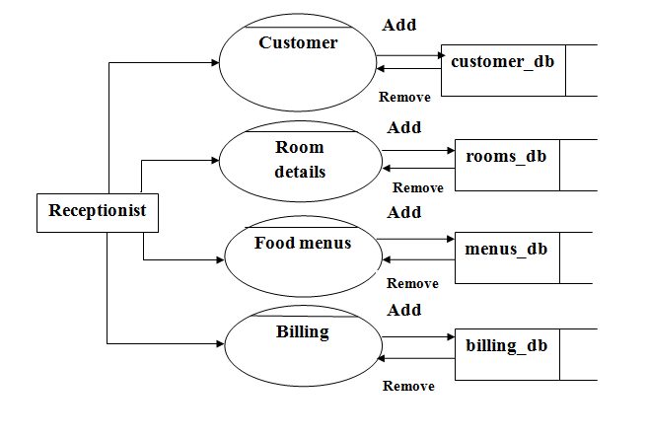
Data Flow Diagram
Second level DFD continued…

Slide 27
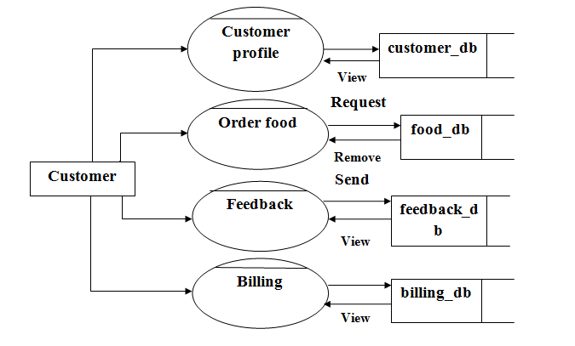
Data Flow Diagram
Second level DFD continued…

Slide 28
Data Dictionary
Customer table
Fields | Type | Description
c_id | int(100) | Primary key
c_name | varchar(100)
c_mobileno | varchar(100)
c_email | varchar(100)
c_address | varchar(100)
c_type | varchar(100)
c_idproof | varchar(100)

Slide 29
Manager table
Fields | Type | Description
m_id | int(100) | Primary key
m_name | varchar(100)
m_mobileno | varchar(100)
m_email | varchar(100)
m_status | varchar(100)
Receptionist table
Fields | Type | Description
r_id | int(100) | Primary key
r_name | varchar(100)
r_mobileno | varchar(100)
r_email | varchar(100)
r_status | varchar(100)

Slide 30
Login table
Fields | Type | Description
Username | varchar(100)
Password | varchar(100)
Type | varchar(100)
sec_que | varchar(100)
sec_ans | varchar(100)
Status | varchar(100)

Slide 31
Booking details table
Fields | Type | Description
b_id | int(100) | Primary key
c_id | int(100) | Foreign key
r_id | int(100) | Foreign key
b_date | varchar(100)
b_from | varchar(100)
b_to | varchar(100)
b_status | varchar(100)

Slide 32
Room details table
Fields | Type | Description
r_id | int(100) | Primary key
r_no | varchar(100)
r_type | varchar(100)
r_description | varchar(500)
r_amenities | varchar(100)
rm_price | varchar(100)
rm_image | varchar(100)
rm_status | varchar(100)

Slide 33
Order details table
Fields | Type | Description
o_id | int(100) | Primary key
c_id | int(100) | Foreign key
mn_id | int(100) | Foreign key
o_date | varchar(100)
o_status | varchar(100)
Menu details table
Fields | Type | Description
mn_id | int(100) | Primary key
mn_name | varchar(100)
mn_description | varchar(100)
mn_price | varchar(100)
mn_image | varchar(100)

Slide 34
Amenity details table
Fields | Type | Description
a_id | int(100) | Primary key
a_name | varchar(100)
a_description | varchar(100)
a_image | varchar(100)
Notice table
Fields | Type | Description
n_id | int(100) | Primary key
n_from | varchar(100)
n_to | varchar(100)
n_notice | varchar(100)
n_date | varchar(100)
n_status | varchar(100)

Slide 35
Feedback table
Fields | Type | Description
f_id | int(100) | Primary key
f_from | varchar(100)
f_to | varchar(100)
f_feedback | varchar(100)
f_date | varchar(100)
f_status | varchar(100)
Billing details table
Fields | Type | Description
bl_id | int(100) | Primary key
c_id | varchar(100) | Foreign key
t_amount | varchar(100)
p_date | varchar(100)
b_status | varchar(100)

Slide 36
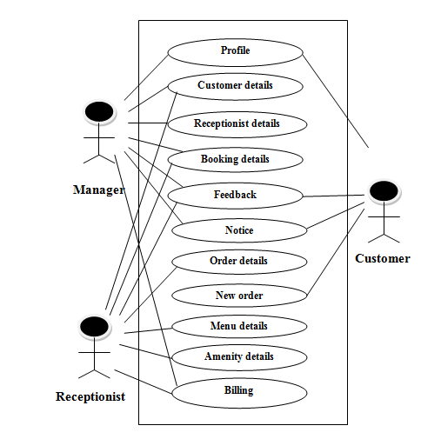
Use case diagrams
System use case diagram

Slide 37
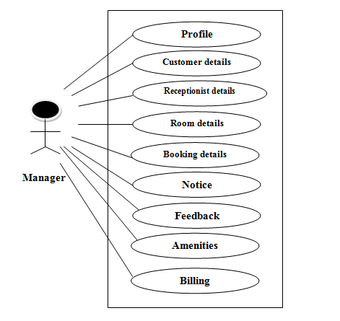
Manager level use case diagram

Slide 38
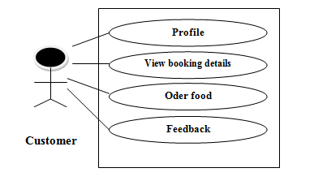
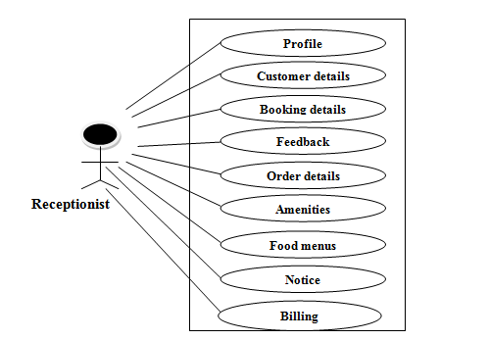
Customer use case diagram
Receptionist use case diagram

Slide 39
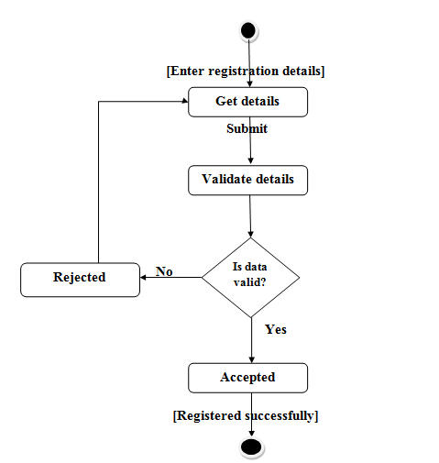
Registration page activity diagram

Slide 40
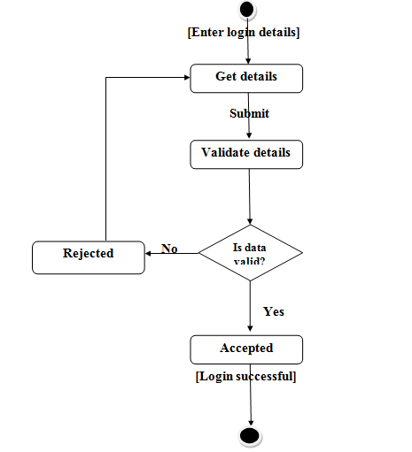
Login page activity diagram

Slide 41
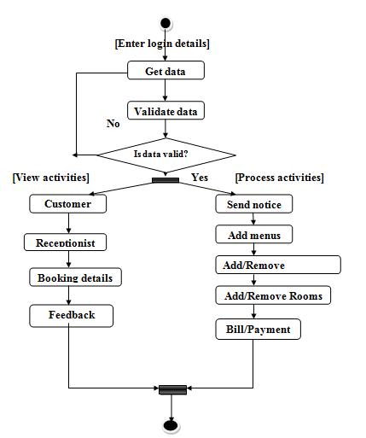
Manager activity diagram

Slide 42
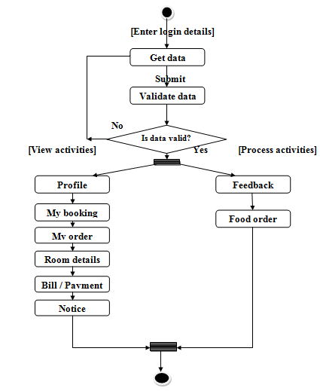
Customer activity diagram

Slide 43
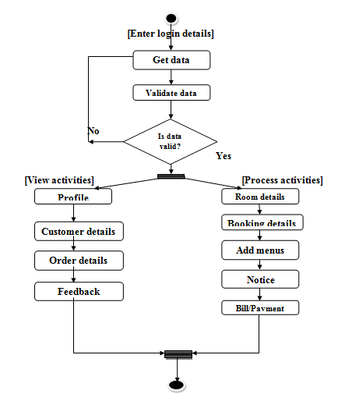
Receptionist activity diagram

Slide 44
Testing methodology
V-Model:
V-Model it is one of the software development life cycle model, we are using this model for software developing and testing purpose. V-Model is software verification and validation model. The V-Model focuses on a fairly typical waterfall method that follows strict, step-by-step stages. While initial stages are broad design stages, progress proceeds down through more and more granular stages, leading into implementation and coding, and finally back through all testing stages prior to completion of the project.

Slide 45
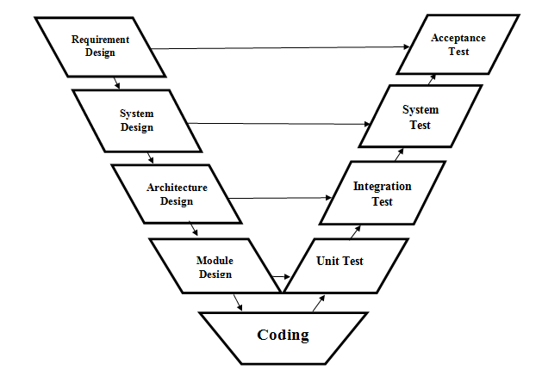
V-Model

Slide 46
CONCLUSION
This project has got clear advantage over the manual system. The computerized system is more reliable, efficient and fast and does maximum work within minimum time. It provides comfort and suitability to everyone. Providing maximum facilities and comfort to customers.

Slide 47
Thank you…

