Slide 1
Processes

Slide 2
What are they?

Slide 3
Why do we need them?

Slide 4
Imagine that you want something
ready made, off the shelf

Slide 5
shop around
touch and feel
try it
talk to people using it

Slide 6
Now imaging wanting to buy something
custom made

Slide 7
Will it be what I want
When will I get it
What will I have to pay

Slide 8
Lots of uncertainties
Lots of anxieties
How do you decide?

Slide 9
What's the cost of an error?

Slide 10
Factors:
Stage of induction
Stage of discovery

Slide 11
What is the cost of the effort to correct the error?

Slide 12
How much at which stage?
Can we save over all cost
by re-distributing effort in different stages?

Slide 13
What is the cost of a change?

Slide 14
We can't avoid change!
Caused by ambiguity
Caused by error
Change in need
Change in technology
Change in environment – competition...

Slide 15
We need some systematic way
of approaching the problem.
Need not be the same for all problems
Expect it to be similar for similar class of problems

Slide 16
What do we need to do systematically?

Slide 17
The core steps
Gather requirements
Translation them into programmable concepts
Implement them
Ensure that the implementation meets the requirements

Slide 18
Process Models

Slide 19
Waterfall

Slide 20
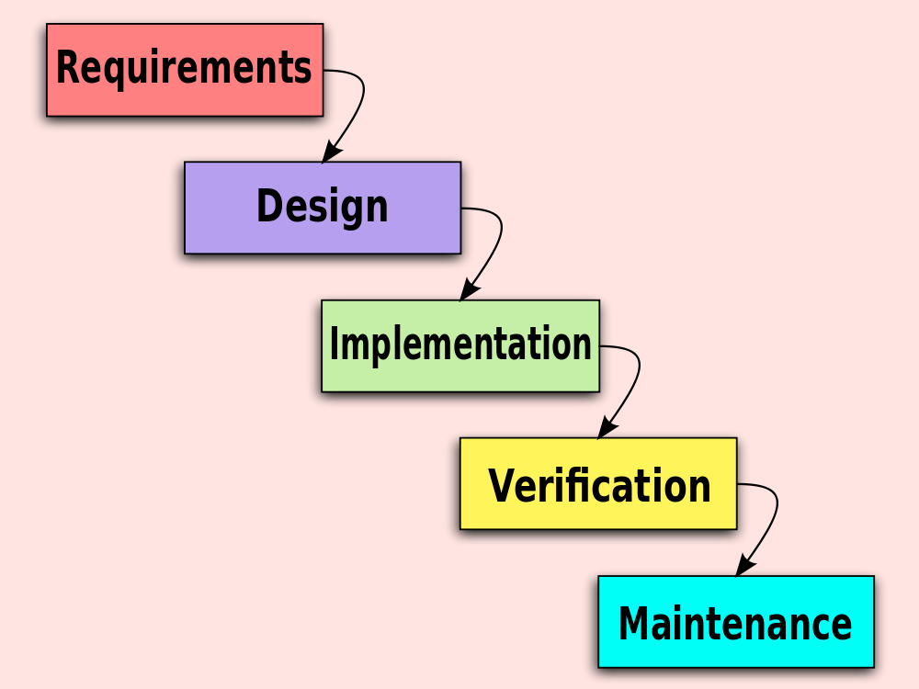

Slide 21
V Model

Slide 22
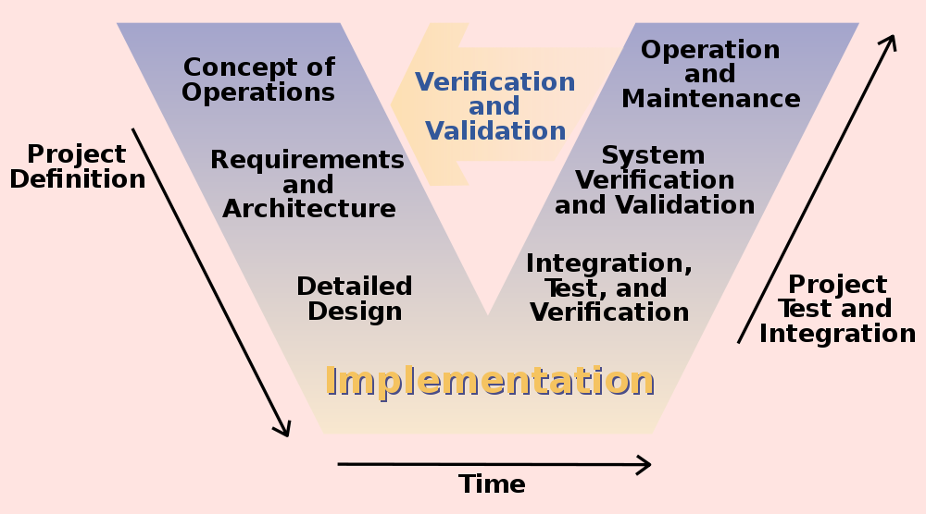

Slide 23
Incremental/Iterative Process Models

Slide 24
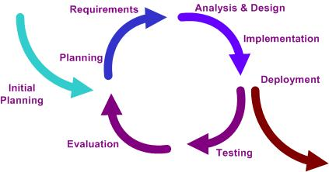

Slide 25
Time Boxing

Slide 26
Spiral

Slide 27
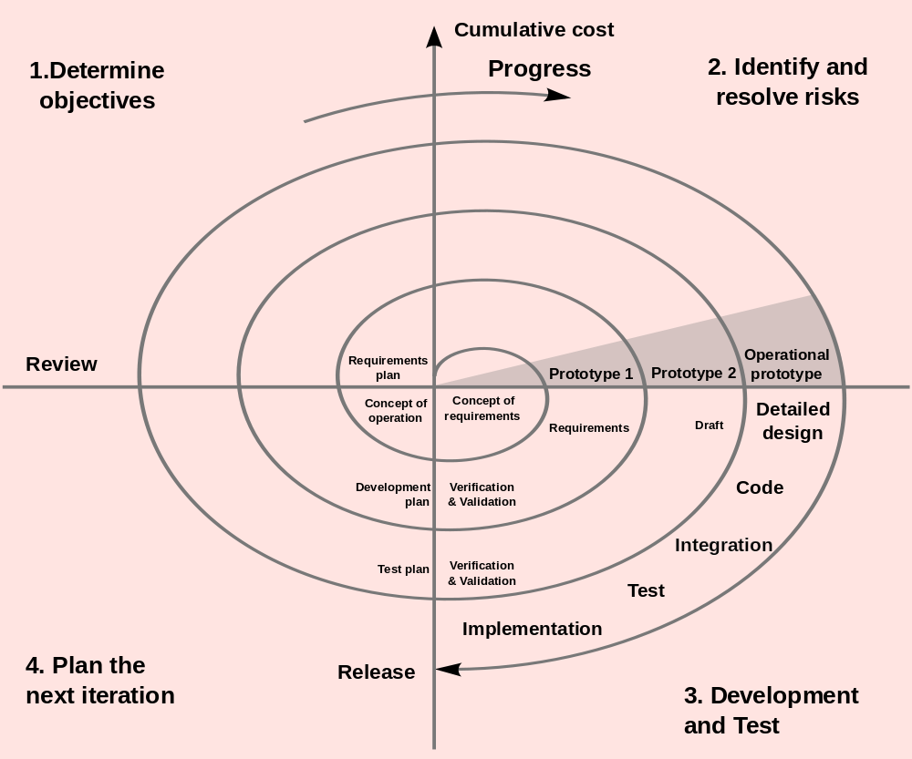

Slide 28
Prototyping

Slide 29
Identify basic requirements
Develop Initial Prototype
Review
Revise and Enhance the Prototype

Slide 30
Proof of Concept

Slide 31
Visual Prototype

Slide 32
Agile Methodologies

Slide 33
Agile Methodologies

Slide 34
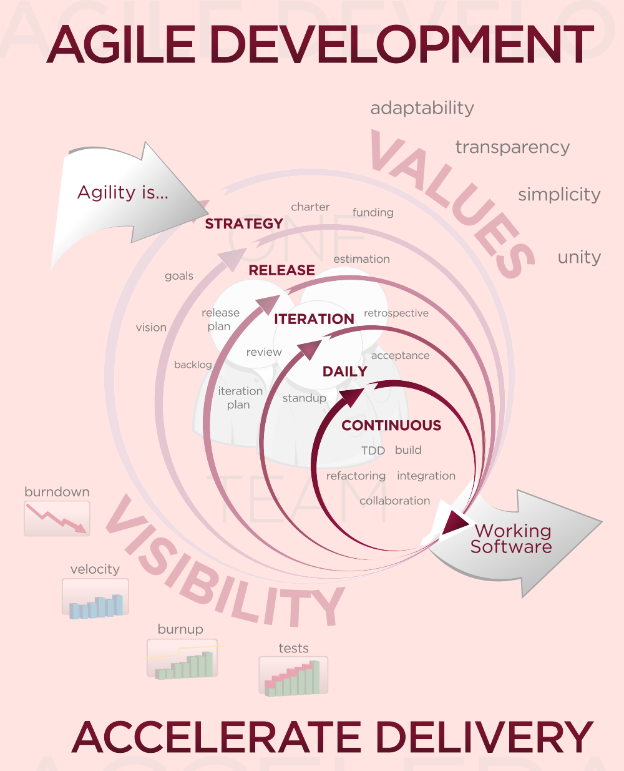

Slide 35
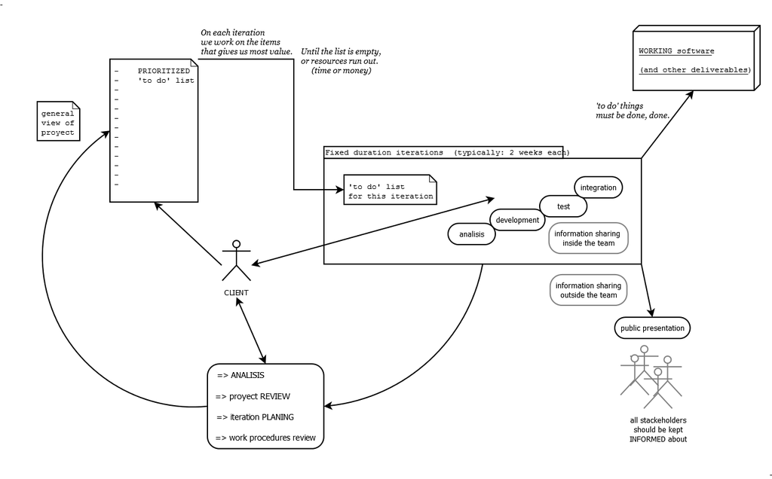

Slide 36
XP
eXtreme Programming

Slide 37
Pair Programming

Slide 38
Test Driven Development

Slide 39
Continuous Integration

Slide 40
Refactoring

Slide 41
User Stories

Slide 42
"As a <role>, I want <goal/desire> so that <benefit>"

Slide 43
"As a <role>, I want <goal/desire>"

Slide 44
Scrum

Slide 45
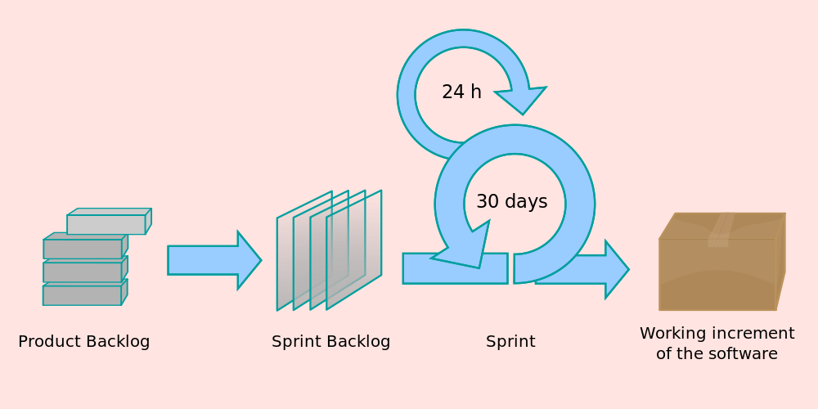

Slide 46
Scrum Team
core roles are often referred to as pigs
and
ancillary roles as chickens
(after the story The Chicken and the Pig).

Slide 47
daily scrum, or the daily standup

Slide 48
What have you done since yesterday?
What are you planning to do today?
Any impediments/stumbling blocks?

Slide 49
Any impediment/stumbling block identified
is documented by the Scrum Master
and
worked towards resolution outside of this meeting.
No detailed discussions shall happen in this meeting.

