Slide 1
Correctness is clearly the prime quality.
If a system does not do what it is supposed to do,
then everything else about it matters little.
-- Bertrand Meyer

Slide 2
How do you ensure correctness of your code?

Slide 3
As soon as we started programming,
we found to our surprise
that it wasn't as easy to get programs right
as we had thought.
Debugging had to be discovered.
I can remember the exact instant
when I realized that
a large part of my life from then on
was going to be spent
in finding mistakes in my own programs.
— Maurice Wilkes discovers debugging, 1949

Slide 4
How do you debug your code?

Slide 5
Suppose you have written code to find the square root

Slide 6
What would you test?

Slide 7
How would you verify the code?

Slide 8
There are two ways of constructing a software design:
One way is to make it so simple
that there are obviously no deficiencies
and the other way
is to make it so complicated
that there are no obvious deficiencies.
— C.A.R. Hoare, The 1980 ACM Turing Award Lecture

Slide 9
What does it mean?

Slide 10
Simplicity is prerequisite for reliability.
— Edsger W. Dijkstra

Slide 11
What does reliability have to do with simplicity?

Slide 12
How can you write code which is simple even if the task is complex?

Slide 13
The competent programmer
is fully aware of the limited size of his own skull.
He therefore approaches his task with full humility,
and avoids clever tricks like the plague.
— Edsger W. Dijkstra

Slide 14
Why would a programmer be proud of using 'clever tricks'?

Slide 15
What does it do?
if x=y ....

Slide 16
Some programming concepts:
Either useful or prone to errors

Slide 17
Iteration vs Recursion

Slide 18
Copy vs Deep Copy

Slide 19
Mutable vs Immutable

Slide 20
Arrays, Lists, Tuples

Slide 21
Generators and Iterators (yield statement)

Slide 22
Generics(Java), Templates (C++) vs Dynamic Programming Languages

Slide 23
Scope of a variable – global, local, nested, closure,

Slide 24
Lazy evaluation

Slide 25
Common Coding Errors
(search Google also)

Slide 26
Memory leaks

Slide 27
Null pointers

Slide 28
Array errors

Slide 29
String manipulation errors

Slide 30
Buffer overflows

Slide 31
Synchronization errors:
Deadlocks
Race conditions
Inconsistent synchronization

Slide 32
Coding Style:
What is it?
Why is it important?

Slide 33
Coding Style:
Tool-assisted enforcement?

Slide 34
The most effective debugging tool
is still careful thought,
coupled with judiciously placed print statements.
— Brian W. Kernighan, in the paper Unix for Beginners (1979)

Slide 35
How do you enforce careful thought?

Slide 36
What is code review?
What do you verify?

Slide 37
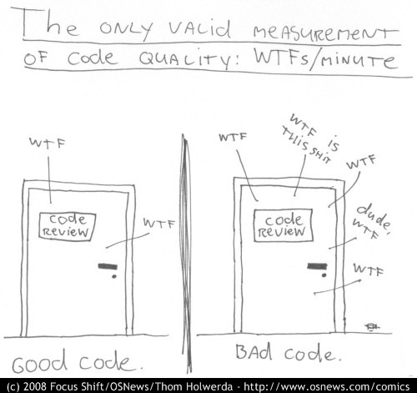
http://www.osnews.com/story/19266/WTFs_m

Slide 38
Is there more than one type of testing?

Slide 39
Test in the small

Slide 40
Unit test

Slide 41
Test in the large

Slide 42
Module test (a single module)
Integration test (more than one module)
System test (the entire system)

Slide 43
Acceptance Test

Slide 44
Functional test
Non functional test
Performance
Stress
Recovery
Security
Deployment

Slide 45
Alternate classifications:
White box testing
Black box testing
Performance testing
Reliability testing

Slide 46
Why is testing hard?

Slide 47
Debugging aids:
Debugger

Slide 48
Conditional compilations/executions
Assert statement

Slide 49
Loggers

Slide 50
Core dump

Slide 51
Web testing
Anything different?

Slide 52
Selenium automates browsers

Slide 53
Read about Software Design Patterns
Before
Next Class

