Slide 1
How do you create better code?

Slide 2
Copying?

Slide 3
What's a pattern?

Slide 4
Kurt Vonnegut
http://www.laphamsquarterly.org/voices-in-time/
kurt-vonnegut-at-the-blackboard.php

Slide 5
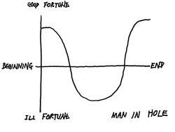

Slide 6
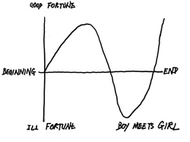

Slide 7
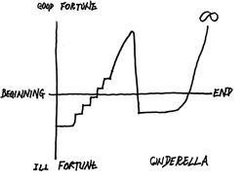

Slide 8
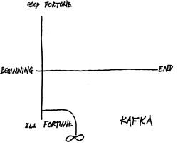

Slide 9
What is a Design Patterns?

Slide 10
a design pattern is a general reusable solution to a commonly occurring problem within a given context

Slide 11
Any difference between a reusable code module
and a design pattern?

Slide 12
Design patterns gained popularity in computer science after the book
Design Patterns: Elements of Reusable Object-Oriented Software was published in 1994
by the so-called "Gang of Four" (Gamma et al.),
which is frequently abbreviated as "GOF".

Slide 13
GoF defined 23 design patterns.
Focussed on issues of object oriented languages

Slide 14
Design Patterns in Dynamic Languages
http://www.norvig.com/design-patterns/

Slide 15
16 of the 23 quite simple in Lisp/Dylan

Slide 16
However, these languages may suggest new designs

Slide 17
For example, using functions as parameters

Slide 18
Design Patterns have a name.
Why?

Slide 19
What information would be useful to know about a design pattern?

Slide 20
Categorisation of Patterns
As per GoF

Slide 21
Creational

Slide 22
Structural

Slide 23
Behavioural

Slide 24

Factory Method

Slide 25
Graphical Modeling of Classes

Slide 26
What does it do?

Slide 27
Why would it be useful in your project?

Slide 28
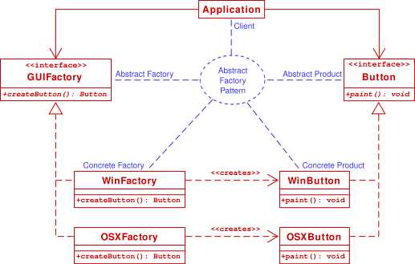
Abstract Factory

Slide 29
What's Happening?

Slide 30
Utility with reference to the project?

Slide 31
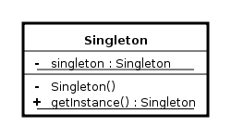
Singleton

Slide 32
Explain this class

Slide 33
How is it different from a Global?

Slide 34
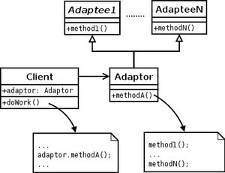
Adapter Pattern

Slide 35

Explain the classes

Slide 36
How is it relevant in your project?

Slide 37
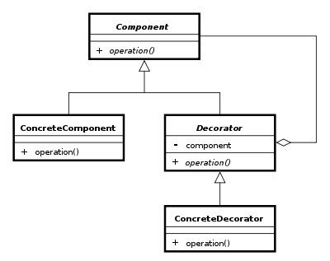
Decorator

Slide 38
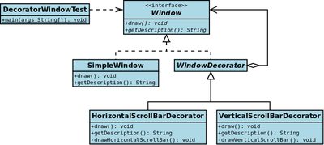
Explain this example

Slide 39
When would it be useful?

Slide 40
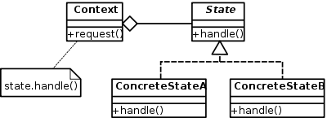
State Pattern

Slide 41
Where could it be useful?

Slide 42
Examples of states in use?
Do they need state pattern?

Slide 43
Some Criticisms

Slide 44
Design patterns are a form of complexity.
As with all complexity, I'd rather see developers focus on simpler solutions before going straight to a complex recipe of design patterns.
http://www.codinghorror.com/blog/2007/07/
rethinking-design-patterns.html

Slide 45
Most of the criticisms of design patterns ... relate to a distaste for the structuring and labeling of what they consider to be just good object oriented practices.
Most patterns boil down to programming to interfaces, and other SOLID principles.
The feeling is that when we teach patterns we cause developers .. to try to cram all problems into the set of patterns that they have learned, which can create more obtuse and cumbersome problems than if they had taken a more 'straight forward' approach.
http://stackoverflow.com/questions/3990899/
design-patterns-criticism-sources

