Slide 1
Object Design
Unified Modelling Language
UML

Slide 2
Why do we need UML?

Slide 3
What should it allow us to do?

Slide 4
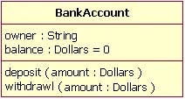
Class

Slide 5
Relationship between classes

Slide 6
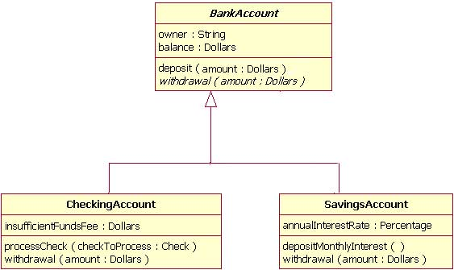
Inheritance

Slide 7
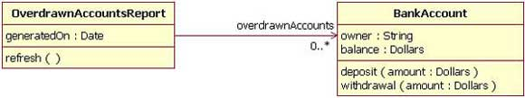
Association : uni-directional

Slide 8
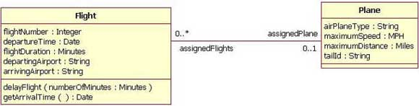
Association : bidirectional

Slide 9
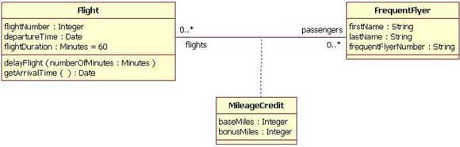
Association Class

Slide 10

Aggregation

Slide 11

Composition

Slide 12
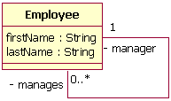
Reflexive Association

Slide 13

Roles

Slide 14
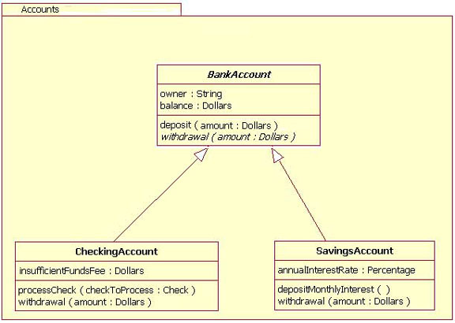
Package

Slide 15
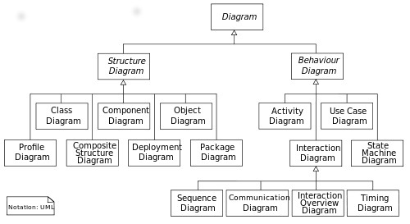
UML Diagram Overview

Slide 16
'Behaviour of Classes
Or
Interaction Between Classes

Slide 17
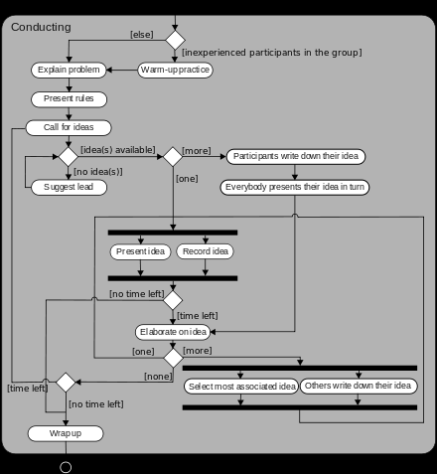
Activity Diagram

Slide 18
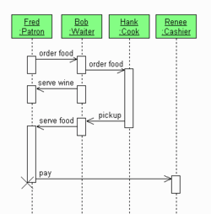
Sequence Diagram (asynchronous)

Slide 19
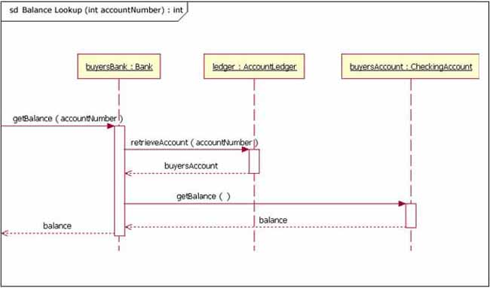
Sequence Diagram (synchronous)

Slide 20
When are sequence diagrams likely to be very useful?

Slide 21
An Example of a Card Game

Slide 22
Card Deck

Slide 23
Playing Card

Slide 24
Collections of cards:
Cards in hand
Cards won
Unallocated Cards
Cards on a table
Heap?
Pile?
Hand?

Slide 25
Player

Slide 26
Game

Slide 27
Another Example

Slide 28
