Slide 1
Design Principles

Slide 2
But what we really want:
write good code

Slide 3
Needs well designed, testable classes

Slide 4
Many programmers
=> Code to interfaces

Slide 5
Need to design classes
Formally

Slide 6
Obvious classes not enough -
Too Complex

Slide 7
But how to decide when and what to split.
CRC card full is just an indicator.

Slide 8
You ain't gonna need it

Slide 9
AVOID
temptation to write code not necessary now,
but might be in the future

Slide 10
Why?

Slide 11
Yagni Principle
Time spent now – could be better used
Additional documentation, testing debugging
May impose constraints when actually needed
Code bloat
Feature creep

Slide 12
Your code is better,
because you avoid polluting it with 'guesses'
that turn out to be more or less wrong
but stick around anyway

Slide 13
When you need it,
Add code
and
Refactor if needed

Slide 14
When do you need refactoring?

Slide 15
What does it achieve?

Slide 16
Opposite of
If it is working, don't change

Slide 17
Don't repeat yourself

Slide 18
What does DRY imply?

Slide 19
Every piece of knowledge must have a
single,
unambiguous,
authoritative
representation within a system.

Slide 20
Is it the same as code reuse?

Slide 21
Duplication (inadvertent or purposeful)
can lead to
maintenance nightmares,
poor factoring,
and logical contradictions.

Slide 22
Clone And Modify Programming
is generally cited
as the chief culprit

Slide 23
Whether in code, architecture,
requirements documents, or user documentation,
duplication of knowledge - not just text -
is the real culprit.

Slide 24
KISS principle

Slide 25
Leonardo da Vinci's
"Simplicity is the ultimate sophistication",

Slide 26
Mies Van Der Rohe's
"Less is more",

Slide 27
Antoine de Saint Exupéry's
"It seems that perfection is reached
not when there is nothing left to add,
but when there is nothing left to take away"

Slide 28
Occam's razor
Among competing hypotheses,
the one which makes the fewest assumptions
should be selected.

Slide 29
Why is this emphasised?
Do programmers really want to complicate code?

Slide 30
I can just see someone saying the human body is way too complex. Please refactor.
http://c2.com/cgi/wiki?SimplicityIsOverRated

Slide 31
"Keep it simple" does not mean
"Make complex things simple".
It has a specific and restricted meaning, i.e.,
"add no unnecessary complexity".

Slide 32
Cohesion
degree to which the elements of a module belong together

Slide 33
Why is high cohesion desirable?

Slide 34
code readability and
the likelihood of reuse is increased,
while complexity is kept manageable.

Slide 35
Coupling
degree to which each program module
relies on each one of the other modules

Slide 36
Why is loose coupling desirable?

Slide 37
A change in one module
usually forces a ripple effect of changes
in other modules.

Slide 38
Assembly of modules might require
more effort
and/or time
due to the increased inter-module dependency.

Slide 39
A particular module might be harder
to reuse
and/or test
because dependent modules must be included.

Slide 40
Why do
Coupling and Cohesion
frequently occur together?

Slide 41
Low coupling and
high cohesion
seem to be correlated.
Why?

Slide 42
Quality Considerations

Slide 43
Functionality

Slide 44
Reliability

Slide 45
Usability

Slide 46
Efficiency

Slide 47
Maintainability

Slide 48
Portability

Slide 49
Are there alternates to object oriented design?

Slide 50
Divide and rule:
Components

Slide 51
What is a component?

Slide 52
Object oriented view : an object
Functional view: a functional module

Slide 53
Where would a functional view be very useful?

Slide 54
How do you create a functional module?

Slide 55
Focuses on a single task

Slide 56
Focuses on a single task

Slide 57
Low coupling, high cohesion

Slide 58
Guidelines For Functional Design
Consider the product's goal
Consider who will be using it
Consider what your audience intends to do with it
Is it clear how to use it
How does your user know it is working
Is it engaging to your customers
How does it handle mistakes

Slide 59
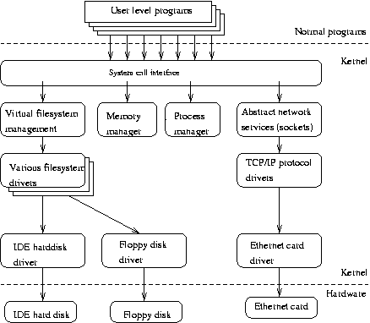

Slide 60
If you want to program in C,
do you need to do a functional design
or
can you implement oo design in C?

Slide 61
Difference between a struct and class?
A method in a class in Python
has self as the first parameter.
Why?

Slide 62
Classes are Abstract Data Types.
What is abstraction?

Slide 63
The process of formulating
generalized ideas or concepts
by extracting common qualities
from specific examples

Slide 64
Abstractions may be formed by reducing the information content of a concept
or an observable phenomenon,
typically to retain only information
which is relevant for a particular purpose.

