Slide 1
Project Planning

Slide 2
Plans are nothing; planning is everything — Dwight D. Eisenhower

Slide 3
You have the design of classes.
What next?

Slide 4
“An ounce of action is worth a ton of theory.” – Friedrich Engels

Slide 5
Who will do what?

Slide 6
When will it get done?

Slide 7
How do you know whether you are on target?

Slide 8
Rien n'est plus difficile, et donc plus précieux, que d'être capable de décider.
[Nothing is more difficult, and therefore more precious, than being able to decide.]
Napolean Buonaparte

Slide 9
I have always wished that my computer
would be as easy to use as my telephone.
My wish has come true.
I no longer know how to use my telephone.
— Bjarne Stroustrup

Slide 10
Plans are only good intentions unless
they immediately degenerate into hard work.
Peter Drucker

Slide 11
There are no good project managers -
only lucky ones.
The more you plan the luckier you get.

Slide 12
Work breakdown structures

Slide 13
Running a project without a WBS
is like going to a strange land without a roadmap.
J. Phillips

Slide 14
Task Allocation

Slide 15
Resources

Slide 16
You can't turn a herd of turtles
into a twenty-mule work team.
L. Todryk

Slide 17
Managing IT people is like herding cats.

Slide 18
Various sources for quotes, including:
http://www.famous-quotes.net/Topic.aspx?Project_Management

Slide 19
Estimates

Slide 20
Costs

Slide 21
Metrics
only way to measure progress

Slide 22
Lines of code

Slide 23
Lines of code:
Depends on language
Depends on coder

Slide 24
Time Tracking

Slide 25
Time tracking:
Task and duration
Expected time vs actual time

Slide 26
Quality

Slide 27
Quality:
Bugs & problems reported
Code complexity metrics
Complaints and appreciations

Slide 28
Development Effort

Slide 29
if you're measuring effort as your progress,
you're not measuring the right thing

Slide 30
Suppose a project is expected to take 2 man-years
You have spent 1 man-year.
Is 50% of project done?

Slide 31
Tools

Slide 32
Microsoft Project
Planner

Slide 33
Online sites like
http://basecamp.com/

Slide 34
Ruby on Rails to Basecamp
21 Mar 2004 by David Heinemeier Hansson
The use of Ruby and Rails in developing Basecamp seems to have sparked interested in both language and framework.
So if you want to learn more about Ruby, ...

Slide 35
The one I really liked seems to be dormant
but still works
http://faces.homeip.net/
http://sourceforge.net/projects/faces-project/

Slide 36
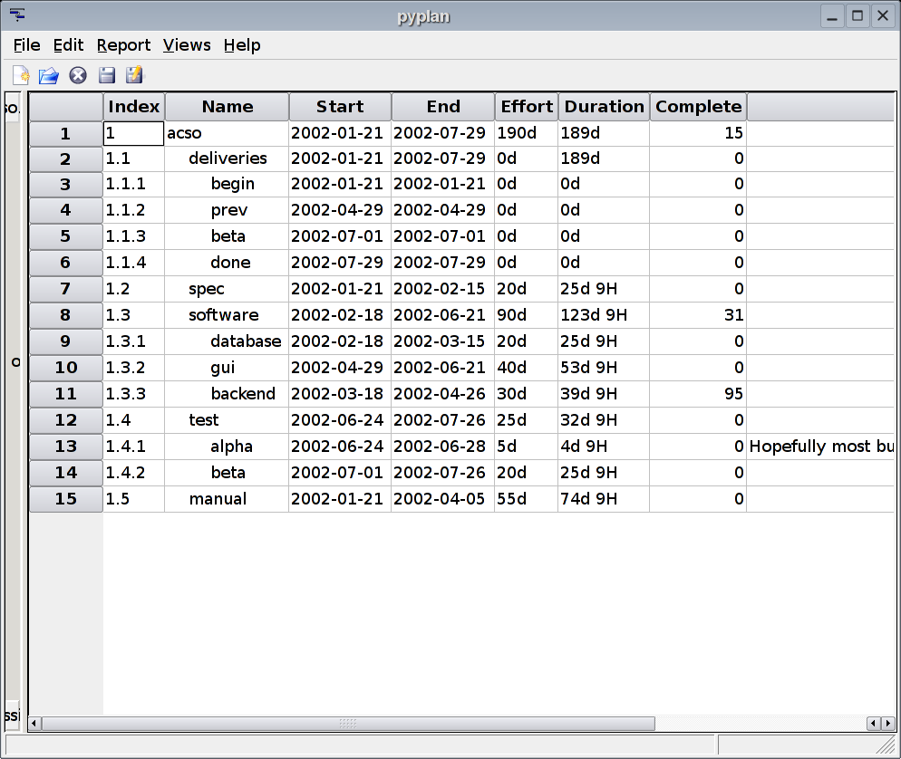

Slide 37
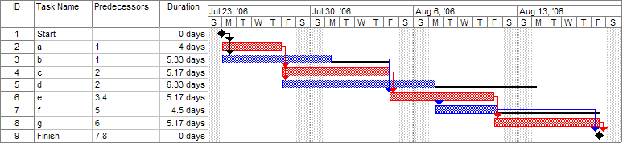
Gnatt Chart
& Critical Path (Red)

Slide 38
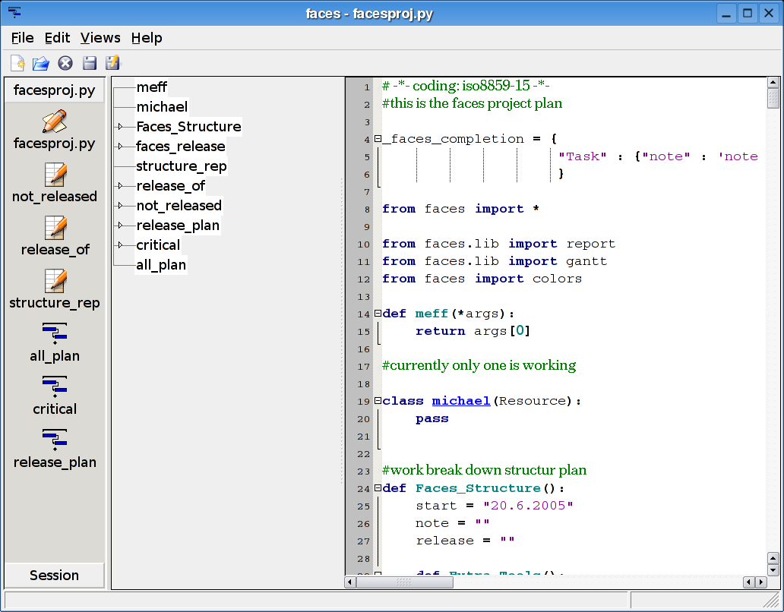

Slide 39
Previous slide probably explains
why faces pm failed to capture any mind share
Project Managers
or those who monitor progress
are rarely programmers!

Slide 40
When planning for a year, plant corn.
When planning for a decade, plant trees.
When planning for life, train and educate people —
Chinese Proverb.
Know your planning horizon.

