Slide 1
Guardian Of Trust
Cutting the middle man out

Slide 2

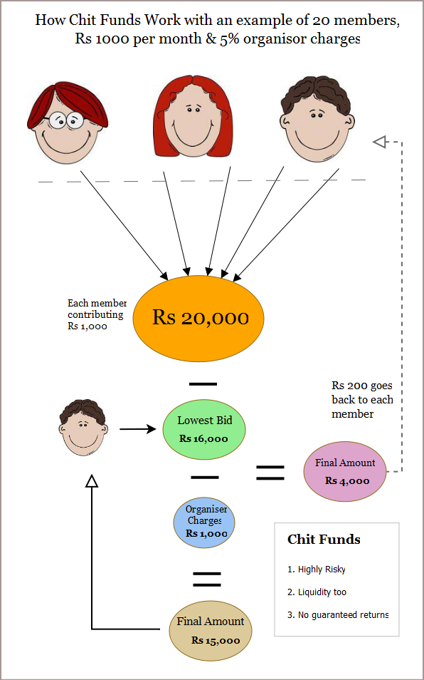
Chit funds – commoner's savings scheme

