Slide 1
Guardian Of Trust
Cutting the middle man out

Slide 2

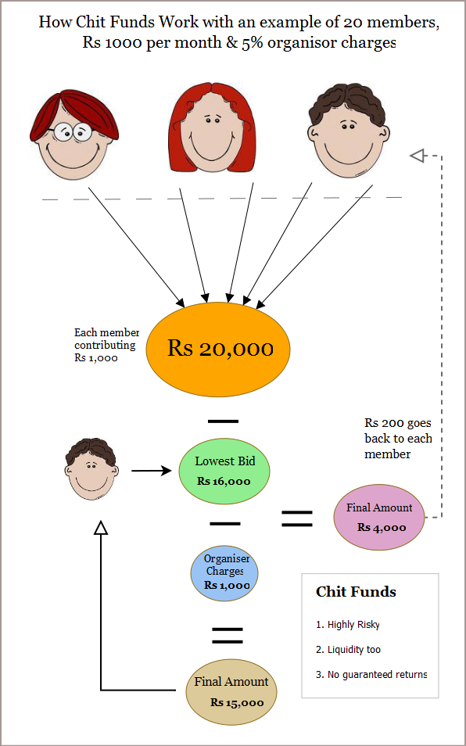
Chit funds – commoner's savings scheme

Slide 3
Proposed solution using Blockchain
Centralized KYC
Fiat Currency Converter
Escrow Smart Contract
Leverage the existing centralized KYC Registry for vetting the users of the system https://testbed.ckycindia.in/ckyc/index.php
Use existing FinTech Solutions like PayPal to onboard users quickly and to simplify the Fiat to Cypto currency conversions
Replace the middle man with Escrow Smart Contract to store the chit fund sum securely and to automate the withdrawal rpocess

