Slide 1
DBMS
Database Management Systems

Slide 2
What is Database?
Database is a collection of related data and data is a collection of facts and figures that can be processed to produce information.
Mostly data represents recordable facts. Data aids in producing information, which is based on facts. For example, if we have data about marks obtained by all students, we can then conclude about toppers and average marks.

Slide 3
Database Management Systems
A database management system stores data in such a way that it becomes easier to retrieve, manipulate, and produce information.

Slide 4
Characteristics of DBMS
A modern DBMS has the following characteristics −
Real-world entity − A modern DBMS is more realistic and uses real-world entities to design its architecture. It uses the behavior and attributes too. For example, a school database may use students as an entity and their age as an attribute.

Slide 5
Characteristics of DBMS
Relation-based tables − DBMS allows entities and relations among them to form tables. A user can understand the architecture of a database just by looking at the table names

Slide 6
Characteristics of DBMS
Isolation of data and application − A database system is entirely different than its data. A database is an active entity, whereas data is said to be passive, on which the database works and organizes. DBMS also stores metadata, which is data about data, to ease its own process.

Slide 7
Characteristics of DBMS
Less redundancy − DBMS follows the rules of normalization, which splits a relation when any of its attributes is having redundancy in values. Normalization is a mathematically rich and scientific process that reduces data redundancy.

Slide 8
Characteristics of DBMS
Consistency − Consistency is a state where every relation in a database remains consistent. There exist methods and techniques, which can detect attempt of leaving database in inconsistent state. A DBMS can provide greater consistency as compared to earlier forms of data storing applications like file-processing systems.

Slide 9
Characteristics of DBMS
ACID Properties − DBMS follows the concepts of Atomicity, Consistency, Isolation, and Durability (normally shortened as ACID). These concepts are applied on transactions, which manipulate data in a database. ACID properties help the database stay healthy in multi-transactional environments and in case of failure.

Slide 10
Characteristics of DBMS
Multiuser and Concurrent Access − DBMS supports multi-user environment and allows them to access and manipulate data in parallel.
Multiple views − DBMS offers multiple views for different users. A user who is in the Sales department will have a different view of database than a person working in the Production department.

Slide 11
Characteristics of DBMS
Security − Features like multiple views offer security to some extent where users are unable to access data of other users and departments. DBMS offers methods to impose constraints while entering data into the database and retrieving the same at a later stage. DBMS offers many different levels of security features, which enables multiple users to have different views with different features. For example, a user in the Sales department cannot see the data that belongs to the Purchase department.

Slide 12
DBMS - Architecture
The design of a DBMS depends on its architecture. It can be centralized or decentralized or hierarchical. The architecture of a DBMS can be seen as either single tier or multi-tier. An n-tier architecture divides the whole system into related but independent n modules, which can be independently modified, altered, changed, or replaced.

Slide 13
DBMS - Architecture
In 1-tier architecture, the DBMS is the only entity where the user directly sits on the DBMS and uses it. Any changes done here will directly be done on the DBMS itself. It does not provide handy tools for end-users. Database designers and programmers normally prefer to use single-tier architecture.

Slide 14
DBMS - Architecture
If the architecture of DBMS is 2-tier, then it must have an application through which the DBMS can be accessed. Programmers use 2-tier architecture where they access the DBMS by means of an application. Here the application tier is entirely independent of the database in terms of operation, design, and programming.

Slide 15
DBMS - Architecture
3-tier Architecture
A 3-tier architecture separates its tiers from each other based on the complexity of the users and how they use the data present in the database. It is the most widely used architecture to design a DBMS.

Slide 16
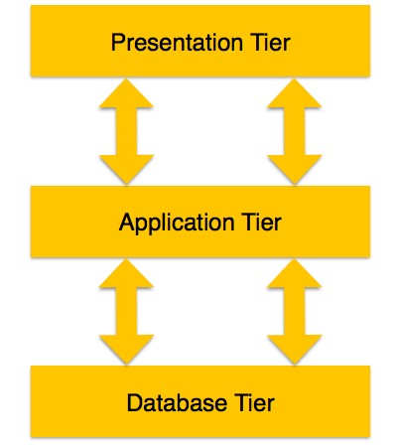
DBMS - Architecture

Slide 17
DBMS - Architecture
Database (Data) Tier − At this tier, the database resides along with its query processing languages. We also have the relations that define the data and their constraints at this level.
Application (Middle) Tier − At this tier reside the application server and the programs that access the database. For a user, this application tier presents an abstracted view of the database.

Slide 18
DBMS - Architecture
End-users are unaware of any existence of the database beyond the application. At the other end, the database tier is not aware of any other user beyond the application tier. Hence, the application layer sits in the middle and acts as a mediator between the end-user and the database.

Slide 19
DBMS - Architecture
User (Presentation) Tier − End-users operate on this tier and they know nothing about any existence of the database beyond this layer. At this layer, multiple views of the database can be provided by the application. All views are generated by applications that reside in the application tier.

Slide 20
DBMS - Data Schemas
A database schema is the skeleton structure that represents the logical view of the entire database. It defines how the data is organized and how the relations among them are associated. It formulates all the constraints that are to be applied on the data.

Slide 21
DBMS - Data Schemas
A database schema defines its entities and the relationship among them. It contains a descriptive detail of the database, which can be depicted by means of schema diagrams. It’s the database designers who design the schema to help programmers understand the database and make it useful.

Slide 22
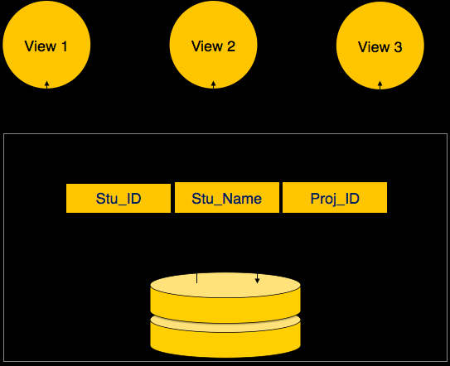
DBMS - Data Schemas

Slide 23
DBMS - Data Schemas
A database schema can be divided broadly into two categories −
Physical Database Schema − This schema pertains to the actual storage of data and its form of storage like files, indices, etc. It defines how the data will be stored in a secondary storage.
Logical Database Schema − This schema defines all the logical constraints that need to be applied on the data stored. It defines tables, views, and integrity constraints.

Slide 24
DBMS - Data Independence
A database system normally contains a lot of data in addition to users’ data. For example, it stores data about data, known as metadata, to locate and retrieve data easily. It is rather difficult to modify or update a set of metadata once it is stored in the database. But as a DBMS expands, it needs to change over time to satisfy the requirements of the users. If the entire data is dependent, it would become a tedious and highly complex job.

Slide 25
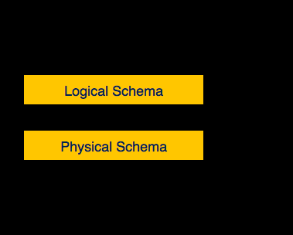
DBMS - Data Independence

Slide 26
DBMS - Data Independence
Metadata itself follows a layered architecture, so that when we change data at one layer, it does not affect the data at another level. This data is independent but mapped to each other.

Slide 27
DBMS - Data Independence
Logical Data Independence
Logical data is data about database, that is, it stores information about how data is managed inside. For example, a table (relation) stored in the database and all its constraints, applied on that relation.
Logical data independence is a kind of mechanism, which liberalizes itself from actual data stored on the disk. If we do some changes on table format, it should not change the data residing on the disk.

Slide 28
DBMS - Data Independence
Physical Data Independence
All the schemas are logical, and the actual data is stored in bit format on the disk. Physical data independence is the power to change the physical data without impacting the schema or logical data.
For example, in case we want to change or upgrade the storage system itself − suppose we want to replace hard-disks with SSD − it should not have any impact on the logical data or schemas.

Slide 29
Hierarchical Database Model
A hierarchical database model is a data model in which the data is organized into a tree-like structure. The data is stored as records which are connected to one another through links. A record is a collection of fields, with each field containing only one value. The entity type of a record defines which fields the record contains.

Slide 30
The hierarchical database model mandates that each child record has only one parent, whereas each parent record can have one or more child records. In order to retrieve data from a hierarchical database the whole tree needs to be traversed starting from the root node. This model is recognized as the first database model created by IBM in the 1960s

Slide 31
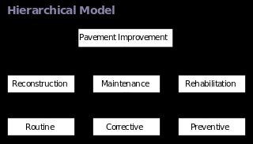

Slide 32
Network model
The network model is a database model conceived as a flexible way of representing objects and their relationships. Its distinguishing feature is that the schema, viewed as a graph in which object types are nodes and relationship types are arcs, is not restricted to being a hierarchy or lattice.

Slide 33
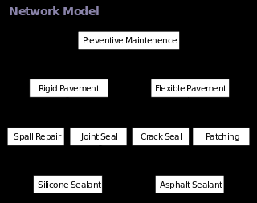

Slide 34
Relational DBMS
Relational data model is the primary data model, which is used widely around the world for data storage and processing. This model is simple and it has all the properties and capabilities required to process data with storage efficiency.

Slide 35
Object Relational DBMS
An object-relational database (ORD), or object-relational database management system (ORDBMS), is a database management system (DBMS) similar to a relational database, but with an object-oriented database model: objects, classes and inheritance are directly supported in database schemas and in the query language. In addition, just as with pure relational systems, it supports extension of the data model with custom data-types and methods.

Slide 36
Object Relational DBMS
The basic goal for the Object-relational database is to bridge the gap between relational databases and the object-oriented modeling techniques used in programming languages such as Java, C++, Visual Basic .NET or C#. However, a more popular alternative for achieving such a bridge is to use a standard relational database systems with some form of object-relational mapping (ORM) software. Whereas traditional RDBMS or SQL-DBMS products focused on the efficient management of data drawn from a limited set of data-types (defined by the relevant language standards), an object-relational DBMS allows software developers to integrate their own types and the methods that apply to them into the DBMS.

Slide 37
Object Relational DBMS
The ORDBMS (like ODBMS or OODBMS) is integrated with an object-oriented programming language. The characteristic properties of ORDBMS are 1) complex data, 2) type inheritance, and 3) object behavior. Complex data creation in most SQL ORDBMSs is based on preliminary schema definition via the user-defined type (UDT). Hierarchy within structured complex data offers an additional property, type inheritance. That is, a structured type can have subtypes that reuse all of its attributes and contain additional attributes specific to the subtype. Another advantage, the object behavior, is related with access to the program objects. Such program objects must be storable and transportable for database processing, therefore they usually are named as persistent objects. Inside a database, all the relations with a persistent program object are relations with its object identifier (OID). All of these points can be addressed in a proper relational system, although the SQL standard and its implementations impose arbitrary restrictions and additional complexity[

Slide 38
Object Relational DBMS
CREATE TABLE Customers ( Id Cust_Id NOT NULL PRIMARY KEY, Name PersonName NOT NULL, DOB DATE NOT NULL );
SELECT Formal( C.Id ) FROM Customers C WHERE BirthDay ( C.DOB ) = TODAY;

Slide 39
Introduction to MYSQL
MySQL is a fast, easy-to-use RDBMS being used for many small and big businesses. MySQL is developed, marketed, and supported by MySQL AB, which is a Swedish company.

Slide 40
Introduction to MYSQL
MySQL is becoming so popular because of many good reasons:
MySQL is released under an open-source license. So you have nothing to pay to use it.
MySQL is a very powerful program in its own right. It handles a large subset of the functionality of the most expensive and powerful database packages.
MySQL uses a standard form of the well-known SQL data language.
MySQL works on many operating systems and with many languages including PHP, PERL, C, C++, JAVA, etc

Slide 41
Introduction to MYSQL
MySQL works very quickly and works well even with large data sets.
MySQL is very friendly to PHP, the most appreciated language for web development.
MySQL supports large databases, up to 50 million rows or more in a table. The default file size limit for a table is 4GB, but you can increase this (if your operating system can handle it) to a theoretical limit of 8 million terabytes (TB).
MySQL is customizable. The open-source GPL license allows programmers to modify the MySQL software to fit their own specific environments.

