Slide 1
Creating Functions and Debugging Subprograms

Slide 2
Objectives
After completing this lesson, you should be able to do the following:
Differentiate between a procedure and a function
Describe the uses of functions
Create stored functions
Invoke a function
Remove a function
Understand the basic functionality of the SQL Developer debugger

Slide 3
Lesson Agenda
Working with functions:
Differentiating between a procedure and a function
Describing the uses of functions
Creating, invoking, and removing stored functions
Introducing the SQL Developer debugger

Slide 4
Overview of Stored Functions
A function:
Is a named PL/SQL block that returns a value
Can be stored in the database as a schema object for repeated execution
Is called as part of an expression or is used to provide a parameter value for another subprogram
Can be grouped into PL/SQL packages

Slide 5
Creating Functions
The PL/SQL block must have at least one RETURN statement.
CREATE [OR REPLACE] FUNCTION function_name [(parameter1 [mode1] datatype1, . . .)]
RETURN datatype IS|AS
[local_variable_declarations;
. . .]
BEGIN -- actions;
RETURN expression;
END [function_name];
PL/SQL Block

Slide 6
The Difference Between Procedures and Functions
Procedures | Functions
Execute as a PL/SQL statement | Invoke as part of an expression
Do not contain RETURN clause in the header | Must contain a RETURN clause in the header
Can pass values (if any) using output parameters | Must return a single value
Can contain a RETURN statement without a value | Must contain at least one RETURN statement

Slide 7

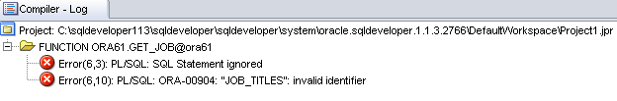










Creating and Running Functions: Overview
View errors/warnings in SQL Developer
YES
Use SHOW ERRORS command in SQL*Plus
Create/edit function
Compiler warnings/errors?
View compiler warnings/errors
NO
Use USER/ALL/DBA_ ERRORS views
Invoke function

Slide 8

Creating and Invoking a Stored Function Using the CREATE FUNCTION Statement: Example
CREATE OR REPLACE FUNCTION get_sal
(p_id employees.employee_id%TYPE) RETURN NUMBER IS
v_sal employees.salary%TYPE := 0;
BEGIN
SELECT salary
INTO v_sal
FROM employees
WHERE employee_id = p_id;
RETURN v_sal;
END get_sal;
/
-- Invoke the function as an expression or as
-- a parameter value.
EXECUTE dbms_output.put_line(get_sal(100))

Slide 9


Using Different Methods for Executing Functions
-- As a PL/SQL expression, get the results using host variables
VARIABLE b_salary NUMBER
EXECUTE :b_salary := get_sal(100)
-- As a PL/SQL expression, get the results using a local
-- variable SET SERVEROUTPUT ON
DECLARE
sal employees.salary%type;
BEGIN
sal := get_sal(100);
DBMS_OUTPUT.PUT_LINE('The salary is: '|| sal);
END;
/

Slide 10

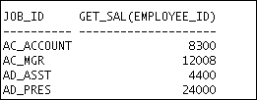

Using Different Methods for Executing Functions
-- Use as a parameter to another subprogram
EXECUTE dbms_output.put_line(get_sal(100))
-- Use in a SQL statement (subject to restrictions)
SELECT job_id, get_sal(employee_id)
FROM employees;
. . .

Slide 11
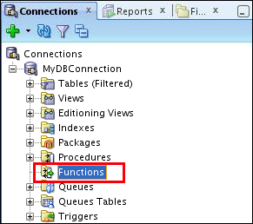
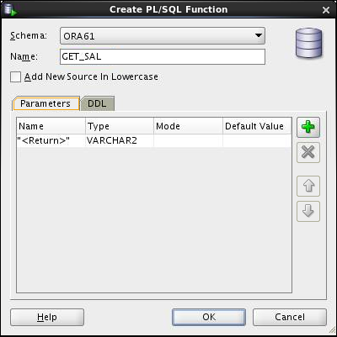
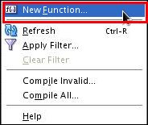
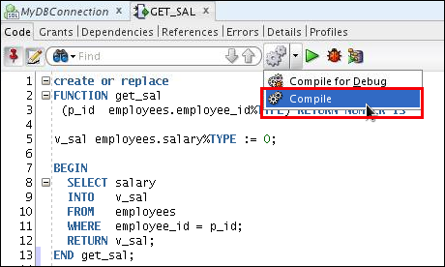
Creating and Compiling Functions Using SQL Developer
2
1
3
5
4

Slide 12
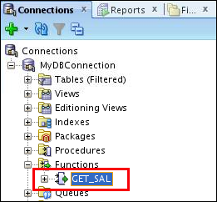
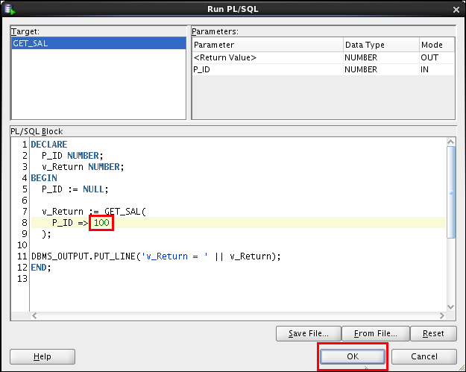
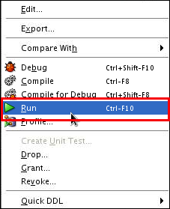
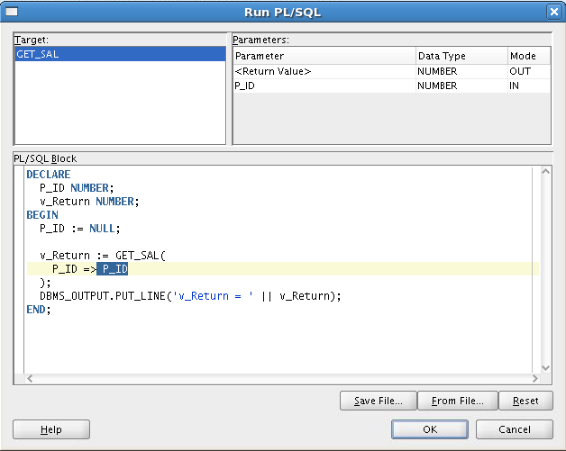
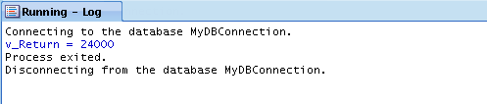
Executing Functions Using SQL Developer
1
2
4
Replace the second P_ID with the actual value 100.
3

Slide 13
Advantages of User-Defined Functions in SQL Statements
Can extend SQL where activities are too complex, too awkward, or unavailable with SQL
Can increase efficiency when used in the WHERE clause to filter data, as opposed to filtering the data in the application
Can manipulate data values

Slide 14
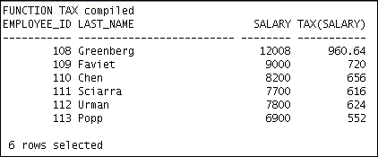
Using a Function in a SQL Expression: Example
CREATE OR REPLACE FUNCTION tax(p_value IN NUMBER)
RETURN NUMBER IS
BEGIN
RETURN (p_value * 0.08);
END tax;
/
SELECT employee_id, last_name, salary, tax(salary)
FROM employees
WHERE department_id = 100;

Slide 15
Calling User-Defined Functions in SQL Statements
User-defined functions act like built-in single-row functions and can be used in:
The SELECT list or clause of a query
Conditional expressions of the WHERE and HAVING clauses
The CONNECT BY, START WITH, ORDER BY, and GROUP BY clauses of a query
The VALUES clause of the INSERT statement
The SET clause of the UPDATE statement

Slide 16
Restrictions When Calling Functions from SQL Expressions
User-defined functions that are callable from SQL expressions must:
Be stored in the database
Accept only IN parameters with valid SQL data types and PL/SQL-specific data types
Return valid SQL data types and PL/SQL-specific data types
When calling functions in SQL statements:
You must own the function or have the EXECUTE privilege
You may need to enable the PARALLEL_ENABLE keyword to allow a parallel execution of the SQL statement

Slide 17
Controlling Side Effects When Calling Functions from SQL Expressions
Functions called from:
A SELECT statement cannot contain DML statements
An UPDATE or DELETE statement on a table T cannot query or contain DML on the same table T
SQL statements cannot end transactions (that is, cannot execute COMMIT or ROLLBACK operations)
Note: Calls to subprograms that break these restrictions are also not allowed in the function.

Slide 18
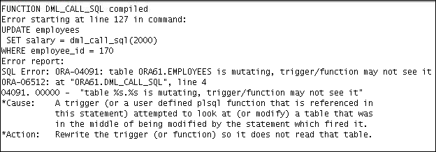
Restrictions on Calling Functions from SQL: Example
CREATE OR REPLACE FUNCTION dml_call_sql(p_sal NUMBER)
RETURN NUMBER IS
BEGIN
INSERT INTO employees(employee_id, last_name, email, hire_date, job_id, salary)
VALUES(1, 'Frost', 'jfrost@company.com',
SYSDATE, 'SA_MAN', p_sal);
RETURN (p_sal + 100);
END;
UPDATE employees
SET salary = dml_call_sql(2000)
WHERE employee_id = 170;

Slide 19
Named and Mixed Notation from SQL
PL/SQL allows arguments in a subroutine call to be specified using positional, named, or mixed notation.
Prior to Oracle Database 11g, only the positional notation is supported in calls from SQL.
Starting in Oracle Database 11g, named and mixed notation can be used for specifying arguments in calls to PL/SQL subroutines from SQL statements.
For long parameter lists, with most having default values, you can omit values from the optional parameters.
You can avoid duplicating the default value of the optional parameter at each call site.

Slide 20

Named and Mixed Notation from SQL: Example
CREATE OR REPLACE FUNCTION f(
p_parameter_1 IN NUMBER DEFAULT 1,
p_parameter_5 IN NUMBER DEFAULT 5)
RETURN NUMBER
IS
v_var number;
BEGIN
v_var := p_parameter_1 + (p_parameter_5 * 2);
RETURN v_var;
END f;
/
SELECT f(p_parameter_5 => 10) FROM DUAL;

Slide 21
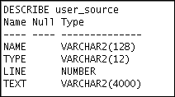
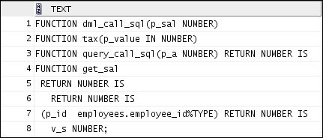
Viewing Functions Using Data Dictionary Views
DESCRIBE USER_SOURCE
SELECT text
FROM user_source
WHERE type = 'FUNCTION'
ORDER BY line;
. . .

Slide 22
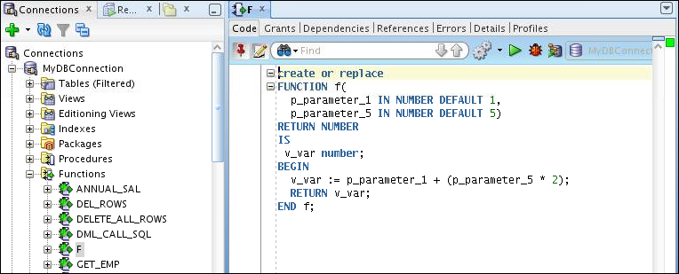
Viewing Functions Information Using SQL Developer
1
3
2

Slide 23
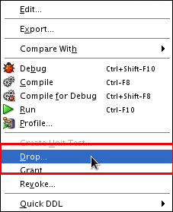
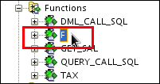
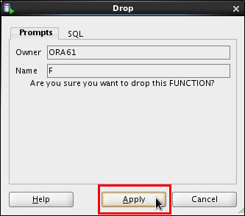
Removing Functions: Using the DROP SQL Statement or SQL Developer
Using the DROP statement:
Using SQL Developer:
DROP FUNCTION f;
1
2
3

Slide 24
Quiz
A PL/SQL stored function:
Can be invoked as part of an expression
Must contain a RETURN clause in the header
Must return a single value
Must contain at least one RETURN statement
Does not contain a RETURN clause in the header

Slide 25
Practice 3-1: Overview
This practice covers the following topics:
Creating stored functions:
To query a database table and return specific values
To be used in a SQL statement
To insert a new row, with specified parameter values, into a database table
Using default parameter values
Invoking a stored function from a SQL statement
Invoking a stored function from a stored procedure

Slide 26
Lesson Agenda
Working with functions:
Differentiating between a procedure and a function
Describing the uses of functions
Creating, invoking, and removing stored functions
Introducing the SQL Developer debugger

Slide 27
Debugging PL/SQL Subprograms Using the SQL Developer Debugger
You can use the debugger to control the execution of your PL/SQL program.
To debug a PL/SQL subprogram, a security administrator needs to grant the following privileges to the application developer:
DEBUG ANY PROCEDURE
DEBUG CONNECT SESSION
GRANT DEBUG ANY PROCEDURE TO ora61;
GRANT DEBUG CONNECT SESSION TO ora61;

Slide 28
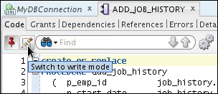
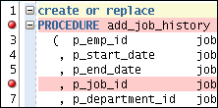
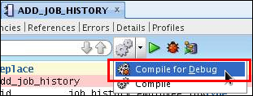
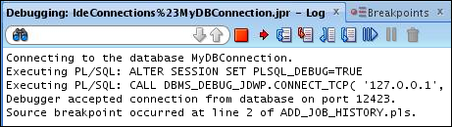


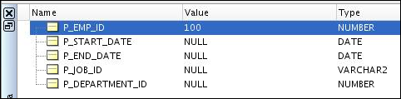
Debugging a Subprogram: Overview
1. Edit procedure
2. Add breakpoints
3. Compile for Debug
6. Choose debugging tool, and monitor data
5. Enter parameter value(s)
4. Debug

Slide 29
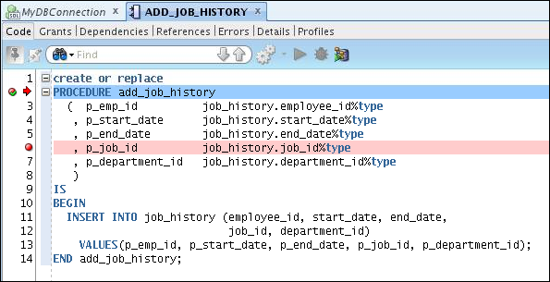
The Procedure or Function Code Editing Tab

Slide 30
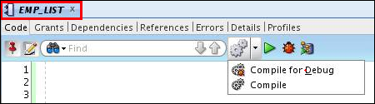
The Procedure or Function Tab Toolbar
3
4
5
1
2
Icon | Description
1. Compile for Debug | Compiles the subprogram so that it can be debugged
2. Compile | Compiles the subprogram
3. Run | Starts normal execution of the function or procedure, and displays the results in the Running - Log tab
4. Debug | Executes the subprogram in debug mode, and displays the Debugging - Log tab, which includes the debugging toolbar for controlling execution
5. Profile | Displays the Profile window that you use to specify parameter values for running, debugging, or profiling a PL/SQL function or procedure

Slide 31
The Debugging – Log Tab Toolbar
3
1
2
4
Icon | Description
1. Terminate | Halts and exits the execution
2. Find Execution Point | Goes to the next execution point
3. Step Over | Bypasses the next subprogram and goes to the next statement after the subprogram
4. Step Into | Executes a single program statement at a time. If the execution point is located on a call to a subprogram, it steps into the first statement in that subprogram

Slide 32
The Debugging – Log Tab Toolbar
5
7
9
6
8
Icon | Description
5. Step Out | Leaves the current subprogram and goes to the next statement with a breakpoint
6. Step to End of Method | Goes to the last statement of the current subprogram
7. Resume | Continues execution
8. Pause | Halts execution but does not exit
9. Garbage Collect | Removes invalid objects from the cache

Slide 33
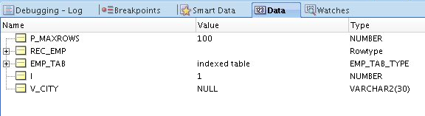
Additional Tabs
Tab | Description
Breakpoints | Displays breakpoints, both system-defined and user-defined.
Smart Data | Displays information about variables. You can specify these preferences by right-clicking in the Smart Data window and selecting Preferences.
Data | Located under the code text area; displays information about all variables
Watches | Located under the code text area; displays information about watches

Slide 34
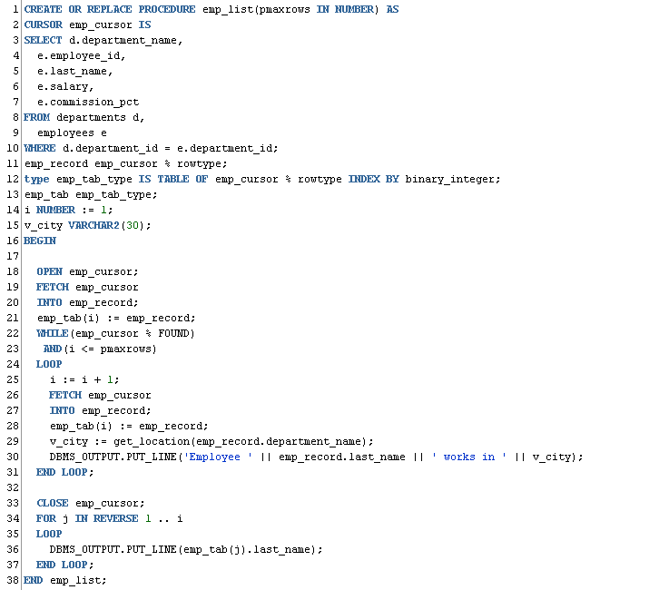
Debugging a Procedure Example: Creating a New emp_list Procedure

Slide 35
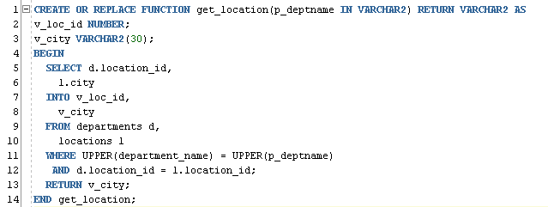
Debugging a Procedure Example: Creating a New get_location Function

Slide 36
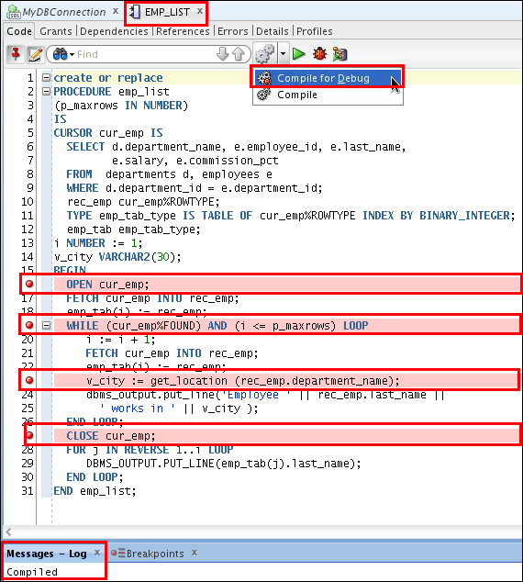
Setting Breakpoints and Compiling emp_list for Debug Mode

Slide 37
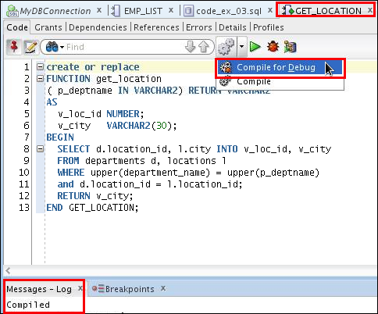
Compiling the get_location Function for Debug Mode

Slide 38
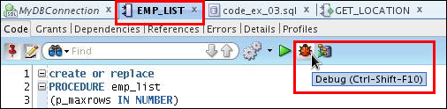
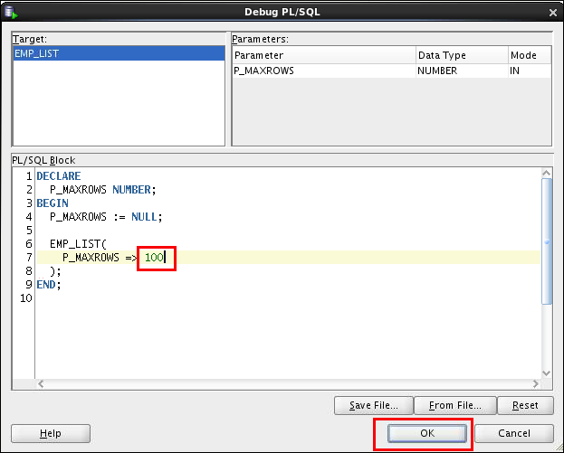
Debugging emp_list and Entering Values for the PMAXROWS Parameter
Enter the procedure’s parameter value using the anonymous block.

Slide 39
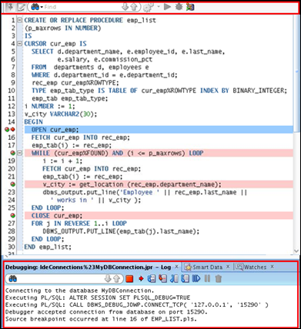
Debugging emp_list: Step Into (F7) the Code
1
Program control stops at first breakpoint.

Slide 40
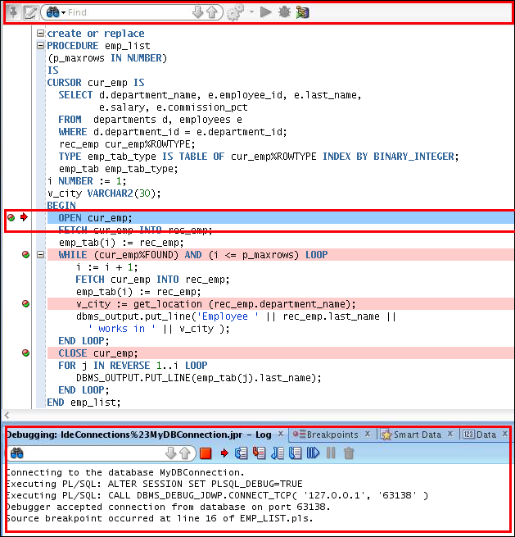

Debugging emp_list: Step Into (F7) the Code
1
2
Step Into (F7): Steps into and executes the cursor code.
3

Slide 41
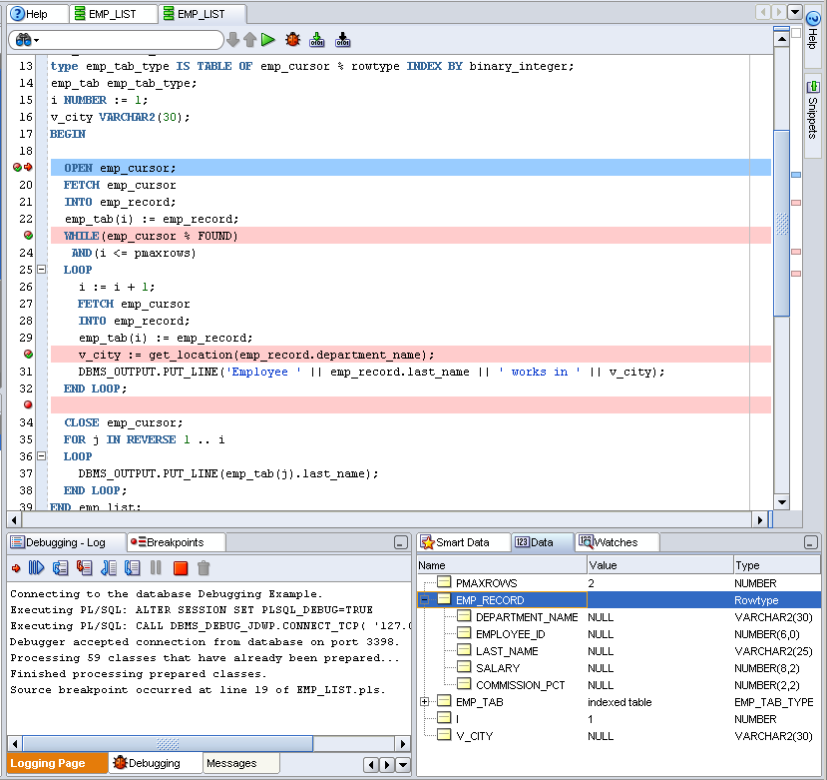
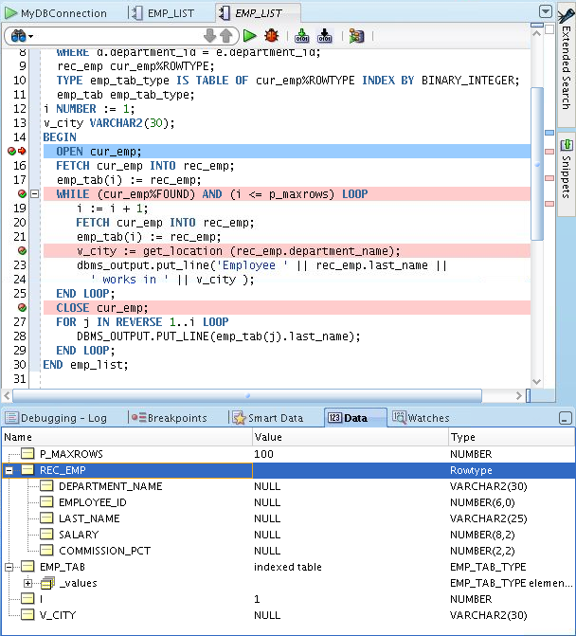

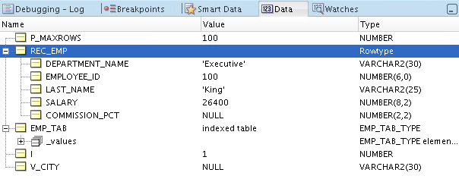
Viewing the Data

Slide 42
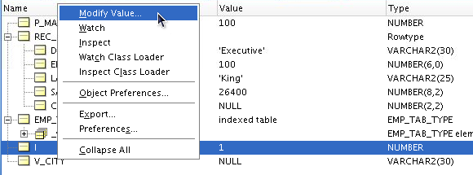
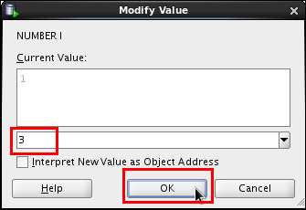
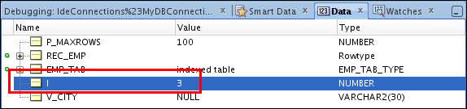
Modifying the Variables While Debugging the Code
2
1
3
4

Slide 43
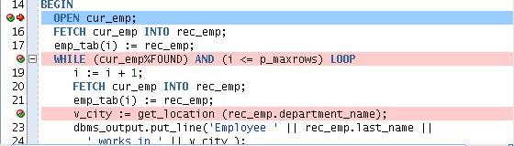
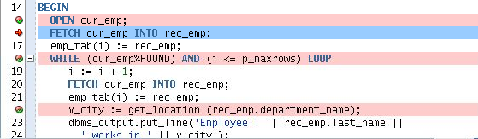
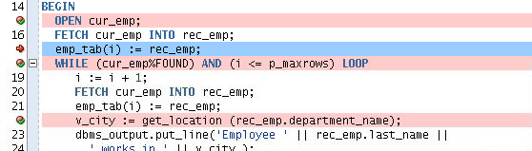
Debugging emp_list: Step Over the Code
1
F8
Step Over (F8): Executes the Cursor
(same as F7),
but control is not transferred
to Open Cursor code
2
F8
3

Slide 44
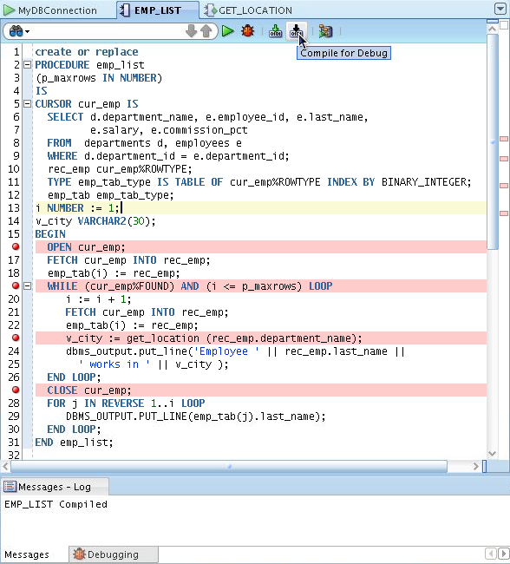
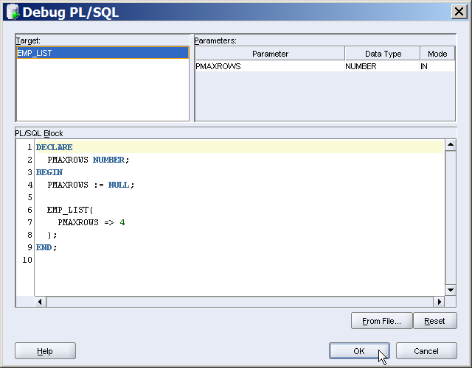
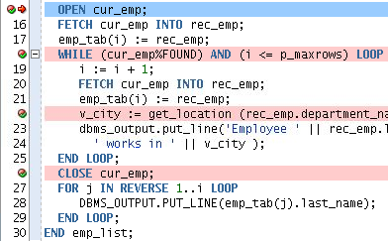
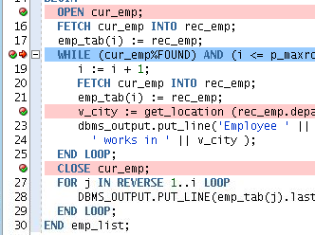

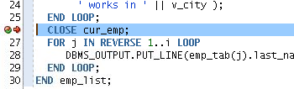
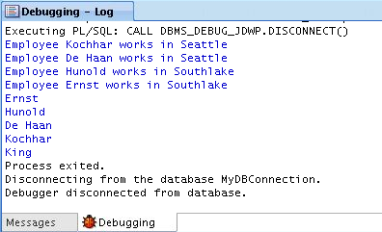

Debugging emp_list: Step Out of the Code (Shift + F7)
1
2
3
4
5
6
8
7

Slide 45


Debugging emp_list: Run to Cursor (F4)
Run to Cursor F4: Run to your cursor location without having to single step or set a breakpoint.

Slide 46



Debugging emp_list: Step to End of Method
Loops until i <> PMAXROWS

Slide 47







Debugging a Subprogram Remotely: Overview
1. Edit procedure
2. Add breakpoints
3. Compile for Debug
6. Issue the debugger connection command and call procedure in another session such as SQL*Plus
5. Enter local machine IP address and debugging port
4. Select Remote Debug
7. When the breakpoint is reached, control passes to SQL Developer
8. Debug and monitor data using debugging tools

Slide 48
Practice 3-2 Overview: Introduction to the SQL Developer Debugger
This practice covers the following topics:
Creating a procedure and a function
Inserting breakpoints in the procedure
Compiling the procedure and function for debug mode
Debugging the procedure and stepping into the code
Displaying and modifying the subprograms’ variables

Slide 49
Summary
In this lesson, you should have learned how to:
Differentiate between a procedure and a function
Describe the uses of functions
Create stored functions
Invoke a function
Remove a function
Understand the basic functionality of the SQL Developer debugger

