Slide 1
Creating Packages

Slide 2
Objectives
After completing this lesson, you should be able to do the following:
Describe packages and list their components
Create a package to group together related variables, cursors, constants, exceptions, procedures, and functions
Designate a package construct as either public or private
Invoke a package construct
Describe the use of a bodiless package

Slide 3
Lesson Agenda
Identifying the benefits and the components of packages
Working with packages:
Creating the package specification and body
Invoking the package subprograms
Displaying the package information
Removing a package

Slide 4
What Are PL/SQL Packages?
A package is a schema object that groups logically related PL/SQL types, variables, and subprograms.
Packages usually have two parts:
A specification (spec)
A body
The specification is the interface to the package. It declares the types, variables, constants, exceptions, cursors, and subprograms that can be referenced from outside the package.
The body defines the queries for the cursors and the code for the subprograms.
Enable the Oracle server to read multiple objects into memory at once.

Slide 5
Advantages of Using Packages
Modularity: Encapsulating related constructs
Easier maintenance: Keeping logically related functionality together
Easier application design: Coding and compiling the specification and body separately
Hiding information:
Only the declarations in the package specification are visible and accessible to applications
Private constructs in the package body are hidden and inaccessible
All coding is hidden in the package body

Slide 6
Advantages of Using Packages
Added functionality: Persistency of public variables and cursors
Better performance:
The entire package is loaded into memory when the package is first referenced.
There is only one copy in memory for all users.
The dependency hierarchy is simplified.
Overloading: Multiple subprograms of the same name

Slide 7


Components of a PL/SQL Package
Package
specification
variable
Public
Procedure A declaration;
variable
Procedure B definition
…
Procedure A definition
BEGIN
…
END;
Private
variable
Package
body

Slide 8

Internal and External Visibility of a Package’s Components
Package
specification
public_var
Procedure A;
External
code
private_var
Procedure B IS BEGIN … END;
Procedure A IS
BEGIN
…
END;
local_var
Package
body

Slide 9










Developing PL/SQL Packages: Overview
View errors/warnings in SQL Developer
YES
Use SHOW ERRORS command in SQL*Plus
Create/edit package spec and body
Compiler warnings/errors?
View compiler warnings/errors
NO
Use USER/ALL/DBA_ ERRORS views
Invoke package subprograms

Slide 10
Lesson Agenda
Identifying the benefits and the components of packages
Working with packages:
Creating the package specification and body
Invoking the package subprograms
Displaying the package information
Removing a package

Slide 11
Creating the Package Specification: Using the CREATE PACKAGE Statement
The OR REPLACE option drops and re-creates the package specification.
Variables declared in the package specification are initialized to NULL by default.
All the constructs declared in a package specification are visible to users who are granted privileges on the package.
CREATE [OR REPLACE] PACKAGE package_name IS|AS
public type and variable declarations
subprogram specifications
END [package_name];

Slide 12
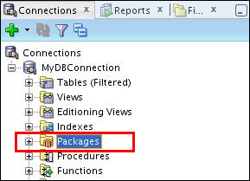
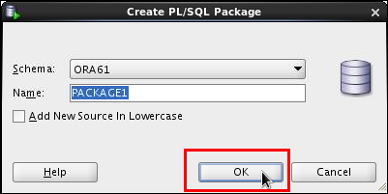
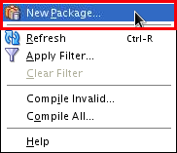
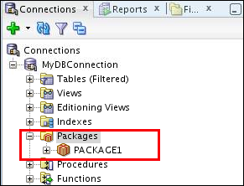
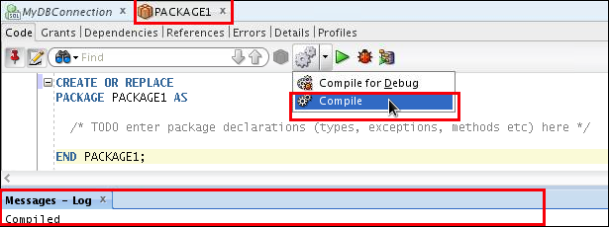
Creating the Package Specification: Using SQL Developer
3
2
1
5
7
4
Enter package’s declarations
6

Slide 13
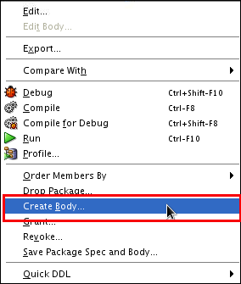
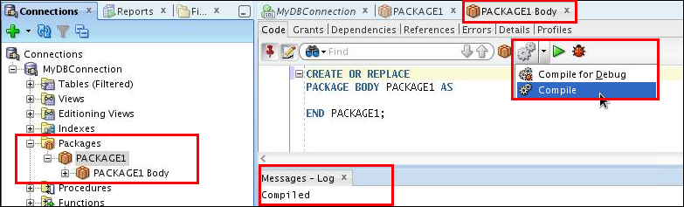
Creating the Package Body: Using SQL Developer
2
1
3
4
6
5
Enter package’s body code

Slide 14
Example of a Package Specification: comm_pkg
-- The package spec with a public variable and a
-- public procedure that are accessible from
-- outside the package.
CREATE OR REPLACE PACKAGE comm_pkg IS
v_std_comm NUMBER := 0.10; --initialized to 0.10
PROCEDURE reset_comm(p_new_comm NUMBER);
END comm_pkg;
/
V_STD_COMM is a public global variable initialized to 0.10.
RESET_COMM is a public procedure used to reset the standard commission based on some business rules. It is implemented in the package body.

Slide 15
Creating the Package Body
CREATE [OR REPLACE] PACKAGE BODY package_name IS|AS
private type and variable declarations
subprogram bodies
[BEGIN initialization statements]
END [package_name];
The OR REPLACE option drops and re-creates the package body.
Identifiers defined in the package body are private and not visible outside the package body.
All private constructs must be declared before they are referenced.
Public constructs are visible to the package body.

Slide 16
Example of a Package Body: comm_pkg
CREATE OR REPLACE PACKAGE BODY comm_pkg IS
FUNCTION validate(p_comm NUMBER) RETURN BOOLEAN IS
v_max_comm employees.commission_pct%type;
BEGIN
SELECT MAX(commission_pct) INTO v_max_comm
FROM employees;
RETURN (p_comm BETWEEN 0.0 AND v_max_comm);
END validate;
PROCEDURE reset_comm (p_new_comm NUMBER) IS
BEGIN
IF validate(p_new_comm) THEN
v_std_comm := p_new_comm; -- reset public var
ELSE RAISE_APPLICATION_ERROR(
-20210, 'Bad Commission');
END IF;
END reset_comm;
END comm_pkg;

Slide 17
Invoking the Package Subprograms: Examples
-- Invoke a function within the same packages:
CREATE OR REPLACE PACKAGE BODY comm_pkg IS ...
PROCEDURE reset_comm(p_new_comm NUMBER) IS
BEGIN
IF validate(p_new_comm) THEN
v_std_comm := p_new_comm;
ELSE ...
END IF;
END reset_comm;
END comm_pkg;
-- Invoke a package procedure from SQL*Plus:
EXECUTE comm_pkg.reset_comm(0.15)
-- Invoke a package procedure in a different schema:
EXECUTE scott.comm_pkg.reset_comm(0.15)

Slide 18
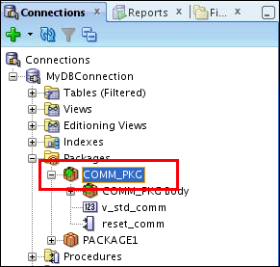
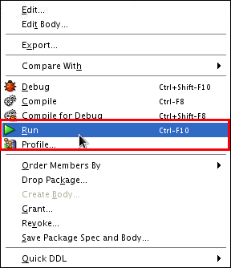
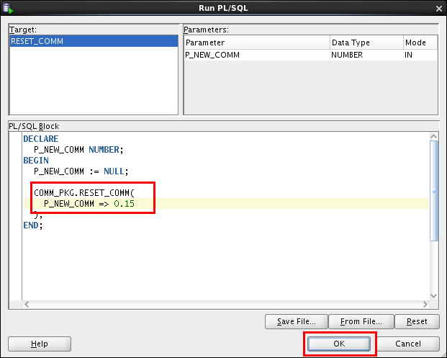
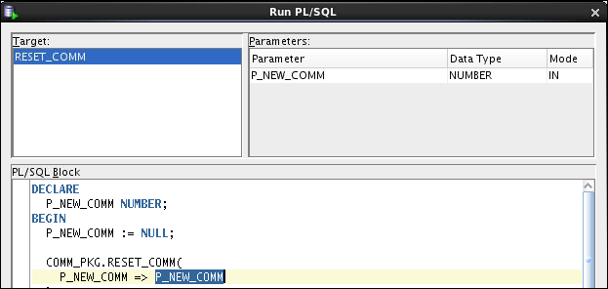
Invoking the Package Subprograms: Using SQL Developer
2
1
3
4

Slide 19
Creating and Using Bodiless Packages
CREATE OR REPLACE PACKAGE global_consts IS
c_mile_2_kilo CONSTANT NUMBER := 1.6093;
c_kilo_2_mile CONSTANT NUMBER := 0.6214;
c_yard_2_meter CONSTANT NUMBER := 0.9144;
c_meter_2_yard CONSTANT NUMBER := 1.0936;
END global_consts;
SET SERVEROUTPUT ON
BEGIN
DBMS_OUTPUT.PUT_LINE('20 miles = ' ||
20 * global_consts.c_mile_2_kilo || ' km');
END;
SET SERVEROUTPUT ON
CREATE FUNCTION mtr2yrd(p_m NUMBER) RETURN NUMBER IS
BEGIN
RETURN (p_m * global_consts.c_meter_2_yard);
END mtr2yrd;
/
EXECUTE DBMS_OUTPUT.PUT_LINE(mtr2yrd(1))

Slide 20
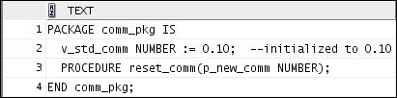
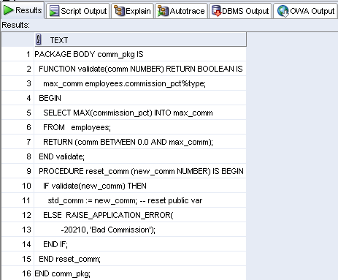
Viewing Packages by Using the Data Dictionary
-- View the package specification.
SELECT text
FROM user_source
WHERE name = 'COMM_PKG' AND type = 'PACKAGE'
ORDER BY LINE;
-- View the package body.
SELECT text
FROM user_source
WHERE name = 'COMM_PKG' AND type = 'PACKAGE BODY'
ORDER BY LINE;

Slide 21
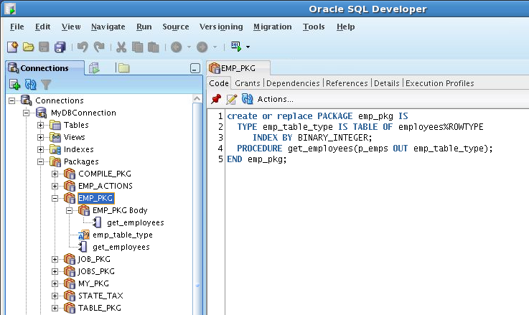
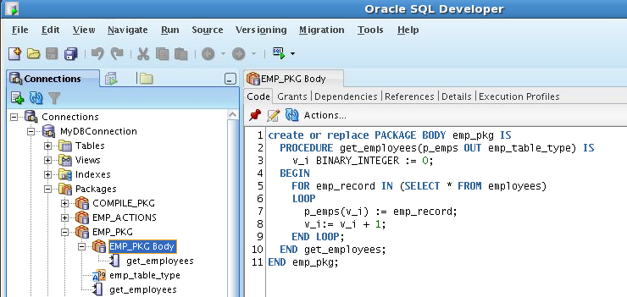
Viewing Packages by Using SQL Developer
To view the package spec, click the package name.
1
3
2
To view the package body, click the package body.
1
3
2

Slide 22
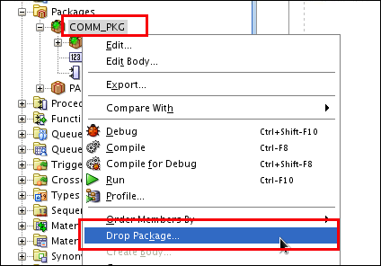
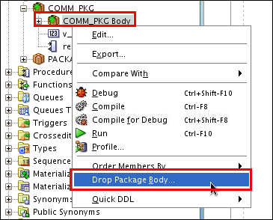
Removing Packages by Using SQL Developer or the SQL DROP Statement
Drop the package specification and body.
Drop only the package body.
-- Remove the package specification and body
DROP PACKAGE package_name;
-- Remove the package body only
DROP PACKAGE BODY package_name;

Slide 23
Guidelines for Writing Packages
Develop packages for general use.
Define the package specification before the body.
The package specification should contain only those constructs that you want to be public.
Place items in the declaration part of the package body when you must maintain them throughout a session or across transactions.
The fine-grain dependency management reduces the need to recompile referencing subprograms when a package specification changes.
The package specification should contain as few constructs as possible.

Slide 24
Quiz
The package specification is the interface to your applications. It declares the public types, variables, constants, exceptions, cursors, and subprograms available for use. The package specification may also include PRAGMAs, which are directives to the compiler.
True
False

Slide 25
Summary
In this lesson, you should have learned how to:
Describe packages and list their components
Create a package to group related variables, cursors, constants, exceptions, procedures, and functions
Designate a package construct as either public or private
Invoke a package construct
Describe the use of a bodiless package

Slide 26
Practice 4 Overview: Creating and Using Packages
This practice covers the following topics:
Creating packages
Invoking package program units

