Slide 1
Handling Exceptions

Slide 2
Objectives
After completing this lesson, you should be able to do the following:
Define PL/SQL exceptions
Recognize unhandled exceptions
List and use different types of PL/SQL exception handlers
Trap unanticipated errors
Describe the effect of exception propagation in nested blocks
Customize PL/SQL exception messages

Slide 3
Agenda
Understanding PL/SQL exceptions
Trapping exceptions

Slide 4
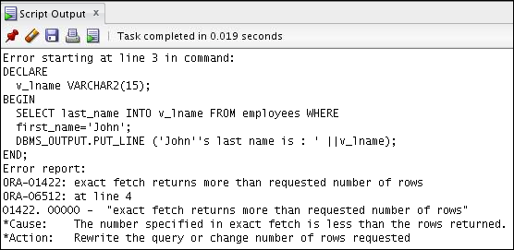
What Is an Exception?
DECLARE
v_lname VARCHAR2(15);
BEGIN
SELECT last_name INTO v_lname
FROM employees
WHERE first_name='John';
DBMS_OUTPUT.PUT_LINE ('John''s last name is :' ||v_lname);
END;

Slide 5
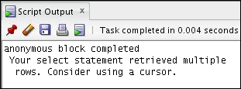
Handling the Exception: An Example
DECLARE
v_lname VARCHAR2(15);
BEGIN
SELECT last_name INTO v_lname
FROM employees
WHERE first_name='John';
DBMS_OUTPUT.PUT_LINE ('John''s last name is :' ||v_lname);
EXCEPTION
WHEN TOO_MANY_ROWS THEN
DBMS_OUTPUT.PUT_LINE (' Your select statement retrieved
multiple rows. Consider using a cursor.');
END;
/

Slide 6
Understanding Exceptions with PL/SQL
An exception is a PL/SQL error that is raised during program execution.
An exception can be raised:
Implicitly by the Oracle Server
Explicitly by the program
An exception can be handled:
By trapping it with a handler
By propagating it to the calling environment

Slide 7

Handling Exceptions
Is the exception trapped?
Terminate abruptly.
No
Yes
Exception is raised.
Execute statements in the EXCEPTION section.
Propagate the exception.
Terminate gracefully.

Slide 8
Exception Types
}
Predefined Oracle Server
Nonpredefined Oracle Server
User-defined
Implicitly raised
Explicitly raised

Slide 9
Agenda
Understanding PL/SQL exceptions
Trapping exceptions

Slide 10
Syntax to Trap Exceptions
EXCEPTION
WHEN exception1 [OR exception2 . . .] THEN
statement1;
statement2;
. . .
[WHEN exception3 [OR exception4 . . .] THEN
statement1;
statement2;
. . .]
[WHEN OTHERS THEN
statement1;
statement2;
. . .]

Slide 12
Guidelines for Trapping Exceptions
The EXCEPTION keyword starts the exception-handling section.
Several exception handlers are allowed.
Only one handler is processed before leaving the block.
WHEN OTHERS is the last clause.

Slide 13
Trapping Predefined Oracle Server Errors
Reference the predefined name in the exception-handling routine.
Sample predefined exceptions:
NO_DATA_FOUND
TOO_MANY_ROWS
INVALID_CURSOR
ZERO_DIVIDE
DUP_VAL_ON_INDEX

Slide 16
Trapping Nonpredefined Oracle Server Errors
Declare
Associate
Reference
Declarative section
EXCEPTION section
Name the exception.
Use PRAGMA EXCEPTION_INIT.
Handle the raised exception.

Slide 17
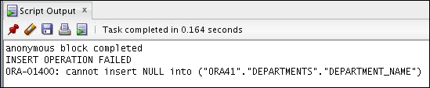
Nonpredefined Error Trapping: Example
To trap Oracle Server error 01400 (“cannot insert NULL”):
DECLARE
e_insert_excep EXCEPTION;
PRAGMA EXCEPTION_INIT(e_insert_excep, -01400);
BEGIN
INSERT INTO departments (department_id, department_name) VALUES (280, NULL);
EXCEPTION
WHEN e_insert_excep THEN
DBMS_OUTPUT.PUT_LINE('INSERT OPERATION FAILED');
DBMS_OUTPUT.PUT_LINE(SQLERRM);
END; /
1
2
3

Slide 18
Functions for Trapping Exceptions
SQLCODE: Returns the numeric value for the error code
SQLERRM: Returns the message associated with the error number

Slide 19
Functions for Trapping Exceptions
DECLARE
error_code NUMBER;
error_message VARCHAR2(255);
BEGIN
...
EXCEPTION
...
WHEN OTHERS THEN
ROLLBACK;
error_code := SQLCODE ;
error_message := SQLERRM ;
INSERT INTO errors (e_user, e_date, error_code,
error_message) VALUES(USER,SYSDATE,error_code,
error_message);
END;
/

Slide 20
Trapping User-Defined Exceptions
Declare
Raise
Reference
Declarative
section
Executable
section
Exception-handling
section
Name the exception.
Explicitly raise the exception by using the RAISE statement.
Handle the raised exception.

Slide 21

Trapping User-Defined Exceptions
DECLARE
v_deptno NUMBER := 500;
v_name VARCHAR2(20) := 'Testing';
e_invalid_department EXCEPTION;
BEGIN
UPDATE departments
SET department_name = v_name
WHERE department_id = v_deptno;
IF SQL%NOTFOUND THEN
RAISE e_invalid_department;
END IF;
COMMIT;
EXCEPTION
WHEN e_invalid_department THEN
DBMS_OUTPUT.PUT_LINE('No such department id.');
END;
/
1
2
3

Slide 22
Propagating Exceptions in a Subblock
DECLARE
. . .
e_no_rows exception;
e_integrity exception;
PRAGMA EXCEPTION_INIT (e_integrity, -2292);
BEGIN
FOR c_record IN emp_cursor LOOP
BEGIN
SELECT ...
UPDATE ...
IF SQL%NOTFOUND THEN
RAISE e_no_rows;
END IF;
END;
Subblocks can handle an exception or pass the exception to the enclosing block.
END LOOP;
EXCEPTION
WHEN e_integrity THEN ...
WHEN e_no_rows THEN ...
END;
/

Slide 23
The RAISE Statement
Stops normal execution of a PL/SQL block or subprogram and transfers control to an exception handler
Explicitly raises predefined exceptions or user-defined exceptions
Syntax:
RAISE exception_name ;

Slide 24
RAISE_APPLICATION_ERROR Procedure
raise_application_error (error_number,
message[, {TRUE | FALSE}]);
Syntax:
You can use this procedure to issue user-defined error messages from stored subprograms.
You can report errors to your application and avoid returning unhandled exceptions.

Slide 25
RAISE_APPLICATION_ERROR Procedure
Is used in two different places:
Executable section
Exception section
Returns error conditions to the user in a manner consistent with other Oracle Server errors

Slide 26
RAISE_APPLICATION_ERROR Procedure
Executable section:
Exception section:
BEGIN
...
DELETE FROM employees
WHERE manager_id = v_mgr;
IF SQL%NOTFOUND THEN
RAISE_APPLICATION_ERROR(-20202,
'This is not a valid manager');
END IF;
...
...
EXCEPTION
WHEN NO_DATA_FOUND THEN
RAISE_APPLICATION_ERROR (-20201,
'Manager is not a valid employee.');
END; /

Slide 27
Quiz
You can trap any error by including a corresponding handler
within the exception-handling section of the PL/SQL block.
True
False

Slide 28
Summary
In this lesson, you should have learned to:
Define PL/SQL exceptions
Add an EXCEPTION section to the PL/SQL block to deal with exceptions at run time
Handle different types of exceptions:
Predefined exceptions
Non-predefined exceptions
User-defined exceptions
Propagate exceptions in nested blocks and call applications

Slide 29
Practice 9: Overview
This practice covers the following topics:
Creating and invoking user-defined exceptions
Handling named Oracle Server exceptions

