Slide 1
Creating Procedures

Slide 2
Objectives
After completing this lesson, you should be able to do the following:
Identify the benefits of modularized and layered subprogram design
Create and call procedures
Use formal and actual parameters
Use positional, named, or mixed notation for passing parameters
Identify the available parameter-passing modes
Handle exceptions in procedures
Remove a procedure and display its information
Bind PL/SQL only Types

Slide 3
Lesson Agenda
Using a modularized and layered subprogram design and identifying the benefits of subprograms
Working with procedures:
Creating and calling procedures
Identifying the available parameter-passing modes
Using formal and actual parameters
Using positional, named, or mixed notation
Handling exceptions in procedures, removing a procedure, and displaying the procedure’s information
Binding PL/SQL only types

Slide 4
Creating a Modularized Subprogram Design
Modularize code into subprograms.
Locate code sequences repeated more than once.
Create subprogram P containing the repeated code
Modify original code to invoke the new subprogram.
1
3
xx xxx xxx
xx xxx xxx
----- --- ---
----- --- ---
xx xxx xxx
xx xxx xxx
----- --- ---
2
P
----- --- ---
----- --- ---
P
----- --- ---
xx xxx xxx
xx xxx xxx
P

Slide 5
Creating a Layered Subprogram Design
Create subprogram layers for your application.
Data access subprogram layer with SQL logic
Business logic subprogram layer, which may or may not use the data access layer

Slide 6
Modularizing Development with PL/SQL Blocks
PL/SQL is a block-structured language. The PL/SQL code block helps modularize code by using:
Anonymous blocks
Procedures and functions
Packages
Database triggers
The benefits of using modular program constructs are:
Easy maintenance
Improved data security and integrity
Improved performance
Improved code clarity

Slide 7
Anonymous Blocks: Overview
Anonymous blocks:
Form the basic PL/SQL block structure
Initiate PL/SQL processing tasks from applications
Can be nested within the executable section of any PL/SQL block
[DECLARE -- Declaration Section (Optional)
variable declarations; ... ]
BEGIN -- Executable Section (Mandatory)
SQL or PL/SQL statements;
[EXCEPTION -- Exception Section (Optional)
WHEN exception THEN statements; ]
END; -- End of Block (Mandatory)

Slide 8




PL/SQL Run-time Architecture
PL/SQL block
procedural
Procedural statement executor
PL/SQL Engine
SQL
PL/SQL
Oracle Server
SQL statement executor

Slide 9

What Are PL/SQL Subprograms?
A PL/SQL subprogram is a named PL/SQL block that can be called with a set of parameters.
You can declare and define a subprogram within either a PL/SQL block or another subprogram.
A subprogram consists of a specification and a body.
A subprogram can be a procedure or a function.
Typically, you use a procedure to perform an action and a function to compute and return a value.
Subprograms can be grouped into PL/SQL packages.

Slide 10





The Benefits of Using PL/SQL Subprograms
Easy maintenance
Improved data security and integrity
Subprograms: Stored procedures and functions
Improved code clarity
Improved performance

Slide 11
Differences Between Anonymous Blocks and Subprograms
Anonymous Blocks | Subprograms
Unnamed PL/SQL blocks | Named PL/SQL blocks
Compiled every time | Compiled only once
Not stored in the database | Stored in the database
Cannot be invoked by other applications | Named and, therefore, can be invoked by other applications
Do not return values | Subprograms called functions must return values.
Cannot take parameters | Can take parameters

Slide 12
Lesson Agenda
Using a modularized and layered subprogram design and identifying the benefits of subprograms
Working with procedures:
Creating and calling procedures
Identifying the available parameter-passing modes
Using formal and actual parameters
Using positional, named, or mixed notation
Handling exceptions in procedures, removing a procedure, and displaying the procedures’ information
Binding PL/SQL only types

Slide 13

What Are Procedures?
Are a type of subprogram that perform an action
Can be stored in the database as a schema object
Promote reusability and maintainability
Procedures

Slide 14







Creating Procedures: Overview
View errors/warnings in SQL Developer
YES
Use SHOW ERRORS command in SQL*Plus
Create/edit procedure
Compiler warnings/errors?
View compiler warnings/errors
NO
Use USER/ALL/DBA_ ERRORS views
Execute procedure

Slide 15
Creating Procedures with the SQL CREATE OR REPLACE Statement
Use the CREATE clause to create a stand-alone procedure that is stored in the Oracle database.
Use the OR REPLACE option to overwrite an existing procedure.
CREATE [OR REPLACE] PROCEDURE procedure_name
[(parameter1 [mode] datatype1,
parameter2 [mode] datatype2, ...)]
IS|AS
[local_variable_declarations; ...]
BEGIN -- actions;
END [procedure_name];
PL/SQL block

Slide 16
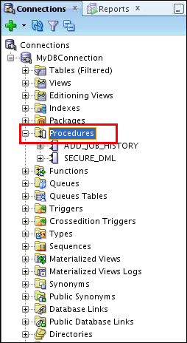
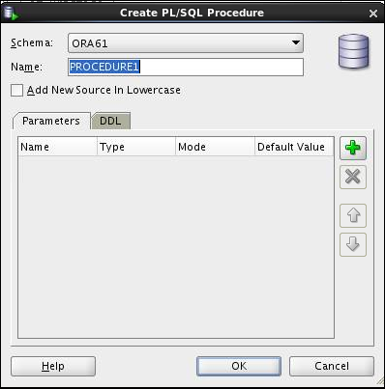
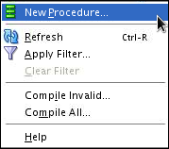
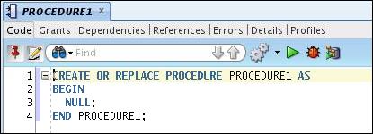
Creating Procedures Using SQL Developer

Slide 17
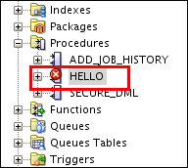
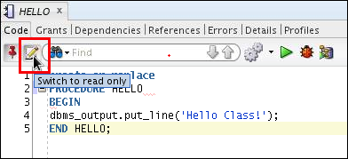
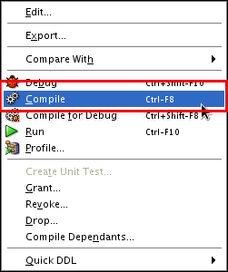
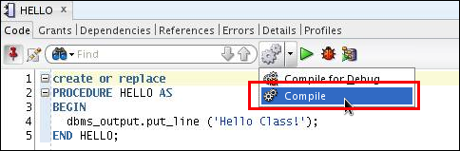
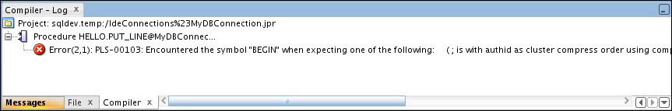
Compiling Procedures and Displaying Compilation Errors in SQL Developer
1
2
OR

Slide 18
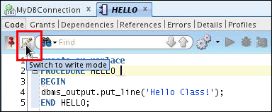
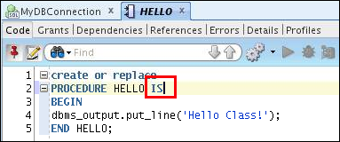

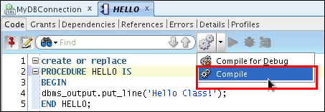

Correcting Compilation Errors in SQL Developer
1. Edit procedure
2. Correct error (add keyword IS)
4. Recompilation successful
3. Recompile procedure

Slide 19
Naming Conventions of PL/SQL Structures Used in This Course
PL/SQL Structure | Convention | Example
Variable | v_variable_name | v_rate
Constant | c_constant_name | c_rate
Subprogram parameter | p_parameter_name | p_id
Bind (host) variable | b_bind_name | b_salary
Cursor | cur_cursor_name | cur_emp
Record | rec_record_name | rec_emp
Type | type_name_type | ename_table_type
Exception | e_exception_name | e_products_invalid
File handle | f_file_handle_name | f_file

Slide 20
What Are Parameters and Parameter Modes?
Are declared after the subprogram name in the PL/SQL header
Pass or communicate data between the calling environment and the subprogram
Are used like local variables but are dependent on their parameter-passing mode:
An IN parameter mode (the default) provides values for a subprogram to process
An OUT parameter mode returns a value to the caller
An IN OUT parameter mode supplies an input value, which may be returned (output) as a modified value

Slide 21
Formal and Actual Parameters
Formal parameters: Local variables declared in the parameter list of a subprogram specification
Actual parameters (or arguments): Literal values, variables, and expressions used in the parameter list of the calling subprogram
-- Procedure definition, Formal_parameters
CREATE PROCEDURE raise_sal(p_id NUMBER, p_sal NUMBER) IS BEGIN
. . .
END raise_sal;
-- Procedure calling, Actual parameters (arguments)
v_emp_id := 100;
raise_sal(v_emp_id, 2000)

Slide 22
Procedural Parameter Modes
Parameter modes are specified in the formal parameter declaration, after the parameter name and before its data type.
The IN mode is the default if no mode is specified.
CREATE PROCEDURE proc_name(param_name [mode] datatype)
...
Modes
Calling environment
IN (default)
OUT
IN OUT
Procedure

Slide 23
Comparing the Parameter Modes
IN
OUT
IN OUT
Default mode
Must be specified
Must be specified
Value is passed into subprogram
Value is returned to the calling environment
Value passed into sub-program; value returned to calling environment
Formal parameter acts as a constant
Uninitialized variable
Initialized variable
Actual parameter can be a literal, expression, constant, or initialized variable
Must be a variable
Must be a variable
Can be assigned a default value
Cannot be assigned
a default value
Cannot be assigned
a default value

Slide 24

Using the IN Parameter Mode: Example
CREATE OR REPLACE PROCEDURE raise_salary
(p_id IN employees.employee_id%TYPE,
p_percent IN NUMBER)
IS
BEGIN
UPDATE employees
SET salary = salary * (1 + p_percent/100)
WHERE employee_id = p_id;
END raise_salary;
/
EXECUTE raise_salary(176, 10)

Slide 25
Using the OUT Parameter Mode: Example
CREATE OR REPLACE PROCEDURE query_emp
(p_id IN employees.employee_id%TYPE,
p_name OUT employees.last_name%TYPE,
p_salary OUT employees.salary%TYPE) IS
BEGIN
SELECT last_name, salary INTO p_name, p_salary
FROM employees
WHERE employee_id = p_id;
END query_emp;
/
SET SERVEROUTPUT ON
DECLARE
v_emp_name employees.last_name%TYPE;
v_emp_sal employees.salary%TYPE;
BEGIN
query_emp(171, v_emp_name, v_emp_sal);
DBMS_OUTPUT.PUT_LINE(v_emp_name||' earns '|| to_char(v_emp_sal, '$999,999.00'));
END;
/

Slide 26
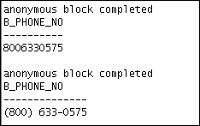
Using the IN OUT Parameter Mode: Example
Calling environment
p_phone_no (before the call)
p_phone_no (after the call)
'8006330575'
'(800) 633-0575'
CREATE OR REPLACE PROCEDURE format_phone
(p_phone_no IN OUT VARCHAR2) IS
BEGIN
p_phone_no := '(' || SUBSTR(p_phone_no,1,3) ||
') ' || SUBSTR(p_phone_no,4,3) ||
'-' || SUBSTR(p_phone_no,7);
END format_phone;
/

Slide 27

Viewing the OUT Parameters: Using the DBMS_OUTPUT.PUT_LINE Subroutine
Use PL/SQL variables that are printed with calls to the DBMS_OUTPUT.PUT_LINE procedure.
SET SERVEROUTPUT ON
DECLARE
v_emp_name employees.last_name%TYPE;
v_emp_sal employees.salary%TYPE;
BEGIN
query_emp(171, v_emp_name, v_emp_sal);
DBMS_OUTPUT.PUT_LINE('Name: ' || v_emp_name);
DBMS_OUTPUT.PUT_LINE('Salary: ' || v_emp_sal);
END;

Slide 28
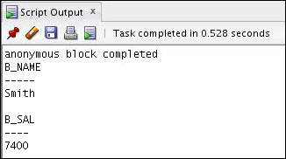
Viewing OUT Parameters: Using SQL*Plus Host Variables
Use SQL*Plus host variables.
Execute QUERY_EMP using host variables.
Print the host variables.
VARIABLE b_name VARCHAR2(25)
VARIABLE b_sal NUMBER
EXECUTE query_emp(171, :b_name, :b_sal)
PRINT b_name b_sal

Slide 29
Available Notations for Passing Actual Parameters
When calling a subprogram, you can write the actual parameters using the following notations:
Positional: Lists the actual parameters in the same order as the formal parameters
Named: Lists the actual parameters in arbitrary order and uses the association operator (=>) to associate a named formal parameter with its actual parameter
Mixed: Lists some of the actual parameters as positional and some as named
Prior to Oracle Database 11g, only the positional notation is supported in calls from SQL
Starting in Oracle Database 11g, named and mixed notation can be used for specifying arguments in calls to PL/SQL subroutines from SQL statements

Slide 30

Passing Actual Parameters: Creating the add_dept Procedure
CREATE OR REPLACE PROCEDURE add_dept(
p_name IN departments.department_name%TYPE,
p_loc IN departments.location_id%TYPE) IS
BEGIN
INSERT INTO departments(department_id,
department_name, location_id)
VALUES (departments_seq.NEXTVAL, p_name , p_loc );
END add_dept;
/

Slide 31
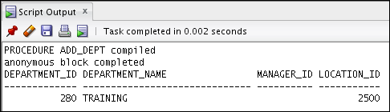
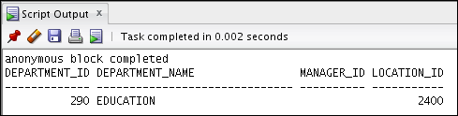
Passing Actual Parameters: Examples
-- Passing parameters using the positional notation.
EXECUTE add_dept ('TRAINING', 2500)
-- Passing parameters using the named notation.
EXECUTE add_dept (p_loc=>2400, p_name=>'EDUCATION')

Slide 32
Using the DEFAULT Option for the Parameters
Defines default values for parameters
Provides flexibility by combining the positional and named parameter-passing syntax
CREATE OR REPLACE PROCEDURE add_dept(
p_name departments.department_name%TYPE:='Unknown',
p_loc departments.location_id%TYPE DEFAULT 1700)
IS
BEGIN
INSERT INTO departments (department_id, department_name, location_id)
VALUES (departments_seq.NEXTVAL, p_name, p_loc);
END add_dept;
EXECUTE add_dept
EXECUTE add_dept ('ADVERTISING', p_loc => 1200)
EXECUTE add_dept (p_loc => 1200)

Slide 34
Calling Procedures
You can call procedures using anonymous blocks, another procedure, or packages.
You must own the procedure or have the EXECUTE privilege.
CREATE OR REPLACE PROCEDURE process_employees
IS
CURSOR cur_emp_cursor IS
SELECT employee_id
FROM employees;
BEGIN
FOR emp_rec IN cur_emp_cursor
LOOP
raise_salary(emp_rec.employee_id, 10);
END LOOP;
COMMIT;
END process_employees;
/

Slide 35
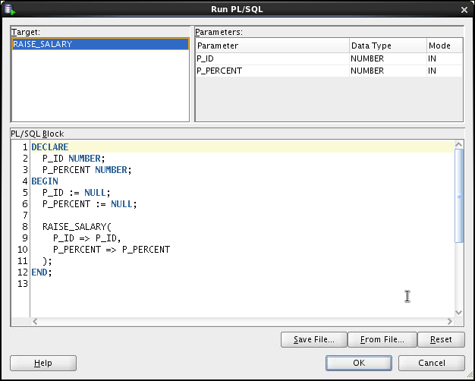
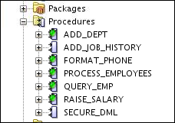
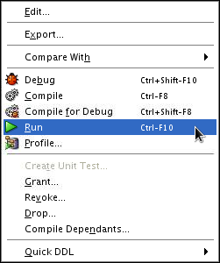
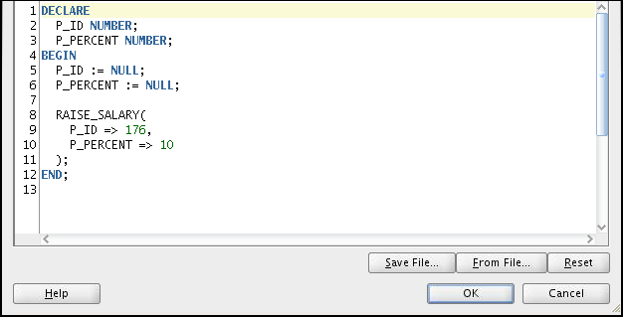
Calling Procedures Using SQL Developer
1
Replace P_ID and P_PERCENT with actual values
2
3
4

Slide 36
Lesson Agenda
Using a modularized and layered subprogram design and identifying the benefits of subprograms
Working with procedures:
Creating and calling procedures
Identifying the available parameter-passing modes
Using formal and actual parameters
Using positional, named, or mixed notation
Handling exceptions in procedures, removing a procedure, and displaying the procedure’s information
Binding PL/SQL only types

Slide 37
Handled Exceptions
Calling procedure
Called procedure
PROCEDURE
PROC1 ...
IS
...
BEGIN
...
PROC2(arg1);
...
EXCEPTION
...
END PROC1;
PROCEDURE
PROC2 ...
IS
...
BEGIN
...
EXCEPTION
...
END PROC2;
Exception raised
Exception handled
Control returns to calling procedure

Slide 38


Handled Exceptions: Example
CREATE PROCEDURE add_department(
p_name VARCHAR2, p_mgr NUMBER, p_loc NUMBER) IS
BEGIN
INSERT INTO DEPARTMENTS (department_id,
department_name, manager_id, location_id)
VALUES (DEPARTMENTS_SEQ.NEXTVAL, p_name, p_mgr, p_loc);
DBMS_OUTPUT.PUT_LINE('Added Dept: '|| p_name);
EXCEPTION
WHEN OTHERS THEN
DBMS_OUTPUT.PUT_LINE('Err: adding dept: '|| p_name);
END;
CREATE PROCEDURE create_departments IS
BEGIN
add_department('Media', 100, 1800);
add_department('Editing', 99, 1800);
add_department('Advertising', 101, 1800);
END;

Slide 39
Exceptions Not Handled
Calling procedure
Called procedure
PROCEDURE
PROC1 ...
IS
...
BEGIN
...
PROC2(arg1);
...
EXCEPTION
...
END PROC1;
PROCEDURE
PROC2 ...
IS
...
BEGIN
...
EXCEPTION
...
END PROC2;
Exception raised
Exception not handled
Control returned to exception section of calling procedure

Slide 40
Exceptions Not Handled: Example
SET SERVEROUTPUT ON
CREATE PROCEDURE add_department_noex(
p_name VARCHAR2, p_mgr NUMBER, p_loc NUMBER) IS
BEGIN
INSERT INTO DEPARTMENTS (department_id,
department_name, manager_id, location_id)
VALUES (DEPARTMENTS_SEQ.NEXTVAL, p_name, p_mgr, p_loc);
DBMS_OUTPUT.PUT_LINE('Added Dept: '|| p_name);
END;
CREATE PROCEDURE create_departments_noex IS
BEGIN
add_department_noex('Media', 100, 1800);
add_department_noex('Editing', 99, 1800);
add_department_noex('Advertising', 101, 1800);
END;

Slide 41
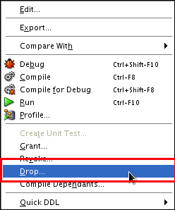
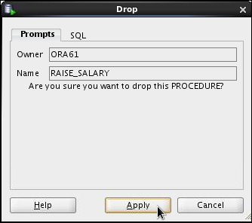
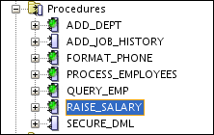
Removing Procedures: Using the DROP SQL Statement or SQL Developer
DROP PROCEDURE raise_salary;
Using the DROP statement:
Using SQL Developer:
1
2
3

Slide 42
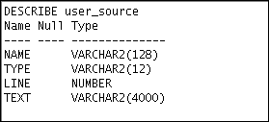
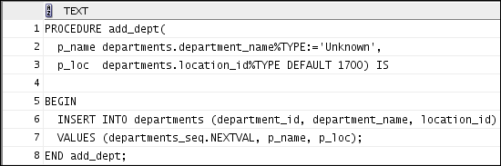
Viewing Procedure Information Using the Data Dictionary Views
DESCRIBE user_source
SELECT text
FROM user_source
WHERE name = 'ADD_DEPT' AND type = 'PROCEDURE'
ORDER BY line;

Slide 43
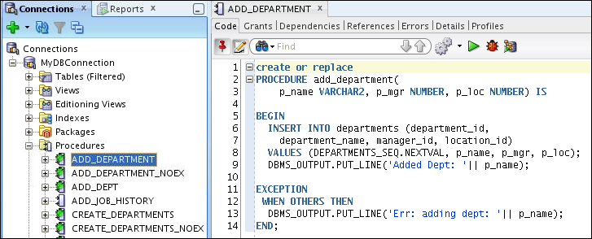
Viewing Procedures Information Using SQL Developer
3
1
2

Slide 44
Lesson Agenda
Using a modularized and layered subprogram design and identifying the benefits of subprograms
Working with procedures:
Creating and calling procedures
Identifying the available parameter-passing modes
Using formal and actual parameters
Using positional, named, or mixed notation
Handling exceptions in procedures, removing a procedure, and displaying the procedure’s information
Binding PL/SQL only types

Slide 45

PL/SQL Bind Types
A PL/SQL anonymous block, a SQL CALL statement, or a SQL query can invoke a PL/SQL function that has parameters of the following types:
BOOLEAN
Record declared in a package specification
Collection declared in a package specification

Slide 46

Subprogram with a BOOLEAN Parameter
CREATE OR REPLACE PROCEDURE p (x BOOLEAN) AUTHID CURRENT_USER AS
BEGIN
IF x THEN
DBMS_OUTPUT.PUT_LINE('x is true');
END IF;
END;
/
DECLARE
b BOOLEAN := TRUE;
BEGIN
p(b);
END;
/

Slide 47
Quiz
Formal parameters are literal values, variables, and expressions used in the parameter list of the calling subprogram
True
False

Slide 48
Summary
In this lesson, you should have learned how to:
Identify the benefits of modularized and layered subprogram design
Create and call procedures
Use formal and actual parameters
Use positional, named, or mixed notation for passing parameters
Identify the available parameter-passing modes
Handle exceptions in procedures
Remove a procedure
Display the procedure’s information

Slide 49
Practice 2 Overview: Creating, Compiling, and Calling Procedures
This practice covers the following topics:
Creating stored procedures to:
Insert new rows into a table using the supplied parameter values
Update data in a table for rows that match the supplied parameter values
Delete rows from a table that match the supplied parameter values
Query a table and retrieve data based on supplied parameter values
Handling exceptions in procedures
Compiling and invoking procedures

