Slide 1
Machine learning Enabling
By Dr. Siva, PhD
Cognizant Technology Solutions.
(91)9940651233
263749

Slide 2
Purpose
Giving a overview of the machine learning algorithms with the complete mathematical ideas behind so that the data scientists can
Get deeper insight of the algorithms.
Choose the right machine learning algorithm for different business problems.
Choose correct parameter settings and validation strategies
Trouble shooting when coming across poor results
Estimate the confidence measures for the obtained solutions.
Last but not least, the necessary background to understand the contents of the books and research papers in data science!!!

Slide 3
Approach
We identified a following types of audience
People with experience in implementation of data analytics projects but need the foundational theory
People who want to migrate from other groups but need the foundation.
Hence the approach in this course will be
General information such as
Different terminologies used for data science.
What type of problems data science solve? A few examples.(email spam, customer profiling etc.,).
What is the major difference with other projects?
Popular machine learning algorithms which perform the ‘learning’ process.
Mathematical back ground.
Revisit machine learning algorithms in detail including performance assessment.

Slide 4
Examples for Machine learning
The standard examples are
Email spam
Credit rating
Credit limits
Customer profiling for marketing campaign.
Crew scheduling in airways etc., etc.,
Machine learning is used in many different fields such as retail (customer profiling), telecom, health care, utilities and many more.
Machine learning is used for the purpose of fraud analytics, sales forecasts, identification of customer preferences, factory management etc., etc.,
One of the fundamental principle in all our lives is “learn from the experience”.
What did we do?
We collected the data, analyzed for our purpose, give different stimulus and again looked at the results, derive some ideas or logic either by matching or some other means, implement it and continuously improve upon the results.
An automated systematic way of performing the above operations is achieved by ‘Machine learning’.

Slide 5
Examples for Machine learning
The standard example are
Email spam
Credit rating
Credit limits
Customer profiling for marketing campaign
One of the fundamental principle in all our lives is “learn from the experience”.
What did we do?
We collected the data, analyzed for our purpose, give different stimulus and again looked at the results, derive some ideas or logic either by matching or some other means, implement it and continuously improve upon the results.
An automated systematic way of performing the above operations is achieved by ‘Machine learning’.

Slide 6
Email spam identification (http://ats.cs.ut.ee/u/kt/hw/spam/spam.pdf)
Identification of spam email is difficult task. There are two ways to handle it.
Method 1: Rule base
Based on experience, the experts develop rules to filter them off.
An example: A mail with subject containing the word(s) “BUY NOW” is certainly a spam.
Problems with rule base:
Constantly to be updated.
The spammers would also learn from experience!!!!
Method 2: Machine learning
A set of pre-classified documents (training samples) is needed.
A specific algorithm is then used to “learn” the classification rules from this data.

Slide 7
Machine learning in Spam detection
Suppose we have a large number of samples classified as either spam or genuine.
Email content | Spam or not
Win the prize $10000. Unbelievable!!! | Y
Ram won the prize in music competition. | N
Free Himalayan tour! Ne’er in lifetime!!! | Y

Slide 8
step1
Extract some specific features from the sample data in the form of numbers (feature vector).
Most of the time the vector that indicate the presence of the words or something similar is used.
Here the reference list is
Words = ( “WIN”, “PRIZE”, “FREE”)
Spam email1: x1 “Win the prize $10000. Unbelievable”
Data Vector x1 = (1,1,0);
Output = 1
Non spam email2 : Ram won the prize in music competition.
Data vector = (0,1,0) ; Output = -1;
Spam mail 3:” Free Himalayan tour! Ne’er in lifetime!!!
data vector = ( 0,0,1); Output = 1;
This data set is just for demo purpose. May not reflect the true situation.

Slide 9
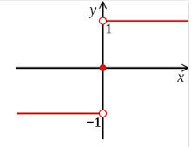
Fundamental approach for solutions to the problems (Improved guess := original guess + step size * error
Training
w1, w2,w3, … be the weights for each data element. W(=(w1,w2,w3)) and b are the parameters to be determined. ‘c_{i} ’ denotes whether the email ‘i’ is a spam or not. c_{i} = 1 if it is spam and -1 if it is not.
Algorithm:
Initialize w and b (to random values or to 0).
Find a training example (x_{i}, c_{i} ) for which
sign(w^{T} x_{i} + b) != c_{i} .
Sign(.023) = 1; sign(-.223)=-1
If there is no such example, training is completed. Store the final w and b and stop. Otherwise go to next step.

Slide 10
Algorithm…
3) Update (w, b):
w(new) := w + c_{i} * x_{i}, b := b + c_{i} after ‘I’th sample is received.
w1(new) = w1 + c_{i} * x1_{i};
w2(new) = w2 + c_{i} * x2_{i};…….
Go to previous step.
(This algorithm is arrived at by minimizing the objective function
Σ (w^{T} x + b)
for a set of x which misclassified. Here ‘x’ itself is the ‘gradient’. Details would be dealt later.
Classification
1. Given a message x, determine its class as sign(w^{T} x + b)
Basic idea behind the algorithm:
Improved guess := original guess + step size * error. ‘

Slide 11
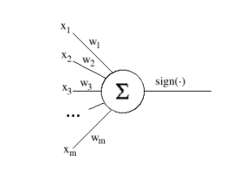
Perceptron and neural network
The above algorithm gave rise to ‘Neural networks’.
This process is called ‘Perceptron’.
This structure resembles the functioning of neurons in brain.
The neurons in the brain are triggered by incoming nerves when the total sum of the electric potentials reach some threshold called ‘firing potential’.
For practical purposes (which ‘d be described later) the switching function Sign() is replaced by a function called sigmoidal function.
If the vectors to be classified have only two components (i.e. x ∈ R 2 ), they can be represented as points on a plane. The decision function of a perceptron can then be represented as a line that divides the plane in two parts. Vectors in one half-plane will be classified as belonging to one class, vectors in the other half-plane—as belonging to the other class.
Dropping the subscripts, we can write these as
w1 x1 + w2 x2 +b <> 0. This means that if we find a line in 2 dim plane based on the above expression that line divides the plane in to two halves.
One half represents Spam and the other normal.

Slide 12
Support vector
The equation represents the ‘classification’ governing equation.
It could be seen to divide the plane into two parts.
Now, there are plenty of lines which could divide such that the circles and triangles are separated.
We can choose the one such that the points are away from the ‘dividing line’ as far as possible.
This method is known as ‘support vector’ which is very popular.
w1 x1 + w2 x2 +b = 0

Slide 13
Linear regression – least squares formulation
Assume that there are only two attributes for the purpose of illustration.
The same problem can be formulated as
W * Xi + b= 1 if it is spam.
= 0 if it is not spam.
Here Xi be the i’th vector and W be the corresponding parameter vector.
The problem is to choose W such that the total error for all the samples is minimum.
Suppose there are just n sample data sets and 2 features then we will have a system of equations
w1 x1₁ + w2 x2₁ + b= 1 and
w1 x1₂ + w2 x2₂ + b= 0;
w1 x1₃ + w2 x2₃ + b =1;
.
.
w1 x1_{n} + w2 x2_{n} + b =0

Slide 14
Linear regression ….
Let n= 3;
Now there are 3 free variables w1, w2,b but number of equations is equal to number of samples..
We remember that there can’t exist a solution at all.
This means we have to do the best!
Possibly, for any given values of w1,w2 and bwe can compute the error in all the above equations and find the total.
We tweak w1, w2 and b in such a way that the error is minimum.
To our surprise, this approach gives a nice easily computable solution.

Slide 15
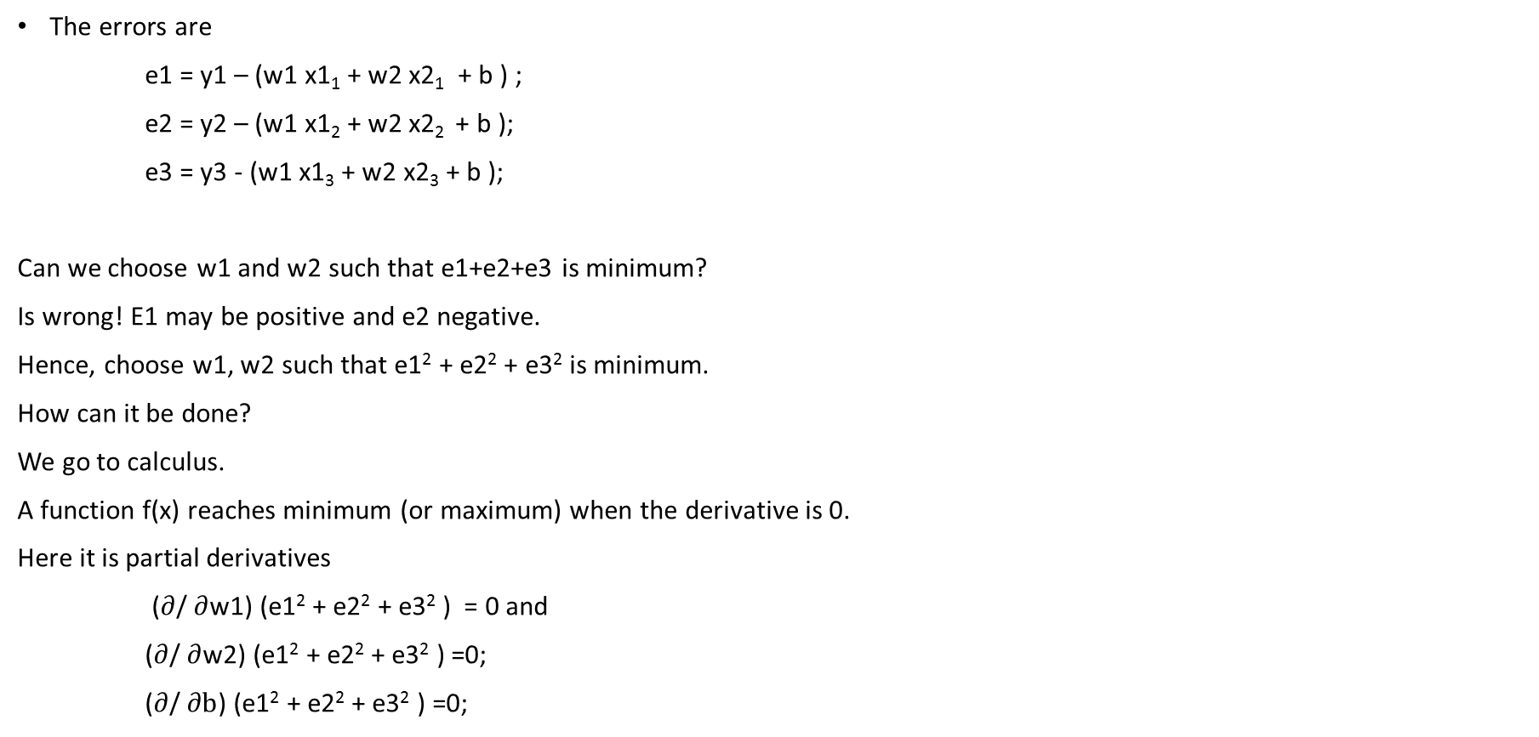
System of equations
The errors are
e1 = y1 – (w1 x1₁ + w2 x2₁ + b ) ;
e2 = y2 – (w1 x1₂ + w2 x2₂ + b );
e3 = y3 - (w1 x1₃ + w2 x2₃ + b );
Can we choose w1 and w2 such that e1+e2+e3 is minimum?
Is wrong! E1 may be positive and e2 negative.
Hence, choose w1, w2 such that e1² + e2² + e3² is minimum.
How can it be done?
We go to calculus.
A function f(x) reaches minimum (or maximum) when the derivative is 0.
Here it is partial derivatives
($∂$/ $∂$w1) (e1² + e2² + e3² ) = 0 and
($∂$/ $∂$w2) (e1² + e2² + e3² ) =0;
($∂$/ $∂b$) (e1² + e2² + e3² ) =0;
Eqn 1.1

Slide 16
Least squares
This ‘d give rise to 3 equations with 3 variables.
2( y1– (w1 x1₁ + w2 x2₁ +b ) )* x1₁ + 2( y2– (w1 x1₂ + w2 x2₂ +b ) )* x1₂ + 2 ( y3– (w1 x1₃ + w2 x2₃ +b)) *x1₃ ) = 0;
2( y1– (w1 x1₁ + w2 x2₁ +b) )* x2₁ + 2( y2– (w1 x1₂ + w2 x2₂ +b ) )* x2₂ + 2 ( y3– (w1 x1₃ + w2 x2₃+b ) )*x2₃ ) = 0;
2( y1– (w1 x1₁ + w2 x2₁ +b) ) + 2( y2– (w1 x1₂ + w2 x2₂ +b ) ) + 2 ( y3– (w1 x1₃ + w2 x2₃+b ) )
= 0;
Ultimately, in practical problems this’d give rise to lot many equations, variables etc.,
This analysis give rise to the following questions.
Is there a way to represent the system of equations Eqn1.1 in a simpler form?
Will the ‘derivative operations’ be represented in the simple representation?
The ‘matrix’ representation facilitates the above requirements.
A system of equations Eqn1.1 can be represented in the form
y -Xw where

Slide 17

Matrix representation
x1₁ | x2₁ 1
x1₂ | x2₂ 1
x1₃ | x2₃ 1
w1
w2 b
y1 y2
y3
$$=$$
X W = Y;
E = Y – X W;
|| E||²₂ = ( Y – XW)^{T} ( Y – XW );
Taking the derivative w.r.t.W we get
X^{T} (Y – XW) = 0;
X^{T} Y – X^{T} X W = 0;
W = ( X^{T} X)⁻¹ X^{T} Y;
We are led to explicit formula for the weight vector W with Matrix calculus.
The data matrix x(ij) transforms the parameters into observations. Using Eigen values theory, there is a possibility of reducing the data requirement in a systematic manner. (Principal component analysis).
This example tells us the necessity of the following mathematical machinery.
i) Matrices (Linear algebra) ii) Calculus iii) Optimization.

Slide 18
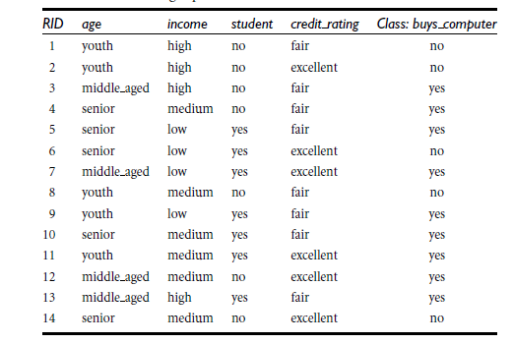
Decision tree
Motivation: When there are large number of classes, large number of attributes and most of them are discrete values, the regression approach may not perform satisfactorily and may not go well with intuition.
Many classification rules in practice are represented by rules in the form of a tree.
Question: Given some past data (features and classifications) can we derive the rule set?
Example: The diagram here gives the data on buying preferences arrived from an Electronics customer database.
The class labels: : whether a customer buys computer or not.
The data given is in the form of a table. The attributes that determine the class are age, income, student (binary) and credit rating. All are modeled as discrete values.
Expected form of the rules:
If the customer is youth, income is high and credit rating is high, he would buy computer.
If the customer is old and credit rating is fair he won’t buy the computer.

Slide 19
Basic ideas behind decision tree construction
Now, based on these attributes, customers can be split.
In a particular split, if all belong to one class, then that is desired at the top.
This means that splits which ensure high certainty should come to the top.
This means that the split which gets highest information gain be selected first.
This requires some ‘measure’ for the information content of the splits.
The information theory which had been used to compute the ‘error correcting codes’ came to the help.

Slide 20
Uncertainty and information
Measure of impurity (Information content).
Impurity – Surprising content – Information – related concepts.
How much information is contained in a split?
Consider an example of some binary event (Tossing the coin)
The probabilities (chances) of occurrence is given at sides.
Probability .9 .1
Probability .5 .5
Probability .1 .9
Case 1 case 2 Case 3

Slide 21
Measure for information
In case 1 and case 3, after an event happens, there is not much information as the probabilities indicate the outcome.
In case 2, in the case of a binary event, the probability is .5. Highest degree of uncertainty hence corresponds to maximum information.
The ‘surprisal’ definition should be such that it should be 1 (maximum) when a binary event is having the probability of .5 (2⁻¹) and 0 when the probability is 1.
So, the definition turned out to be –log₂(p).
The entropy of the event is defined as the average of all surprisals hence it is
p₁ log₂(p₁) + p₂ log₂(p₂)

Slide 22
Notes on entropy
Shannon lists the advantage of using this for information content as follows.
Practically useful because many engineering parameters vary linearly with logarithm of possibilities.
Mathematically more suitable since it is logarithm of possibilities.
The name was suggested by famous scientist Von Neumann as
Uncertainty function has been used in statistical mechanics with the same name.
No one knows what exactly Entropy is so in a debate you will have the advantage.
Ofcourse there are still some debates on this.

Slide 23
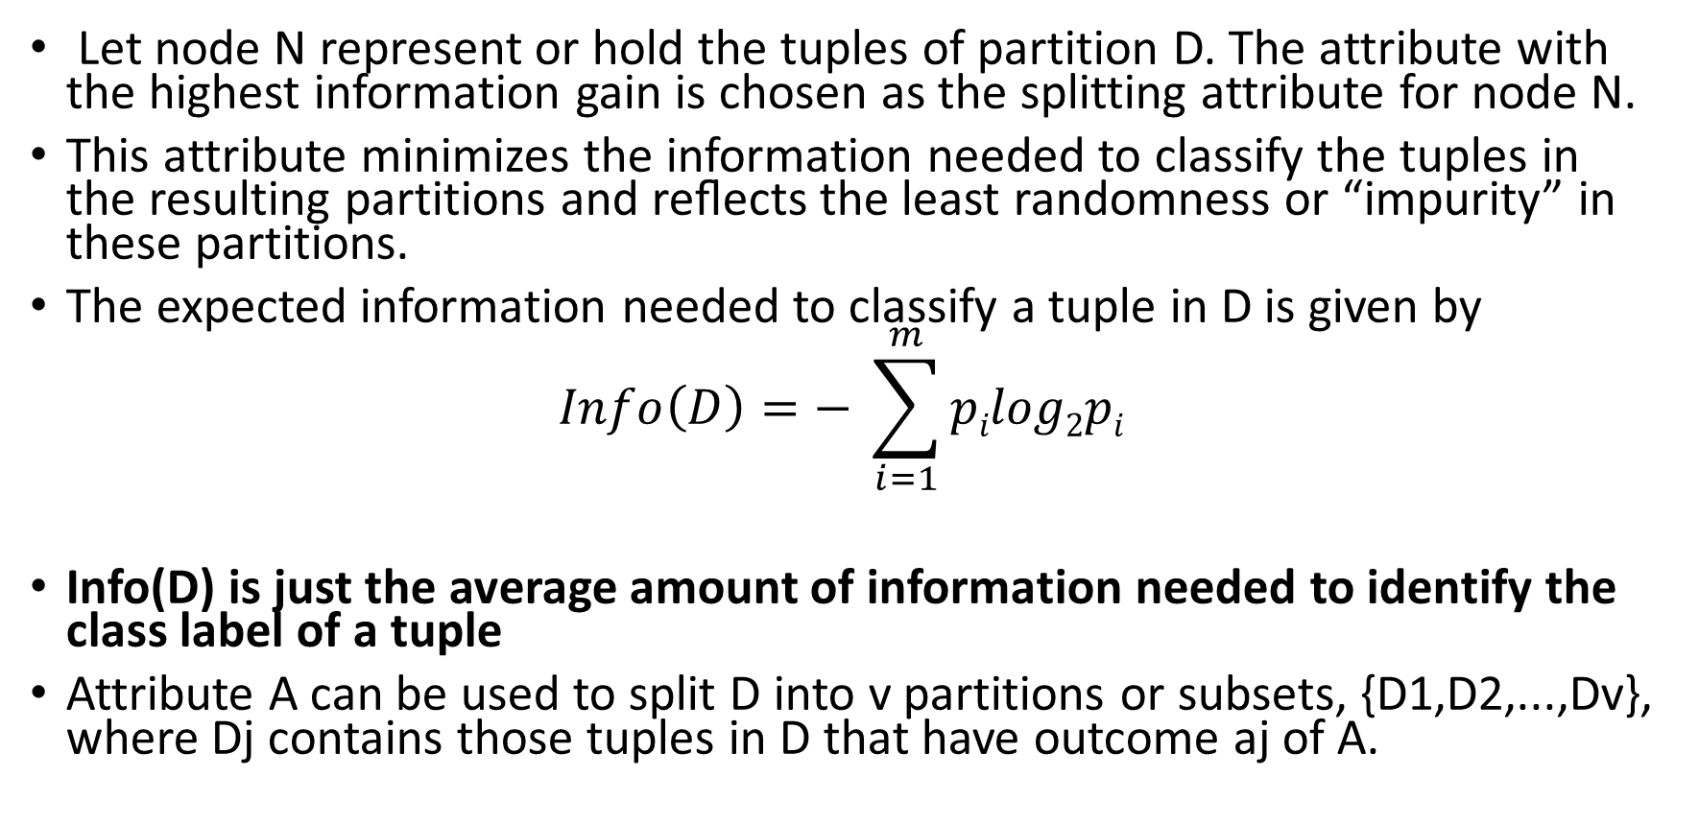
Information content in decision tree
Let node N represent or hold the tuples of partition D. The attribute with the highest information gain is chosen as the splitting attribute for node N.
This attribute minimizes the information needed to classify the tuples in the resulting partitions and reﬂects the least randomness or “impurity” in these partitions.
The expected information needed to classify a tuple in D is given by
$$Info\left(D\right)=− \sum_{i=1}^{m}{pilog2pi}$$
Info(D) is just the average amount of information needed to identify the class label of a tuple
Attribute A can be used to split D into v partitions or subsets, {D1,D2,...,Dv}, where Dj contains those tuples in D that have outcome aj of A.

Slide 24
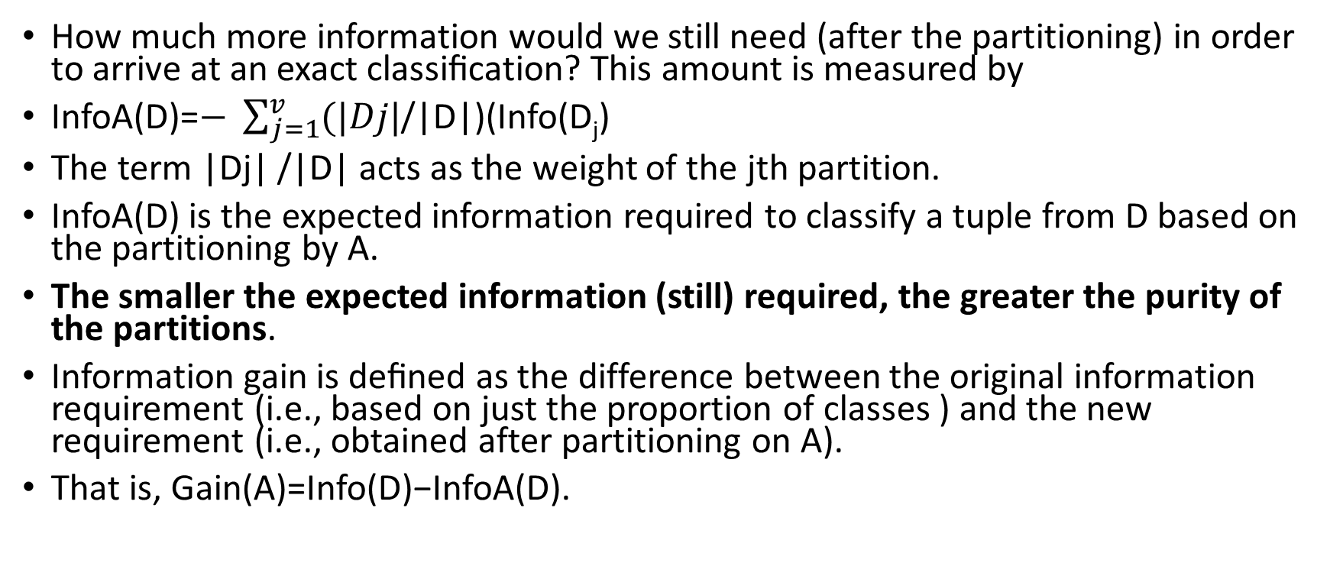
Information content for decision tree construction
How much more information would we still need (after the partitioning) in order to arrive at an exact classiﬁcation? This amount is measured by
InfoA(D)=$− \sum_{j=1}^{v}{(|Dj|}$/|D|)(Info(D_{j})
The term |Dj| /|D| acts as the weight of the jth partition.
InfoA(D) is the expected information required to classify a tuple from D based on the partitioning by A.
The smaller the expected information (still) required, the greater the purity of the partitions.
Information gain is deﬁned as the difference between the original information requirement (i.e., based on just the proportion of classes ) and the new requirement (i.e., obtained after partitioning on A).
That is, Gain(A)=Info(D)−InfoA(D).

Slide 25
Back to Decision tree construction
Purpose: The below diagram is a decision tree arrived at for an Electronics customer database.
The class labels: : whether a customer buys computer or not.
The data given is in the form of following table. The attributes that determine the class are age, income, student (binary) and credit rating. All are modeled as discrete values.
Observations:
Count(buys_computer=Yes) = 9
Count( buys_computer=No) = 5;
The information content required =Average information of both the events =
Info(D) = -(9/14) log₂(9/14) -(5/14) log₂(5/14) .
Now, the information content of the partitioning of the data based on the ‘Age factor’ is derived as follows:
Youth – 5;
Middle aged -5
Senior - 4

Slide 26
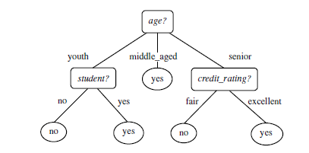
The tree (to be)constructed

Slide 27
With partition by Age, the information is
Info(age)(D) =
(Youth)(5/14)* {-(2/5) log₂(2/5) –(3/5) log₂(3/5)} + (middle aged)
(4/14)* {-(4/4) log₂(4/4) –(0/4) log₂(0/4)} +
(senior) (5/14)* {-(3/5) log₂(3/5) –(2/5) log₂(2/5)}.
Compute Info gain = Info(D) – Info(age)(D)
The same computations are to be performed for other classifications and the one which has maximum gain is taken.
There are many more issues like stopping criterion, sampling with replacement when there are a large number of attributes, bagging which ‘d be dealt later.

Slide 28
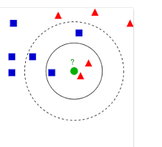
K nearest neighbors
Basic idea:
Define a metric(distance) between two strings. We will get back to it later. For the time being assume that we can define a distance between any two strings.
Ex: Strings “ABCD” and “ADCFG” Distance can be defined as
For all positions, if characters are same, d=0 else 1.
Sum all the ‘d’
Assume there are two types of data points(white sand and red sand) in a set distributed geographically.
Among these, the types of certain points are well known.
How to find out the ‘type’ of unknown points?
The idea used is that the type of a point is type of points which surround the given point at maximum number.
Given a message x, determine its k nearest neighbors among the messages in the training set. If there are more spams among these neighbors, classify given message as spam. Otherwise classify it as legitimate mail

Slide 29
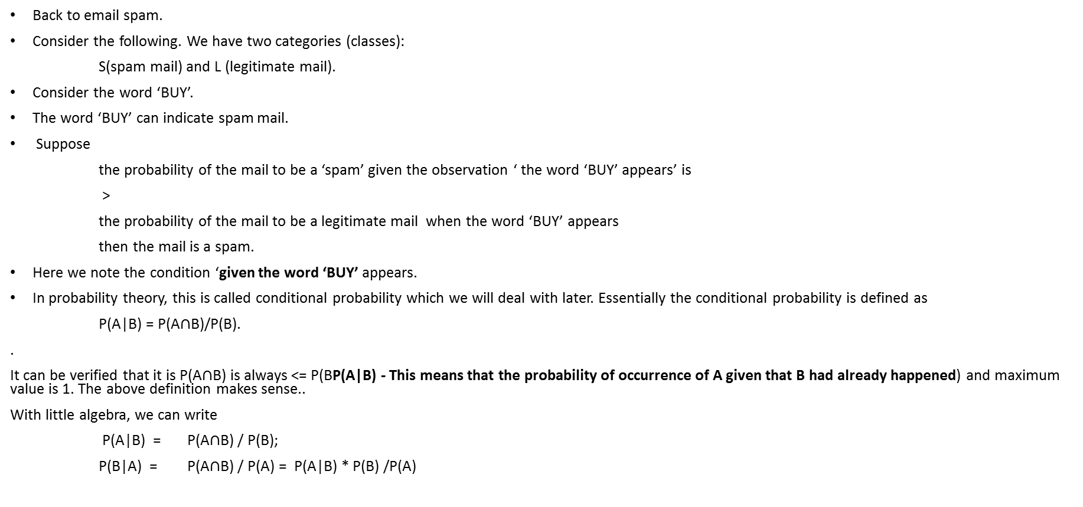
Bayesian – A probabilistic approach
Back to email spam.
Consider the following. We have two categories (classes):
S(spam mail) and L (legitimate mail).
Consider the word ‘BUY’.
The word ‘BUY’ can indicate spam mail.
Suppose
the probability of the mail to be a ‘spam’ given the observation ‘ the word ‘BUY’ appears’ is
>
the probability of the mail to be a legitimate mail when the word ‘BUY’ appears
then the mail is a spam.
Here we note the condition ‘given the word ‘BUY’ appears.
In probability theory, this is called conditional probability which we will deal with later. Essentially the conditional probability is defined as
P(A|B) = P(A$∩$B)/P(B).
.
It can be verified that it is P(A$∩$B) is always <= P(BP(A|B) - This means that the probability of occurrence of A given that B had already happened) and maximum value is 1. The above definition makes sense..
With little algebra, we can write
P(A|B) = P(A$∩$B) / P(B);
P(B|A) = P(A$∩$B) / P(A) = P(A|B) * P(B) /P(A)

Slide 30
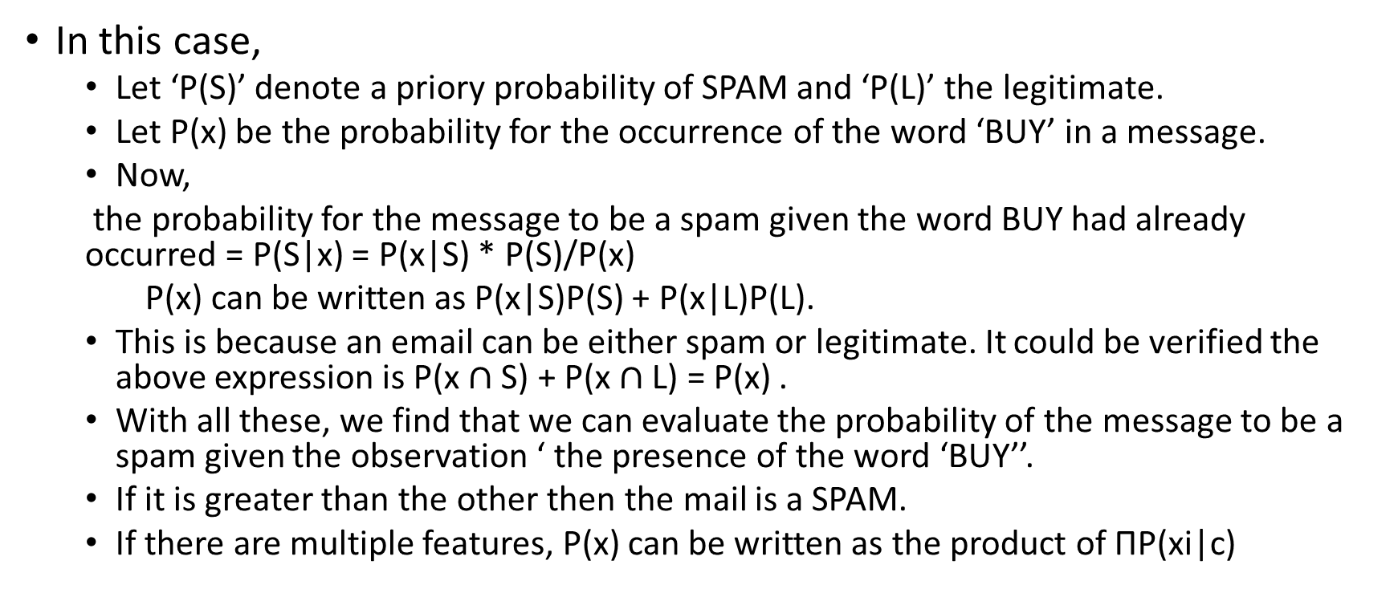
In this case,
Let ‘P(S)’ denote a priory probability of SPAM and ‘P(L)’ the legitimate.
Let P(x) be the probability for the occurrence of the word ‘BUY’ in a message.
Now,
the probability for the message to be a spam given the word BUY had already occurred = P(S|x) = P(x|S) * P(S)/P(x)
P(x) can be written as P(x|S)P(S) + P(x|L)P(L).
This is because an email can be either spam or legitimate. It could be verified the above expression is P(x $∩$ S) + P(x $∩$ L) = P(x) .
With all these, we find that we can evaluate the probability of the message to be a spam given the observation ‘ the presence of the word ‘BUY’’.
If it is greater than the other then the mail is a SPAM.
If there are multiple features, P(x) can be written as the product of ΠP(xi|c)

Slide 31
Clustering
Clustering belongs to the class ‘Unsupervised learning’ in machine learning In which there is no sample data.
Cluster analysis or simply clustering is the process of partitioning a set of data objects (or observations) into subsets.
Each subset is a cluster, such that objects in a cluster are similar to one another, yet dissimilar to objects in other clusters.
The set of clusters resulting from a cluster analysis can be referred to as a clustering.
The related term is ‘Segmenting’. It is the process of putting customers into groups based on similarities, and clustering is the process of finding similarities in customers so that they can be grouped, and therefore segmented.
Cluster analysis is used in a variety of applications. For example it can be used to identify consumer segments, or competitive sets of products, or groups of assets whose prices co-move, or for geo-demographic segmentation, etc.
In general it is often necessary to split our data into segments and perform any subsequent analysis within each segment in order to develop (potentially more refined) segment-specific insights. This could be done even if there are no natural groups

Slide 32
Clustering can also be used for outlier detection, where outliers (values that are “far away” from any cluster) may be more interesting than common cases.
Applications of outlier detection include the detection of credit card fraud and the monitoring of criminal activities in electronic commerce.

Slide 33
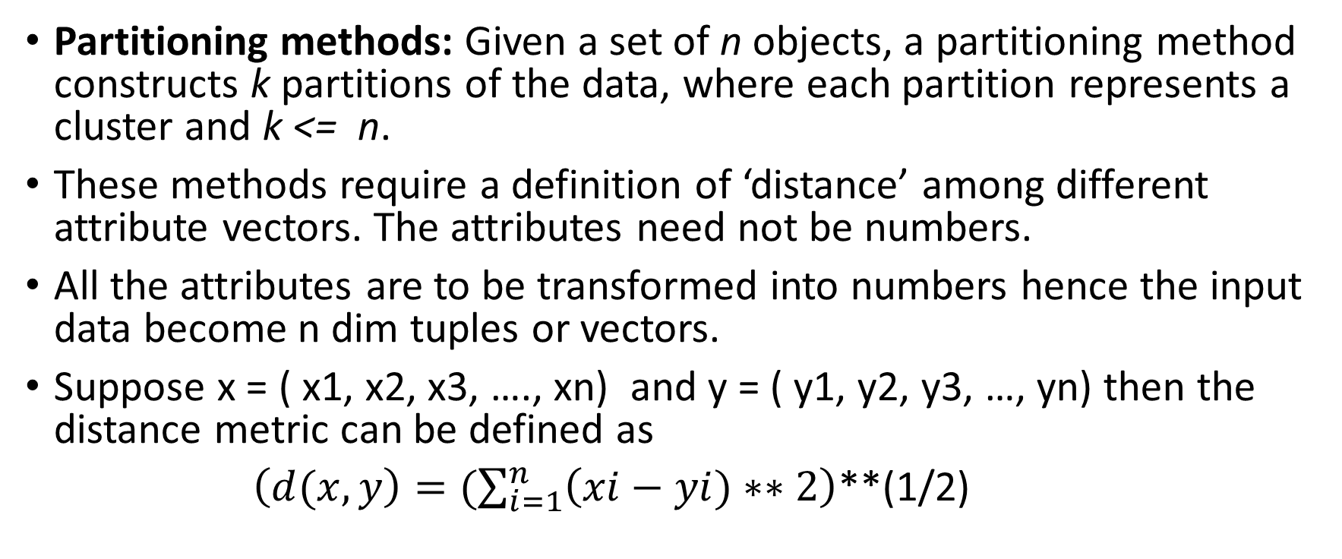
Data representation
Partitioning methods: Given a set of n objects, a partitioning method constructs k partitions of the data, where each partition represents a cluster and k <= n.
These methods require a definition of ‘distance’ among different attribute vectors. The attributes need not be numbers.
All the attributes are to be transformed into numbers hence the input data become n dim tuples or vectors.
Suppose x = ( x1, x2, x3, …., xn) and y = ( y1, y2, y3, …, yn) then the distance metric can be defined as
$\left(d(x,y\right)=(\sum_{i=1}^{n}{\left(xi−yi)∗∗2\right)}$**(1/2)

Slide 34
Distance metric

Slide 35
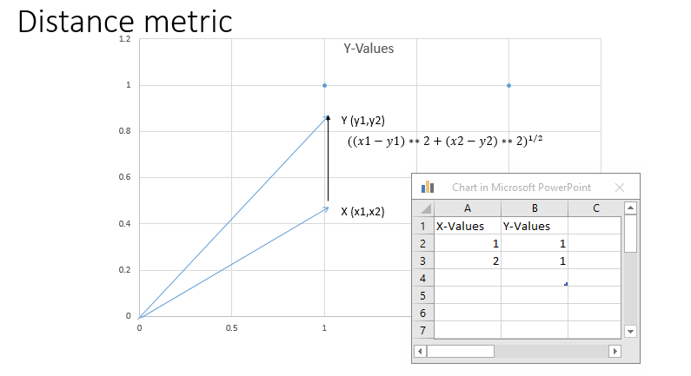

Slide 36
Clustering
If distance metric can be defined between any two attribute vectors, that could be the basis for identification of closed ones.
This leads to an algorithm for clustering called k means.
Suppose the given data elements (feature or attribute ) vectors are given, a metric can be defined between any two as given before.
Suppose we start with some trial points as centroids and a set of all the data points (feature vectors) ,the distance between every one of the data points and each one of centroid point can be computed.
A centroid which is at the lowest distance from a given data point can be computed and the particular data point can be grouped with the centroid.
This exercise can be repeated by finding a new centroid for all the points in every group.
Since the algorithm is based on centroids, it is known as ‘K means’.

Slide 37
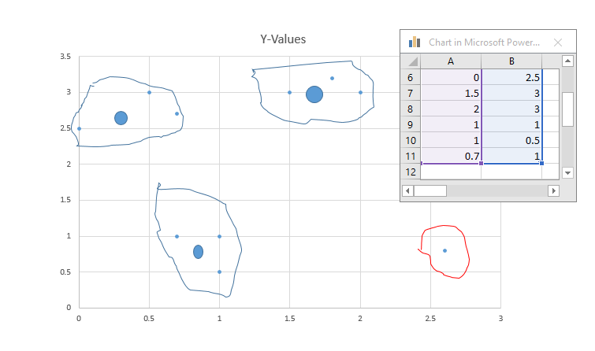

Slide 38
Frequent item sets, Market basket,….
In Amazon.com, we could have seen statements like people who have bought …… have also bought ……..
This information is not just message to the customers but also help in planning and organization of goods in the shops.
A laptop buyer can be expected to buy the accessories like mouse and also the bag.
To identify such ‘groups’ from sales data, there is a need for systematic procedures.

Slide 39
Example
Frequent itemset mining leads to the discovery of associations and correlations among items in large transactional or relational data sets.
With massive amounts of data continuously being collected and stored, many industries are becoming interested in mining such patterns from their databases.
The discovery of interesting correlation relationships among huge amounts of business transaction records can help in many business decision-making processes such as catalog design, cross-marketing, and customer shopping behavior analysis.
A typical example of frequent itemset mining is market basket analysis. This process analyzes customer buying habits by finding associations between the different items that customers place in their “shopping baskets” (

Slide 40
Market basket ideas
If we think of the universe as the set of items available at the store, then each item has a Boolean variable representing the presence or absence of that item.
Each basket can then be represented by a Boolean vector of values assigned to these variables.
These patterns can be represented in the form of association rules.
For example, the information that customers who purchase computers also tend to buy antivirus software at the same time is represented in the following association rule:
Computer => antivirus software [support D 2%,confidence D 60%]. (6.1)
Rule support and confidence are two measures of rule interestingness. They respectively reflect the usefulness and certainty of discovered rules.
Typically, association rules are considered interesting if they satisfy both a minimum support threshold and a minimum confidence threshold. These thresholds can be a set by users or domain experts.

Slide 41
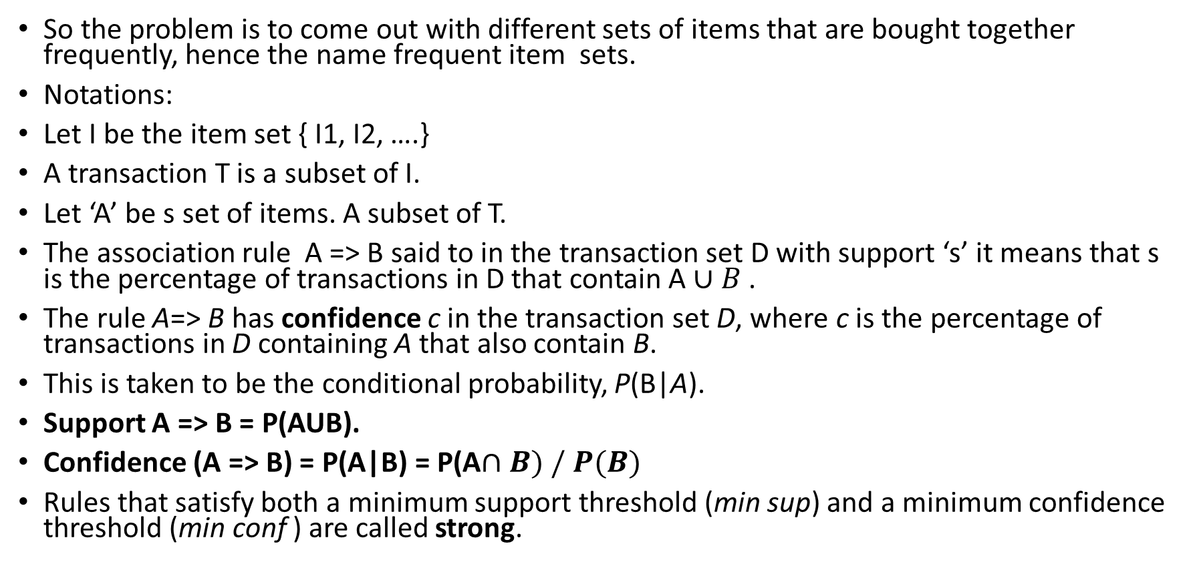
A simple model
So the problem is to come out with different sets of items that are bought together frequently, hence the name frequent item sets.
Notations:
Let I be the item set { I1, I2, ….}
A transaction T is a subset of I.
Let ‘A’ be s set of items. A subset of T.
The association rule A => B said to in the transaction set D with support ‘s’ it means that s is the percentage of transactions in D that contain A $∪B$ .
The rule A=> B has confidence c in the transaction set D, where c is the percentage of transactions in D containing A that also contain B.
This is taken to be the conditional probability, P(B|A).
Support A => B = P(AUB).
Confidence (A => B) = P(A|B) = P(A$∩B) / P(B)$
Rules that satisfy both a minimum support threshold (min sup) and a minimum confidence threshold (min conf ) are called strong.

Slide 42
In general, association rule mining can be viewed as a two-step process:
1. Find all frequent item sets: By definition, each of these itemsets will occur at least as frequently as a predetermined minimum support count, min sup.
2. Generate strong association rules from the frequent itemsets: By definition, these rules must satisfy minimum support and minimum confidence.
Idea: If an item set is frequent then its each subset is frequent.
An itemset X is closed in a data set D if there exists no proper super-itemset Y5 such that Y has the same support count as X inD. An itemset X is a closed frequent itemset in set D if X is both closed and frequent in D.

Slide 43
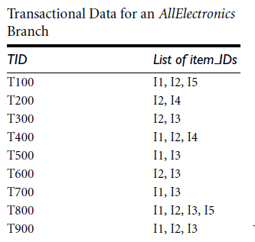
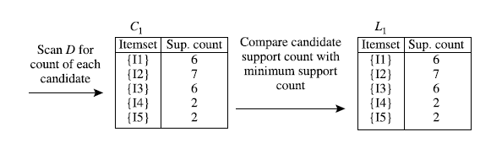
Finding frequent item sets. Apriory algorithm
The method is explained with an example.
The data set is given as follows.

Slide 44
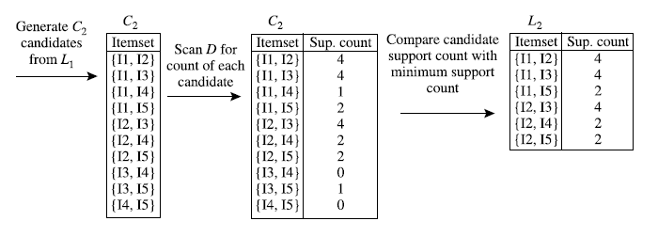
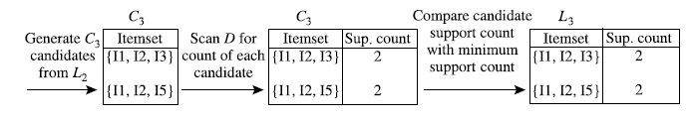
Basic idea of generation of frequent item sets
Once the frequent itemsets from transactions in a database D have been found, it is straightforward to generate strong association rules from them (where strong association rules satisfy both minimum support and minimum confidence). This can be done using the expressions for the confidence derived before. P(A|B) = P( A $∩$B)/P(B)

Slide 45
Statistics after machine learning
Statistics is useful for mining various patterns from data as well as for understanding the underlying mechanisms generating and affecting the patterns. Inferential statistics (or predictive statistics) models data in a way that accounts for randomness and uncertainty in the observations and is used to draw inferences about the process or population under investigation.
Statistical methods can also be used to verify data mining results. For example, after a classification or prediction model is mined, the model should be verified by statistical hypothesis testing.
A statistical hypothesis test (sometimes called confirmatory data analysis) makes statistical decisions using experimental data. A result is called statistically significant if it is unlikely to have occurred by chance. If the classification or prediction model holds true, then the descriptive statistics of the model increases the soundness of the model.

Slide 46
Stats before mining the data
Real-world data are typically noisy, enormous in volume (often several gigabytes or more), and may originate from a hodgepodge of heterogeneous sources.
Many questions will be raised. Some are the following.
What are the types of attributes or fields that make up your data?
What kind of values does each attribute have?
Which attributes are discrete, and which are continuous-valued? What do the data look like? How are the values distributed? Are there ways we can visualize the data to get a better sense of it all?
Can we spot any outliers?
Can we measure the similarity of some data objects with respect to others?
Gaining such insight into the data will help with the subsequent analysis.

Slide 47
Knowing such basic statistics regarding each attribute makes it easier to fill in missing values, smooth noisy values, and spot outliers during data preprocessing.
Knowledge of the attributes and attribute values can also help in fixing inconsistencies incurred during data integration.
Plotting the measures of central tendency shows us if the data are symmetric or skewed.
Quantile plots, histograms, and scatter plots are other graphic displays of basic statistical descriptions.
These can all be useful during data preprocessing and can provide insight into areas for mining.

