Slide 1
Linear algebra
Dr. Siva,
Cognizant Technology Solutions
“The truth is that vectors and matrices have become the language to know.” – Gilbert Strang

Slide 2
Vectors – An introduction
Scalars: These are single numbers that might represent readings from a scale.
A vector represents quantities which have both magnitude and direction.
They are represented by head, tail, a line segment and arrow.
The length of the line denotes the magnitude and the direction arrow denotes the direction.
The vector AB is represented by an arrow at B. The length determines the magnitude and the path A to B gives the direction.
B
A

Slide 3
Vector addition in physics
The basic operations in algebra are addition, subtraction, multiplication by scalar, (and the vectors in our case) can be defined.
Addition can be defined by parallelogram law.
Let us denote the vectors in bold small letters. Ordinary small letters denote scalars.
Let a, b are vectors.
a+ b essentially is the diagonal of the parallelogram formed by a and b as sides. It is derived from physics.

Slide 4
Vector addition and representation
Vector addition: The magnitude is given by ( a**2 + b**2 + 2 |a||b|cosθ ) ** (1/2) where θ is the angle between the vectors.
From the following diagram, a+b can be obtained by moving b to the tip of a and completing the triangle.
Suppose a and b are at 90 degrees angle (along x and y axis in the coordinate plane, then cosθ = cos(90) = 1.
The magnitude is sqrt(a**2 + b**2) (Here, a b represent the magnitudes).
Based on these facts a vector can be represented by its coefficients along x, y axes. Then the length of the diagonal represent the magnitude of vectors. This gave rise to coordinate representation of vectors in rectangular coordinates.
b
a+b
a

Slide 5
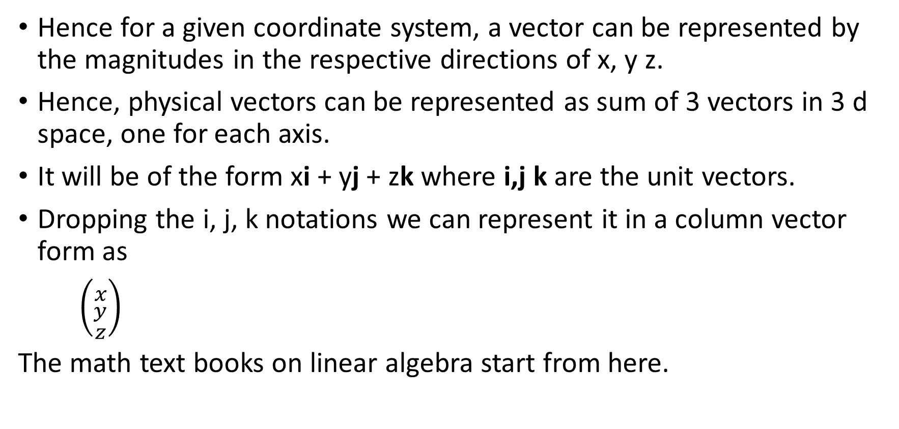
Vector notation and coordinate representation
Hence for a given coordinate system, a vector can be represented by the magnitudes in the respective directions of x, y z.
Hence, physical vectors can be represented as sum of 3 vectors in 3 d space, one for each axis.
It will be of the form xi + yj + zk where i,j k are the unit vectors.
Dropping the i, j, k notations we can represent it in a column vector form as
$\left({x \atop \begin{aligned}y \\ z\end{aligned}}\right)$
The math text books on linear algebra start from here.

Slide 6
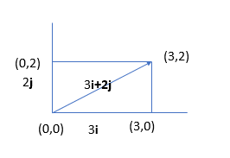
Vectors in Co ordinate system
Vectors in a coordinate space in terms of its components.
In physics, the vector is represented as 3i + 2j where I, j are unit vectors in X and Y direction. IN general, in vector algebra, they are represented as tuple or vector Transpose( 3,2). Actually it is a column vector.
Then addition essentially means addition of the components.
A vector can be multiplied by a scalar which magnifies the vector in the same direction.
The linear combinations span the entire space if vectors are not collinear.

Slide 7
Vector space concept in abstract algebra
Start with R^{n}.
If n is a positive integer, then an ordered n-tuple is a sequence of n real numbers (a1, a2, . . . , an). The set of all ordered n-tuples is called n-space and is denoted by R^{n}.
The vector space R^{n} , likewise is the set of ordered triples, which describe all points and directed line segments in 3-D space.
Definitions
Two vectors u = (u1, u2, . . . , un) and v = (v1, v2, . . . , vn) in R^{n} are called equal
if u1 = v1, u2 = v2, . . . , un = vn
The sum u + v is defined by u + v = (u1 + v1, u2 + v2, . . . , un + vn)
Let k be any scalar, then the scalar multiple ku is defined by ku = (ku1, ku2, . . . , kun)
These two operations of addition and scalar multiplication are called the standard operations on R^{n}
The zero vector in R^{n} is denoted by 0 and is defined to be the vector 0 = (0, 0, . . . , 0)
The negative (or additive inverse) of u is denoted by -u and is defined by −u = (−u₁, − u₂, . . . , −u_{n})
The difference of vectors in R^{n} is defined by v − u = v + (−u)

Slide 8
Useful theorem
Theorem 1.1. If u = (u1, u2, . . . , un), v = (v1, v2, . . . , vn), and w = (w1, w2, . . . , wn) are vectors in and k and l are scalars, then:
1. u + v = v + u
2. u + (v + w) = (u + v) + w
3. u + 0 = 0 + u = u
4. u + (−u) = 0; that is, u − u = 0
5. k(lu) = (kl)u
6. k(u + v) = ku + kv
7. (k + l)u = ku + lu
8. 1u = u

Slide 9
Note on abstract algebra
The main algebraic operations on the different types of numbers are addition, subtraction, multiplication, multiplication by scaler etc.,
With respect to these operations different sets can possess different sets of properties and classification of abstract objects based on the satisfied properties led to many useful analysis.
Abstract algebra (occasionally called modern algebra) is the study of algebraic structures. Algebraic structures include groups, rings, fields, modules, vector spaces, lattices, and algebras.
Abstract algebra emerged around the start of the 20th century, under the name modern algebra. Its study was part of the drive for more intellectual rigor in mathematics.
Most theories that are now recognized as parts of algebra started as collections of disparate facts from various branches of mathematics, acquired a common theme that served as a core around which various results were grouped, and finally became unified on a basis of a common set of concepts.
In data science? Abstract algebra definitely gives you useful tools for thinking about spaces, mappings, functions that you encounter daily in more applied contexts.
Reference: https://www.slideshare.net/samkiller/algebird-abstract-algebra-for-big-data-analytics-devoxx-2014

Slide 10
Fields
In mathematics, a field is a set on which are defined addition, subtraction, multiplication, and division, which behave as they do when applied to rational and real numbers. A field is thus a fundamental algebraic structure, which is widely used in algebra, number theory and many other areas of mathematics.
Definition(Field): A field is a set F with two binary operations + and ·, such that the following properties hold.
(1) ∀ α, β ∈ F, α + β = β + α (commutativity of addition)
(2) ∀ α, β, γ ∈ F, α + (β + γ) = (α + β) + γ (associativity of addition)
(3) ∀ α, β ∈ F, α · β = β · α (commutativity of multiplication)
(4) ∀ α, β, γ ∈ F, (α · β) · γ = α · (β · γ) (associativity of multiplication)
(5) ∀ α, β, γ ∈ F, α · (β + γ) = α · β + α · γ (distributivity)
(6) ∃ 0 ∈ F such that ∀ α ∈ F, 0 + α = α (additive identity)
(7) ∀ α ∈ F, ∃ −α ∈ F such that α + (−α) = 0 (additive inverse)
(8) ∃ 1 ∈ F such that, ∀ α ∈ F, 1 · α = α (multiplicative identity)
(9) ∀ α ∈ F, α != 0, ∃ α ⁻¹ ∈ F such that α · α ⁻¹ = 1 (multiplicative inverse)
Remark: Note that the integers satisfy properties (1) through (8), but not property (9).
For all x ∈ Z, x ₆= 1. So, the integers are not a field.
Example The real numbers R are a field, with respect to the usual addition and multiplication of real numbers.
The rational numbers Q are a field, with respect to the usual addition and multiplication of rational numbers.
The set F = {0, 1} can be made into a field with 2 base binary operations (Addition and multiplication)
Remark: The elements of a field are often called scalars

Slide 11
Abstract definition for a vector space over a field.
A set of axioms can be derived, which if satisfied by a class of objects, entitles those objects to be called “vectors”.
The axioms were chosen by abstracting the most important properties of vectors in R^{n} ; as a consequence, vectors in R^{n} automatically satisfy these axioms.
A vector space V over a field F is a nonempty set on which two operations are defined - addition and scalar multiplication. (Groups – only one operation)
Addition is a rule for associating with each pair of objects u and v in V an object u + v, and scalar multiplication is a rule for associating with each scalar k ∈ F and each object u in V an object ku such that
1. If u, v ∈ V , then u + v ∈ V .
2. If u ∈ V and k ∈ F, then ku ∈ V .
3. u + v = v + u
4. u + (v + w) = (u + v) + w
5. There is an object 0 in V, called a zero vector for V , such that u+0 = 0+u = u for all u in V .
6. For each u in V , there is an object -u in V , called the additive inverse of u, such that u + (−u) = −u + u = 0;
7. k(lu) = (kl)u
8. k(u + v) = ku + kv
9. (k + l)u = ku + lu
10. 1u = u
Remark: The elements of the underlying field F are called scalars and the elements of the vector space are called vectors. Note also that we often restrict our attention to the case when F = R or C.

Slide 12
Examples other than numbers
Let x be a real variable.
The set P²(R) of all real polynomials in the variable x of degree at most 2 is a vector space over R.
More generally, the set P(R) of all real polynomials in the variable x is a vector space over R.
More generally, the set C ∞(R) of all infinitely differentiable functions in the variable x is a vector space over R.

Slide 13
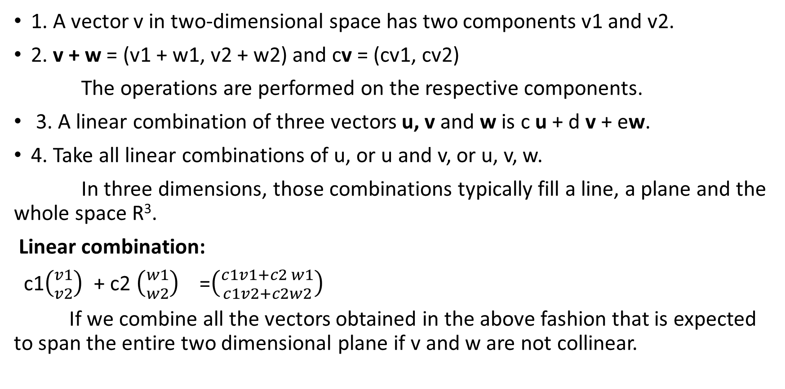
Vector space in practice
1. A vector v in two-dimensional space has two components v1 and v2.
2. v + w = (v1 + w1, v2 + w2) and cv = (cv1, cv2)
The operations are performed on the respective components.
3. A linear combination of three vectors u, v and w is c u + d v + ew.
4. Take all linear combinations of u, or u and v, or u, v, w.
In three dimensions, those combinations typically fill a line, a plane and the whole space R³.
Linear combination:
c1$\left({v1 \atop v2}\right)$ + c2 $\left({w1 \atop w2}\right)$ =$\left({c1v1+c2 w1 \atop c1v2+c2w2}\right)$
If we combine all the vectors obtained in the above fashion that is expected to span the entire two dimensional plane if v and w are not collinear.

Slide 14
Vector Subspace
A subset W of a vector space V is called a subspace of V if W is itself a vector space under the addition and scalar multiplication defined on V
In general, all ten vector space axioms must be verified to show that a set W with addition and scalar multiplication forms a vector space.
W is a subspace of V if and only if W is closed under addition and closed under scalar multiplication
Example 1:
A plane through the origin of R 3 forms a subspace of R**3 .
Example 2:
Let n be a positive integer, and let W consist of all functions expressible in the form p(x) = a0 + a1x + · · · + an x^{n} where a0, . . . , an belong to some field F.
Thus, W consists of the zero function together with all polynomials in F of degree n or less.
The set W is a subspace of P(F) and if F = R it is also a subspace of the vector space of all real-valued functions

Slide 15
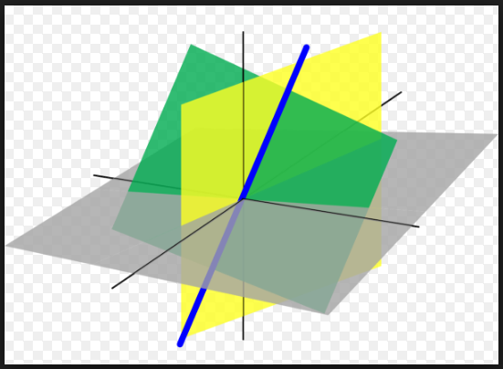
Subspaces in R³

Slide 16
Inner product, dot product
Products:
In physics, two vectors are multiplied in two different contexts.
i) Product is a scalar :
Example: Product of Force and displacement vectors give rise to a scalar quantity called ‘work’ which is a scalar. Here if vectors are in different directions, component of one on another will be effective. The magnitude of the component is the true magnitude * cosine of the angle between the two.
Ii) Product is a vector:
Example: Generally if the product is a vector, its magnitude is the product of the magnitudes and it acts in a direction normal to the plane of both vectors and same as that of rotating a screw from 1st vector to the second.
Hence A X B = - BX A.
Dot product:
Given the vectors v and w the dot product could also be defined as
||v||*||w||*cosθ where θ is the angle between the two vectors.
This angle definition is used in analytics.
Examples:
Let vector F acts on a particle and causes the displacement S.
Then the work done is FSCos(ϴ).
F
ϴ
Fcos(ϴ)
S

Slide 17
Dot product in coordinate space
In coordinate terms let v=(v1,v2) and w=(w1,w2) then the dot product or the inner product is defined as
v1w1 + v2w2.
These definitions are taken based on physical laws. The dot product essentially got by projecting a vector on another and multiplying the magnitude of the original and component of the projected vector.
The formula v1w1 + v2w2 also got by using the same arguments.
This expression is known as inner product <v,w> where v = (v1,v2) and w=(w1,w2).
Equating both expressions we have
<v,w> = ||v||.||w||.cos θ and ‘θ ‘ is
cos⁻¹(<v,w>/( ||v||.||w||)).
By using the notation <v,w> we are generalizing the dot product to many dimensions.

Slide 18
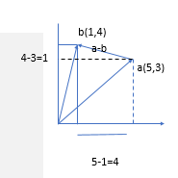
Dot product – Direct product and component vise product
As in the figure, let
vector a = 5 i + 3j
vector b = i +4 j
Now a.b = (5 i + 3j ) . (i +4 j)
= 5i.i + 5i. 4j + 3j.i + 3j . 4j
=5cos(0) + 20(cos(90)) + 3(cos(90))+ 12(cos(0))
= 5+12 = 17.
a.b can be directly computed as ||a||||b||Cos(ϴ)
a = x1i1 + x2i2 + x3i3+……+xnin;
b= y1i1 + y2i2+…..+ynin
<a, b> = a.b = x1y1 + x2y2 + …….+ xnyn

Slide 19
Some properties
Schwartz inequality : |v.w| <= ||v||. ||w||
||v+w|| <= ||v|| + ||w||
Some results on arithmetic mean and geometric mean
Geometric mean <= arithmetic mean
Proof: Let (a,b), and (b,a) be two vectors
Schwartz inequality implies (a, b).(b,a) = 2ab <= a**2 + b**2.
➔ ab <= (a**2 + b**2)/2.
The dot product = ab + ba=2ab
If x= a**2 and y = b**2 then ab is geometric mean of xy. RHS is Arithmetic mean.
Hence Geometric mean <= Arithmetic mean
Length of a vector = a.a= ||a||².
A unit vector is a vector whole length is one. u.u=1.
u = v/llv II is a unit vector in the direction of ‘v’.
Note:
In the xy plane(R², the unit vector at an angle ϴ is (cosϴ, sinϴ) since
If x = cosϴ, y = sinϴ, the magnitude of xi + yj
= sqrt(x² + y²)=1.

Slide 20
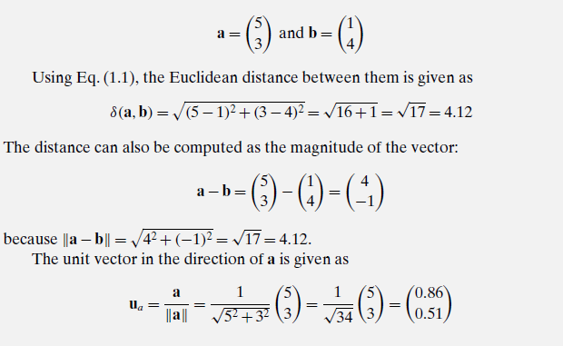
Summary

Slide 21
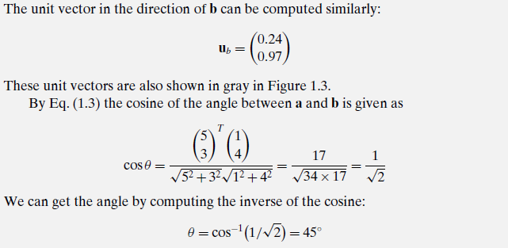

Slide 22
Orthogonal projection
Let a,b ∈ Rm be two m-dimensional vectors. An orthogonal decomposition of the vector b in the direction of another vector a is given as
b = b|| +b⊥ = p+r
where p= b|| is parallel to a, and r=b⊥ is perpendicular or orthogonal to a.
The vector p is called the orthogonal projection or simply projection of b on the vector a.
Note:
The point p ∈ R^{m} is the point closest to b on the line passing through a. Thus, the magnitude of the vector r = b − p gives the perpendicular distance between b and a, which is often interpreted as the residual or error vector between the points b and p.

Slide 23
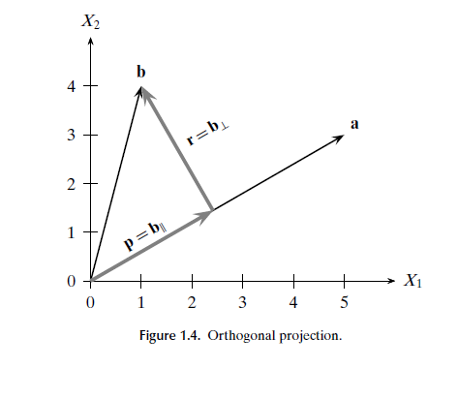

Projections
Let p be the projection of vector b on a.
Let p = ca;
r = b-p
= b – ca
P and r are orthogonal
c = a^{T} b /(a^{T} a)
➔ p = ca = (a^{T} b /(a^{T} a) )a

Slide 24
Orthogonal decompositions on subspace
The orthogonal decomposition can be extended to a subspace by projecting the vector b on unit vectors of the subspace separately.
Let W be subspace of R^{n}

Slide 25
Linear dependence and independence
Span of a set of vectors:
A linear combination of vectors { v1,v2,…,vn} with coefficients { ci} is the span.
The span of any set of vectors form a subspace of the original vector space.
Orthogonal vectors.
Two vectors are orthogonal if the inner product is Zero or Cos(ϴ) = 0. (If the angle between the two vectors is 90 degrees)
Basis vectors:
In Physics, vectors are represented as a linear combination of the unit vectors at x, y and z axis. Example: xi + yj +zk.
It was mentioned that the notation (x,y,z) can be used to represent the vector.
The d-dimensional Cartesian coordinate space is specified via the d unit vectors, called the standard basis vectors, along each of the axes.
The jth standard basis vector e_{j} = (0,0,0,…., 1_{j} ,0,….0)^{T}
If the dimension of the vector space is ‘d’ then Any arbitrary vector x can be written as a linear combination of the unit vectors e_{j} .
It can be verified that the dot product of two basis vectors is always Zero.

Slide 26
Linear independence
Linear Independence We say that the vectors v1,... ,vk are linearly dependent if at least one vector can be written as a linear combination of the others.
Alternatively, the k vectors are linearly dependent if there are scalars c1,c2,... ,ck , at least one of which is not zero, such that
c1v1 + c2v2 +···+ ckvk = 0.
On the other hand, v1,··· ,vk are linearly independent if and only if c1v1 + c2v2 +···+ ckvk = 0 implies c1 = c2 = ··· = ck = 0
Simply put, a set of vectors is linearly independent if none of them can be written as a linear combination of the other vectors in the set.

Slide 27
Vector products
Another product is cross product.
a X b is a vector with magnitude ab(Sin(ϴ)) and direction is at right angles to both a and b and pointing at the direction when a screw is turned from a to b.
The magnitude turns out to be the area of the parallelepiped covered by the vectors.
In general, the area of parallelepiped can be computed with the help of determinant expression written in terms of the coordinates.
This helps us to understand the role of determinants in matrix literature.
Cross product indicates how different the associated vectors are thus the determinant.
In a matrix, depending on how different the columns are, the determinant value varies.

Slide 28
Back to dot product - Example – Cosine angle for comparison of documents.(https://janav.wordpress.com/2013/10/27/tf-idf-and-cosine-similarity/)
Google’s success is mainly due to their ‘page rank algorithm’.
Such requirements require the input query entered by the user should be used to match the relevant documents and score them.
This paper gives the following examples.
There are three documents (sentences).
Document 1: The game of life is a game of everlasting learning
Document 2: The unexamined life is not worth living
Document 3: Never stop learning
Search string: life learning

Slide 29
A few definitions
Term Frequency also known as TF measures the number of times a term (word) occurs in a document. Given below are the terms and their frequency on each of the document.
Normalized TF: Divide the count by total number of counts to get normalized counts for each word in each document
Inverse document frequency: (used to give low weightages for the words like ‘the’, ‘for’ etc.,
Compute 1 + log( e) (Number of documents /Number of documents with the word under consideration) –For words under consideration, compute
Normalized frequency * Inverse document frequency .
Construct vectors for each word in different documents and compare

Slide 30
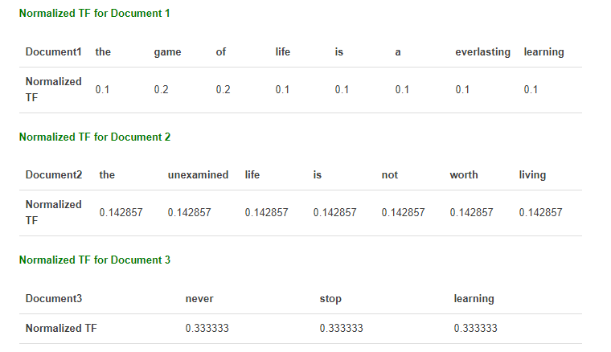
Example in detail. (Word count/total no. of words)
Document 1: The game of life is a game of everlasting learning
Document 2: The unexamined life is not worth living
Document 3: Never stop learning

Slide 31
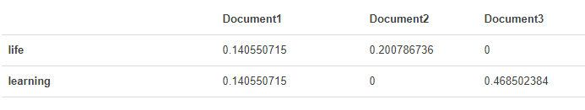
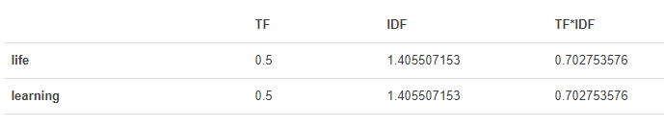
Inverse document frequency
IDF(game) = 1 + log_{e} (Total no. of documents/No. of docs with the word ‘game’).
The word ‘game’ appears in one document.
IDF = 2.098..
TF * IDF for the words considered ‘life’ and ‘learning’
For the query life learning, the above measures can be computed.

Slide 32
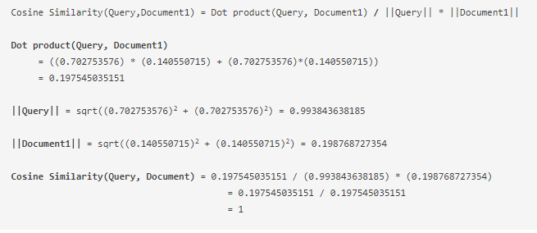
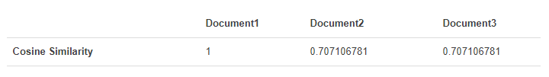

Slide 33
What is document 1?
“The game of life is a game of everlasting learning”.
It contains both words of our search string life and learning.
No surprise it is rated close!!!!

Slide 34
Linear system of equations – An example
THE BEST DEAL WHEN RENTING A CAR
One company charges $30 per day and 40 cents per mile.
Another company charges $45 per day and 30 cents a mile.
Question:
When the costs are the same?
The answer ‘d tell which would be the better deal.
Solution
Let m = total miles to be driven and
Let c1 and c2 be the total cost for each company.
C1 = 30 + 0.40 m
C2 = 45 + 0.30m
When is C1=C2? AT this distance, both rates wile be same.
This essentially means that
30 + .4*m = 45 + .3m
➔ .1m = 15
➔m = 15/.1 = 150
Cost of each company would be the same at 150 miles.
Under 150 miles, the first company is cheaper.
Above 150 miles, the second company is cheaper.

Slide 35
Linear equations in two variables
Two pencils and one eraser cost Rs. 35 and 3 pencils and four erasers cost Rs. 65. Find the cost of pencil and eraser separately.
Let the price of a pen = x
Let the price of pencil = y.
Given:
Price of 2 pens and 1 eraser = 2x + y = 35
Price of 3 pencils and 4 erasers = 3x + 4y = 65.
Now, the question is to find out the price of each pen and pencil.
Solution of the equations:
2x + y = 35
3x + 4y = 65

Slide 36
LU decomposition
Select ‘x’ term in the first equation to make the coefficients of the same term as 0 which ‘d lead to the solution of ‘x’.
Multiply the first equation by 3/2 to make the coefficient of ‘x’ as 3 which is coefficient of ‘x’ term in equation 2.
L2 – 3L1/2 -> L2
3x + 4y - (3/2)2x –(3/2)y = 65 -105/2 = 12.5 ➔ 4y – 1.5y = 12.5 ➔ y = 5
Substituting the value of y in L1, we get x= 15.
What was done?
The variable ‘x’ was chosen as ‘pivot’ variable. It was eliminated from equation L2. This process is called Lower triangularisation.
‘y’ was solved for and the value of ‘y’ was substituted to get ‘x’. This process was known as back substitution.
Essentially, by these operations we got equations in the following form
2x + y = 35
2.5y = 12.5
Writing the coefficients alone , it takes the form
1
0 2.5
A sort of upper triangular form.
After going thro the matrix definitions we will see that the operation L2 – (3/2)L1 -> L2 can be represented as multiplication by a matrix
0 2 1 2 1
-3/2 1 3 4 = 0 2.5

Slide 37




LDU decomposition
It can be verified further
;

Slide 38

Permutation matrix
Sometimes it is necessary to exchange the rows to choose the proper pivot.
Multiplication by matrices like
exchange the rows 1 and 3.
Pij is the identity matrix with I and j reversed. When it multiplies it avoids the difficulty of zero at pivot position.
The row exchanges are to be performed well in advance sothat
PA=LU

Slide 39
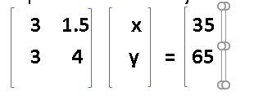
Matrices
In the previous example, we had the equations
2x +y = 35
3x + 4y = 65
Essentially, the matrices were used to solve the above type of equations1000s of year before in China
In the above problem, which combination of x and y produces a particular vector b?

Slide 40
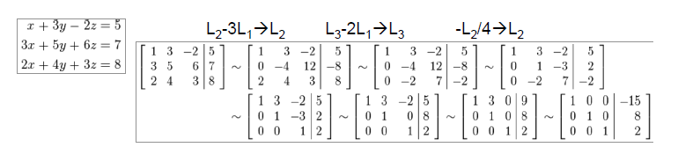
Solution of linear system of equations
Many applications can be cast into the following form

Slide 41

Matrices (cont…)
In the above example, system of linear equations are represented in the form of 2 dimensional and one dimensional arrays.
These two dimensional arrays are defined as Matrices.
Matrices are 2D array of numbers.
Each element is identified by two indices and indicated by the subscripts. (For convenience, indices are written in brackets
Example: (matrix equation)
A_{i} is ith row of the matrix A and A_{:j} denotes ‘j’th column of A.
If all Ai,j are real numbers then A ε R^{mxn}

Slide 42
Matrix form of equations
We had seen that in many applications the problem can be formulated as a set of linear system of equations like
These equationa can be written as matrix form as
A x = b where A =
In such cases x can be written as x = A⁻¹B.

Slide 43
Matrix representation of data
Data can also be represented by n X d matrix.
Here rows correspond to entities in the data set and columns represent attributes or properties of interest.
Depending on the application, the rows can be called as entities, instances, examples, records, transactions, objects, points, feature vectors, tuples.
Columns can be called as features, attributes, properties, variables, fields, and so on.
Number of rows or instances is defined as size of the data and number of columns dimensionality.
Analysis of single attribute is univariate analysis and multiple attributes is multi variate analysis.

Slide 44
Standard dataset for machine learning. The Iris data set.
For development, testing and research, there are many standard data sets made available by data science and statistics researchers.
One such data set is Iris dataset which can be downloaded.
Iris is a flower and it has the attributes
Sepal length
Sepal width
Petal length
Petal width.
Depending on different combinations of values of the above four attributes, Iris can be classified as Iris versacolor, Iris setosa, iris virjinica etc.

Slide 45
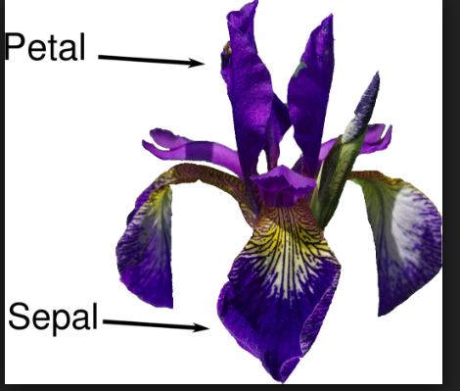
Iris flower

Slide 46
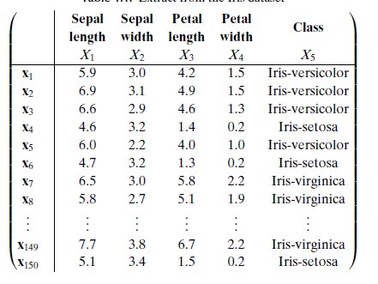
Sample Iris data set

Slide 47
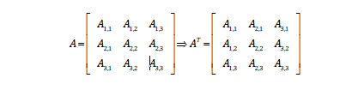
Matrix operations
Like vectors we can define the following operations.
Transpose of a matrix:
Transpose is nothing but the mirror image along the diagonal.
Transpose of a row vector is a column vector.

Slide 48
Matrix addition
If A and B have same shape (height m, width n)
then C = A+ B⇒Ci , j = Ai , j + Bi , j
A scalar can be added to a matrix or multiplied by a scalar
D = cA + b ➔ D_{i,j} = cA_{i,j} + b
Vector added to matrix (non-standard matrix algebra)
D = A + b ➔ A_{i,j} + b_{j}
– Called broadcasting since vector b is added to each row of A

Slide 49
Multiplying matrices
Let A, B and C are matrices.
If C = AB ➔ Ci , j = Ai , : (.) B: , j
This means each (i,j)th element of a product matrix C is the dot product of ‘I’ th row of A (left side) and ‘j’th column of the right side matrix B.
Example:
Let A = [x11, x12; x21 , x22] ; B = [ y11, y12; y21,y22] then

Slide 50
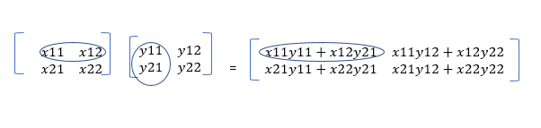
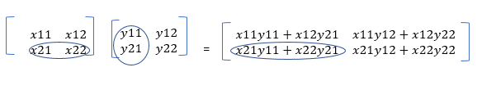
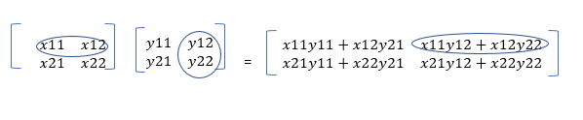
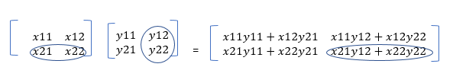
Matrix multiplication - example

Slide 51
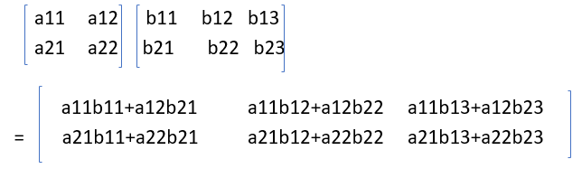
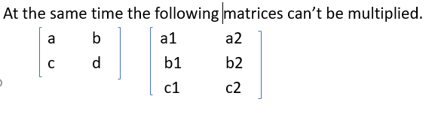
Matrix multiplication
Matrices A and B(AB) can be multiplied iff the number of columns in the left side Matrix A is equal to the number of columns of B.

Slide 52
Matrix multiplication - properties
Distributivity over addition: A(B+C)=AB+AC
• Associativity: A(BC)=(AB)C
• Not commutative: AB=BA is not always true
• Dot product between vectors is commutative:
x^{T}y=y^{T}x
• Transpose of a matrix product has a simple form:
(AB)^{T}=B^{T}A^{T}

Slide 53
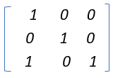
Identity matrix
Matrix inversion is a powerful tool to analytically solve Ax=b
Needs concept of Identity matrix. It should not change the matrix when it multiplies both form left or right. Such a matrix for a given order ‘n=3’ is given by
Properties of Identity matrix
Identity matrix does not change value of vector when we multiply the vector by identity matrix
Identity matrix preserves n-dimensional vectors as they are.
Formally I_{n} ε R^{nxn} .
For x ε R^{n} , I_{n} x = x ;
I_{n} A= A I_{n} = A
The inverse of the matrix A is defined as
A A⁻¹ = I.

Slide 54
Matrix inversion - Analysis
When system of equations are given as
A x = b there are two ways of solving them.
i)Finding the inverse of A. i.e.,
A⁻¹ A x = I x = A⁻¹ b.
ii) Gauss elimination
For a given matrix A, finding inverse using determinant methods is not in use.
LU decomposition can be used. (Gauss elimination).

Slide 55
Dis advantage of closed form solutions
If A⁻¹ exists, the same A⁻¹ can be used for any given b
But
A⁻¹ cannot be represented with sufficient precision
It is not used in practice
Gaussian elimination also has disadvantages
– numerical instability (division by small no.)
– O(n3) for n x n matrix
Software solutions use value of b in finding x
e.g., difference (derivative) between b and output is used iteratively cannot be represented with sufficient precision

Slide 56
Solutions for Ax = b
Let A represent the following system of equations as Ax = b
There can be three situations
There can be unique solution for ‘x’
There can be infinite solutions for ‘x’
There can be no solution for ‘x’
Note:
In no situation there can be multiple solutions between 1 and infinity. The reason is that it can be proved, if x1 is the solution and also x2, then the linear combination will also be a solution.
Can we derive conditions for the existence and uniqueness of a solution prior to going for the actual solution?

Slide 57
Vector space, span of a set of vectors
Let Ax = b where x = (x1,x2,x3)^{T}
And x1 gets multiplied by all the elements in the first column and x2 by the second etc.,
Essentially, in 3 dimensions,
A(:,1) x₁ + A(:,2) x₂ + ….+ A(:,n) x_{n} = b
Here x1, x2 …. All are scalars and A(:,1) … all are m dim vectors.
This implies that the expression in the LHS represent linear combination of vectors A(:,1), A(:,2),…, A(:,n) and if b resides in this space spanned by A(:,*) , then there exists a solution for the above system of equations.
The space spanned by the vectors A(:1) , …..and A(:,n) in the R^{n} and ‘b is inside that.
This space is known as ‘column space’ of the matrix A.
Result: The system of equations Ax=b has a solution iff ‘b’ is contained in the column space of A.

Slide 58
Solution for Ax = 0
For invertible matrices solution is that x=0.
For non square matrices there can be non zero solutions.
Example:
For non invertible (singular) matrix [ 1 2;3,6], what is the Null space?
In equation form, we have
x+2y=0;
3x + 6y =0; The second equation can be derived from the first.
The Null space is characterized by the line x+2y=0;
With one special solution other solutions can be characterized.

Slide 60
Matrix operations
Transpose
Addition
Subtraction
Scalar multiplication
Geometrical analysis of matrix operations
Determinants
Matrix product
Row and column spaces
Dimension and rank
Identity and inverse
Inverse by Gaussian elimination
Lp norm
Eigen values and Eigen vectors and Singular values and singular vectors
Eigen decomposition and singular value decomposition
Projection theorem and least squares minimization.
Gram Schmidt orthoganalisation
Applications.

Slide 61
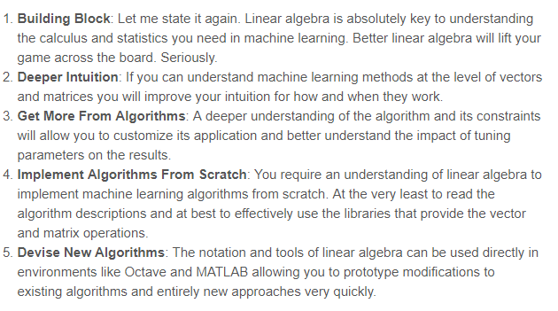

Slide 62
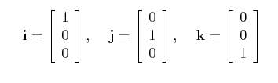
Summary: Vector space and standard basis
A 3-D vector space can be spanned by a set of orthonormal basis vectors, such as the standard basis vectors:
These basis vectors are normalized as their lengths are 1 , and they are orthogonal to each other as their products are zeros.
Let an arbitrary vector be a = xi + yj+zk.
Observe <a,i> = x; <a,j>=y; <a,k>=z

Slide 63
A 3d vector and its components
Z
Y
u
zk
yj
X
xi
Vector u = xi +yj + zk.
u can be represented as (x,y,z)^{T}
x
y
z xi , yj and zk are the components.
In other words, xi is the projection of u along X.
Another way of telling this is ‘xi’ is the best approximation of ‘u’ along X axis.
Also, xi + yj is the projection of u along XY plane.
In other words, xi + yj is the best approximation of u along XY plane.
In other words, xi + yj is the best approximation of u in the subspace XY

Slide 64
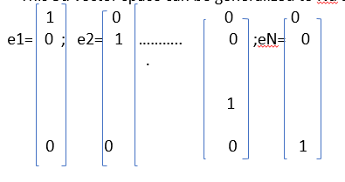

Basis vectors
The basis vectors are always orthonormal.
This 3d vector space can be generalized to N-d as follows.
An N-D vector can be always represented as
a $=\sum_{k=1}^{n}{xk ek}$ ➔ <a, $ek$ > = $xk$

Slide 65
Projections
Let p be the projection of vector b on a.
Let p = ca;
r = b-p
= b – ca
p and r are orthogonal
c = a^{T} b /(a^{T} a)
p = ca = (a^{T} b /(a^{T} a) )a
p and r are orthonormal and components of b along a and its normal.
May be p and r can serve as coordinate system. The question comes, “Given orthogonal set { u1, u2,….,uN} can we find the components of b along { ui }?”

Slide 66
Decompose a vector along an orthogonal set
A set of vectors { u₁, u₂, …,u_{k}} are said to be orthogonal iff
<u_{i},u_{j}> = 1 if i=j else 0.
Suppose S = { u₁, u₂, …,u_{k}} is an orthonormal set in R^{n} , and
W=SPAN( u₁, u₂, …,u_{k}} , Then S is a linearly independent set and therefore a basis for W.
Suppose ‘y’ is an arbitrary vector in W, then y can be written as
y = c1 u₁ + c2 u₂+ …+ ck u_{k}
Where cj = <y, u_{j} > /< u_{j,} u_{j} >

Slide 67
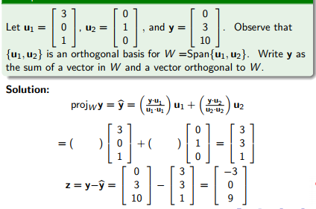
Example – orthogonal projection
y.u1 = (0,3,10 ) 3
0
1
= 0+0+10=10
U1.u1= 9+1**2+0=10;
(y.u1/u1.u1) = 1;
Sameway,
y.u2= 0+3*1+0=3; u2.u2= 1;
Y^ = 1 3 + 3 0 = 3
0 1 3
1 0 1

Slide 68
Projection on subspace
W be a subspace of R^{n} . Each y in R^{n} can be represented in
y = y^ + z where y^ is in W and z is in W’ ; W + W’ = R^{n} .
Here y = c1 u₁ + c2 u₂+ …+ ck u_{k} ; z = y – y^.
The vector y^ is called Orthogonal projection of y onto W. .

Slide 69
The final approximation result
Let W be a subspace of R^{n}. Y^ is the orthogonal projection of y onto W. Then y^ is the point in W closest to y in the sense that
|| y – y^|| < || y – v||
For all v in W distinct from y^.
||.|| indicates magnitude of the vector.
Let v in W. y^ is also in W.
➔v-y^ is in also W.
It is known that y- y^ is normal to W.
y-v = y-y^ + y^-v ➔ || y- v||² = ||y-y^||² + ||y^-v||²
(Based on Pythagoras theorem and the fact that y-y^ and y^-v are normal to each other.)
➔ ||y-y^||² < || y- v||² .

Slide 70
Illustration – Projection theorem
Z
Y
y
y-v
y-y^
v
y^
X
Here XY plane is a subspace of XYZ space.
y^ is the projection of vector y along XY plane.
y^ is obtained by projecting y on XY. Hence the angle between y^ and the normal is 90 degrees.
By triangle law, the normal from y to XY plane is y-y^.
Qn: Is there any other vector v in XY plane such that ||y-v|| is less than ||y-y^||?
Let there be a vector ‘v’ on XY plane.
Then y-v = y - y^ + y^ - v (Adding and subtracting y^)
y-y^ is normal to XY plane ➔ y-y^ is orthogonal to v-y^ since since v and y^ are in XY plane.
||y-v||² = || y- y^||² + ||y^ -v||^{2.} ; ➔ ||y-v||² > || y- y^||^{2 .}

Slide 71
Generation of orthogonal basis based on given set of vectors
Given a vector u and another vector v1, u can be decomposed along u and normal to u as (parallel) and normal.
➔ u = |u|cos(ϴ ) v1 + |u|cos(ϴ ) Normal(v1).
Hence, to get the normal component, subtract the projection from the original. (Remove the parallel from the original(vector addition.)
Get the normal one. Repeat.
u
u
|ucos(ϴ)|.v1
ϴ

Slide 72
Orthogonal system
Z
Y
u1
u2
v1
X
v2
u2 – (<v1,u2>/<v1,v1>) v1 (Component along u1 is removed.
The normal component remains)

Slide 73
Construction of 3rd normal from {u1,u2,u3}
Suppose S = { u₁, u₂, …,u_{k}} is an orthonormal set in R^{n} , and
W=SPAN( u₁, u₂, …,u_{k}} , Then S is a linearly independent set and therefore a basis for for W.
Suppose ‘y’ is an arbitrary vector in W, then y can be written as
y = c1 u₁ + c2 u₂+ …+ ck u_{k}
Where cj = <y, u_{j} > /< u_{j,} u_{j} >
W be a subspace of R^{n} . Each y can be represented in
y = y^ + z where y^ is in W and z is in W’ ; W + W’ = R^{n} .
Here y = c1 u₁ + c2 u₂+ …+ ck u_{k} ; z = y – y^.
Z
Y
u3
u1
u2
v1
X
v2
u2 – (<v1,u2>/<v1,v1>) v1 (Component along u1 is removed.
The normal component remains)
Project u3 on the subspace spanned by v1 and v2. Subtract the projection
From the original to get the 3rd normal.

Slide 74
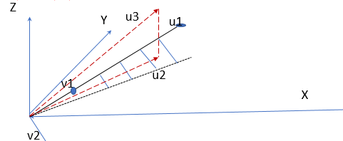
u= xcos( ) i+ y sin()j.
If we substract cos() term from u, we are left with the normal component.

Slide 75
Orthogonolization
Question:
Given a set of vectors { u1,u2,u3,….} not necessarily orthogonal, can we construct an orthonormal basis from them?
We can start with some u1.
When we take u2, we can project u2 on u1. The normal component would form the second basis.
Take u3. Find the projections along u1 and u2 and subtract them from u3.

Slide 76
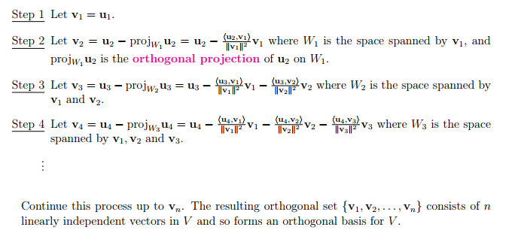
Orthogonalization algorithm

Slide 77
Description of the idea
Start with a vector.
Two vectors form a 2 dimensional subspace(plane).
Hence, the second step is to identify 2 orthonormal vectors one along the given starting vector u1 =v1 and other is to be normal to u1 but in the same plane as that of u2.
It is known that u2 – (<v1,u2>/<v1,v1>) v1 is in the same plane (subspace) where u2 lies and normal to u1. Hence the second vector is generated which is normal to first vector and the subspace contains both vectors.
Now, the third vector u3. If we project u3 on the plane containing v1 and v2, the difference vector would be normal to the plane containing v1 and v2 and thus we will be getting the 3rd one.
The normal vector (difference between u3 and projection on the plane containing u1 and u2 (equivalent to y-y^ before) is given by
u3 – ( ( <v1,u3>/<v1,v1>) v1 + (<v2,u3>/<v2,v2>) v2 )
This process can be repeated.

Slide 78
Linear algebra

Slide 79
Determinants

Slide 80
Determinants
A linear transformation T: R^{n} -> R^{m} is a mapping from n dimensional space to m dimensional space.
If T: R^{n} -> R^{n} then T can be represented by a square matrix.
Once can define a determinant associated with the square matrix which gives an idea of the geometrical properties of the transformation essentially the magnitude and the orientation.
Essentially determinants are defined with respect to an array of vectors. If the arrays refer to the sides of a parallelogram or parallelepipeds then the determinant give the area or volume as per the case.
The determinant expressions (or expansions) were defined based on the computational procedures for the areas and volumes of parallelograms or parallelepipeds.

Slide 81
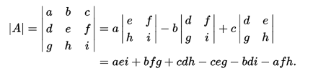
Computation of the value of a determinant
The determinant of a matrix A is denoted det(A), det A, or | A |.
It can be viewed as the scaling factor of the transformation described by the matrix.
For a matrix A=[a b;c d], the determinant is given by
a b
c d
Area of the parallelogram with (a,b), (c,d) as adjacent.
Det
= ad-bc
Volume of the parallelepiped with (a,b,c), (d,e,f) and (g,h,j) as adjacent.
These concepts led to the development of ‘theory of determinants’.
The area covered depends on the ‘normal’ components of vectors. Hence, determinant concept is closely related to vector cross product.

Slide 82
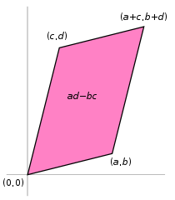

Areas and volumes – Parallelograms and parallelepipeds
Consider a parallelogram in which (a,b) and (c,d) are the adjacent sides.
The area is given by ad-bc
Given the vectors a and b, consider
|a||b|Sin(ϴ ). ϴ is to be measured in a particular way (from a to b.)
This is defined as vector product (a X b = ab(sin(ϴ)) which is base times the height.
Now, if we consider, b X a = |b||a|Sin(- ϴ) = - |a||b|sin(ϴ) = -(a X b)
Check the fact: If a = (a,b) then normal(a) = ( -b, a) ; it can be verified by evaluating (a,b).(-b,a)
Based on the above arguments, any area can be associated with orientation or ‘direction’.

Slide 83
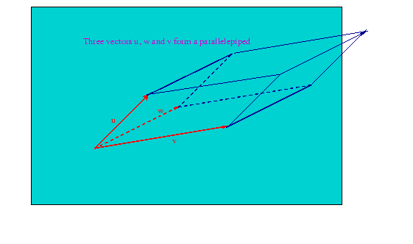
Volumes of parallelepipeds and Determinants
The parallelogram is obtained by subtracting four triangles from a rectangle. Thus, area of the parallelogram = (a + b)(c + d) - ….
= ad - bc.
A new operation called determinant is defined to denote ad-bc given (a, b), (c,d) as sides of a parallelogram.
By analyzing the volume of various polytopes (parallelepipeds), the notion of determinants was generalized.
The volume of the parallelepiped is given by the determinant A where A contains the sides.

Slide 84
3dimensional determinant
The volume of the 3 dimensional parallelepiped with sides (a,b,c), (d,e,f),(g,h,i) is given by the expression
aei + bfg + cdh – ceg – bdi-afh
=a(ei –fh) –b(di – fg) + c(dh – eg)
= a.(area of the parallelogram with sides ( (e,f), (h,i)) –b . (area of the parallelogram with sides (d,f), (g,i)) +
c ( area covered by (d,h),(e,g)).
These formulas could be generalized for ‘N’ dimensions.
In other words, for N dimensional parallelepiped, the volume can be computed by generalizing the above expressions.

Slide 85

Determinant derivation
Consider a parallelogram in which (a,b) and (c,d) are the adjacent sides.
The area is given by ad-bc.
An operator called determinant is defined in terms of (a,b), (c, d) as ad – bc.
Sameway, the volume of the parallelepiped with sides (a,b,c), (d,e,f),(g,h,i) is given by
aei + bfg + cdh – ceg – bdi-afh
This leads to the following.

Slide 86
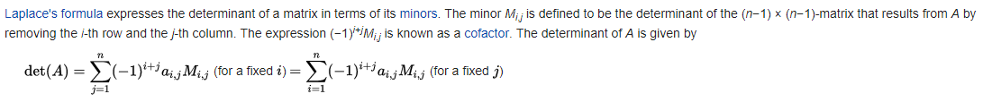
A few definitions: Minor, cofactor, ad joint, inverse (w.r.t. square Matrices)
Minor:
Let Mij (A) (or simply Mij if there is no ambiguity) denote the determinant of the (n − 1) × (n − 1) submatrix of A formed by deleting the i–th row and j–th column of A. (Mij (A) is called the (i, j) minor of A.)
Example: a1 a2 a3 M12 is given by
b1 b2 b3 b1 b3
c1 c2 c3 c1 c3

Slide 87
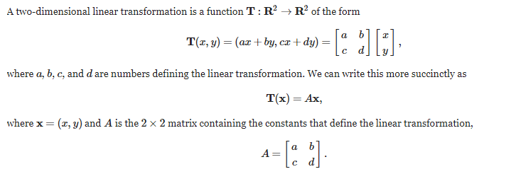
Determinant as a property of transformation

Slide 88
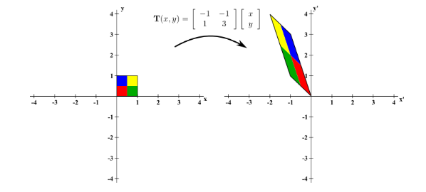
Property of linear transformation as expressed by the determinant – Orientation and magnification

Slide 89
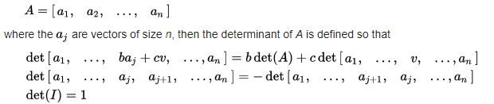
Computation of the value of a determinant
Set of properties

Slide 90
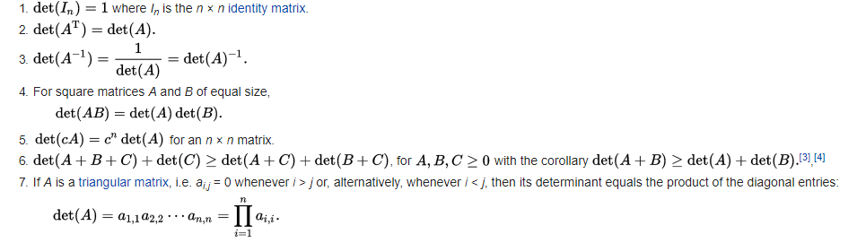
Properties useful in the computation

Slide 91
Determinant properties
If one column of a matrix A is written as a sum v + w of two column vectors, and all other columns are left unchanged, then the determinant of A is
“the sum of the determinants of the matrices obtained from A by replacing the column by v and then by w (and a similar relation holds when writing a column as a scalar multiple of a column vector).”
If in a matrix, any row or column has all elements equal to zero, then the determinant of that matrix is 0.
Determinants – linear dependence – Solution of linear system of equations:
Whenever two columns of a matrix are identical, or more generally some column can be expressed as a linear combination of the other columns (i.e. the columns of the matrix form a linearly dependent set), its determinant is 0.

Slide 92
Properties of determinants – cont……
Interchanging any pair of columns or rows of a matrix multiplies its determinant by −1. More generally, any permutation of the rows or columns multiplies the determinant by the sign of the permutation. By permutation, it is meant viewing each row as a vector R_{i} (equivalently each column as C_{i}) and reordering the rows (or columns) by interchange of R_{j} and R_{k} (or C_{j} and C_{k}), where j,k are two indices chosen from 1 to n for an n × n square matrix.
Adding a scalar multiple of one column to another column does not change the value of the determinant.

Slide 93
Determinant to study the effect of transformation.

Slide 94
Determinant - orientation and magnification
The determinant of the matrix [-1 -1; 1 3] operates on 4 points (0,0),(1,0),(0,1),(1,1).
It could be seen that the magnitude of the determinant indicates the magnitude of the transformation.
The sign of the determinant indicates the orientation of the output area.
There may be dimensional reduction. That case happens if the matrix contains columns are linearly dependent .

Slide 95
Determinant and rank
Following are equivalent
The determinant of a matrix (square) is zero.
The matrix is of lower rank.
The matrix has linearly dependent columns/rows.
Atleast, one Eigen value is zero
The matrix does not have the inverse

Slide 96
Determinants for solving Ax=0;
Example:
2x + 3y = 8;
3x –y = 1;
Matrix representation:
2 3 x 8
3 -1 y = 5
Cramer’s rule is used to solve the equations. The rule is (in two dimensions). The rule says,
X = y = 1 ➔ x/-11 = y/-22 = 1/ -11
8 3 2 8 2 3 ➔ x=1; y = 2;
1 -1 3 1 3 -1

Slide 97
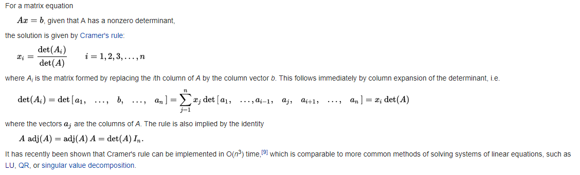
Solution of linear system using determinant

Slide 98
Solution of linear equations with determinants
Example:
2x + 3y = 8;
3x –y = 1;
Matrix representation:
2 3 x 8
3 -1 y = 5
Cramer’s rule is used to solve the equations. The rule is (in two dimensions). The rule says,
X = y = 1 ➔ x/-11 = y/-22 = 1/ -11
8 3 2 8 2 3 ➔ x=1; y = 2;
1 -1 3 1 3 -1

Slide 100
Multiple solutions
Consider an example:
For non invertible (singular) matrix [ 1 2;3,6], what is the Null space?
In equation form, we have
x+2y=0;
3x + 6y =0;
The second equation can be derived from the first.
The Null space is characterized by the line x+2y=0;
With one special solution other solutions can be characterized.

Slide 101
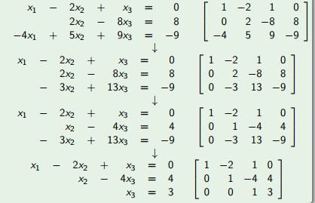
Revisit linear system of equations (Unique solution)

Slide 102
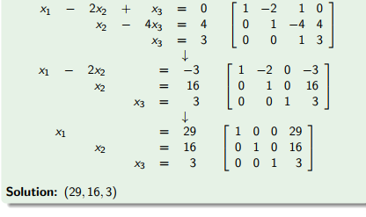
Complete solution by Row operations

Slide 103
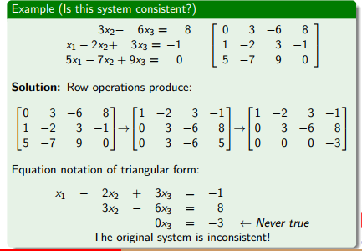
Example for inconsistency

Slide 104
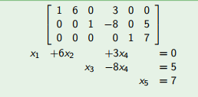
Multiple solutions
Consider a system of equations:
Out gut feeling says that there are infinite solutions.
Is there any systematic way of characterizing the solutions?
In summary, from the given system of equations, can we answer the following?
Is there a solution? (Inconsistency among the equations)
Is there a unique solution? If so how to arrive at?
If there are multiple solutions how to parametrize them?

Slide 105
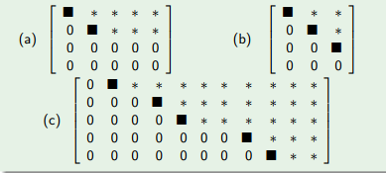
Certain definitions – Row echelon form
Row echelon form
All Nonzero rows are above any rows of all zeros.
Each leading entry (i.e. left most nonzero entry) of a row is in a column to the right of the leading entry of the row above it.
All entries in a column below a leading entry are zero.

Slide 106
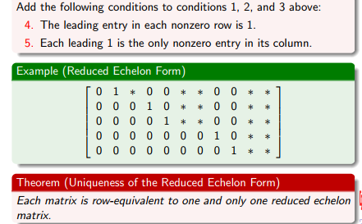
Reduced row echelon form

Slide 107
Some more definitions
Pivot position:
a position of a leading entry in an echelon form of the matrix.
Pivot:
a nonzero number that either is used in a pivot position to create 0’s or is changed into a leading 1, which in turn is used to create 0’s.
Pivot column: a column that contains a pivot position.

Slide 108
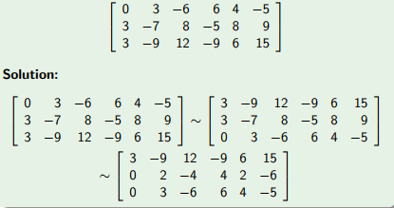
Example – Reduced echelon form
Suppose the equations are
3x2 -6x3 +6x4 +4x5 = -5;
3x1 -7x2+8x3-5x4+8x5=9;
3x1-9x2+12x3-9x4+6x5=15; Form the augmented matrix as shown below.

Slide 109
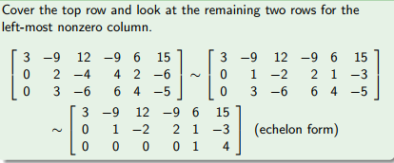

Slide 110
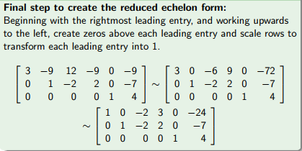


Slide 111

Conclusion

Slide 112

Final step

Slide 113
Rank of a matrix
The maximum number of linearly independent vectors in a matrix is equal to the number of non-zero rows in its row echelon matrix.
Therefore, to find the rank of a matrix, we simply transform the matrix to its row echelon form and count the number of non-zero rows.

Slide 114

Some more interpretations
Row space
The set of all linear combinations of the row vectors of a matrix A is called the row space of A and is denoted by Row A.

Slide 115

If two matrices A and B are row equivalent, then their row spaces are the same. If B is in echelon form, the nonzero rows of B form a basis for the row space of A as well as B.
Analyze the following.
The rank is 2.
This can be confirmed by looking at independent columns and also from the Row echelon form.

Slide 116


Null space of A
From the Echelon form we get
x1-3x3—6x4 =0;
➔ x1=3x3+6x4;
Also x2 = 0;
Then the set of solutions can be written as
3x3 + 6x4
0
x3
x4
Here x3, x4 can take arbitrary values in R. Then the basis can be written as linear combinations of all ‘a’ and ‘b’ such that (3a+6b,0,a,b).Hence the basis was written as { Trans(3,0,1,0 ), trans(6,0,0,1)}

Slide 117


Rank theorem

Slide 118



