Slide 1

EDA on IMDB Dramas

Slide 2

Name : Subhadra Bhupathiraju
Education : Masters Control Engineering
Why Data Science?
Non-linear control and Neural Control created the spark of machine learning and now
Data Science and Machine learning makes the application part of it possible so want
to up skill to be a future Data Scientist
Experience: IT experience as Business Analyst of more than 7 years

Slide 3
Business Problem:
Analyzing what kind of Dramas are popular with Users and Critics
Objective:
Collect data from IMDB which is a reliable ratings website and perform
Exploratory Data Analysis on the collected Data
Website used: www.imdb.com
Primary Genre selected: Romance, Comedy
Primary selection criteria: Most number of user votes
Data Collected: Top 500 Dramas

Slide 4
Webscraping Process:
Used requests and BeautifulSoup modules to read data from website
Used Regex and Python with Numpy and Pandas for Data Collection
Features collected are: title, year_start, year_end, certificates, runtime, genre, rating, votes, gross, metascore, stars, director
Features were collected for 10 pages containing 50 data each to create 500 rows of data with 12 features.
Formatted the collected data and created a dictionary and used this to create a Data Frame
The Columns were named appropriately as Title, Start, End, Certificate, Runtime, Genre, Rating, Votes, Gross, Metascore, Director, Stars
After Webscraping we have a 500 rows x 12 columns DataFrame.
Exported this Data Frame in to a .csv file.
Data Collection Done

Slide 5
Data Before Cleaning
 | Title | Start | End | Certificate | Runtime | Genre | Rating | Votes | Gross | Metascore | Director | Stars
0 | Friends | 1994 | 2004 | 13+ | 22 min | Comedy,Romance | 8.9 | 10,03,700 | NaN | NaN | NaN | Stars:Jennifer Aniston, Courteney Cox, Lisa Ku...
1 | The Big Bang Theory | 2007 | 2019 | U | 22 min | Comedy,Romance | 8.2 | 8,14,328 | NaN | NaN | NaN | Stars:Johnny Galecki, Jim Parsons, Kaley Cuoco...
2 | Le fabuleux destin d'Amélie Poulain | 2001 | 2001 | U | 122 min | Comedy,Romance | 8.3 | 7,60,481 | $33.23M | 69 | Director:Jean-Pierre Jeunet | Stars:Audrey Tautou, Mathieu Kassovitz, Rufus,...
3 | Silver Linings Playbook | 2012 | 2012 | A | 122 min | Comedy,Drama,Romance | 7.7 | 7,13,756 | $132.09M | 81 | Director:David O. Russell | Stars:Bradley Cooper, Jennifer Lawrence, Rober...
4 | La vita è bella | 1997 | 1997 | U | 116 min | Comedy,Drama,Romance | 8.6 | 6,98,695 | $57.60M | 59 | Director:Roberto Benigni | Stars:Roberto Benigni, Nicoletta Braschi, Gior...
... | ... | ... | ... | ... | ... | ... | ... | ... | ... | ... | ... | ...
495 | Laggies | 2014 | 2014 | R | 99 min | Comedy,Drama,Romance | 6.4 | 44,607 | $0.44M | 63 | Director:Lynn Shelton | Stars:Keira Knightley, Chloë Grace Moretz, Sam...
496 | Ugly Betty | 2006 | 2010 | NaN | 60 min | Comedy,Drama,Romance | 6.7 | 44,454 | NaN | NaN | NaN | Stars:America Ferrera, Eric Mabius, Tony Plana...
497 | Arizona Dream | 1993 | 1993 | UA | 142 min | Comedy,Drama,Fantasy | 7.2 | 44,251 | $0.11M | 62 | Director:Emir Kusturica | Stars:Johnny Depp, Jerry Lewis, Faye Dunaway, ...
498 | Cougar Town | 2009 | 2015 | NaN | 22 min | Comedy,Romance | 7 | 44,083 | NaN | NaN | NaN | Stars:Courteney Cox, Christa Miller, Busy Phil...
499 | Vicky Donor | 2012 | 2012 | UA | 126 min | Comedy,Romance | 7.8 | 43,889 | $0.17M | NaN | Director:Shoojit Sircar | Stars:Ayushmann Khurrana, Yami Gautam, Annu Ka...
500 rows × 12 columns

Slide 6
DATA CLEANING
Used Python along with Numpy and Panda for data cleaning. Process followed is:
Imported the Data Frame created previously from .csv file
Dropped the invalid and unnecessary columns
Removed Special Characters
Handled the missing values
Edited the data to match the desired data types
Corrected the Data types of the columns
Result is a Clean Data.

Slide 7
Clean Data
 | Title | Start | End | Certificate | Runtime | Genre | Rating | Votes | Gross | Metascore | Director | Stars
0 | Friends | 1994 | 2004 | 13+ | 22 | Comedy,Romance | 8.9 | 1003700 | 40.57 | 56 | None | Stars:Jennifer Aniston, Courteney Cox, Lisa Ku...
1 | The Big Bang Theory | 2007 | 2019 | U | 22 | Comedy,Romance | 8.2 | 814328 | 40.57 | 56 | None | Stars:Johnny Galecki, Jim Parsons, Kaley Cuoco...
2 | Le fabuleux destin d'Amélie Poulain | 2001 | 2001 | U | 122 | Comedy,Romance | 8.3 | 760481 | 33.23 | 69 | Director:Jean-Pierre Jeunet | Stars:Audrey Tautou, Mathieu Kassovitz, Rufus,...
3 | Silver Linings Playbook | 2012 | 2012 | A | 122 | Comedy,Drama,Romance | 7.7 | 713756 | 132.1 | 81 | Director:David O. Russell | Stars:Bradley Cooper, Jennifer Lawrence, Rober...
4 | La vita è bella | 1997 | 1997 | U | 116 | Comedy,Drama,Romance | 8.6 | 698695 | 57.6 | 59 | Director:Roberto Benigni | Stars:Roberto Benigni, Nicoletta Braschi, Gior...
... | ... | ... | ... | ... | ... | ... | ... | ... | ... | ... | ... | ...
495 | Laggies | 2014 | 2014 | R | 99 | Comedy,Drama,Romance | 6.4 | 44607 | 0.44 | 63 | Director:Lynn Shelton | Stars:Keira Knightley, Chloë Grace Moretz, Sam...
496 | Ugly Betty | 2006 | 2010 | U | 60 | Comedy,Drama,Romance | 6.7 | 44454 | 40.57 | 56 | None | Stars:America Ferrera, Eric Mabius, Tony Plana...
497 | Arizona Dream | 1993 | 1993 | UA | 142 | Comedy,Drama,Fantasy | 7.2 | 44251 | 0.11 | 62 | Director:Emir Kusturica | Stars:Johnny Depp, Jerry Lewis, Faye Dunaway, ...
498 | Cougar Town | 2009 | 2015 | U | 22 | Comedy,Romance | 7 | 44083 | 40.57 | 56 | None | Stars:Courteney Cox, Christa Miller, Busy Phil...
499 | Vicky Donor | 2012 | 2012 | UA | 126 | Comedy,Romance | 7.8 | 43889 | 0.17 | 56 | Director:Shoojit Sircar | Stars:Ayushmann Khurrana, Yami Gautam, Annu Ka...
500 rows × 12 columns

Slide 8
Data Analysis and Visualization (EDA)
Data Analysis is done Visually by using Matplotlib and Seaborn libraries
Data Analysis is also done using Group by, Crosstab and Pivot tables to get better understanding of data
We have both Numerical and Categorical Data and we will Analyse them visually using various charts.
By Visualization of data we will get better understanding on the popular Genre and Certificate
Once we are done with Analysis we can provide the recommendations to the client on what sector of audience to target for future dramas.

Slide 9
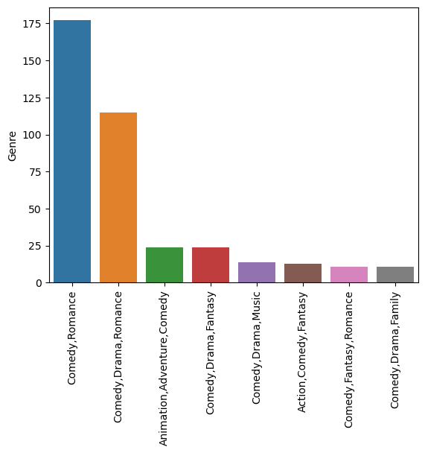
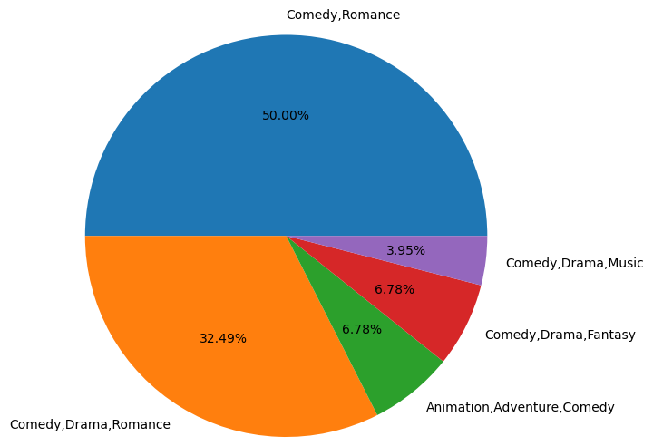
Genre Analysis
Interpretation
"Comedy,Romance" and "Comedy,Drama,Romance" comprise most of the data i.e. more than 82%
None of the other genres have much presence
We can say that people appreciate mainly these 2 genres so new dramas need to focus on these genres

Slide 10
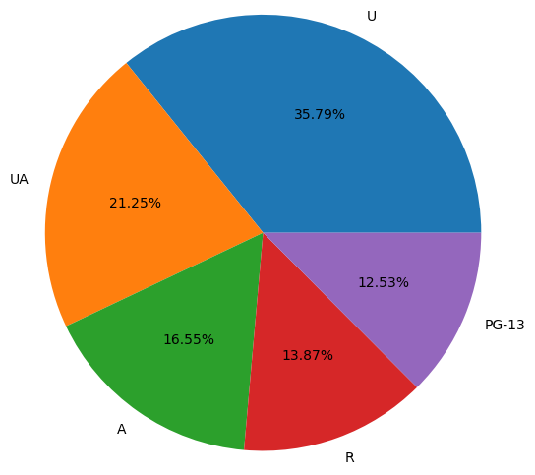
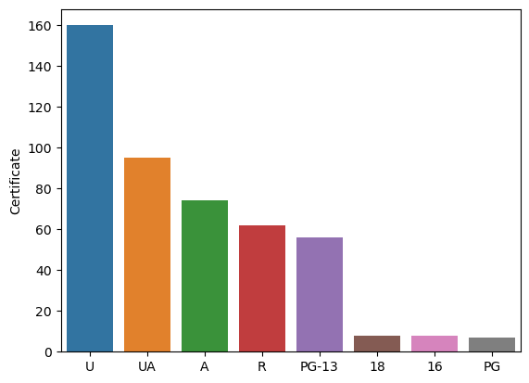
Certificate Analysis
Interpretation from Analysing top 5 Certificate:
Family friendly dramas comprise most of the data i.e. more than 65%
There is some presence of Adult rated dramas but it is less compared to Family friendly dramas
We can see where the people appreciation lies and need to focus on these kind of dramas.
# In Romance Comedy most appreciated dramas are family friendly dramas (U,UA,PG-13 etc) compared to A or R or other certified ones
# Family friendly dramas comprise of more than 65% of dramas

Slide 11
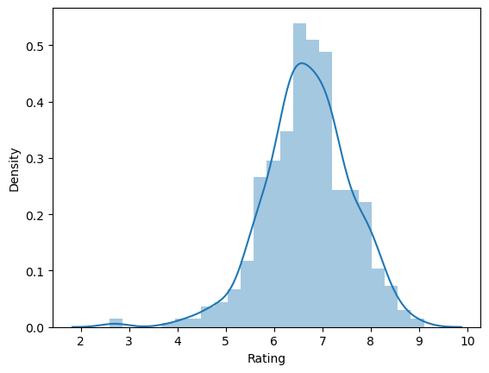
Rating Analysis
Interpretation :
Since the data we have chosen has maximum number of votes and from the graph we observe that
density of Rating between 6-8 is high, so most of ratings are above average.
So we can interpret that people tend to vote when they like a drama rather than when they don’t like it

Slide 12
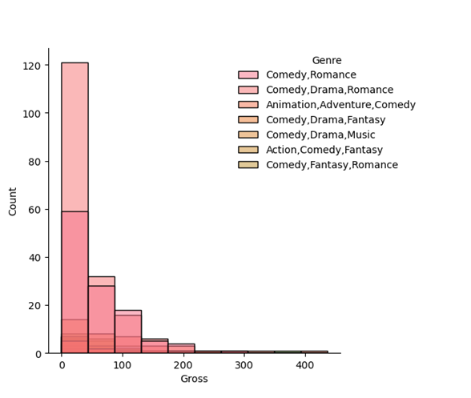
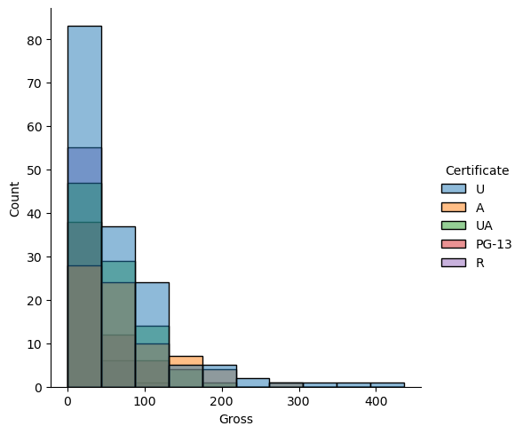
Analysis of Gross with respect to Certificate and Genre
Interpretation
Gross values exist mainly for Family Dramas with Romance Comedy or Drama added to this genre.

Slide 13
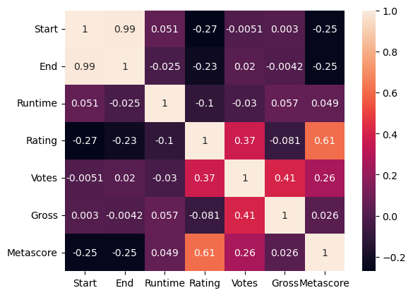
Analysis of Correlation between the Numerical data
Interpretation is Maximum Correlation exists between:
Metascore vs Rating
Gross vs Votes
Votes vs Rating

Slide 14
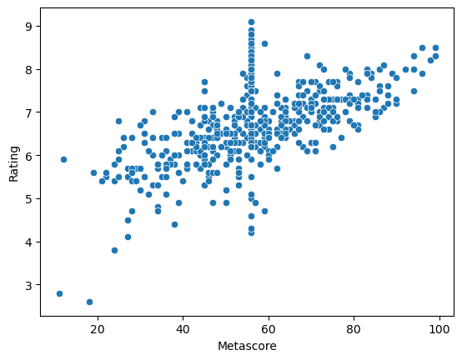
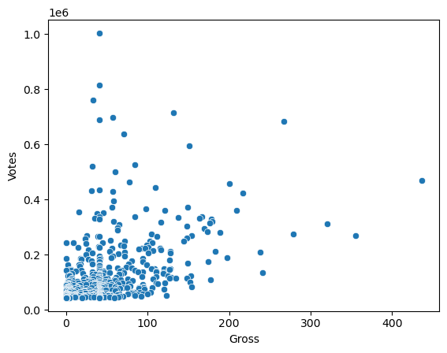
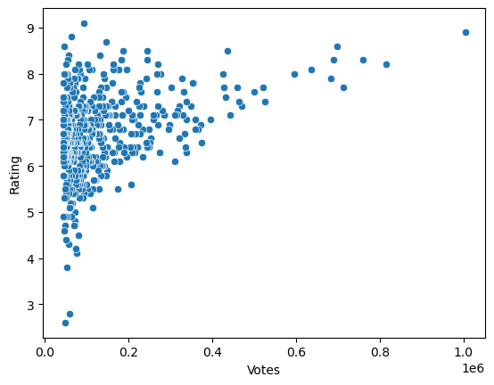
Analysis on Correlation
Interpretation
Metascore and Rating have a high positive correlation which infers that user and critic ratings are in sync for most of the cases
Gross and Votes have a positive correlation so Gross of dramas is more when there are more number of votes
Votes and Rating have a positive correlation so Ratings of dramas are more when there are more votes

Slide 15
Genre vs Certificate Analysis
Genre | Comedy,Drama,Fantasy | Comedy,Drama,Music | Comedy,Drama,Romance | Comedy,Romance | Total
Certificate
A | 3 | 2 | 28 | 26 | 59
PG-13 | 3 | 3 | 19 | 11 | 36
R | 5 | 2 | 30 | 7 | 44
U | 5 | 2 | 45 | 24 | 76
UA | 6 | 2 | 37 | 31 | 76
Total | 22 | 11 | 159 | 99 | 291
Interpretation
We observe that count is high for "Comedy,Drama,Romance" and "Comedy,Romance" in Genre and "U" "UA" and “PG-13” in Certificate

Slide 16
Votes for Genre vs Certificate Analysis
Certificate | A | PG-13 | R | U | UA
Genre
Comedy,Drama,Fantasy | 191206.3333 | 139450.6667 | 90997.6 | 219888.6 | 112937.1667
Comedy,Drama,Music | 376933 | 78913 | 131043 | 50088 | 86941.5
Comedy,Drama,Romance | 207032.6071 | 75458.10526 | 94415.66667 | 127990.7333 | 129236.7838
Comedy,Romance | 163267.6154 | 88501.36364 | 65402.28571 | 163503.125 | 141397.1613
Interpretation
We observe that the votes are good across all the Popular Genre and Certificate, but since the count of Dramas from previous table is more for "Comedy,Drama,Romance" & "Comedy,Romance" and Certificate "U", "UA" and "PG-13"
We can conclude that this combination is the most popular

Slide 17

Conclusion
From the data collected and Analysed we conclude that in dramas most
Popular are Family Certificate dramas in Romance Comedy or Romance
Drama Comedy genres.
These get the best votes and critic and user ratings
So they are the safe bet money wise

Slide 18


Slide 19

THANK YOU

