Slide 1
VISION-LANGUAGE PROTOTYPE
IMAGE - TO - TOPIC
CLASSIFICATION
KASHISH BISHNOI (2304025)
VAASAV DUHARIA (2330053)
ABHYUDAYA MISHRA (2330059)
SHUBBAN SUNDAR (2330268)
From uploaded image to topic, keywords, and profession context using CLIP, FLAN-T5, and Flask.

Slide 2
PROBLEM STATEMENT
- Manual identification and categorization of images is time-consuming and inefficient.
- Traditional image classification systems often require labelled datasets and task-specific training.
- Images alone do not provide easily accessible textual information about their subjects.
- There is a need for an automated system that can classify images into relevant topics and generate meaningful supporting information.
**Proposed Solution:** Develop an AI-based Image-to-Topic Classification System using CLIP for zero-shot classification and FLAN-T5 for keyword generation, integrated through a Flask-based web application.

Slide 3

THE DEMO OUTPUT
One upload becomes an interpretable result
01
Input
A user-selected image in a browser.
02
Output
One topic, a normalized similarity score, five keywords, and a short profession description.
03
Scope
Farming, Education, Healthcare, Tourism, and Transportation.
02

Slide 4
USER JOURNEY
The demo workflow hides the model complexity
1
2
3
Select
Receive
Explain
Select an image and click Classify Image.
Flask receives and safely stores the upload.
The system predicts a topic, enriches it with language, and renders the result page.
03

Slide 5
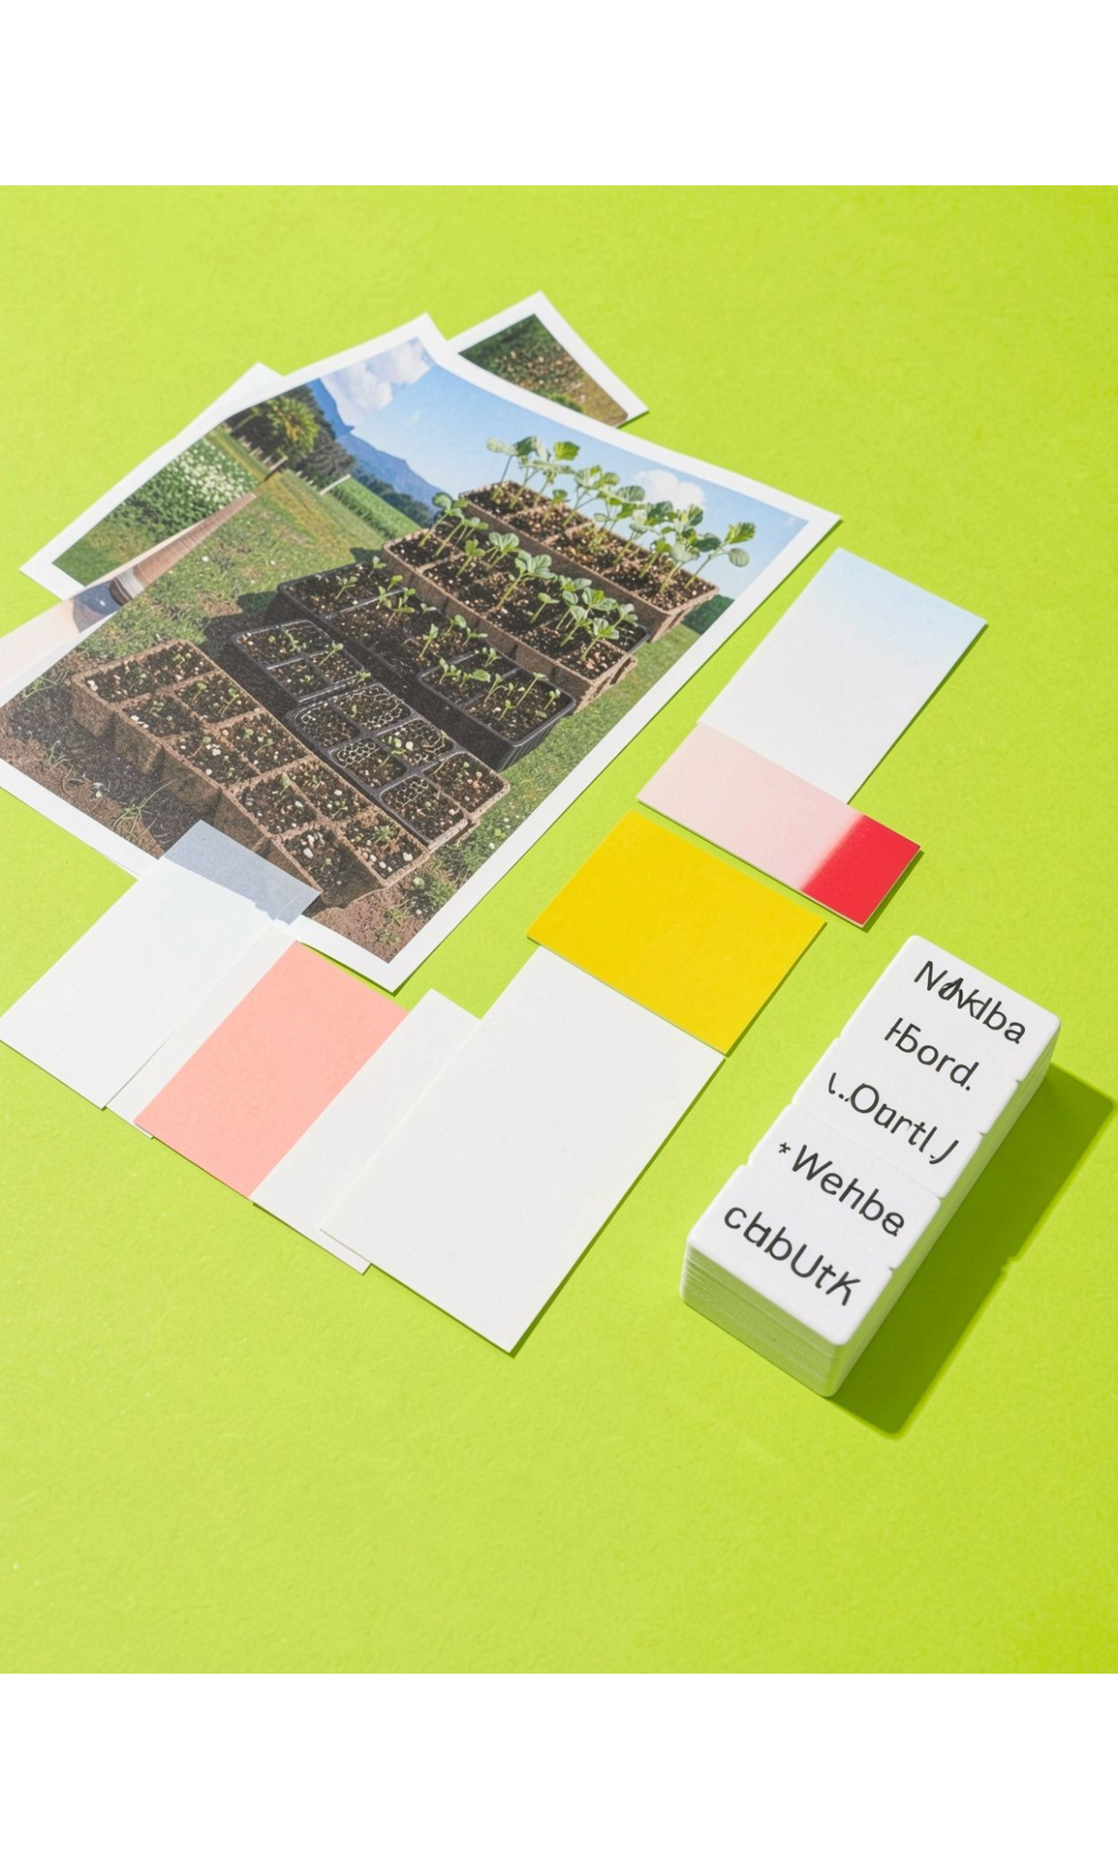
PROCESSING PIPELINE
The pipeline turns vision into context
Upload image and convert it to RGB.
CLIP compares the image with five natural-language category prompts.
Select the highest-ranked topic from the similarity scores.
FLAN-T5 generates five keywords from the predicted topic.
A predefined mapping adds profession context before results are displayed.
04

Slide 6



MODEL MECHANISM
CLIP enables zero-shot topic classification
Image encoder
Shared space
Top match
The project uses openai/clip-vit-base-patch32 in inference mode.
Image and text encoders create representations in a shared space.
The highest similarity among the five prompts becomes the predicted category.
05

Slide 7
APPLICATION ARCHITECTURE
FLAN-T5 enriches the result inside a simple Flask app
Generated keywords are parsed, deduplicated, and supplemented with fallback terms when needed
Flask coordinates upload handling, validation, inference, and result rendering
HTML and CSS organize the topic, score, keywords, and description into readable result cards
The layered design separates
presentation
application logic
AI inference
content
storage
06

Slide 8
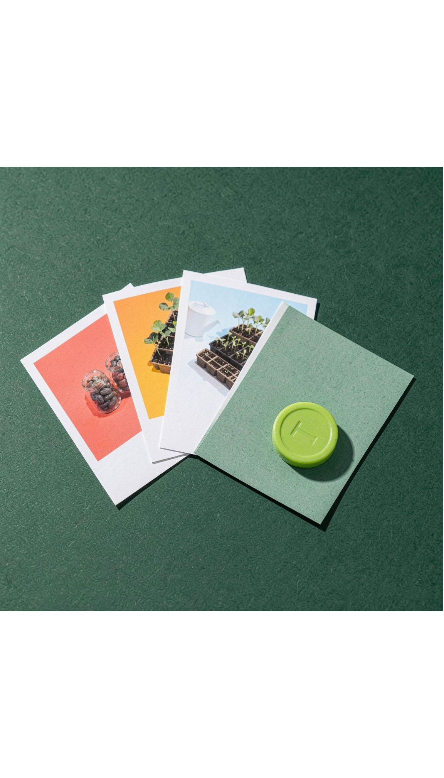
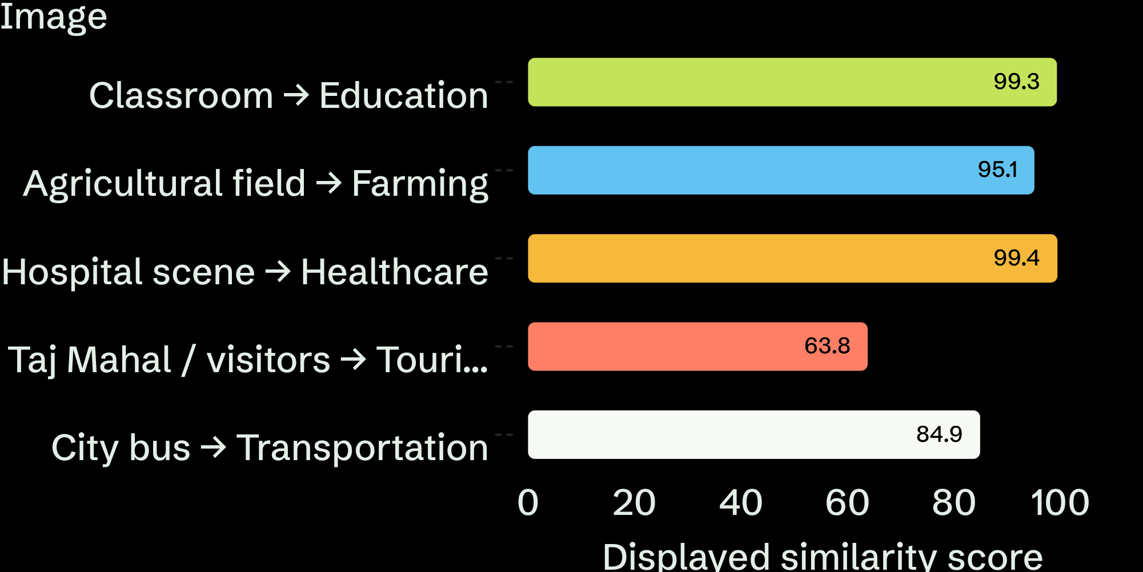
SAMPLE OUTPUTS
Five demonstration images produced five top-ranked topics
These are normalized similarity scores reproduced from the supplied application outputs, not measured accuracy.
07

Slide 9
EVALUATION BOUNDARY
The key evaluation lesson: similarity is not accuracy
99.39%
≠
What the score means
What it does not mean
A selected class’s share of the normalized similarity distribution for that image and candidate set.
It does not mean 99.39% of all images will be classified correctly.
Formal evaluation requires a labelled dataset, repeatable prompts, and metrics such as accuracy, precision, recall, F1-score, confusion matrix, latency, and keyword validity.
08

Slide 10
RECOMMENDED NEXT STEPS
What the prototype can do next
01
02
Broaden the scope
Test systematically
Expand beyond five broad topics and add an unknown / out-of-scope class.
Compare checkpoints and prompt ensembles on a labelled dataset.
03
04
Enrich access
Harden deployment
Add image captioning, richer language generation, multilingual support, and mobile access.
Deploy with HTTPS, monitoring, model caching, and explicit privacy controls.
09

Slide 11
CONCLUSION
Upload. Classify.
Enrich. Explain.
The project demonstrates a complete vision-language application while keeping its evidence and limitations visible.
Pretrained models
Separated architecture
Next credibility step
Reduce the need to train a classifier from scratch.
Interface, inference, content, and storage concerns stay distinct.
Systematic evaluation beyond screenshots.
10

