Slide 1
Image Stegnography

Slide 2
Introduction
Steganography is the practice of concealing a message within another message or a physical object. In computing/electronic contexts, a computer file, message, image, or video is concealed within another file, message, image, or video
How is steganography used today?
In modern digital steganography, data is first encrypted or obfuscated in some other way and then inserted, using a special algorithm, into data that is part of a particular file format such as a JPEG image, audio or video file. The secret message can be embedded into ordinary data files in many different ways. One technique is to hide data in bits that represent the same color pixels repeated in a row in an image file. By applying the encrypted data to this redundant data in some inconspicuous way, the result will be an image file that appears identical to the original image but that has "noise" patterns of regular, unencrypted data.

Slide 3
Encoding Decoding
Binary Encoding – text -> ASCII value ->binary
Binary Decoding – binary -> ASCII value -> text
ASCII Encoding – text-> ASCII array
ASCII decoding -> ASCII array ->text

Slide 4
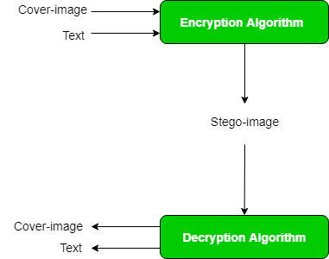
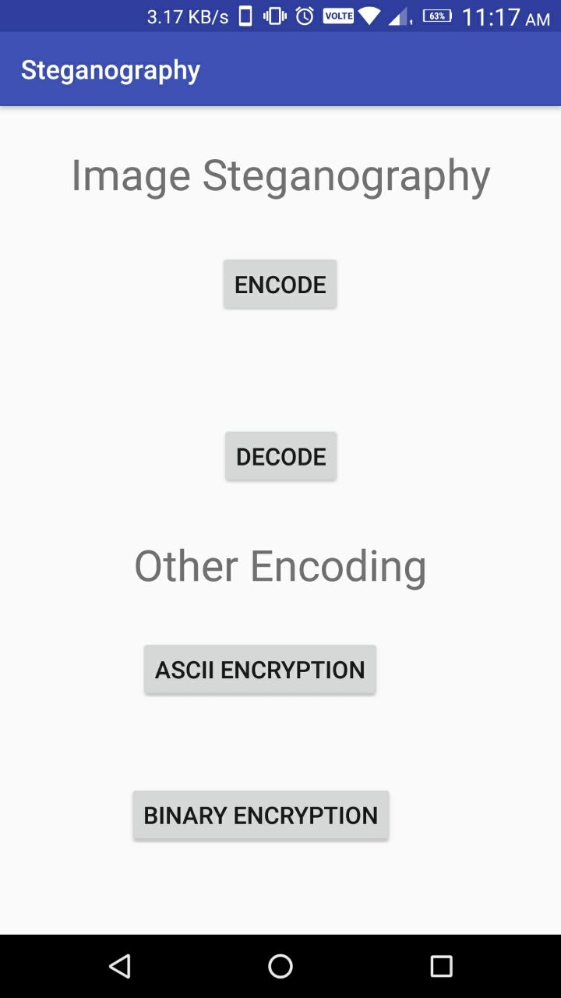
Flowchart

Slide 5
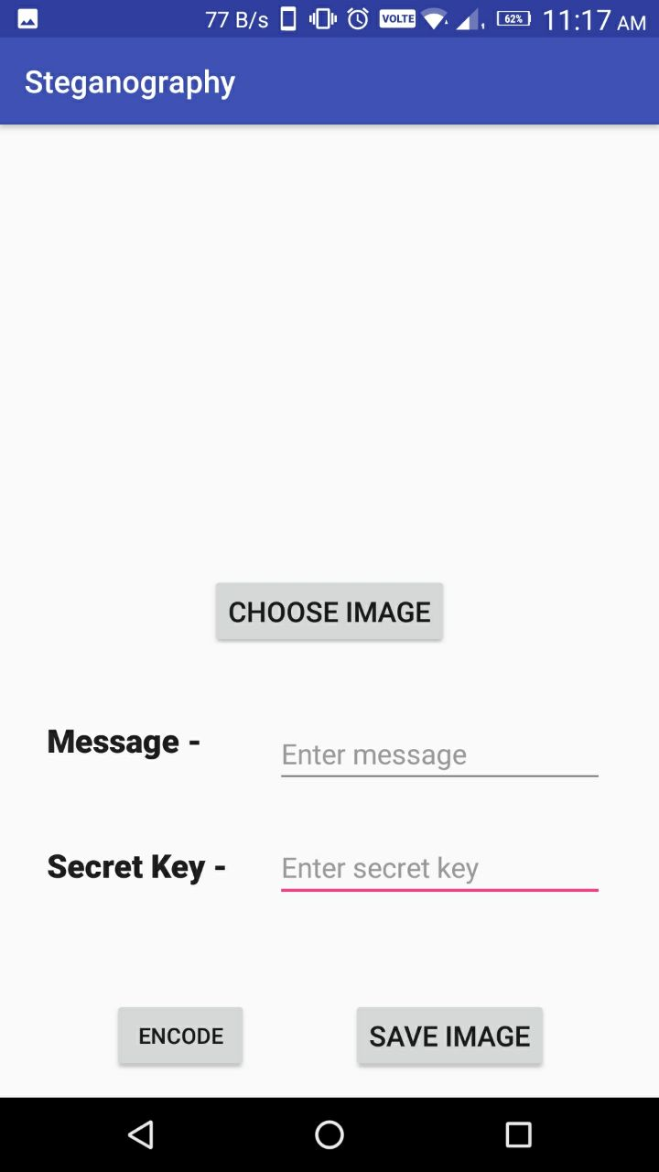
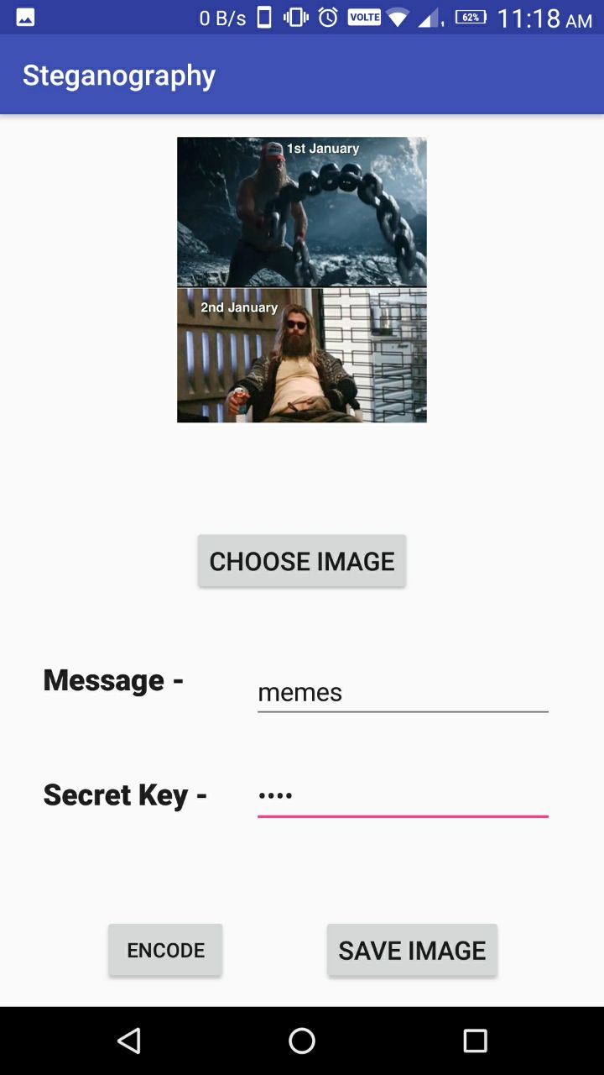
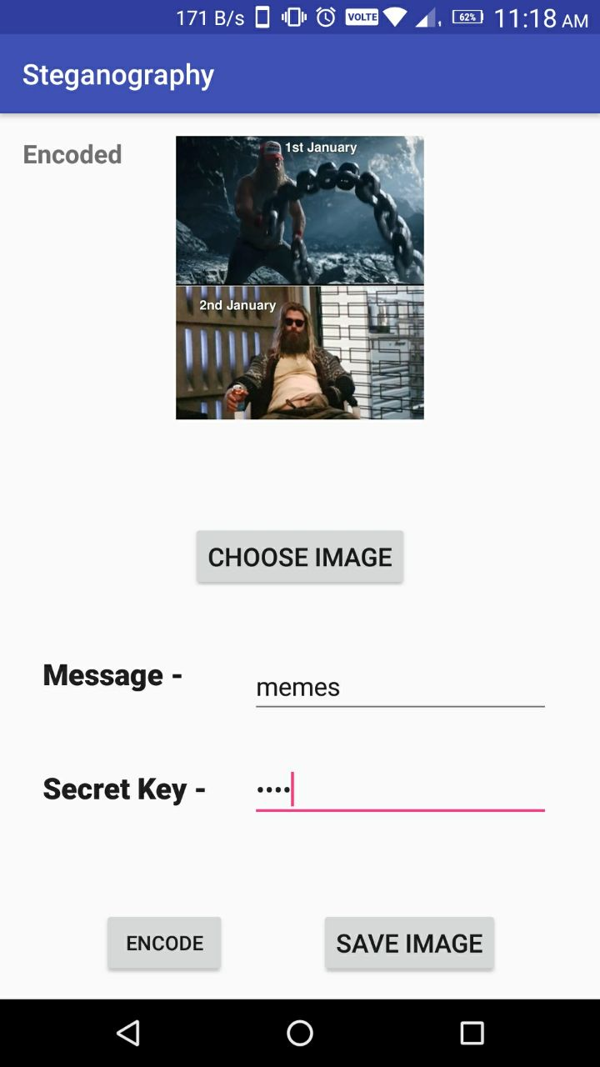

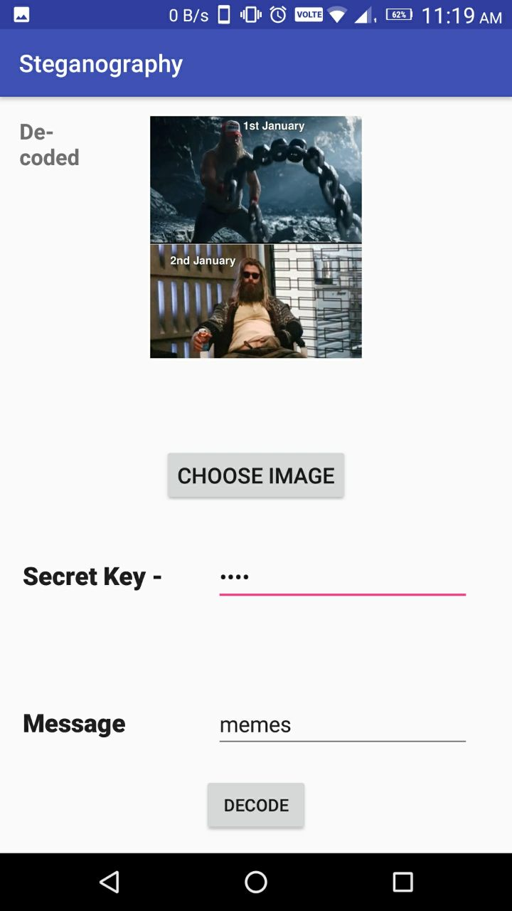
Enter data
Encode and save
encode
Choose image
Choose and decode button
decode

Slide 6
Library Used
aagarwal1012/Image-Steganography-Library-Android
Encoding -
1. public class MainActivity extends AppCompatActivity implements TextEncodingCallback
create object with args as message , secret_key, image_obj
2. ImageSteganography imageSteganography = new ImageSteganography(message, secret_key, original_image);
Pass activity create obj of text encoding
3.TextEncoding textEncoding = new TextEncoding(MainActivity.this,MainActivity.this);
execute
4. textEncoding.execute(imageSteganography);

Slide 7
Decoding steps
Create obj
TextDecoding textDecoding = new TextDecoding(MainActivity.this, MainActivity.this);
Execute
textDecoding.execute(imageSteganography);

Slide 8
Demo
Demonstration

Slide 9
Conclusion
Thank You
By Shubham Dhumale 1921321246075
By Abhishek Badmore 1921321246026

