Slide 1


Title: IoT based Anti-Theft floor Mat System
Team:
Navyashree JM
Sakshi
Shubda

Slide 2
Introduction
The Anti-Theft Floormat project is a simple and smart security system designed to protect homes and offices from unauthorized entry. It uses piezoelectric sensors placed inside a floor mat to detect footsteps. When someone steps on the mat, the sensors sense the pressure and convert it into an electrical signal. This signal is processed by a Raspberry pi microprocessor, which helps identify possible intrusion. The system works quietly in the background and provides an easy, low-cost solution to improve security using modern technology.

Slide 3
Problem Statement
Homes and offices are not fully safe from intruders.
Security systems are costly and hard to use in small places.
There is no simple way to detect someone walking on the floor.
Many systems do not give instant alerts.
A low-cost system is needed to detect footsteps on a mat.
The system should alert the user immediately when someone steps on the mat.
IoT helps send alerts in real time and improves safety.
.

Slide 4
Proposed System
The project improves security using a smart floor mat.
A piezo sensor detects footsteps on the mat.
Even small pressure can be detected easily.
When someone steps on the mat, a buzzer rings.
An email alert is sent to the user.
A potentiometer is used to adjust the sensitivity.
The system is easy to use and low cost.
It helps prevent unauthorized entry.

Slide 5
Block Diagram
Raspberry Pi 4B Model
Buzzer
Piezoelectric sensor plates
Potentiometer

Slide 6
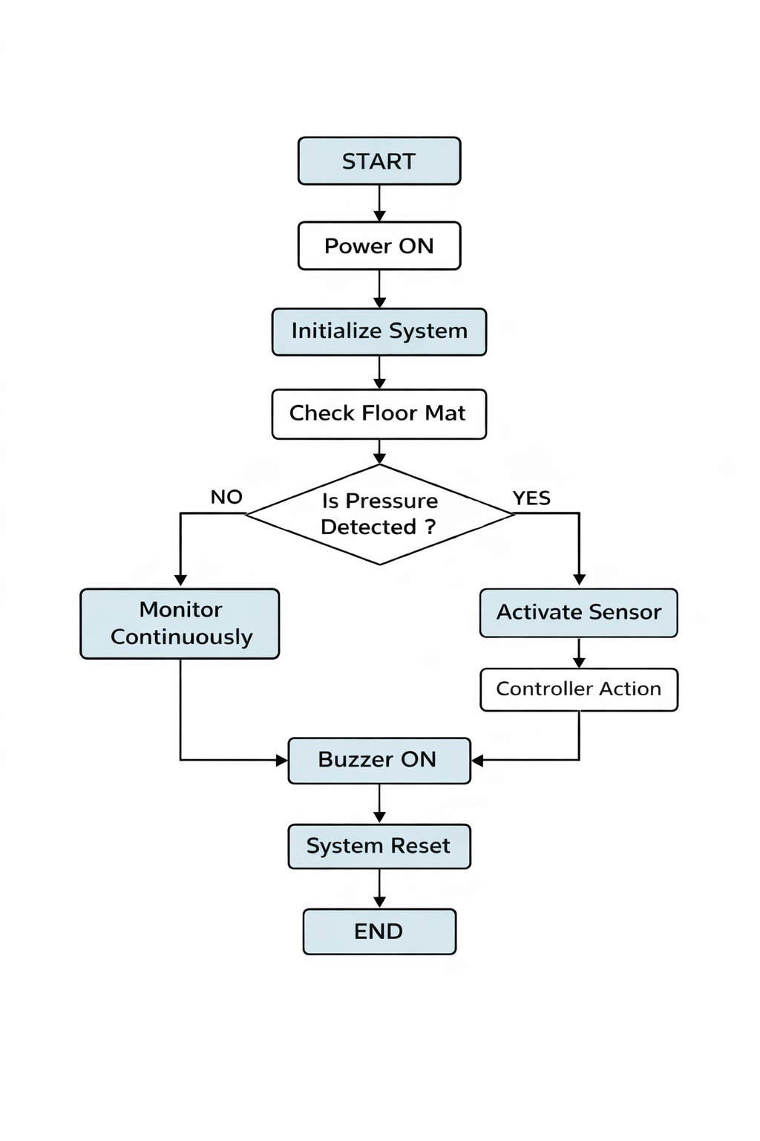
Flow Chart

Slide 7
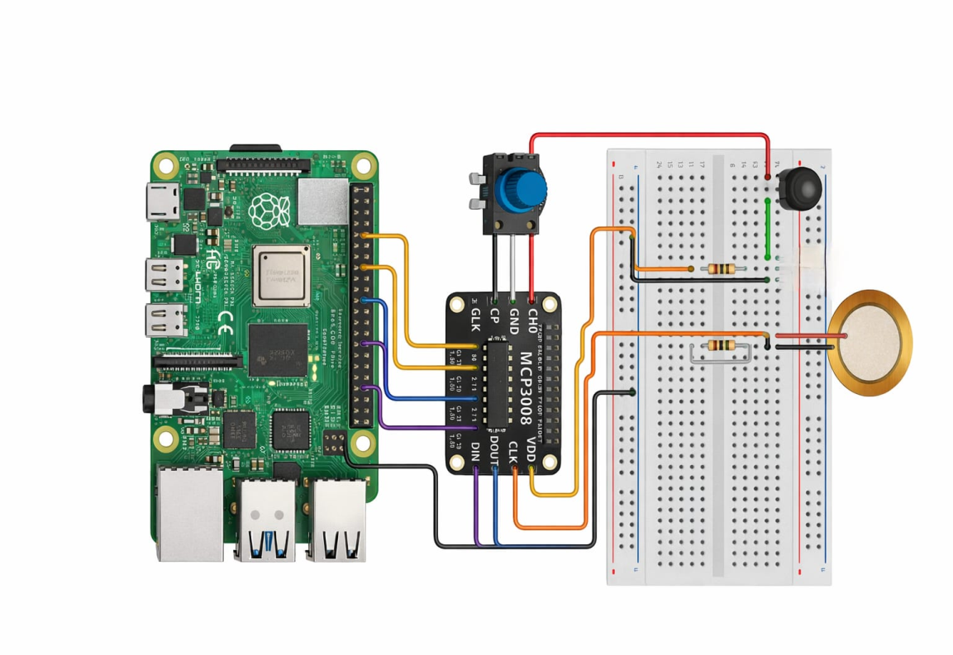
Circuit Diagram

Slide 8
Applications
Houses: Kept near doors or windows. If someone enters without permission, the buzzer will sound.
Shops: Used in shops to stop theft. When someone steps into a restricted area, the buzzer turns ON.
Banks and ATM rooms: Placed near lockers or ATM cabins to catch intruders, especially at night.
Jewelry shops: Helps protect gold and valuables by giving an alert when someone steps inside.
Offices: Used near important rooms like server rooms to stop unknown people from entering.
Godowns\Warehouses: Used to protect stored goods from stealing.
Hospitals: Used near medicine stores or lab rooms to avoid unauthorized entry.

Slide 9
Tools and Technology
Software Requirements:
1. Raspberry Pi OS: Raspberry Pi OS is the operating system used in the Raspberry Pi.
It helps the Raspberry Pi to start, run programs, and control hardware components like sensors and buzzer. All the coding and system control is done using Raspberry Pi OS.
2. PuTTY: PuTTY is a software tool used to connect a computer to the Raspberry Pi.
It allows us to access the Raspberry Pi remotely using SSH.
With PuTTY, we can write and run programs and check the output without connecting a monitor or keyboard to the Raspberry Pi.

Slide 10
Hardware Components:
1. Potentiometer
  A potentiometer is a variable resistor.
  Resistance value can be changed by rotating it.
  Used to adjust and test the input level of the system.
2. Piezoelectric Plate Sensor
  Used to detect pressure or vibration.
  Generates a small electrical signal when force is applied.
  Helps the system detect unauthorized entry.
3. Buzzer
  A buzzer is an output device.
  Produces sound when activated.
  Used to alert people during intrusion.

Slide 11
Future Scope
The system can be connected to a mobile app for easy monitoring.
SMS or call alerts can be added along with email notifications.
A camera can be added to capture the intruder’s image.
The system can be improved to detect multiple footsteps.
It can be used in homes, offices, banks, and shops.
Battery backup can be added for power failure situations.
Integration with smart home systems can make it more advanced

Slide 12
Project Results
The anti-theft floor mat system was designed and tested successfully.
The piezoelectric plate sensor detects pressure when someone steps on the floor mat.
The potentiometer is used to adjust and test the input sensitivity of the system.
The Raspberry Pi processes the pressure signal correctly.
When pressure is detected, the buzzer is activated immediately.
At the same time, an email alert is sent with the message “Pressure detected on the floor mat.”
The system works without using a camera.
The project provides a simple and low-cost security solution.

Slide 13
THANK YOU

