Slide 1

PlacementRadar
Job intelligence and outreach automation for college placement cells
Shubham Chavan · Roll No. 17030925005
Semester III Mini Project · K. J. Somaiya Institute of Management
Notes:
Hi, I'm Shubham. My project is PlacementRadar, built for the people on our placement committee who spend their evenings looking for HR contacts.

Slide 2
Every year, a committee starts from zero
25 hours
23.5%
20+
to find contacts for 300 companies, at five minutes each
of the contacts I first collected belonged to the wrong company
job portals, and no single one lists every opening
The committee is students with coursework. When they graduate, the calls, notes and contacts leave with them.
Notes:
Our placement work is basically a sales funnel run by volunteers. Five minutes per company sounds small until it is three hundred companies. And when I checked my first batch of contacts, almost a quarter were filed under the wrong employer.

Slide 3
So I built a tool for the tedious part
01
02
03
04
05
Finds jobs
Checks the company
Finds contacts
Scores them
Tracks the outreach
on 23 boards at once, keeping tech roles
by confirming its real website first
HR emails and phones, with where each came from
so the most reliable ones get called first
a call sheet, pipeline and history the whole committee shares
It costs nothing to run. Render's free plan hosts it, GitHub Actions does the heavy scraping, and MongoDB Atlas's free tier stores the data.
Notes:
Five steps. The second one matters most: before trusting anything about a company, the tool confirms its real website. And it runs entirely on free tiers, which matters for a college.

Slide 4
How the pieces fit together
Browser app
React, works on phones
Flask API
on Render, with sign-in
Gmail
cold emails, follow-ups
The web
job boards, websites, maps
GitHub Actions
runs the scraper
MongoDB Atlas
jobs + separate logins
Searches run on GitHub's servers, so the free web server never does the heavy lifting. All 18 diagrams are in PROJECT_DIAGRAMS.pdf.
Notes:
The browser talks to a Flask API. When someone runs a search, the API hands it to a GitHub Actions worker that scrapes and saves straight into MongoDB. Login accounts are kept in a separate database from the job data.

Slide 5
Trusting a contact took five checks
Is the page real?
REAL CASES THAT SHAPED THESE CHECKS
Redirects and off-topic pages are rejected, even with an OK reply
“Genesis”
Is it the right company?
A website counts only if its own title or footer names the company
is three different firms in our data. A name alone is not an identity.
Does the address work?
rethink.org vs rethink.com
Email domains get a live mail-server check; phones are validated
look alike but are different organisations.
How much do we trust it?
A 0 to 1 score from independent evidence
“Private”
Not sure?
in “Private Limited” once gave one company another's HR contacts.
A person reviews it. Nothing is deleted, only set aside
Notes:
This slide is the heart of the project. Each of these checks exists because of a real mistake I found: three different companies called Genesis, two look-alike domains, and the word Private matching one company to another's contacts.

Slide 6
Contacts grew more than fourfold in a month
97.5%
of 2,046 emails pass a live mail-server check
1,823
contacts name a real person, not just info@
Notes:
Over the last month: 314 companies became 1,732, and 501 contacts became 2,324. 2,181 are ranked good enough to use. Almost every email passes a live mail-server check, and most contacts name an actual person.

Slide 7
I measured what worked, and what didn't
Only 7 of 23 job boards
returned jobs in the final test. Naukri now asks for a captcha.
Switching the defaults
to Indeed, LinkedIn and Internshala gave 29 jobs from 23 companies in one search.
Three planned sources
were dropped after testing. Guessing email formats was kept: 72% exact, against 59% by default.
Notes:
Automated matching more than doubled the companies with a confirmed website, and human review took it to 61 percent. I also tested every job board: only 7 of 23 still work, and simply changing the default boards tripled what a search finds.

Slide 8
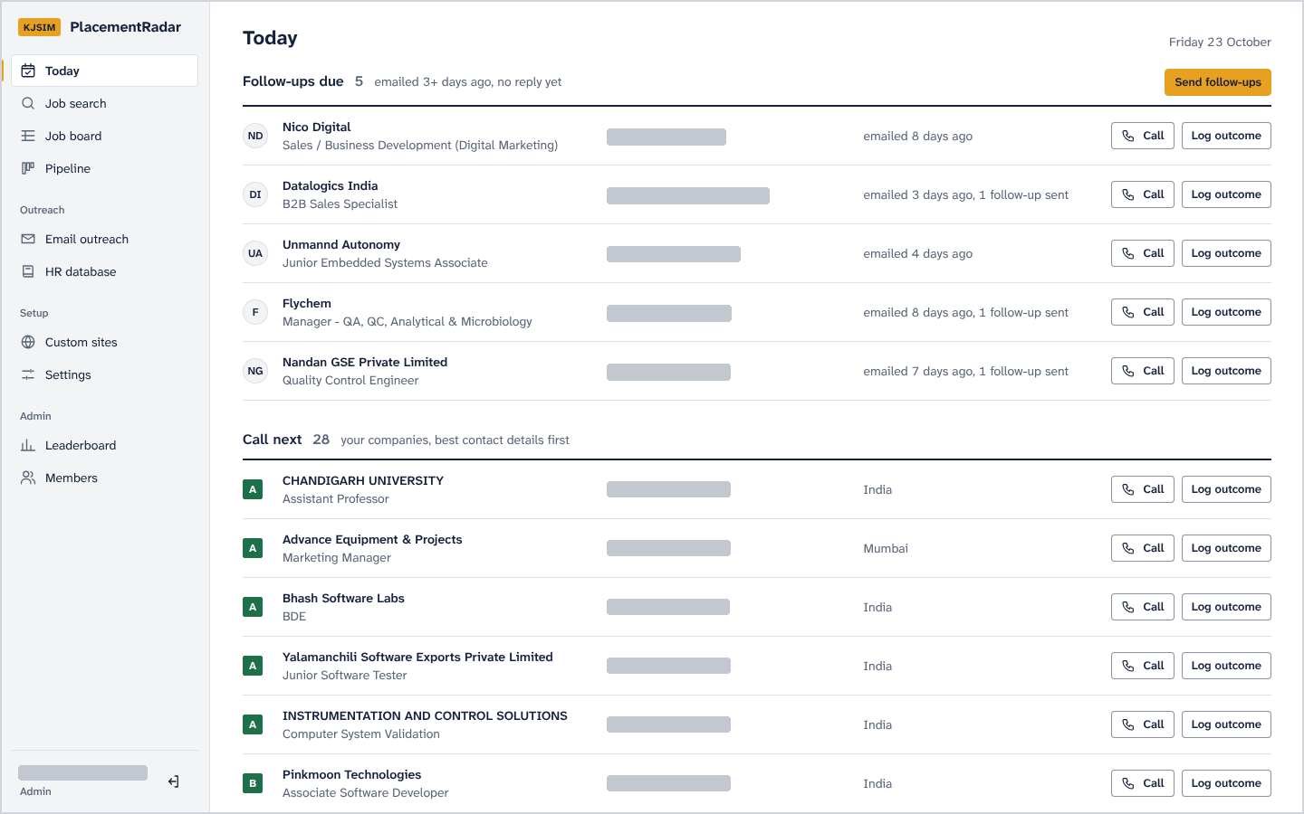
Each morning starts with who to call
Follow-ups due
emailed 3+ days ago, no reply yet
Call next
best contact details first, graded A to F
One tap
Call, then log what happened
Phone numbers and emails are hidden in all screenshots.
Notes:
This is the home page a member opens. Follow-ups due, then the next companies to call, best contacts first. Logging an outcome takes the row off the list. I've hidden all contact details in these screenshots.

Slide 9
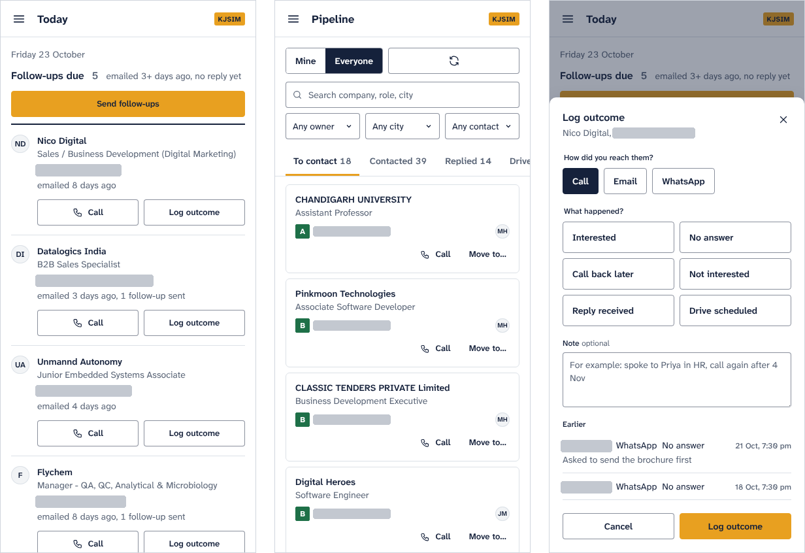
Built for phones, where calls happen
Below 900 px the side menu becomes a drawer and tables become cards with full-width Call buttons.
The pipeline is shared: only a company's owner or an admin can move it, so two people never chase the same firm.
Today, Pipeline and Log outcome on a phone
Notes:
Committee members make calls from their phones, between classes, so the whole app works on a phone. The pipeline is shared, and ownership stops two people calling the same company in the same week.

Slide 10
What I learned
“The totals kept saying the system worked, while individual records were wrong.”
HTTP 200 doesn't mean success
Validation can throw value away
Measure before building
Pages answered OK while showing a captcha, a generic list or a parked domain.
Mobile-only phone checks silently rejected every office landline.
Testing first ruled out three sources that would never have worked.
Notes:
If I had to keep one lesson: totals lie. Every serious bug I found only showed up when I read individual records. So each fix added a check to the pipeline itself instead of trusting the summary numbers.

Slide 11
Where it stands, and what comes next
Still open
Next
15 of 23 job boards return no jobs
The phone directories are blocked or outdated
103 contacts wait for human labels to set the score threshold
The new version runs locally; the live site is the older one
Add 333 offices from OpenStreetMap, tagged as switchboard numbers
Match our alumni list to companies, within the DPDP Act
A student portal with resume-to-role matching
One shared setup that several colleges can use
Notes:
I want to be honest about what isn't finished. Most job boards now block scrapers, and the phone directories are blocked. The next big step is adding office numbers from OpenStreetMap, then the alumni list.

Slide 12






Thank You
Questions, or a live demo of the app
simsr.somaiya.edu
Notes:
Thank you. I can answer questions or open the app and walk through the Today page and the pipeline.

