Slide 1

K BHAWANA
Predicting Customer Churn

Slide 2
Summary
Predicting Customer Churn
2
Introduction
EDA
Feature Transformation
Machine Learning Models
Conclusion

Slide 3
Predicting Customer Churn
3
1. Introduction
▸ Problem Statement:
Predicting Customer Churn (also known as Customer Attrition) represents an additional potential revenue source for any business. Customer Churn impacts the cost to the business. Higher Customer Churn leads to loss in revenue and the additional marketing costs involved with replacing those customers with new ones.
Objective:
Our objective is to build a machine learning model to predict whether the customer will churn or not in the next six months.
Metric : Macro f1 score

Slide 4
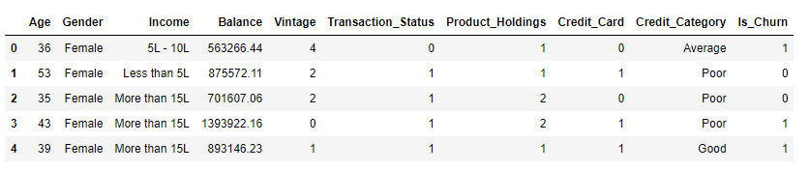
Predicting Customer Churn
5
Data Overview

Slide 5
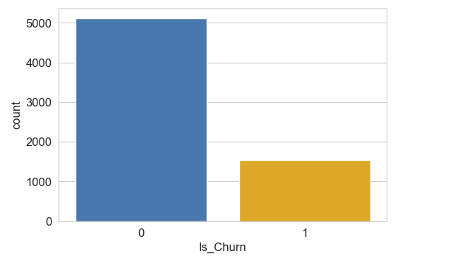
Predicting Customer Churn
7
Data Overview
▸ Total 6650 training data with 9 features + 1 target feature.
▸ It’s a binary classification problem with class 0 and 1.
▸ Data has no missing values as well as no duplication.
▸ There are 5113 values belonging to class 0 and 1537 belonging to class 1.
▸ Data is highly imbalance. ( will be using class weight = balanced for oversampling, smote failed)

Slide 6
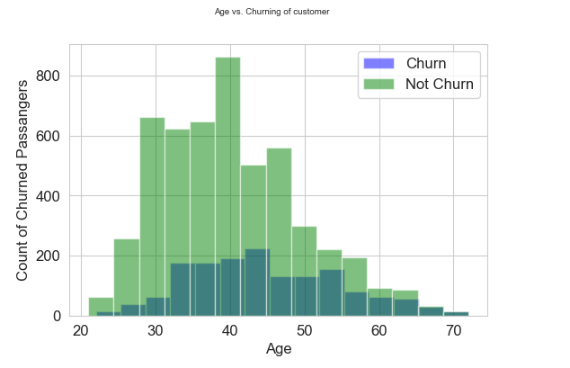
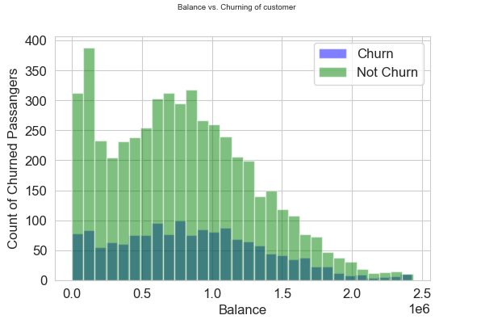
Predicting Customer Churn
3
2. EDA
EDA of numerical data
Observation: From the age graph ,we can conclude that customers at the age of 40-50 are churning more.

Slide 7
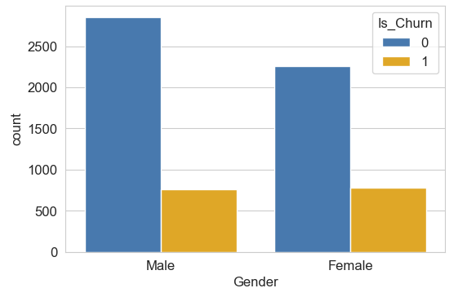
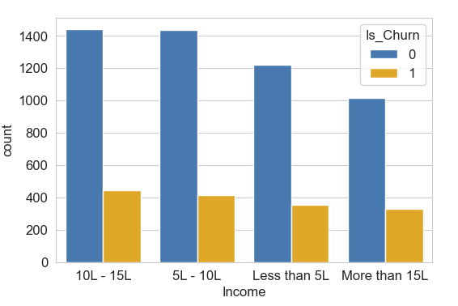
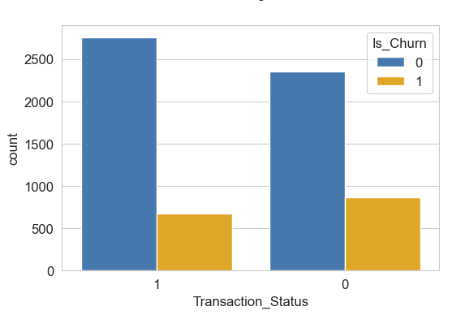
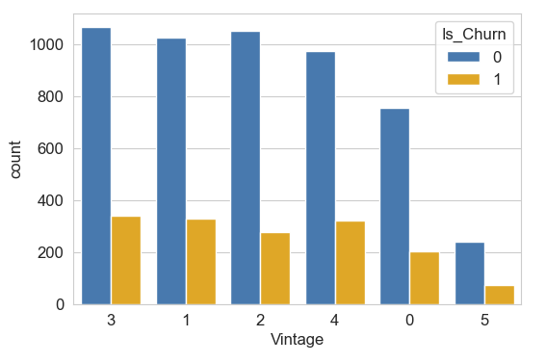
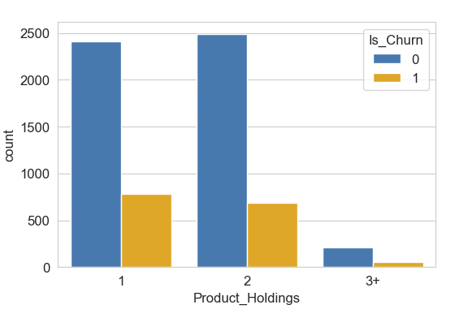
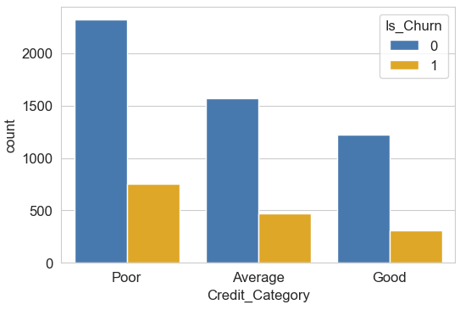
Predicting Customer Churn
3
EDA of Categorical and nominal data
Observation: All data distribution across both classes seems in good balance. Feature Credit_card has not been taken here because in later section we will know that it is not adding any value in prediction

Slide 8
Predicting Customer Churn
3
3. Feature Transformation
I have tried with both One hot encoding and Label Encoding. Label Encoding is working better than One hot encoding.
For standardization of data I have used StandardScale and MinMax Scaler. Standard Scaler is working better than MinMax Scaler but in final model I have not used any scaling metric because raw data was giving better F1 Score.

Slide 9
Predicting Customer Churn
3
4. Machine Learning Models
There are total 6 models are used in this hackathon
Logistic Regression
Naïve Bayes
Random Forest
Light GBM
Stacking
Final Model with feature selection
All models have been hypertuned with wide range of parameters.

Slide 10
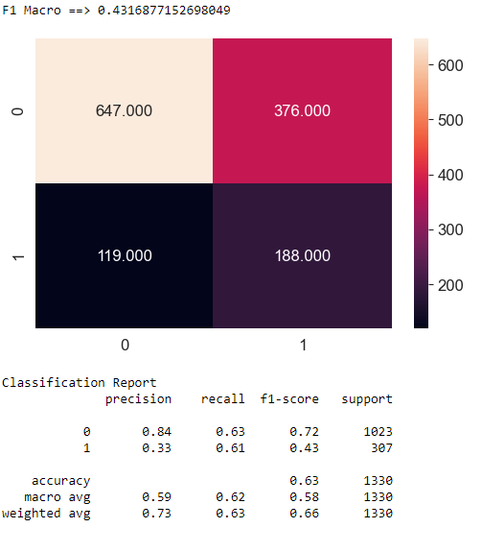
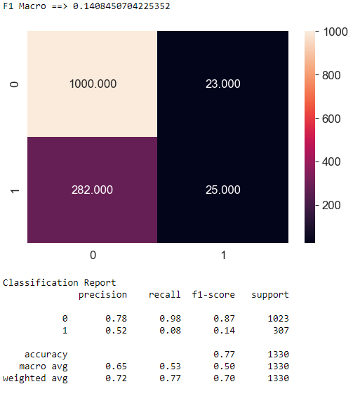
Predicting Customer Churn
3
Comparison of all Models
1. Logistic Regression
2. Naïve Bayes

Slide 11
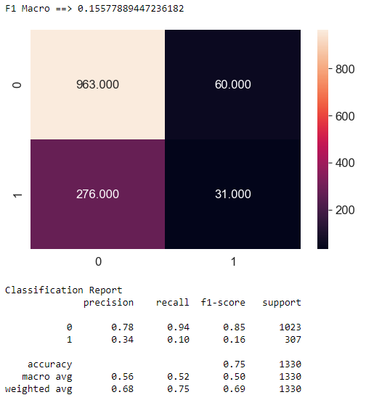
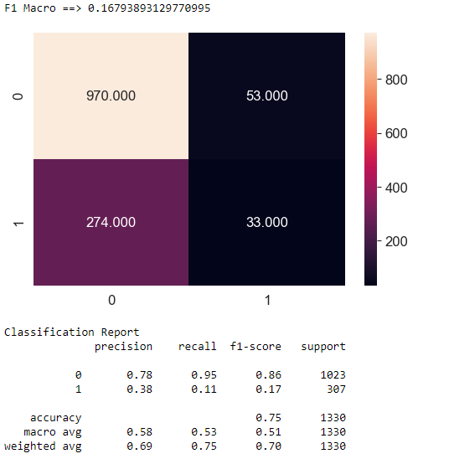
Predicting Customer Churn
3
3. Random Forest
4. Stacking (Random Forest + Logistic Regression)
Conclusion: Logistic Regression is working best among all models with f1 score of 0.4316 on test data(20%) with is split of train data.

Slide 12
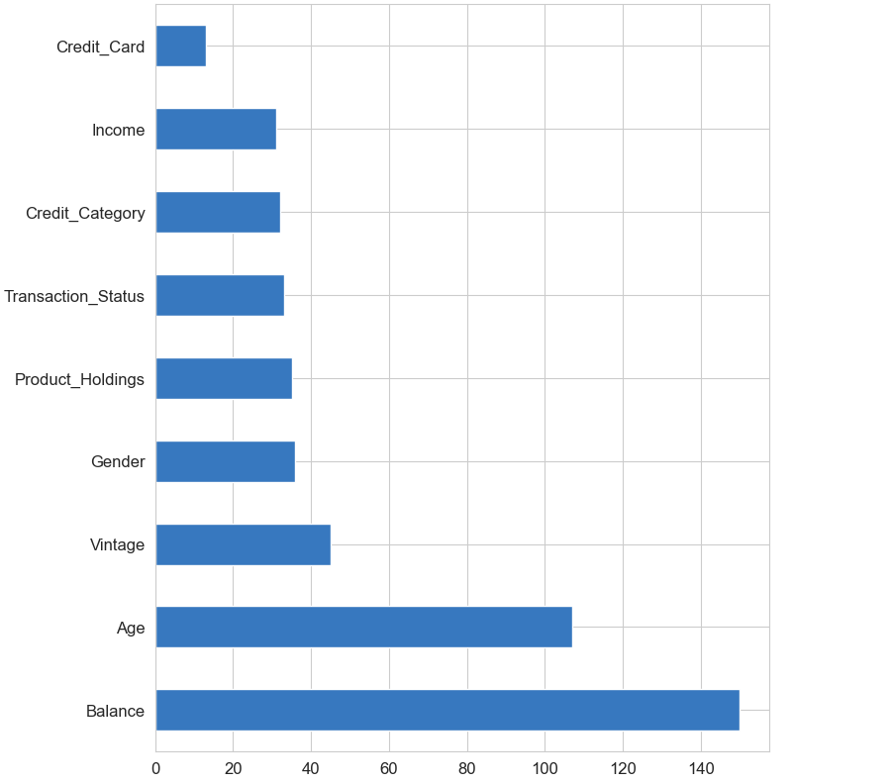

Predicting Customer Churn
3
5. Light GBM
Conclusion: LightGBM is not working well either, but it is useful in getting feature importance. So according to light gbm credit_card is least useful. We will drop this feature and build final model.

Slide 13
Predicting Customer Churn
3
6. Final Model
All Features are taken except Credit_card
Label Encoding of categorical Featres + no standard scaling
Logistic Regression with parameters:
class_weight="balanced“
C= 0.1
penalty = 'l2’
solver = 'newton-cg'
With threshold of 0.572 achieved highest F1_ macro score on leaderboards.

Slide 14
Predicting Customer Churn
3
Conclusion
After trying with complex models such as Light GBM, XGBoost etc f1 macro score keep deteriorating. Also standard scale failed, raw data was working better.
So final best model is logistic regression with label encoding + oversampling of classes with changing the threshold from 0.5 to o.072 was getting highest f1 macro score.
Sometimes complex models failed miserably while models like logistic regression works like a charm.

Slide 15
Predicting Customer Churn
3
Thank You
My Portfolio: https://bhawana.netlify.app/
My Github: https://github.com/bhawna94110

