Slide 1
Mahindra First Choice Services (MFCS)
Shubendu Biswas

Slide 2
Problem Statement-1
Geolocation Based Customer Analysis:
Identifying the ownership pattern of cars throughout the
country. This also captures the problem wherein information regarding the
spending patterns can be identified

Slide 3
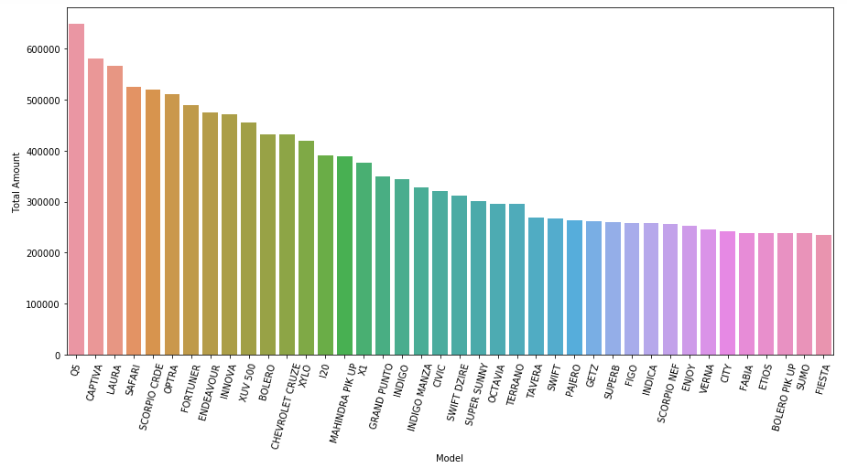
Top 30 cars which are generating highest revenue

Slide 4
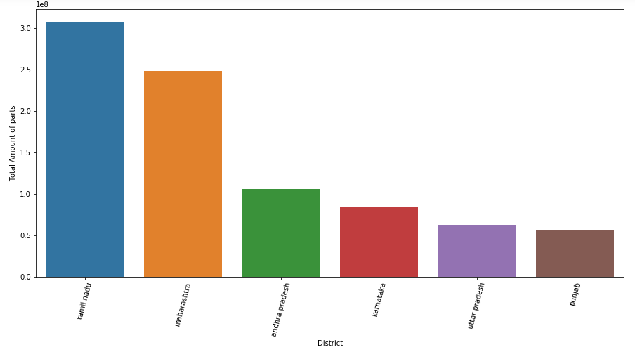
Which Regions has the highest part sales revenue?

Slide 5
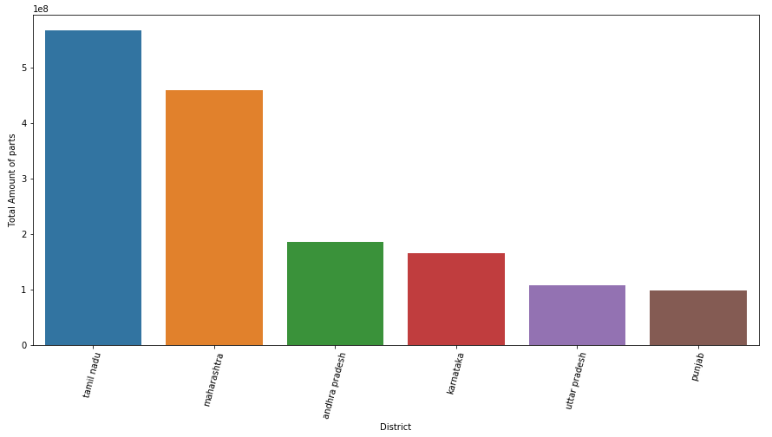
Which Regions have the highest revenue?

Slide 6
Problem Statement-2
Identify the type of order each state receives and present it as an interactive visualization.

Slide 7
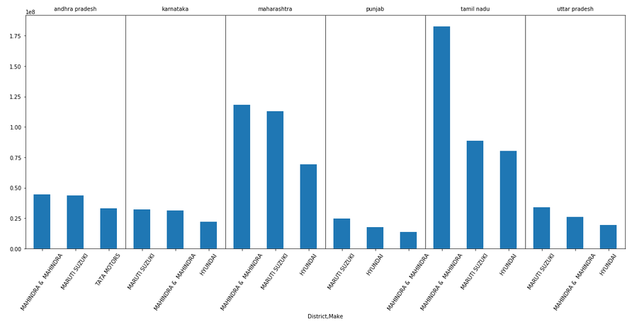
Which car company has the highest revenue in Top 6 region?

Slide 8
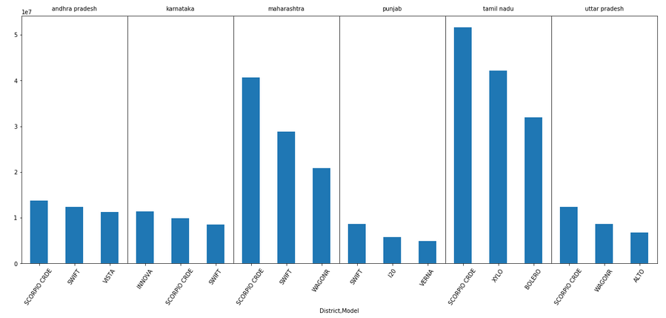
Which cars has the highest revenue in Top 6 region?

Slide 9
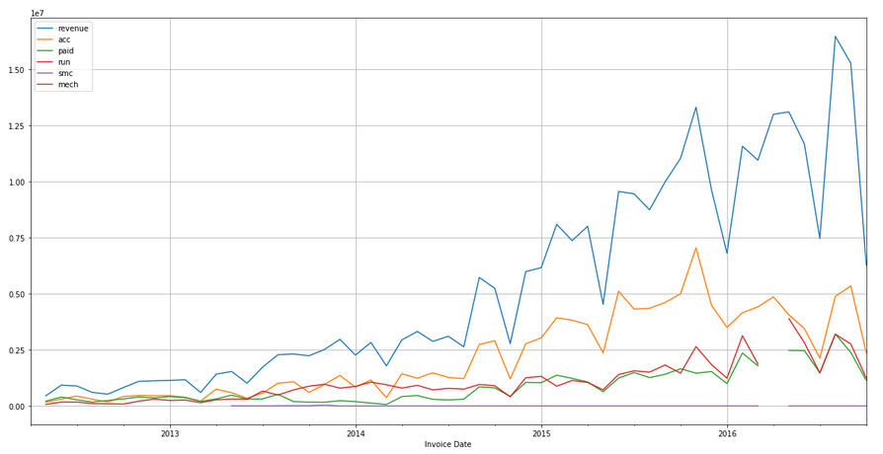
Revenue Generated by various order types

Slide 10
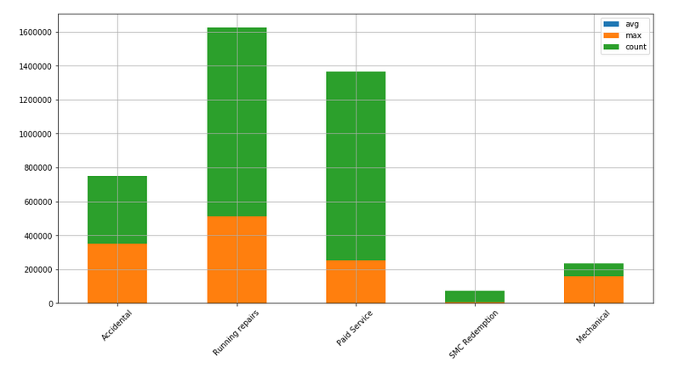
What is the distribution of order types?

Slide 11
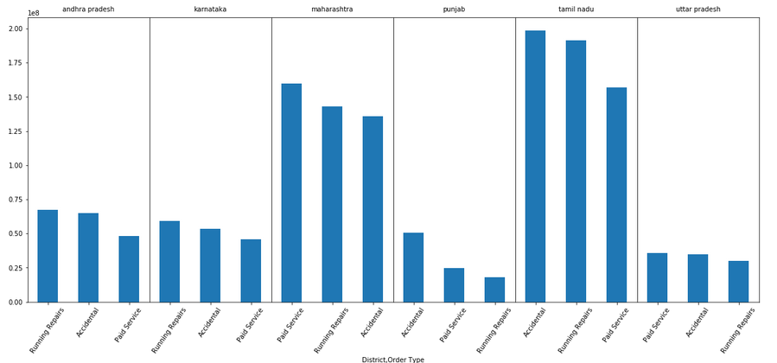
Which type Of order has the most revenue in top 6 region?

Slide 12
Market Segmentation:
Times Series Analysis
Customer Lifetime value prediction

Slide 13
Arima model
Revenue Forecast - Times Series Analysis with ARIMA

Slide 14
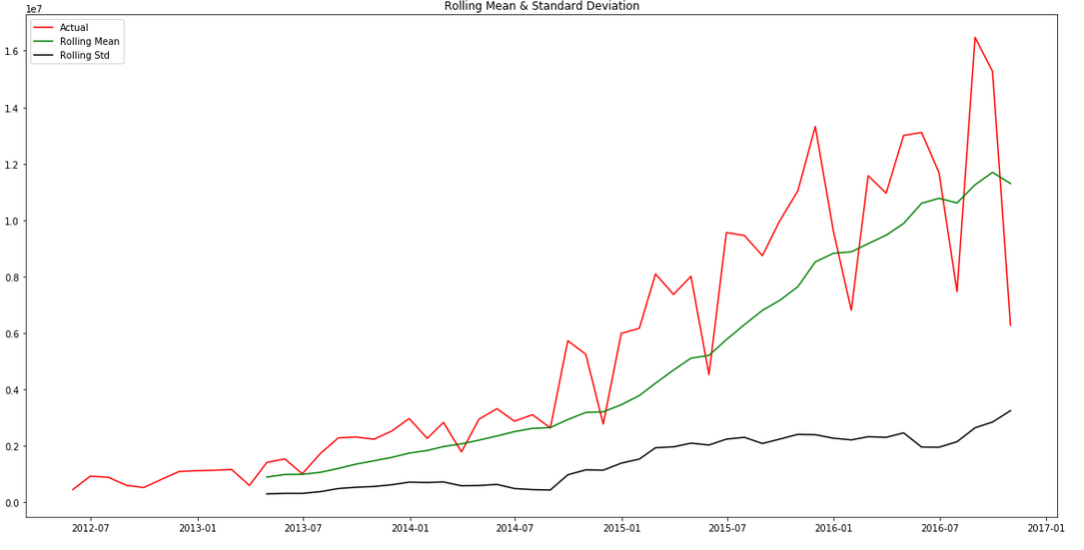
Stationarity??

Slide 15
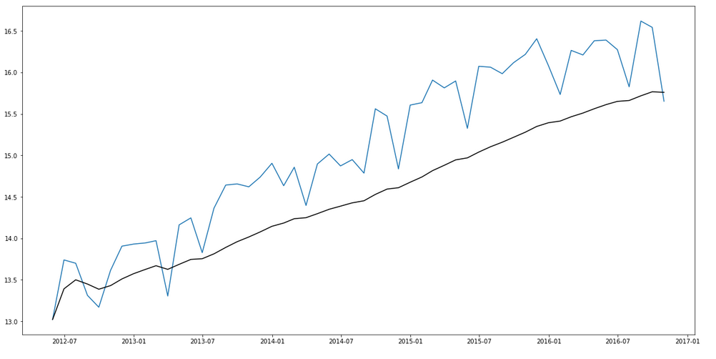
1st transformation : weighted avg

Slide 16
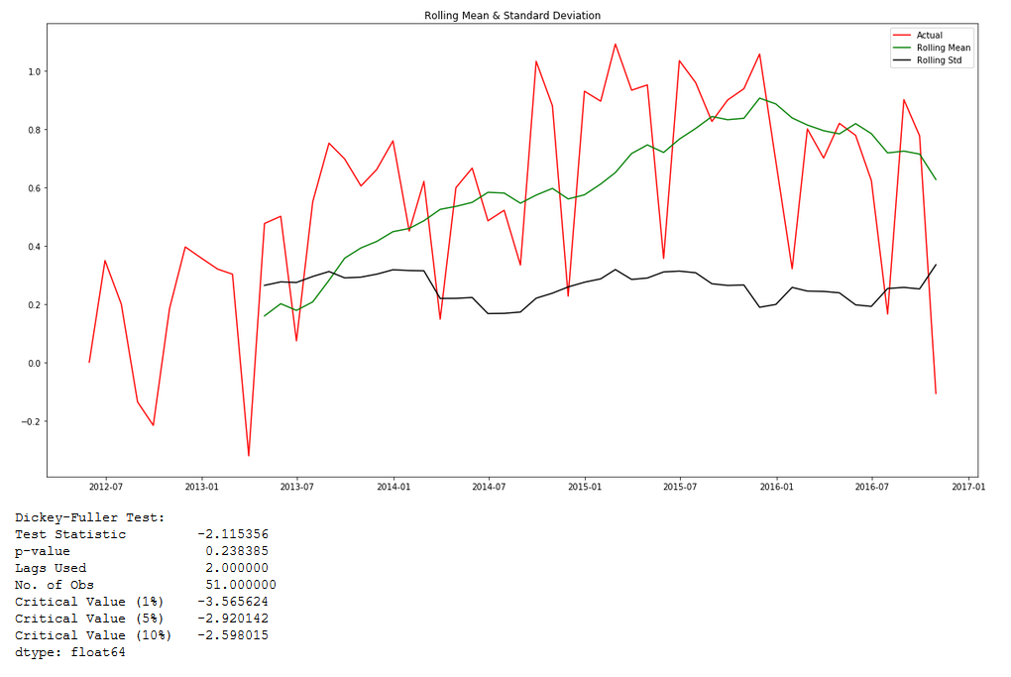
2nd transformation :

Slide 17
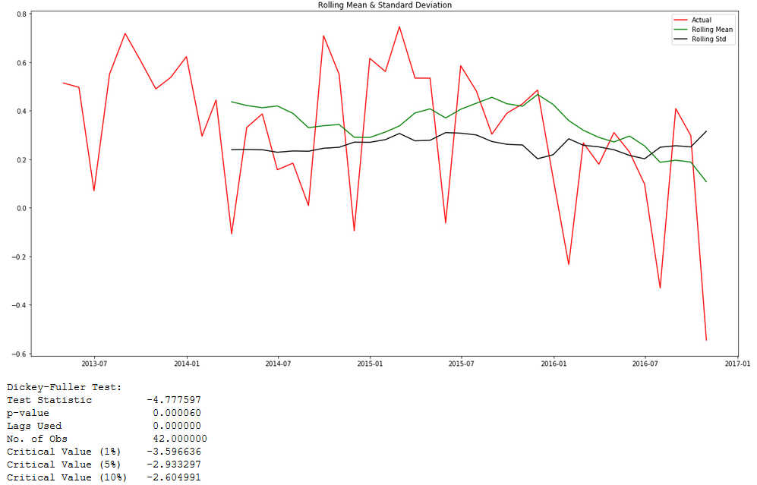
Dickey-Fuller Test AND Rolling Test

Slide 18
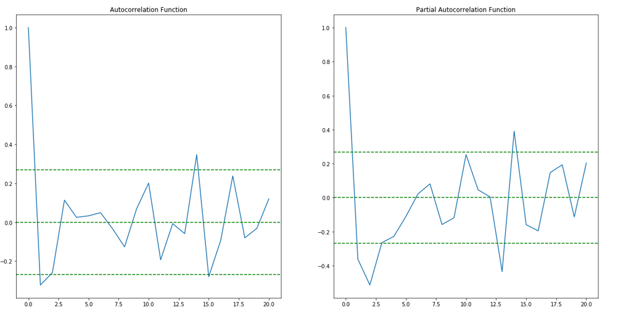
Values of AR + MA

Slide 19
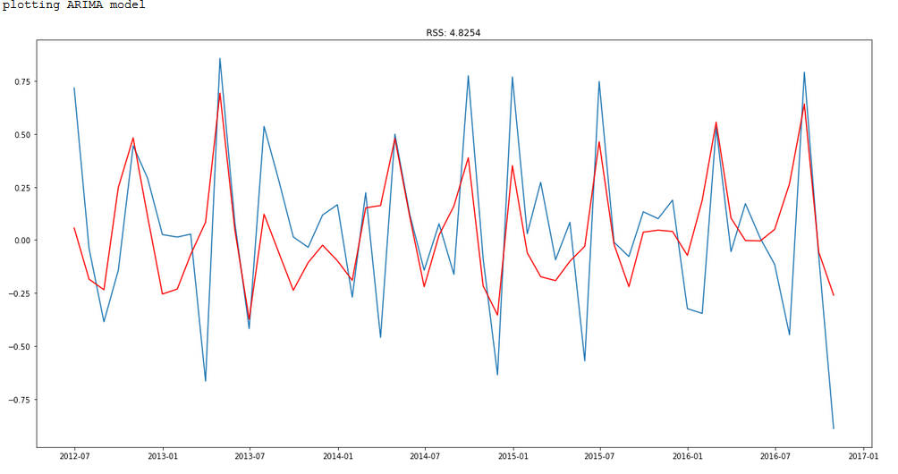
Plotting arima model with order(2,1,2)

Slide 20
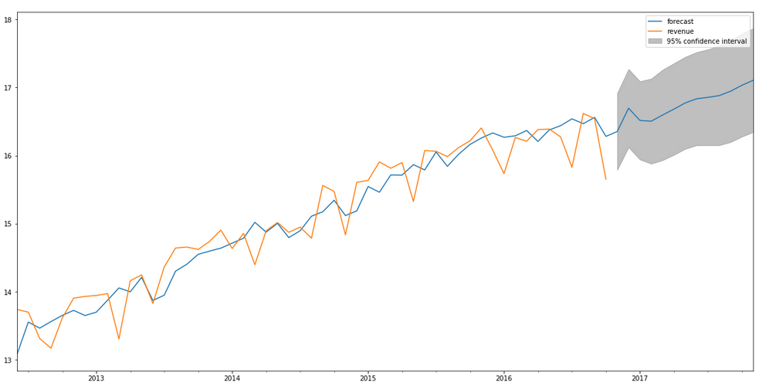
Forecasting with arima model (period = 12months)

Slide 21
RFM
RECENCY | FREQUENCY | MONETARY VALUE

Slide 22
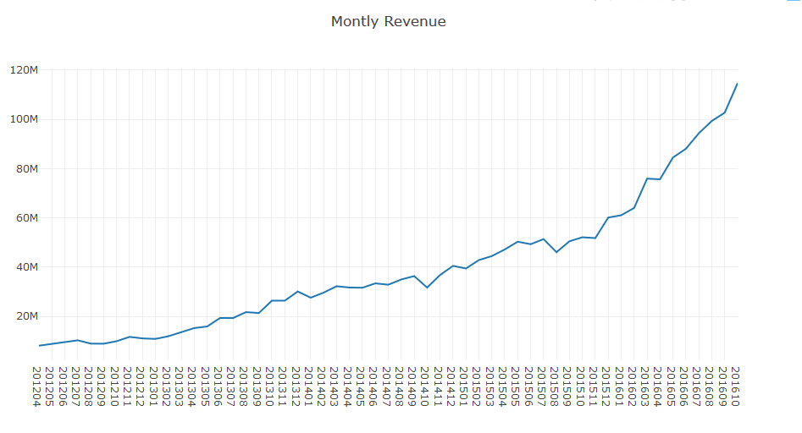
Uptrend !!

Slide 23
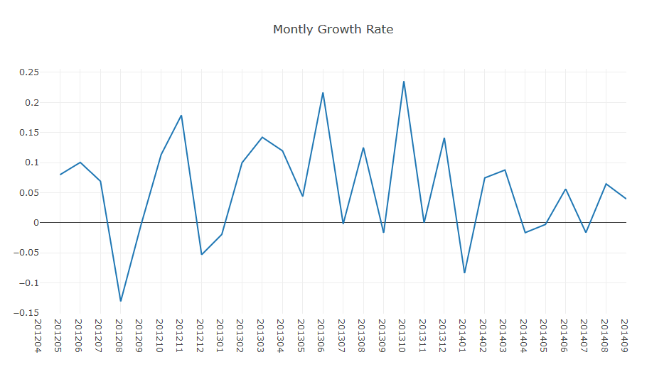
Monthly Growth rate

Slide 24
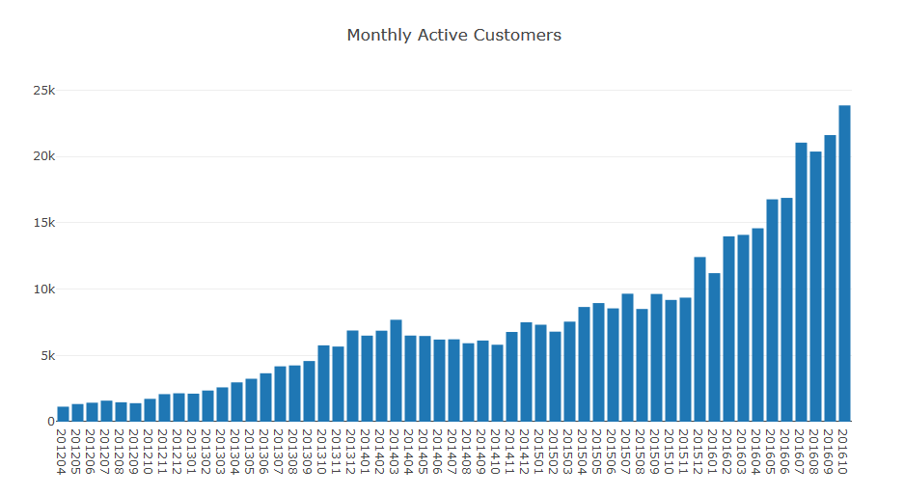
Monthly Active Customers

Slide 25
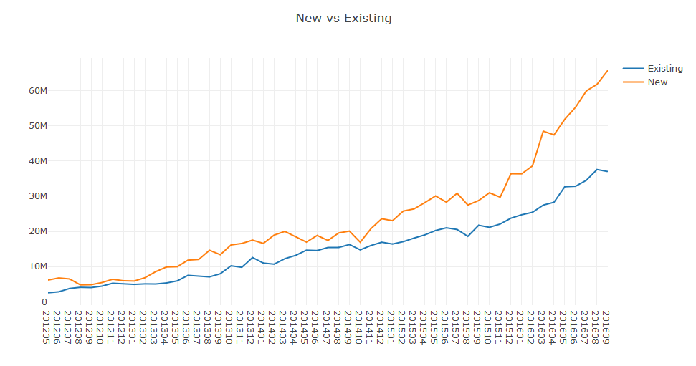
Existing customers are showing a positive trend and tell us that our customer base is growing

Slide 26
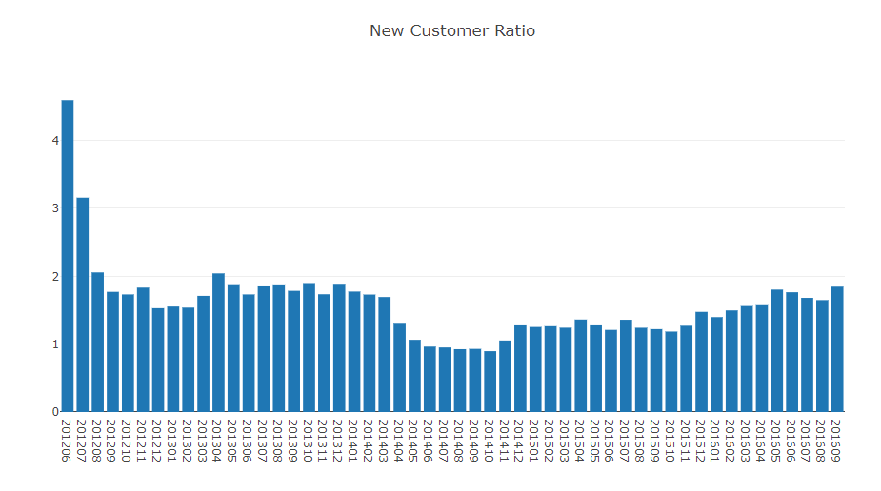
we are losing our existing customers or unable to attract new ones???

Slide 27
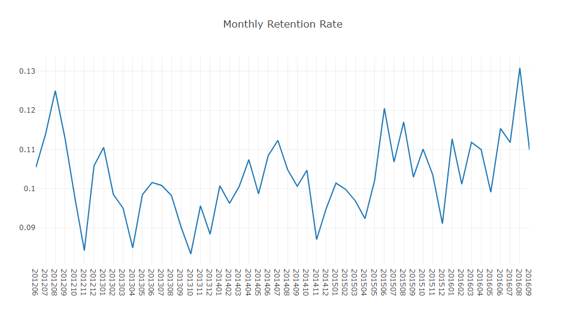
how sticky is your service and how well your product fits the market???

Slide 28
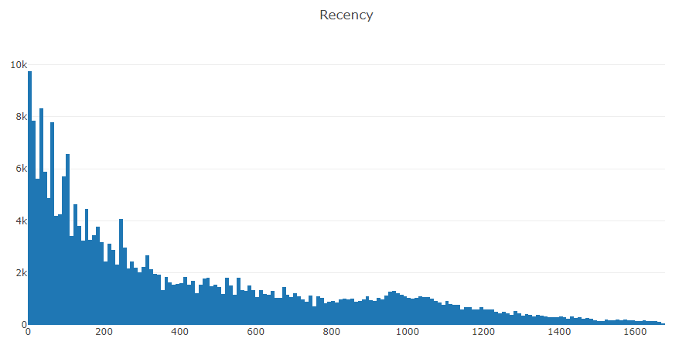
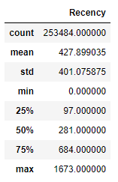
Recency

Slide 29
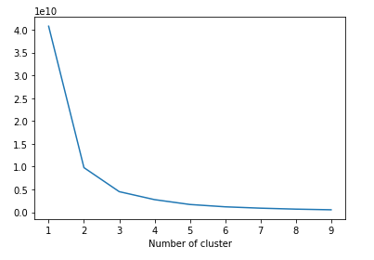
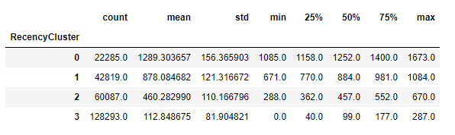
Applying K-means clustering to assign a recency score

Slide 30
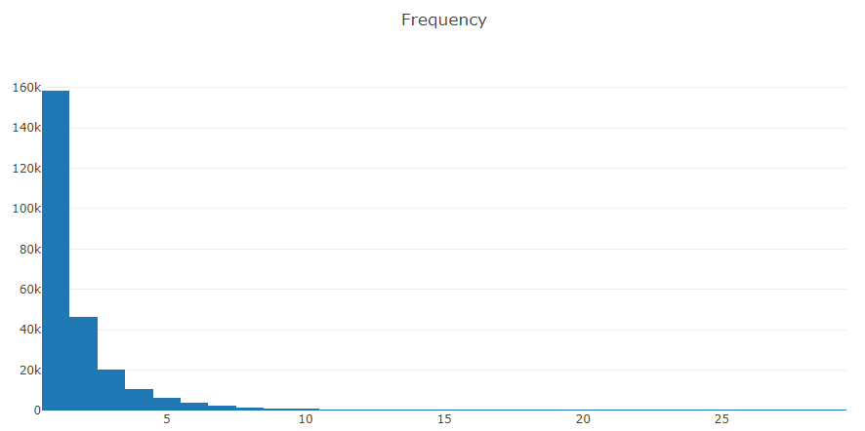
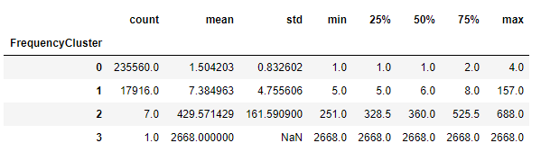
Frequency

Slide 31
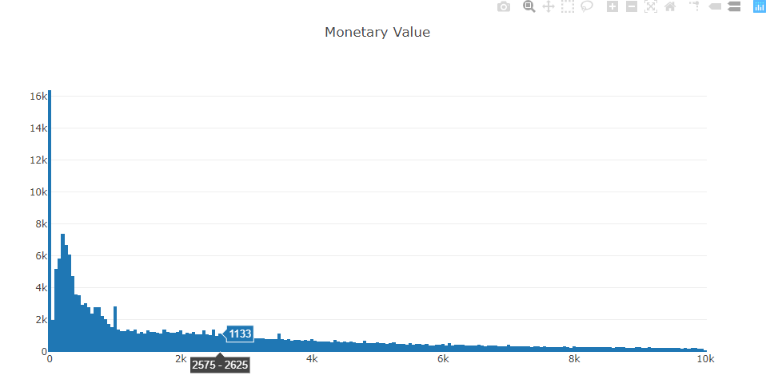
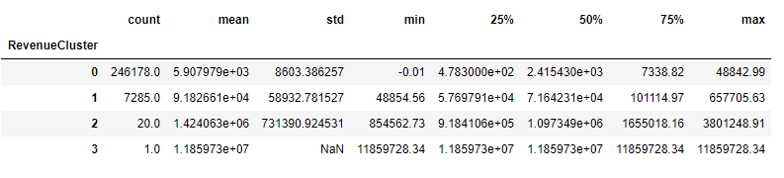
monetary

Slide 32
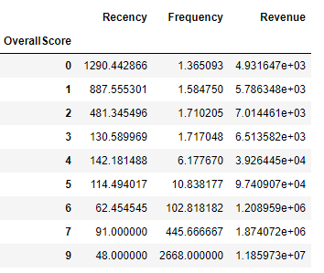

Overall score
customers with score 8 is our best customers whereas 0 is the worst.
Categorizing the whole data:
0 to 2: Low Value
3 to 4: Mid Value
5+: High Value
Total value counts of customers

Slide 33
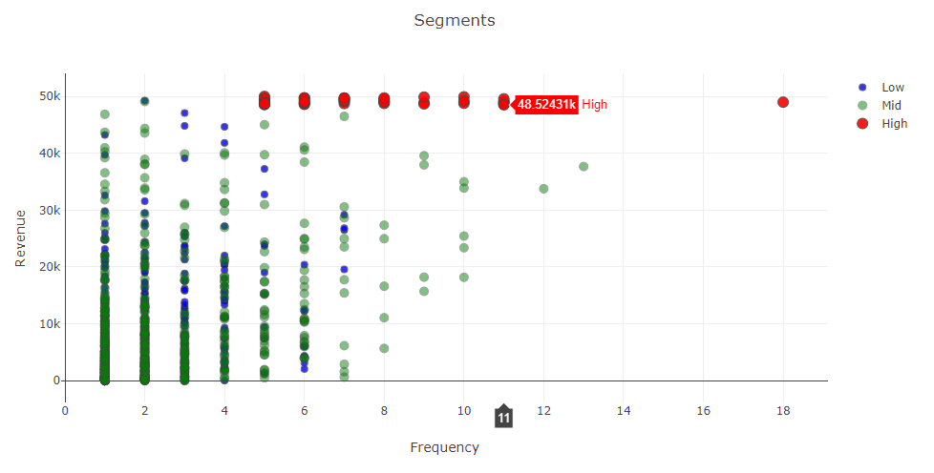
Revenue vs frequency

Slide 34
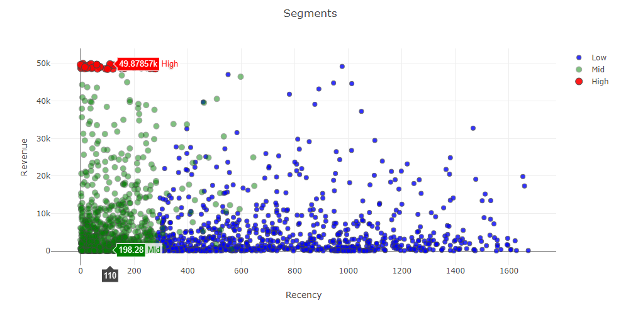
Revenue vs recency

Slide 35
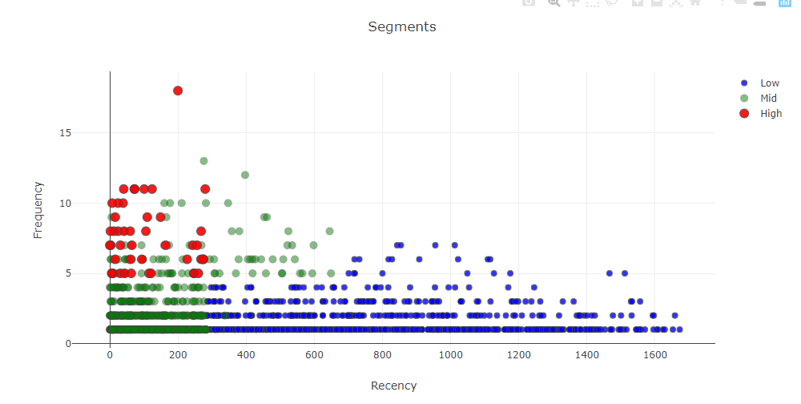
Frequency vs recency

Slide 36
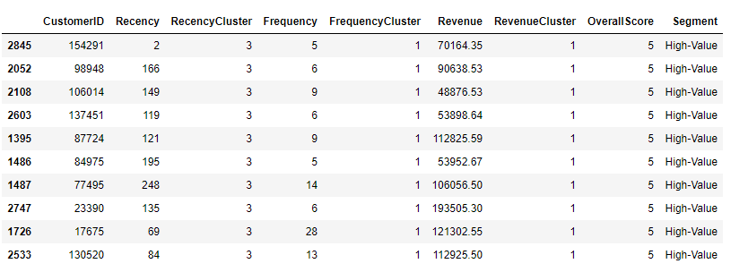
Best customers

Slide 37
Some suggestions
We can start taking actions with this segmentation. The main strategies are quite clear:
High Value: Improve Retention
Mid Value: Improve Retention + Increase Frequency
Low Value: Increase Frequency

Slide 38
Customer Lifetime Value Prediction
Lifetime Value: Total Gross Revenue - Total Cost
We are going to build a simple machine learning model that predicts our customers lifetime value
Define an appropriate time frame for Customer Lifetime Value calculation
Identify the features we are going to use to predict future and create them
Calculate lifetime value (LTV) for training the machine learning model
Build and run the machine learning model
Check if the model is useful
RFM scores for each customer ID are the perfect candidates for feature set. To implement it correctly, we need to split our dataset. We will take 3 months of data, calculate RFM and use it for predicting next 6 months. So we need to create two dataframes first and append RFM scores to them

Slide 39
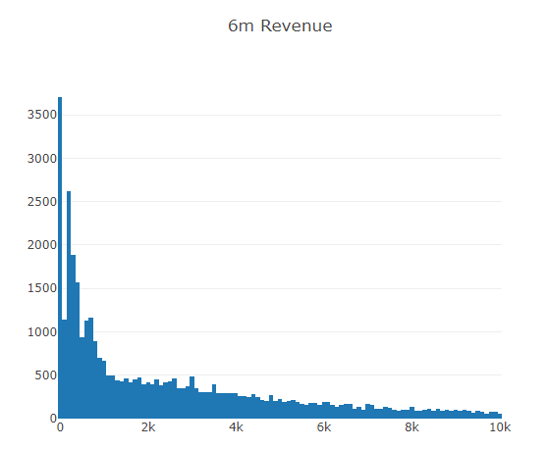
6 month customer review

Slide 40
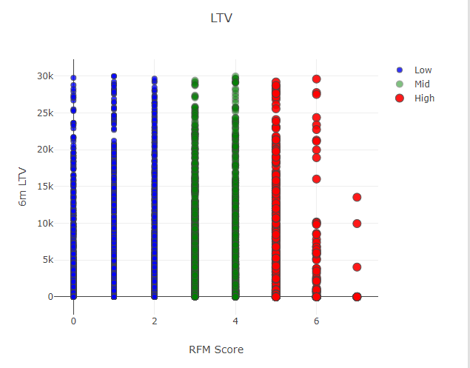
6months LTV vs RFM

Slide 41
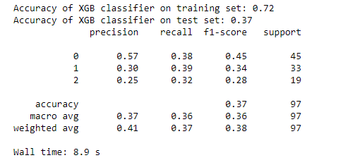
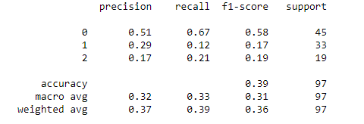
Predicting our customer LTV using clustering technique on Logistic regression and Xgboost
Logistic Regression
XGBoost

Slide 42
Refrences
https://towardsdatascience.com/data-driven-growth-with-python-part-2-customer-segmentation-5c019d150444
https://www.appliedaicourse.com/
https://www.youtube.com/watch?v=e8Yw4alG16Q&t=1043s

