Slide 1
TELECOM CHURN ANALYSIS
Description: Predicting Customer Churn and Deriving Data-Driven Retention Strategies
Tools & Technologies:
Python
SQL
Scikit-learn
SHAP
ELI5
Pandas
Matplotlib
Presented by: Shubham S Data Analyst Intern Elevate Labs

Slide 2
PROJECT OVERVIEW
Objective: To predict which telecom customers are likely to churn and derive actionable strategies to improve customer retention in a competitive environment.
Key Goals:
Identify churn-prone customers using machine learning
Interpret churn drivers using model explainability tools
Segment customers into strategic groups for marketing
3. Tools & Techniques:
SQL: Data aggregation from telecom database
Python ML: Random Forest for binary classification
Explainability: SHAP and ELI5 for feature impact analysis

Slide 3
DATASET SUMMARY
SOURCE CODE:
# Step 1: Load Data
df = pd.read_csv('telecom_customers.csv')
# Convert 'last_recharge_date' to datetime and create recency feature
df['last_recharge_date'] = pd.to_datetime(df['last_recharge_date'], errors='coerce')
df['recency_days'] = (pd.Timestamp.today() - df['last_recharge_date']).dt.days
df['recency_days'].fillna(df['recency_days'].median(), inplace=True)
print("Data Sample:")
print(df.head())
print("\nData Info:")
print(df.info())
print("\nChurn distribution:")
print(df['churn_flag'].value_counts())
Source: telecom_customers table from internal SQL database Records: 200 unique customer entries
Features Extracted:
Demographics: Age, Gender, Region
Usage: Call duration, Internet usage, Recharges
Support: Complaints, Tickets
Revenue: Monthly charges, Plan type, Contract type
Target Variable:
churn_flag: 1 (Churned), 0 (Retained)
Churn Rate: 80 / 200 = 40%

Slide 4
DATA PROCESSING & FEATURE ENGINEERING
Preprocessing:
Missing Values:
Numeric: filled using median
Categorical: filled using mode
Encoding: Label Encoding for Gender, Region, Plan Type, and Contract Type
Feature Engineering:
recency_days: Days since last recharge (derived from last_recharge_date)
total_recharges, num_complaints, and internet_usage_GB included as predictive factors
Final Feature Set: 12 independent variables used for modeling
SOURCE CODE:
# Step 2: Data Preprocessing
numeric_cols = ['age', 'monthly_charges', 'recency_days', 'calls_made', 'call_duration_total',
'num_complaints', 'internet_usage_GB', 'support_tickets', 'total_recharges']
for col in numeric_cols:
if col in df.columns:
df[col].fillna(df[col].median(), inplace=True)
categorical_cols = ['gender', 'region', 'plan_type', 'contract_type']
label_encoders = {}
for col in categorical_cols:
if col in df.columns:
df[col].fillna(df[col].mode()[0], inplace=True)
le = LabelEncoder()
df[col] = le.fit_transform(df[col])
label_encoders[col] = le
# Features and target
X = df.drop(columns=['customer_id', 'churn_flag', 'last_recharge_date', 'churn'], errors='ignore')
y = df['churn_flag']
# Train-test split with stratification
X_train, X_test, y_train, y_test = train_test_split(
X, y, test_size=0.2, random_state=42, stratify=y
)

Slide 5
MODEL TRAINING & PERFORMANCE
Model Used: Random Forest Classifier (100 Trees) Train-Test Split: 80:20 with Stratified Sampling Performance Metrics:
Accuracy: 80%
Recall for Churners: 81%
Precision for Churners: 72%
ROC AUC Score: 0.8958
The model performs well in identifying customers likely to churn, with a strong balance between precision and recall.
SOURCE CODE:
# Step 3: Model Training
clf = RandomForestClassifier(n_estimators=100, random_state=42)
clf.fit(X_train, y_train)

Slide 6
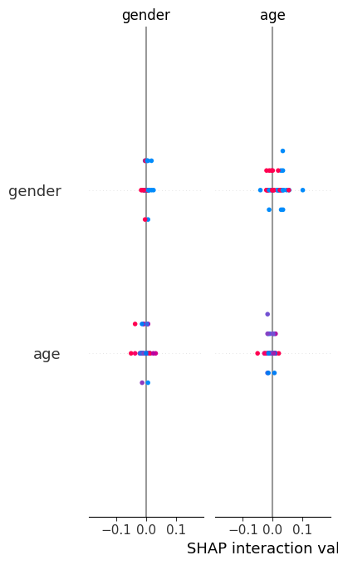
FEATURE IMPORTANCE & EXPLAINABILITY
Tools Used:
ELI5: Permutation importance
SHAP: SHapley Additive Explanations
Top Influential Features:
Monthly Charges
Recency Days
Internet Usage
Call Duration Total
Number of Complaints
Insights:
Higher charges and longer time since last recharge increase churn probability
Lower usage and more complaints also correlate with churn

Slide 7
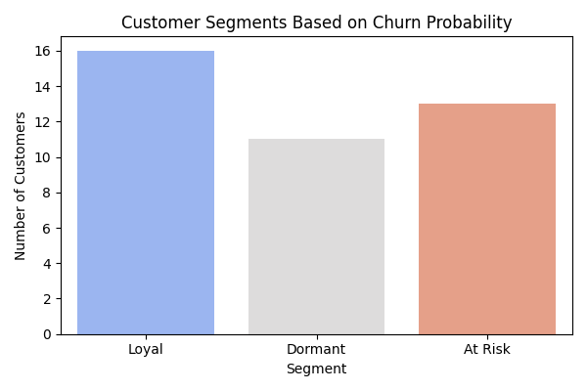
CUSTOMER SEGMENTATION
Method: Segmenting customers based on churn probability (y_proba)
Segments Created:
At Risk: Probability > 0.7
Dormant: 0.3 ≤ Probability ≤ 0.7
Loyal: Probability < 0.3
Segment Distribution:
Helps marketing focus offers on high-risk customers
Enables loyalty rewards for low-risk customers
Dormant users may need nudges to stay engaged

Slide 8
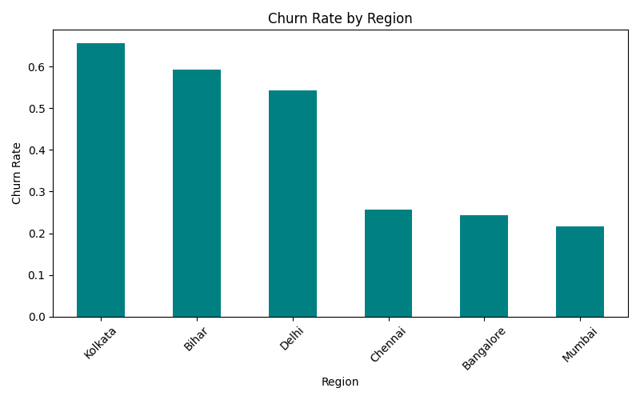
REGIONAL INSIGHTS
Analysis: Churn rates calculated per region after decoding label-encoded region values.
Findings:
Some regions (e.g., Delhi or Chennai) show higher churn rates than others
These regions may require localized retention campaigns
Action:
Prioritize support improvements and personalized plans in high-churn regions

Slide 9
FINAL RECOMMENDATIONS
1. Target High-Risk Customers
Use retention offers, recharge bonuses, or loyalty discounts
2. Reduce Complaint Volume
Improve support experience for customers with high ticket counts
3. Reward Loyal Customers
Launch a loyalty program or special renewal benefits
4. Monitor Dormant Users
Use engagement campaigns to revive potentially inactive users
5. Regional Strategy
Allocate budget to high-churn regions for personalized offers and better service

Slide 10
THANK YOU

