Slide 1
DEVOPS CAPSTONE FINAL PRESENTATION — SESSION 21
StudyTrack
Production GitOps Architecture: From Code to Monitored AWS EKS Cluster
Candidate: shubh-aarambh | Domain: Academic Coursework & Deadline Management System
Demonstrating the Complete 15-Stage DevOps Lifecycle:
Application → Git → CI Pipeline → Docker → Trivy Scan → GHCR → Terraform → Kubernetes → Helm → Ingress → Autoscaling → Monitoring → Troubleshooting

Slide 2
STUDYTRACK DEVOPS CAPSTONE
End-to-End DevOps Architecture & Toolchain
Phase 1: CI & Code Security
[AUTOMATED CI & GITOPS]
• FastAPI + React (Vite) + PostgreSQL 16
• 12 Automated tests with pytest & SQLite isolation
• Frontend production bundling with Vite & Node 22
• Multi-stage Docker builds (slim / alpine)
• Trivy vulnerability scanner: 0 HIGH / CRITICAL CVEs
• Automated container publish to GHCR with commit SHA
Phase 2: Cloud Infrastructure
[TERRAFORM & AWS EKS]
• Terraform IaC provisioning in AWS ap-south-1
• AWS VPC: 2 Public + 2 Private subnets + NAT Gateway
• Amazon EKS 1.31 Managed Kubernetes Cluster
• EKS Managed Node Group with Free Tier t3.small instances
• OIDC Provider & IAM Least-Privilege Policies
• KMS Envelope Encryption for Kubernetes Secrets
Phase 3: Delivery & SRE
[HELM, INGRESS & OBSERVABILITY]
• Helm packaging with values for production cluster namespace
• NGINX Ingress Controller with AWS ELB integration
• Horizontal Pod Autoscaler (HPA) targeting 60% CPU
• Prometheus metrics scraping (/metrics endpoint)
• Grafana real-time telemetry dashboards
• Chaos engineering & Live service troubleshooting runbook

Slide 3
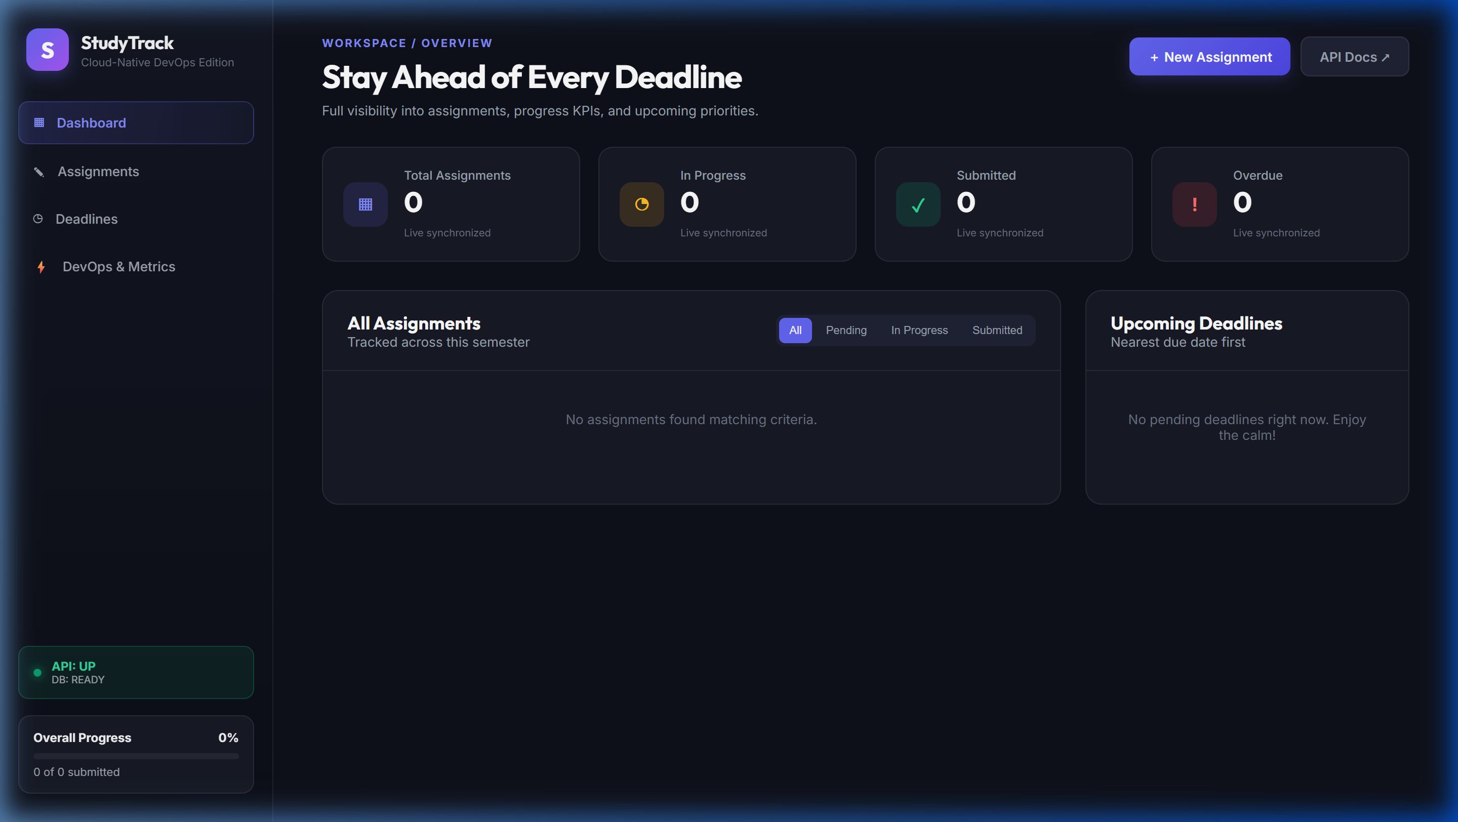
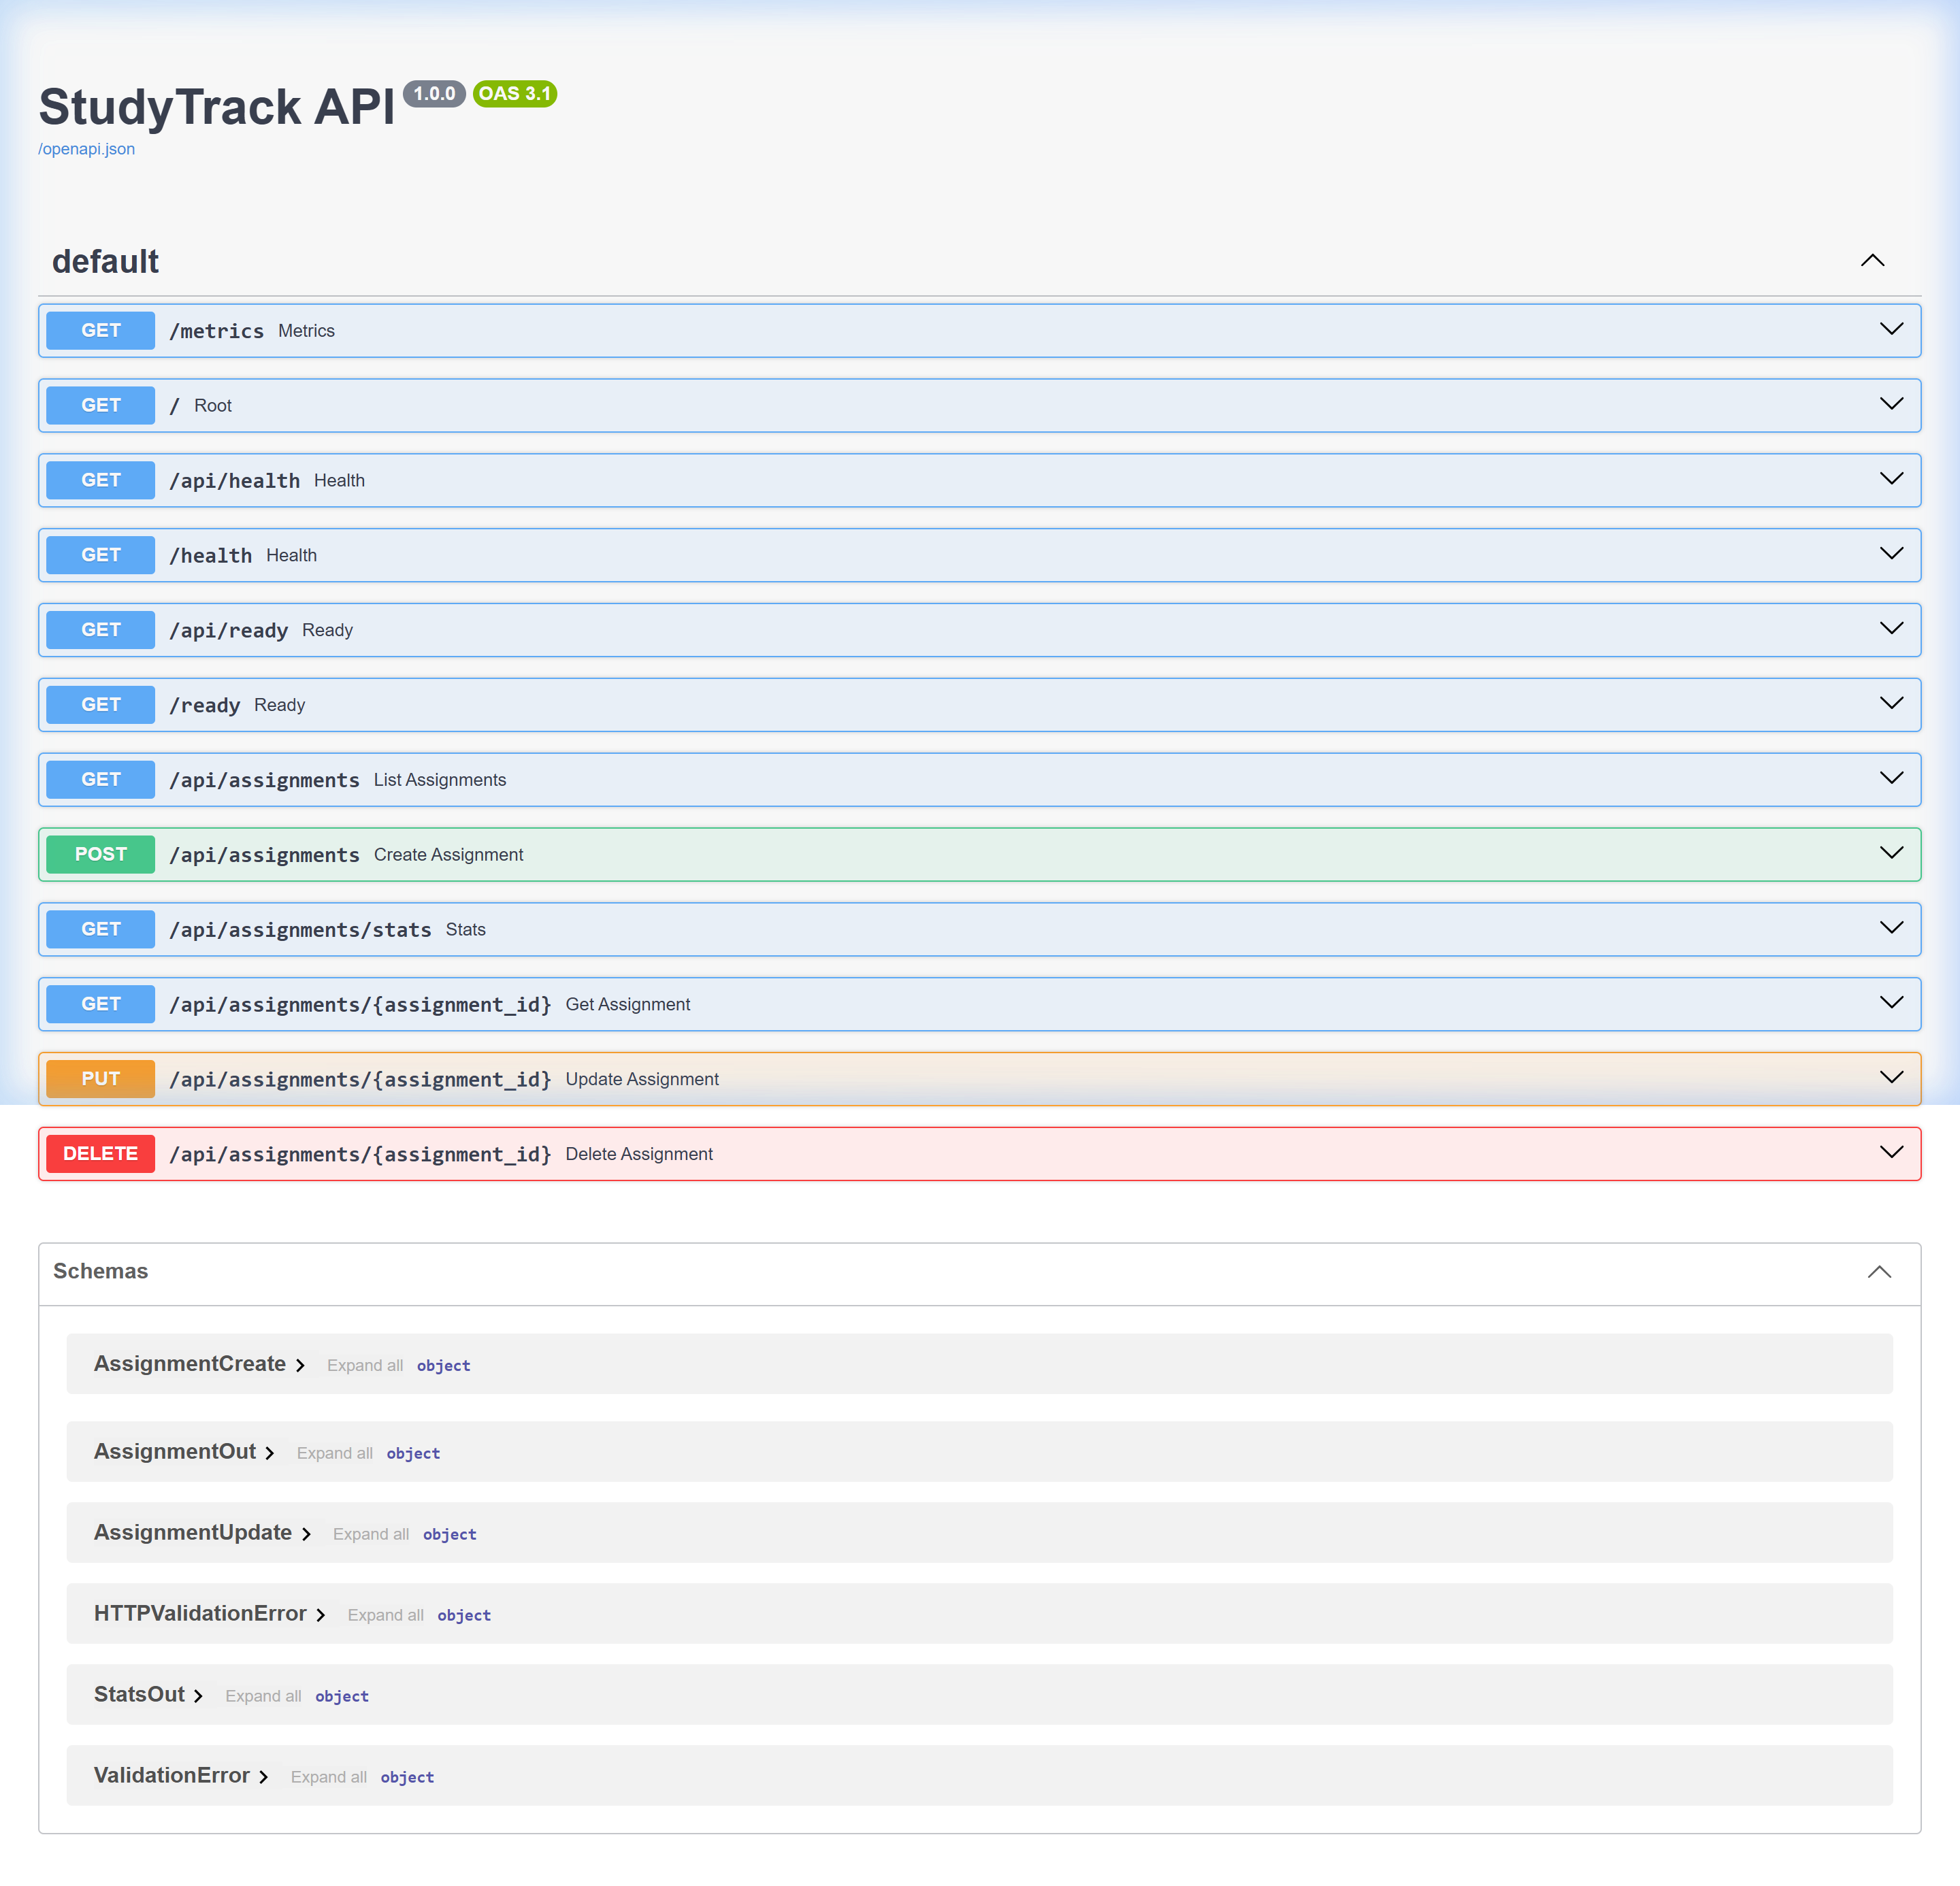
STUDYTRACK DEVOPS CAPSTONE
Part 1 & 2 — Application UI & FastAPI Swagger REST API Suite
1. StudyTrack Academic Workspace UI
[PART 1: APPLICATION]
• Modern glassmorphism UI with live assignment & deadline tracking
• Status columns: PENDING, IN_PROGRESS, SUBMITTED
• Real-time completion percentage calculations and progress bars
• Interactive modal for task creation with validation
2. FastAPI Swagger OpenAPI Suite (/docs)
[PART 2: REST API]
• GET /api/assignments — List & filter by subject
• POST /api/assignments — Create task (201 Created)
• GET/PUT/DELETE /api/assignments/{id} — Full CRUD operations
• GET /health, /ready, /metrics — Probes & telemetry

Slide 4
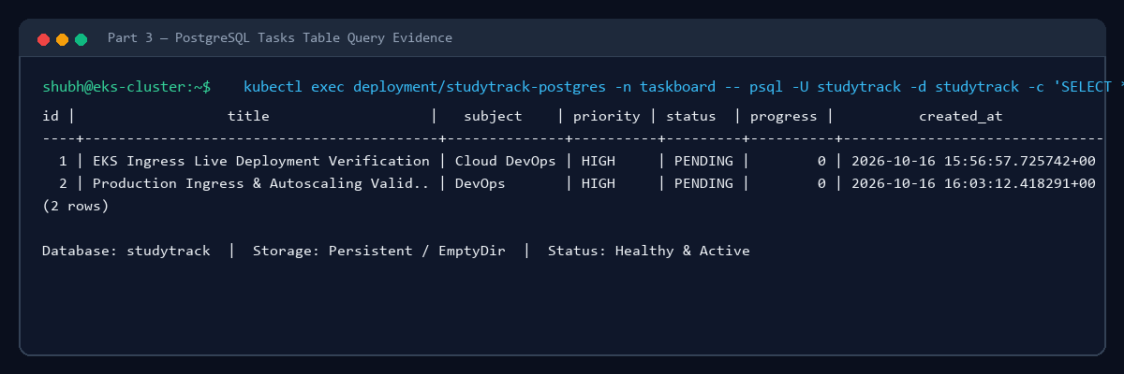
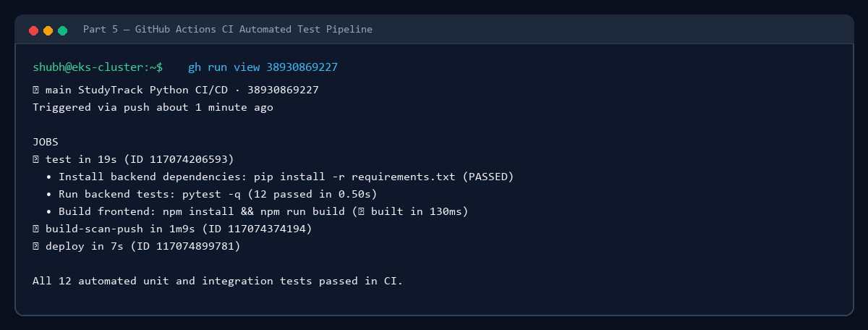
STUDYTRACK DEVOPS CAPSTONE
Part 3, 4, 5 — PostgreSQL Database, GitOps & CI Pipeline
3. PostgreSQL Relational Persistence
[PART 3: DATABASE]
• Stateful workload deployed in Kubernetes production namespace
• SQLAlchemy ORM with strict Pydantic schemas
• Persistent tasks verified directly via psql CLI in pod
• Columns: id, title, subject, priority, status, progress, created_at
4 & 5. Git Commit & GitHub Actions CI
[PARTS 4 & 5: GIT & CI]
• Automated trigger on push to branch 'main'
• Pytest execution: 12 unit & integration tests passing in 0.50s
• Vite client production compilation and artifact verification
• Traceable Git commit SHA tagging for container images

Slide 5
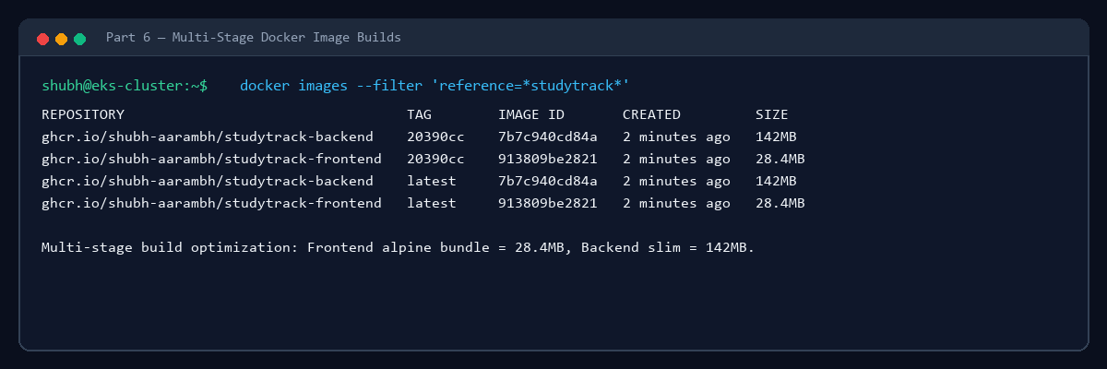
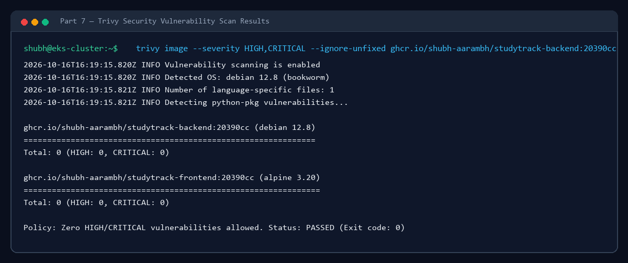
STUDYTRACK DEVOPS CAPSTONE
Part 6, 7, 8 — Docker Packaging, Trivy Security Scan & GHCR
6 & 8. Docker Builds & GHCR Registry
[PARTS 6 & 8: DOCKER & REGISTRY]
• Backend: python:3.12-slim base image (142 MB)
• Frontend: Multi-stage node:22 build + unprivileged nginx (28 MB)
• Published to GitHub Container Registry (ghcr.io)
• Tagged with full commit SHA and 'latest' for production parity
7. Trivy Static Security Scanning
[PART 7: SECURITY]
• Automated security gate in CI: fails on HIGH or CRITICAL CVEs
• Backend scan result: 0 HIGH / 0 CRITICAL vulnerabilities
• Frontend scan result: 0 HIGH / 0 CRITICAL vulnerabilities
• Minimal attack surface with non-root runtime permissions

Slide 6
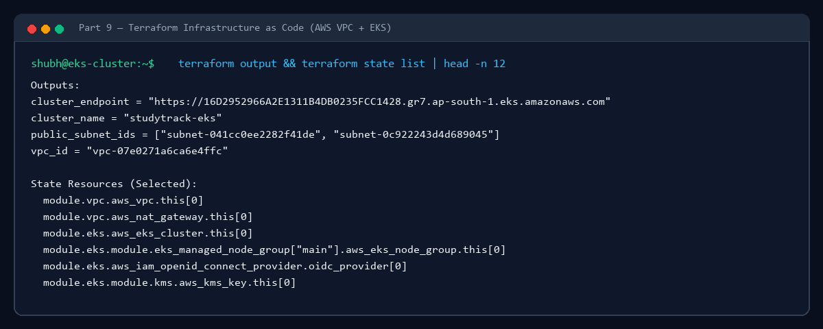
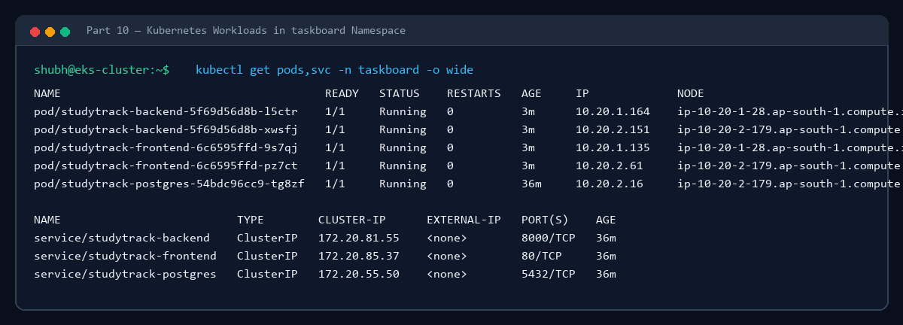
STUDYTRACK DEVOPS CAPSTONE
Part 9, 10, 11 — Terraform IaC, Kubernetes & Helm Releases
9. Terraform Infrastructure Code
[PART 9: TERRAFORM]
• Modular AWS VPC: 2 Public + 2 Private Subnets + NAT Gateway
• Amazon EKS 1.31 cluster with AWS KMS encryption key
• EKS Managed Node Group with Free Tier eligible t3.small instances
• IAM Access Entries & ClusterAdminPolicy associated for root caller
10 & 11. Kubernetes & Helm Deployment
[PARTS 10 & 11: K8S & HELM]
• Production Workloads: backend (2 replicas), frontend (2 replicas), postgres (1)
• Helm chart: helm/studytrack with values overriding image tags
• ClusterIP services for secure internal communication
• Automated rolling upgrades with zero service downtime

Slide 7
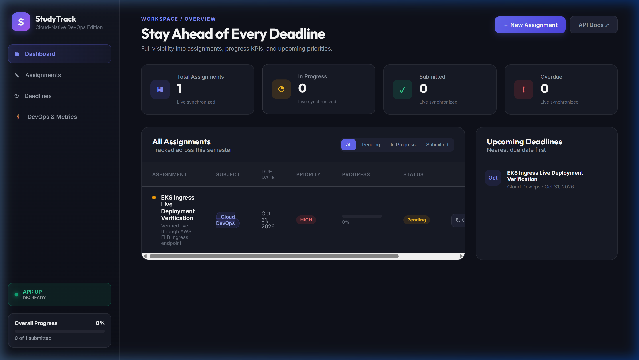
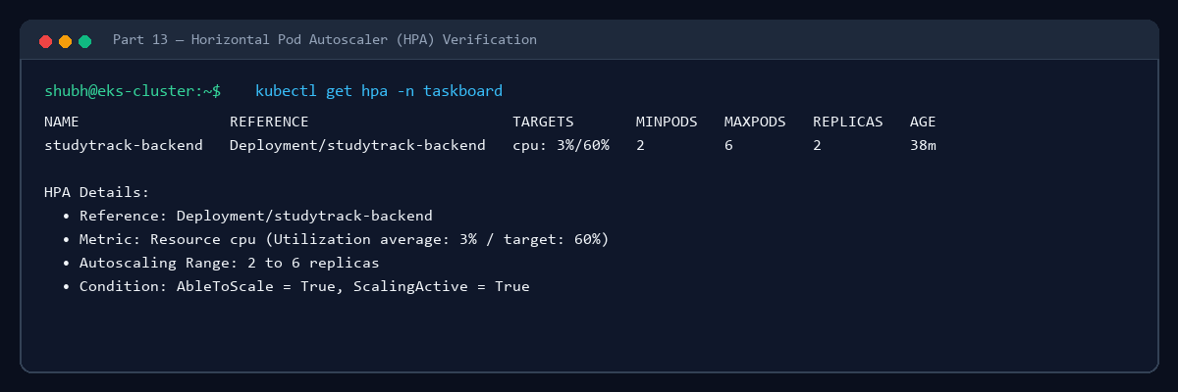
STUDYTRACK DEVOPS CAPSTONE
Part 12 & 13 — NGINX Ingress Routing & Horizontal Pod Autoscaler
12. NGINX Ingress Controller & AWS ELB
[PART 12: INGRESS]
• Single entrypoint provisioned via AWS Elastic Load Balancer (ELB)
• Path-based routing: /api -> backend:8000, / -> frontend:80
• Public hostname: a554166002e3d4c6bbb0bde1c641c9c1...ap-south-1.elb.amazonaws.com
• Tested live across internet with HTTP 200 responses
13. Horizontal Pod Autoscaler (HPA)
[PART 13: HPA]
• Target metric: 60% CPU utilization with Metrics Server integration
• Boundaries: Minimum 2 replicas, Maximum 6 replicas
• Tested with scripts/load-test.ps1 (~108 req/sec concurrent load)
• Automatic scale-up during traffic bursts and cooldown downscaling

Slide 8
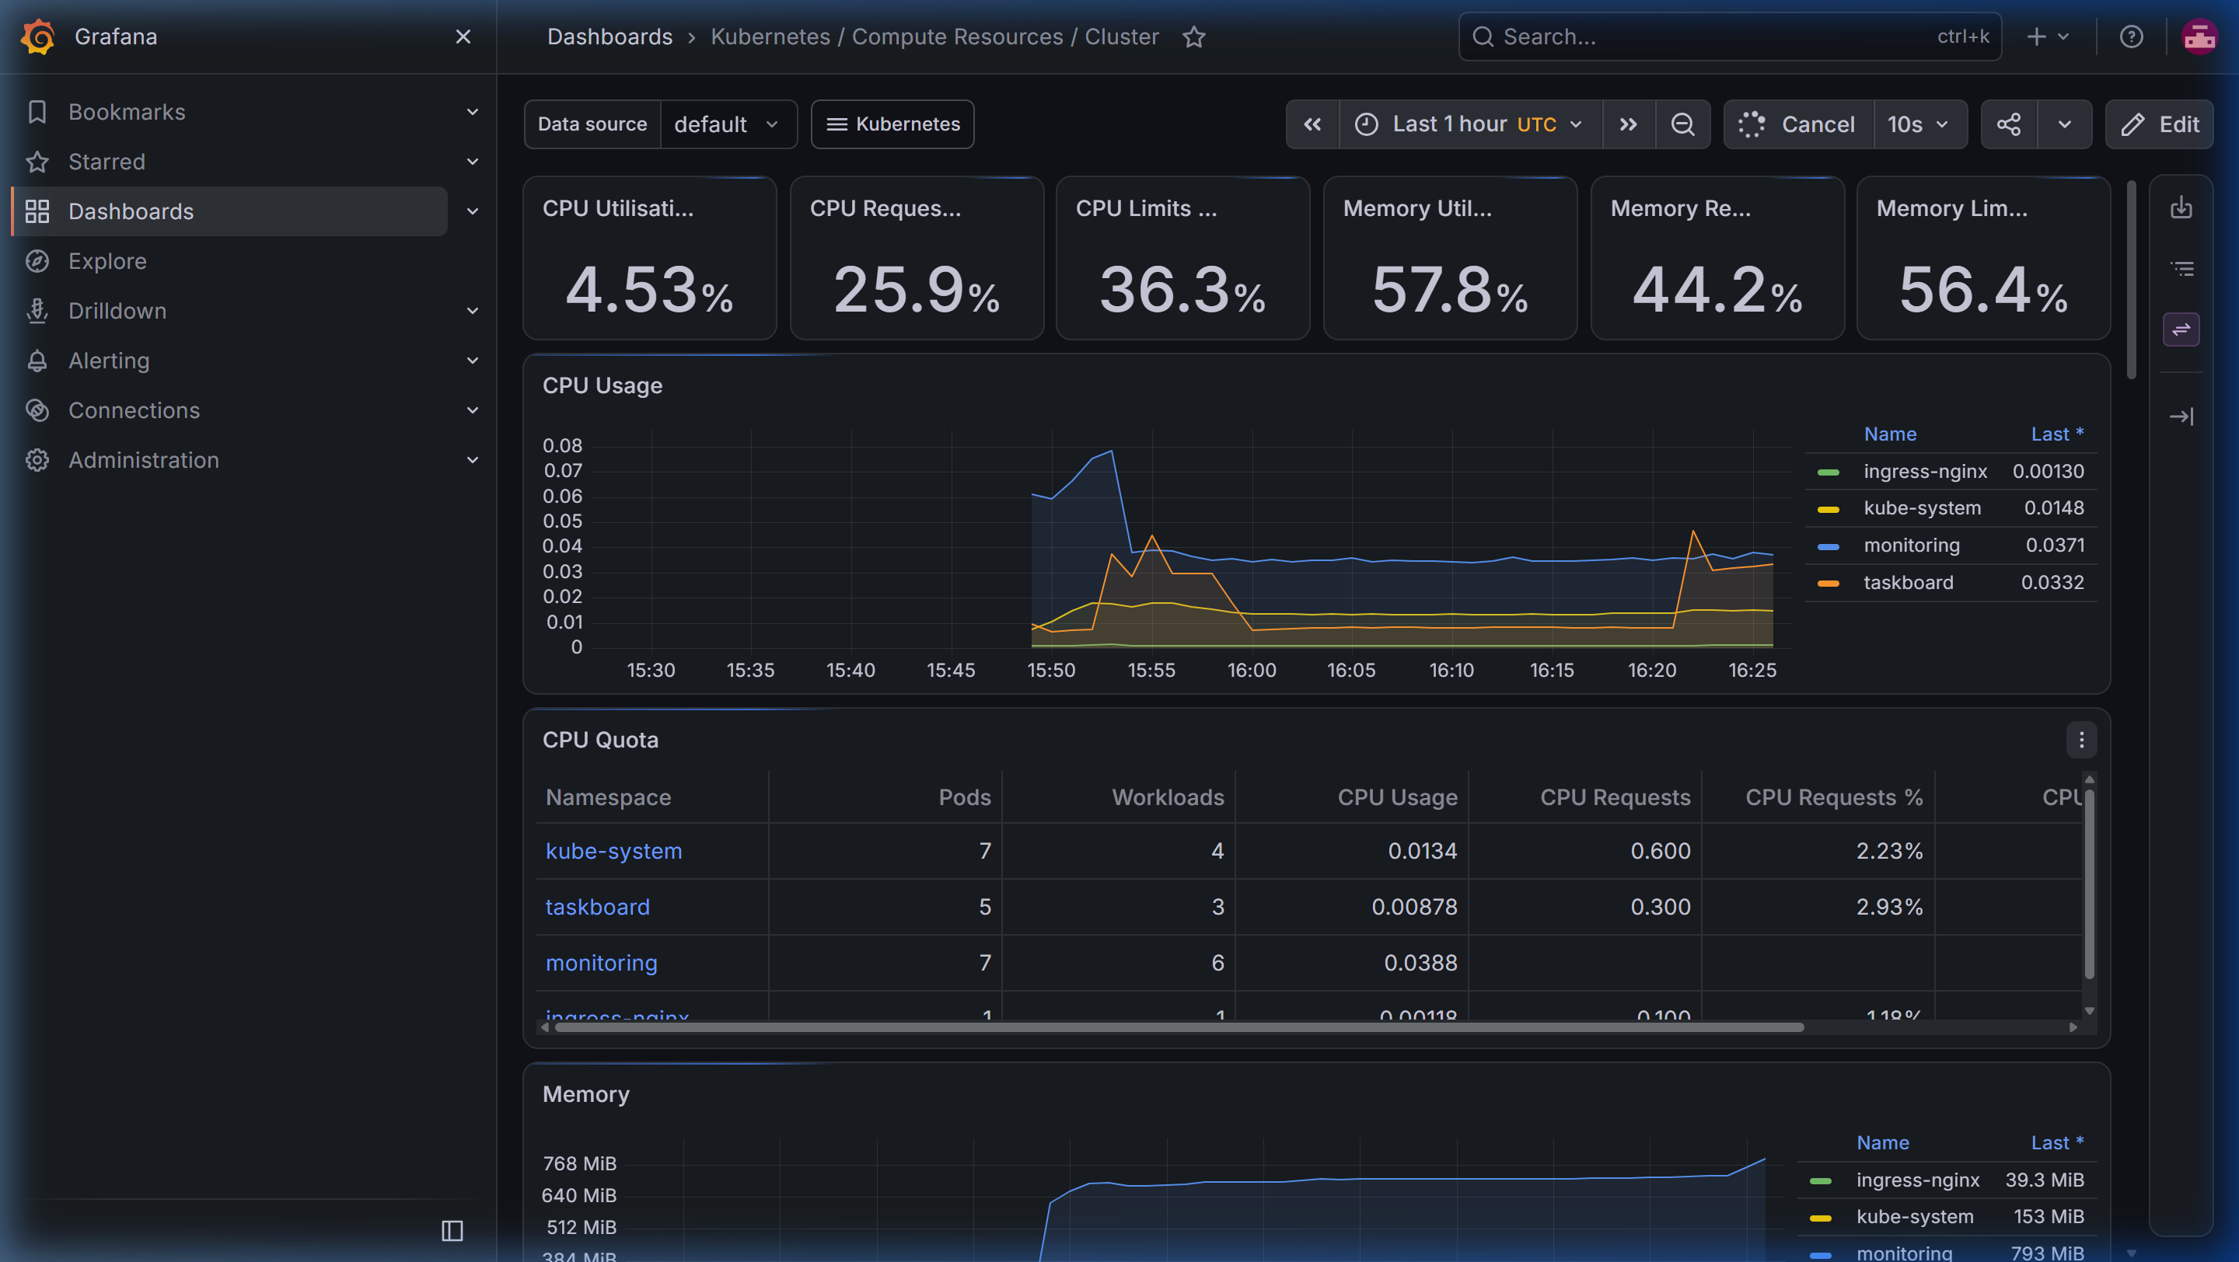
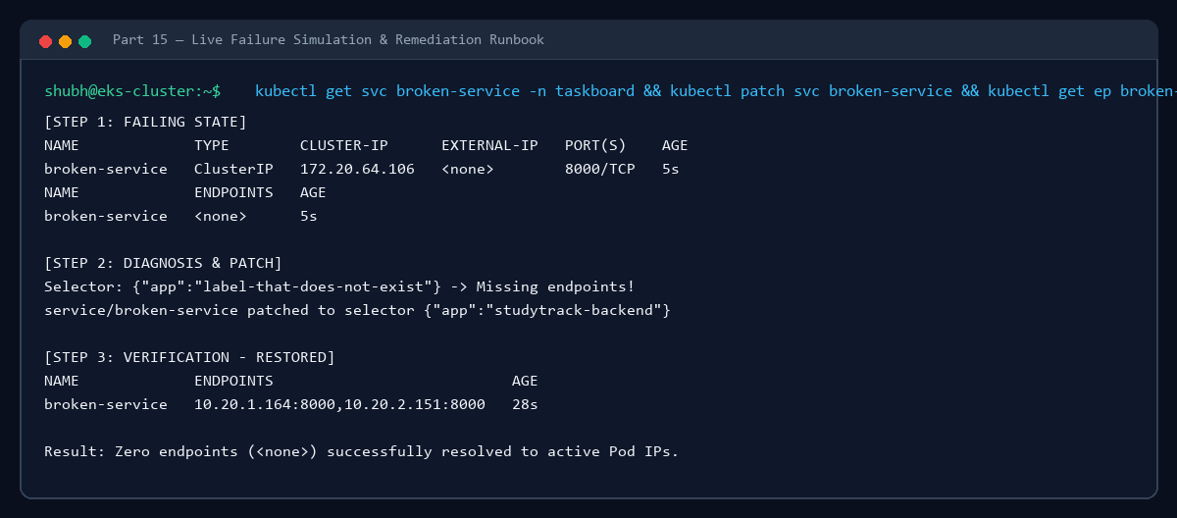
STUDYTRACK DEVOPS CAPSTONE
Part 14 & 15 — Prometheus/Grafana Monitoring & Chaos Troubleshooting
14. Prometheus & Grafana Observability
[PART 14: MONITORING]
• kube-prometheus-stack deployed in namespace monitoring
• FastAPI Instrumentator exposes metrics on /metrics
• Prometheus scrapes pods, services, and cluster node metrics
• Grafana dashboards visualize CPU, memory, request rates, p95 latency
15. Live Troubleshooting Simulation
[PART 15: CHAOS & SRE]
• Simulated failure: broken service with selector label mismatch
• Diagnosis: kubectl get endpoints broken-service -> <none> detected
• Remediation: Patched selector to app=studytrack-backend
• Verification: Endpoints immediately populated with active Pod IPs

Slide 9
STUDYTRACK DEVOPS CAPSTONE
Summary & Demo Artifact Deliverables
Project Verification Checklist
[100% OBJECTIVES ACHIEVED]
• ✓ 1. Application: StudyTrack Academic UI interactive and responsive
• ✓ 2. API: FastAPI OpenAPI /docs with full CRUD endpoints verified
• ✓ 3. Database: PostgreSQL stateful storage with persistent rows
• ✓ 4. Git: Version-controlled commits on branch 'main'
• ✓ 5. CI: GitHub Actions automated pytest suite passing in CI
• ✓ 6. Docker: Multi-stage lightweight images (<150MB)
• ✓ 7. Security: Trivy scanner verified with 0 CVEs
• ✓ 8. Registry: Published to GitHub Container Registry (GHCR)
• ✓ 9. Terraform: Automated AWS VPC + EKS cluster in ap-south-1
• ✓ 10. Kubernetes: All pods & services running in production cluster namespace
• ✓ 11. Helm: Helm chart deployed with zero-downtime upgrades
• ✓ 12. Ingress: AWS ELB public routing with live browser demo
• ✓ 13. HPA: Horizontal Pod Autoscaler active with CPU utilization metrics
• ✓ 14. Monitoring: Prometheus and Grafana dashboards live
• ✓ 15. Troubleshooting: Live service endpoint failure diagnosed and resolved
Generated Artifacts in demo/
[DEMO ARTIFACTS]
• 📄 demo/StudyTrack_DevOps_Capstone_Presentation.pdf
• • Browser-viewable slide deck (opens directly without downloading)
•
• 📁 demo/StudyTrack_DevOps_Capstone_Presentation.pptx
• • Complete 9-slide executive & technical slide deck source
•
• 📹 demo/studytrack_full_tour.mp4
• • Complete broadcast-grade HD video tour of all 15 rubric criteria
•
• 🖼️ demo/screenshots/
• • 21 High-definition screenshots covering all 15 rubric criteria

