Slide 1
MoVIE POster ANALYSIS BASED ON COLOR SCHEMES

Slide 2
The Team
Raghav Sonavane (14EC30025)
Arvind Srivastav (14EC30007)
Jayasurya Pitchuka (14EC10036)
Shubh Agrawal (14ME30003)
Pranshu Agrawal (14ME10071)

Slide 3
Purpose OF MOvie Poster
To attract the audience.
A film poster provides a range of information on an upcoming film.
The photos and graphics of the poster can suggest a particular genre and narrative that the film will follow.
It teases the audience with the attractive components of the film, and arouses interest in seeing it.
Let’s see a poster of very famous movie The Notebook.

Slide 4
In the beginning I would like you to play a game.
These are some steps you need follow:
Step1: Take a close look at this poster.
Step2: What can you infer from it.
Step3: Now close your eyes.
Step4: Remember anything whatsoever comes to your mind.
Now, Let’s compare with what we’ve thought of it.

Slide 5
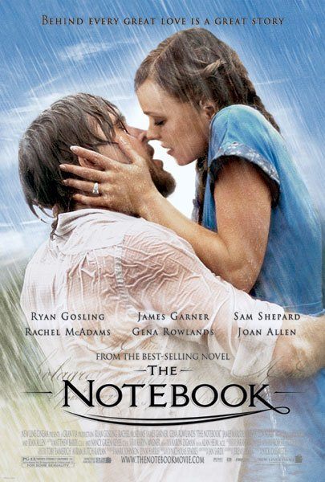

Slide 6
Tagline-Target Audience
Color Shading
Symbol-Ring
Indulgence-Greediness

Slide 7
OKAY,We Understood how to analyze a movie poster But what’s the idea behind this Project

Slide 8
Categorization
A movie poster targets a certain group of people , who tend to infer the infographics of the poster.
A poster can be segregated based on different features such as:
Texture, Colors ,Shades,Objects, Release Date
etc.

Slide 9
Why colors are important?

Slide 10
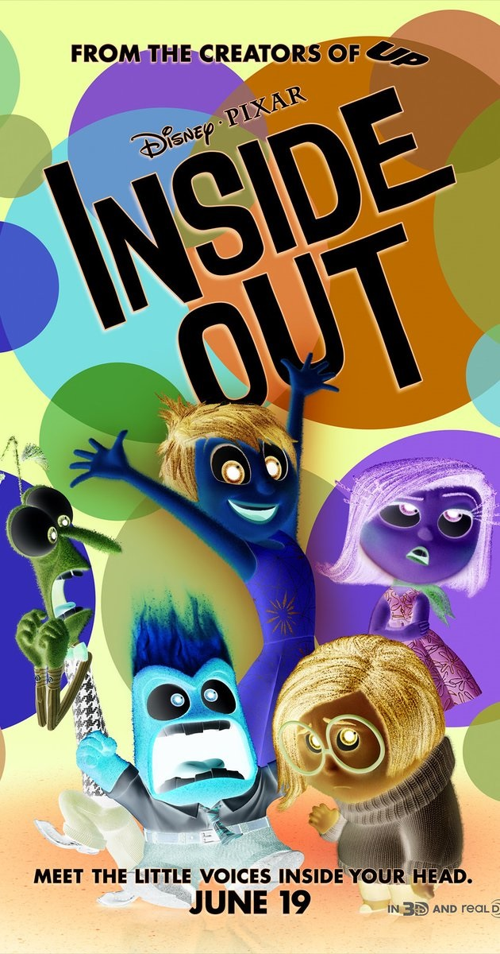
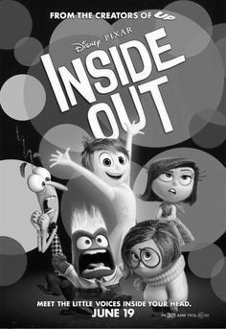
Same Image bring huge change in the perception, meaning and importance on different elements.
In this each emotion is signified by a certain color like red for Rage, Blue for Sadness, etc.
Without colors the essential characteristics portrayed by each character and their emotions cannot be identified easily.

Slide 11
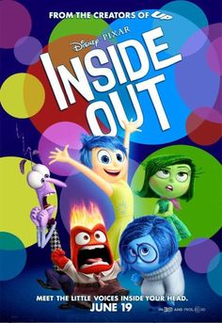
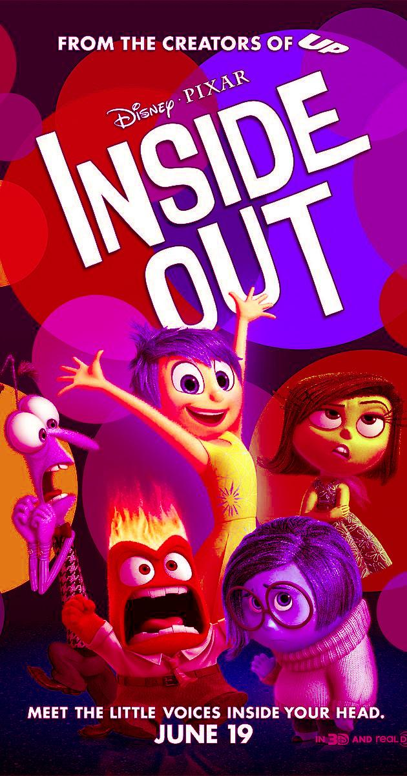
A movie poster with imperfect proportion of colors would not be able to convey its message in as powerful way as it otherwise does.
Emotionally, we react strongly to colors. No matter how good a poster may be in its design, if stripped of all colour it would not be very impressive. .

Slide 12
FOCUS ON COLORS
Colour is one of the best tools in design and allows for a vast amount of possibilities for conveying one's message to the viewer.
There are many layers to Colour Perception. Age, culture, geography and political views all play a part in how we interpret specific colours.

Slide 13
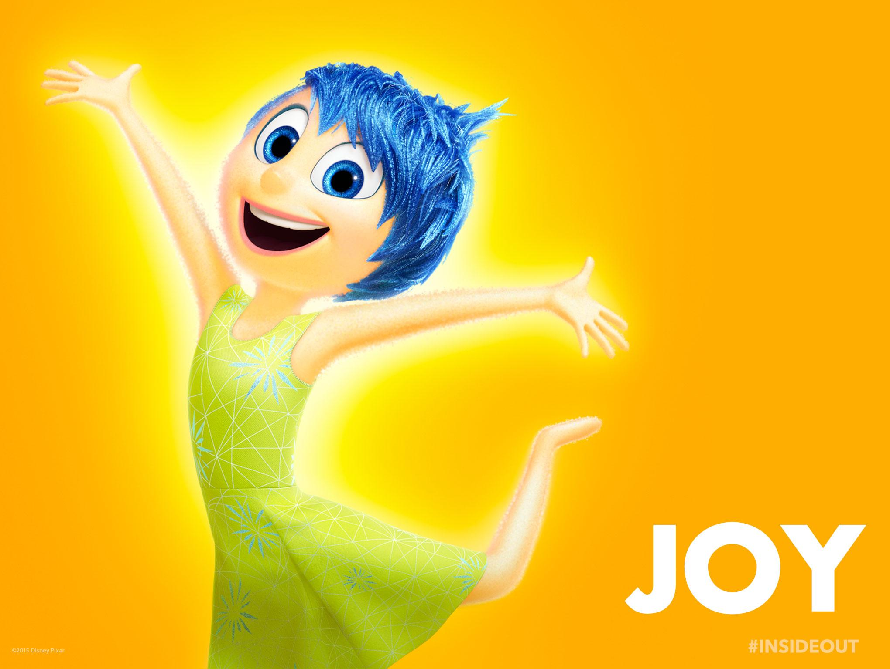

Slide 14
PINK: It is youthful and feminine.Light pink is seen
as a delicate. And humor.
ORANGE:It is a color of fire and derived from fruit.
Due to correspondence with fire and explosion ,action
movies can be related to orange color.
YELLOW:Bright yellows are equally cheerful, although more energetic and eye-catching than the
paler yellows.In contrast, It is mostly used as Warning symbolizing Danger.

Slide 15


Slide 16
RED: It has the greatest emotional impact of all color.It is thought of as power or passion.It is also color of blood , so may symbolize with horror movie genre.
Black: It has an image of darkness, conservative and sophisticated.Yet,in some countries and religions black is considered as pure and elegant.
Blue: It is often thought of as calm and serene color.it is also associated with hospital and sickness. Sea and sky has the same color. it is seen as trustworthy and reliable.

Slide 17
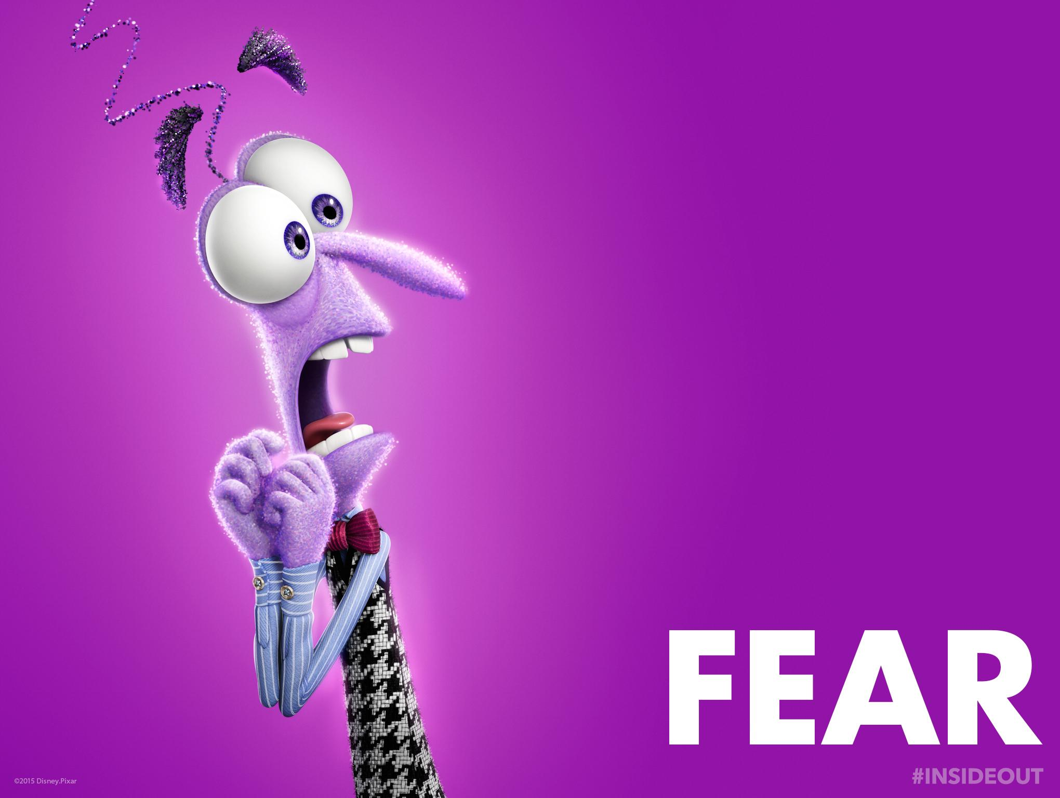

Slide 18
Brown: Logically connected to earth conveying warmth and stability.Negatively, It is also
connected to dirt and odours.Brown is generally not used as an emerging color, though I love it due to chocolates.
Green: It is used to represent nature and purity.In animated movies money is portrayed by green bills.Inexperience and disgust are also described by green due to this being the color of unripe feuits and vegetables.

Slide 19
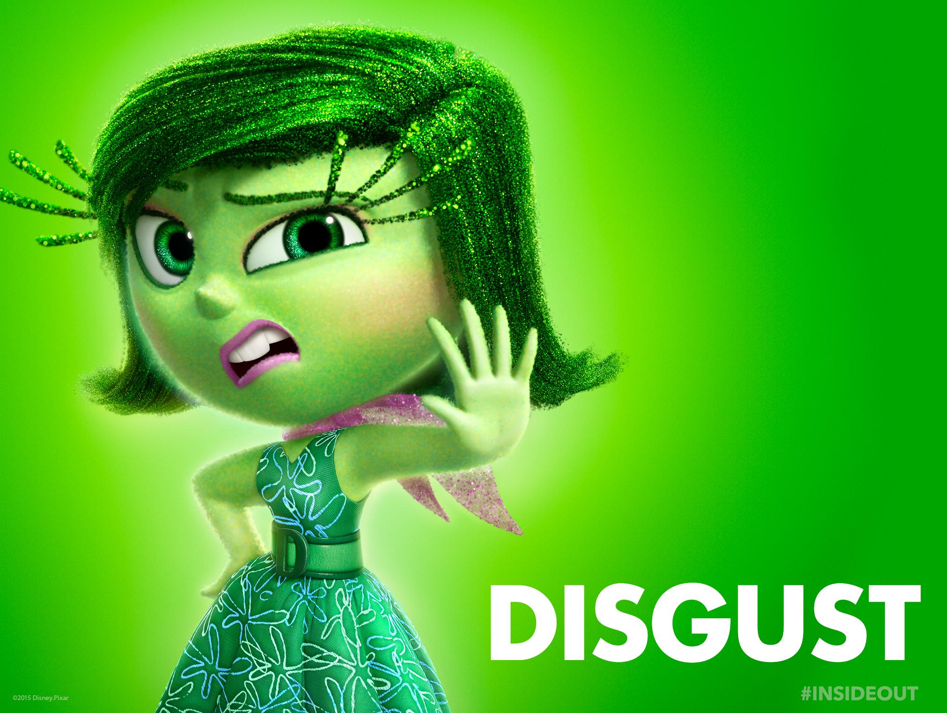

Slide 20
Color symbolism and Psychology
Naturally, age, culture, political views and geographical locations all impact how color symbolism in the movies
is interpreted.
Each genre of movies: be it romantic, Sci-Fi, Action, Animated ,Comedy etc uses certain favored colors to create individual identity for each movie.

Slide 21
1. Understanding the importance of Colors in different genres & how they evolve with time
Our Work
Analysing the evolution of the ever changing styles and cultures in people’s influence in cinema in different eras along with the advancement in technology and poster design.

Slide 22
2. COntrasting two cultures in how their color perception changed with time in different genres
Analysing the difference in cultures between the east and the west and how they affect the essential poster and cinema of the two worlds.
The evolution of the poster design in these cultures with times and their impact.

Slide 23
Basic MEthodology
Genres: Action, Comedy, Horror, and Romance (4)
Timelines used: 1990s: 1985-1999 2000s: 2000-2009 2010s: 2010-2016
Cultures: Bollywood & Hollywood
Image Data scrapped from imdb: 800 images(approx)
Analysis: Image using opencv and Text NLP

Slide 24
But How to Segregate and Compare two poster
Here we used the method of color-symbolism which we discussed earlier in this slide.
We represented different movie poster images in the form of color palettes.
We compared them using Hausdorf and Mahalanobis distance measuring algorithm to find trend between different genres.

Slide 25
We generated a dataset of around 50 posters in each genres for each timeline in two different cultures ie. Bollywood and Hollywood.
We obtained hue values of dominant colors in the poster using K-mean clustering with 2 hidden layer(HMM) machine learning method and analysed for further visualization and post-processing.

Slide 26
Results
Notes:
Action Hollywood 1990-2000

Slide 27


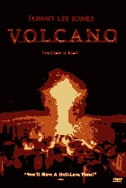
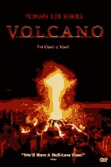

ACTION MOVIE
4 Color Bar and Poster
8 Color Bar and Poster
Original Poster
Notes:
Action Hollywood 1990-2000

Slide 28


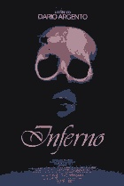
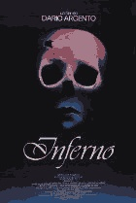
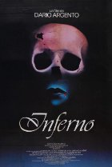
Horror Movie
8 Color Bar and Poster
Original Poster
4 Color Bar and Poster
Notes:
Hollywood Horror 1990-2000

Slide 29

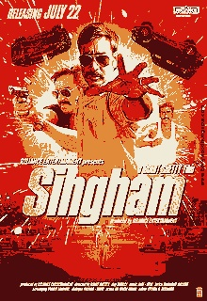
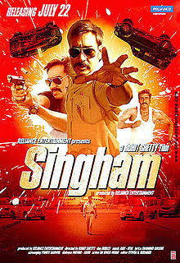

Slide 30



ACTION MOVIE
4 Color Bar and Poster
Original Poster
Notes:
Action Hollywood 1990-2000

Slide 31
SOME TECHNICAL Key Points
Different genres can be influential candidate in different movies altogether.
Assuming movies to be identically independent candidate we applied feature extraction algorithm to get dominant colors.
For different genres in specified tenure, we plotted a histogram of dominant colors(varies from 8-11).

Slide 32
FINAL RESULT: Variation of colors with time
Normalized eigen-components/features
Notes:
Hollywood Horror 2010-2016

Slide 33
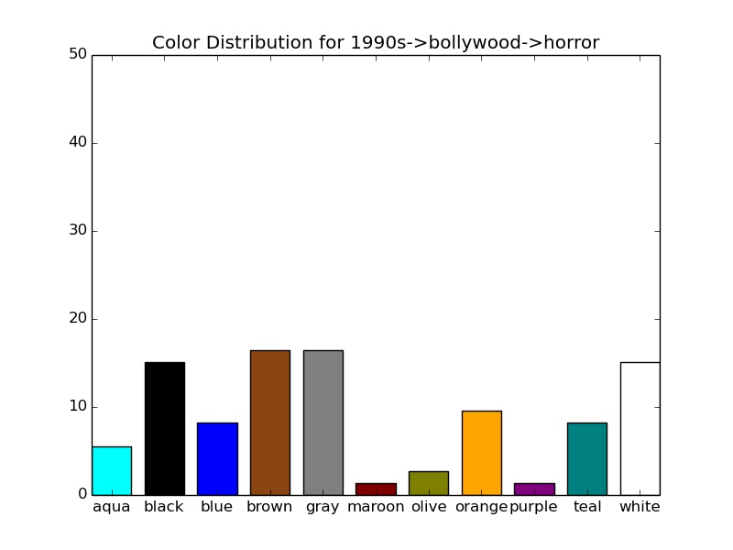
Notes:
Action Hollywood 1990-2000

Slide 34
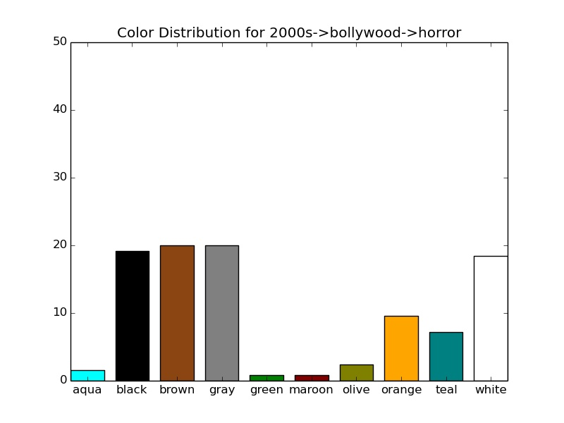
Notes:
Action Hollywood 1990-2000

Slide 35
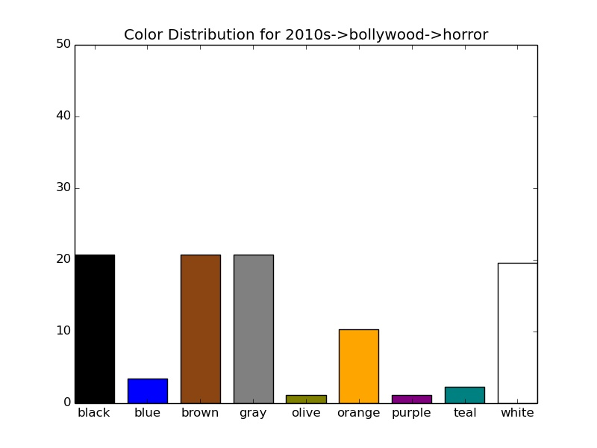
Notes:
Action Hollywood 1990-2000

Slide 36
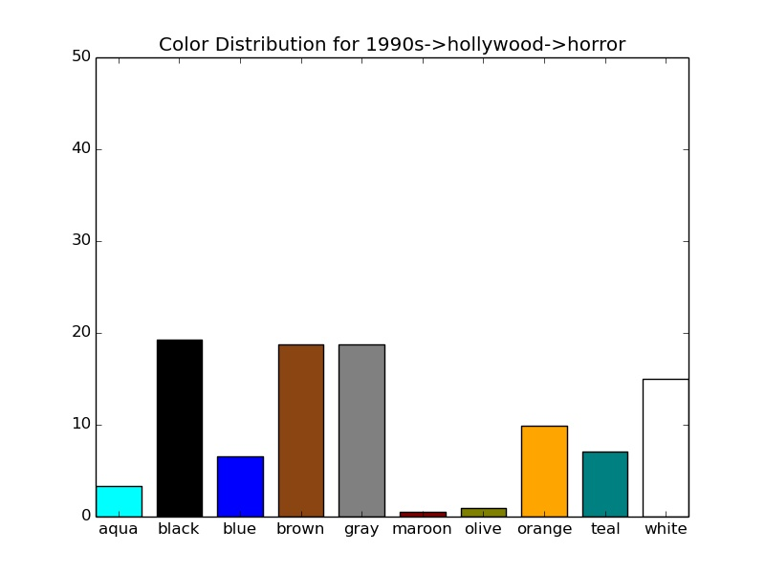
Notes:
Action Hollywood 1990-2000

Slide 37
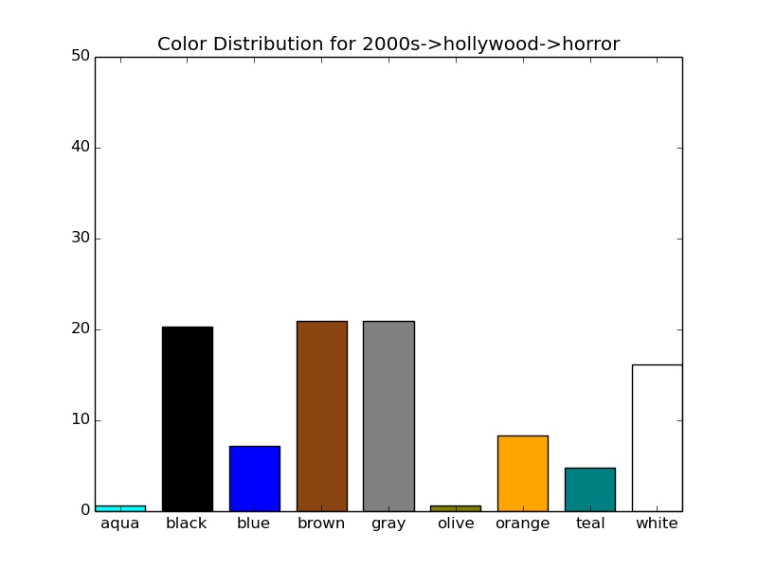
Notes:
Action Hollywood 1990-2000

Slide 38
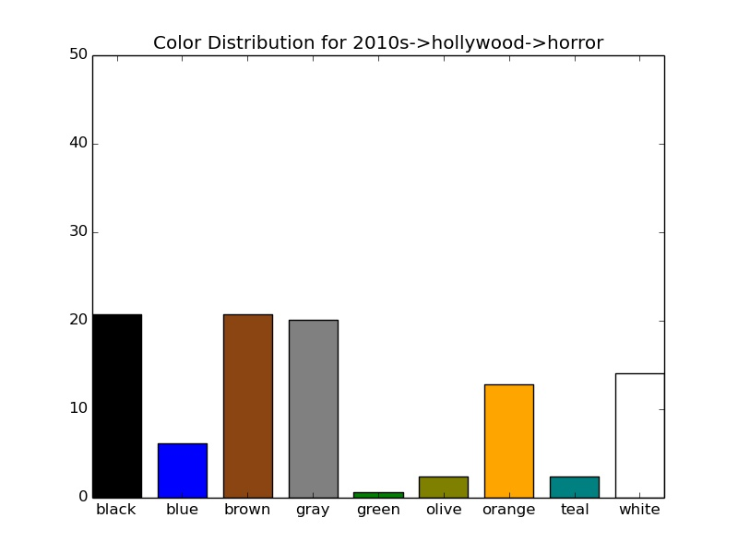
Notes:
Action Hollywood 1990-2000

Slide 39
Poster remaking
Just like heaven
Notes:
Hollywood Horror 2010-2016

Slide 40
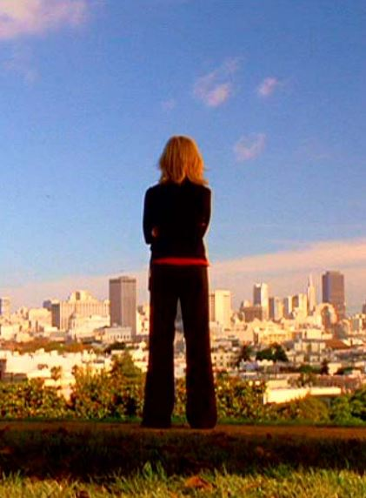
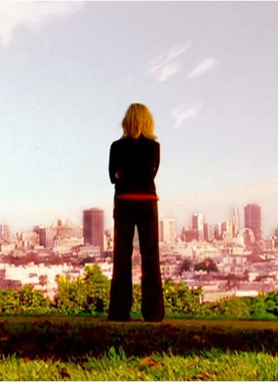
Original Image Romantic Remake
Notes:
Hollywood Horror 2010-2016

Slide 41
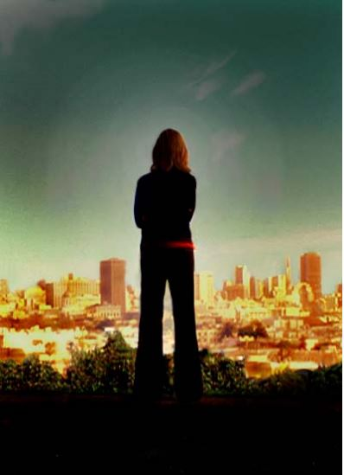
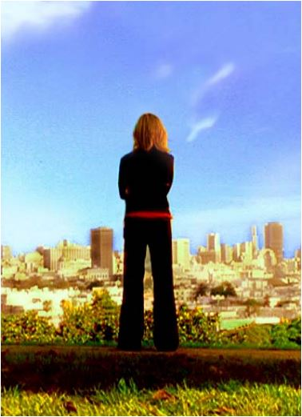
Horror Remake Animated Remake

Slide 42
NLP on MOVIE Description
Notes:
Hollywood Horror 2010-2016

Slide 43
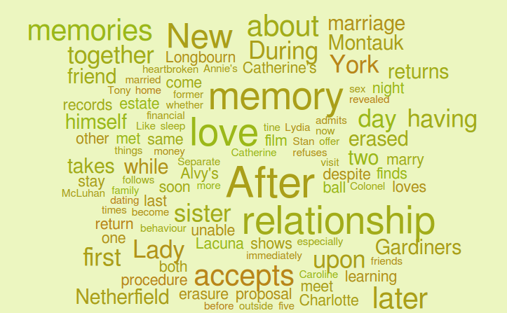
ROMANCE : HOLLYWOOD
Notes:
Action Hollywood 1990-2000

Slide 44
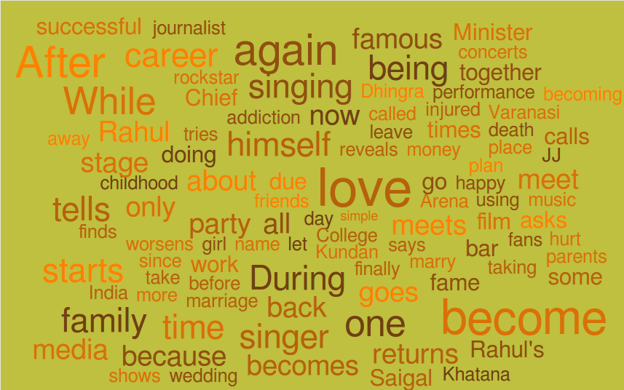
ROMANCE : BOLLYWOOD
Notes:
Comedy Holloywood 1990-2000

Slide 45
Big Ideas
> The colors in two cultures have similar distribution to portray the emotion.
> There has been evolution in colors used for posters with time.
> Even with only a handful of major colors, the posters can be created. Rest of the colors are used for better finish.
> NLP on the movie description suggests that genres clearly demarcate the words and emotions portrayed.

Slide 46
If you like this project ,please fork it from Github:
shubh-agrawal/movie_poster_analysis
Notes:
Hollywood Horror 2010-2016

Slide 47
THANK you

