Slide 1


Pairs Trading Algorithm and Cointegration Test
INDIAN INSTITUTE OF TECHNOLOGY ROORKEE
Name – Shubh Garg
Enrollment No: 23124035

Slide 2
INTRODUCTION
Objective of the project: To understand the Cointegration method and OPTICS clustering Algorithm with the help of pairs trading strategy.
What is Pairs Trading strategy?
Pairs Trading is a well-known investment strategy developed in the 1980s. This strategy comprises two steps.
It requires the identiﬁcation of two securities, for example, two stocks, for which the corresponding prices series display similar behaviour or simply seem to be linked to each other. This indicates that both securities are exposed to related risk factors and tend to react identically.
After identifying the stocks, we have to set up the trade points on which we have to execute the trade.
Problems in ﬁnding the pairs
As popularity of pairs trading strategy grows, it becomes harder to ﬁnd rewarding pairs. The Scarcity of such rewarding pairs forces a search expansion to broader group of securities, expecting the likelihood of ﬁnding a good pair will increase by considering a larger group.

Slide 3
INTRODUCTION
But in taking larger group of securities, two problem arises –
The computational cost of testing mean-reversion for all the possible combinations increases drastically as more data is taken.
Emerging problem is frequent when performing multiple hypothesis tests at once, referred to as the multiple comparisons problem.
For this, application of unsupervised learning algorithm is used, so that it can give meaningful clusters of data from which to select the pairs.
Methodology encompasses three following step
Dimensionality reduction—ﬁnd a compact representation for each security.
Unsupervised Learning—applying an appropriate clustering algorithm, for example- OPTICS
Select pairs—deﬁne a set of rules to select pairs for trading. For example - the cointegration test.
Note: In this project, I will be focusing on selection criteria of pairs, not on the trading or setting up trade points.

Slide 4



Order of Integration
The order of integration d is a summary statistic which reports the minimum number of differences required to obtain a stationary series(whose statistical property doesn’t depend on time).
Mathematical Form:
A time series is integrated of order d if
Is a stationary process, where L is a lag operator and 1-L is the ﬁrst difference, i.e.
In other words, a process is integrated to order d if taking repeated differences d times yields a stationary process.
In particular, if a series is integrated of order 0, then is stationary.

Slide 5
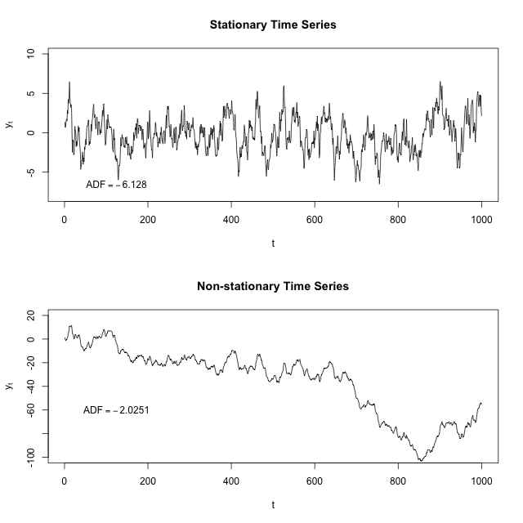
Stationarity and Non Stationarity
The concept of stationarity can be visualized as a form of statistical equilibrium. The statistical properties such as mean and variance of a stationary process do not depend upon time.
A stationary process can also be referred to with respect to its order of integration I(d), in which case a stationary time series is said to be an I(0) process.
Use in Finance?
Stationary series are particularly interesting for ﬁnancial traders who take advantage of the stationary property by placing orders when the price of a security deviates considerably from its historical mean, considering the price will revert back. However, they are rarely found in set of ﬁnancial time series.
In Pairs Trading it is particularly interesting because it provides a way of obtaining an artiﬁcial stationary time series from the combination of two non-stationary time series.

Slide 6
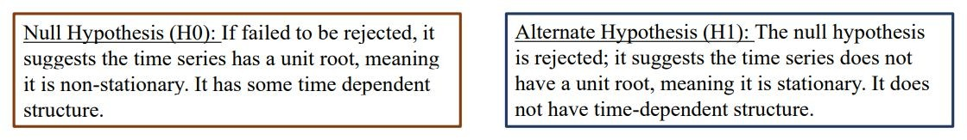
Augmented Dickey Fuller Test
The Augmented Dickey-Fuller test is a type of statistical test called a unit root test. The intuition behind a unit root test is that it determines how strongly a time series is deﬁned by a trend.
There are a number of unit root tests and the Augmented Dickey-Fuller may be one of the more widely used. It uses an autoregressive model and optimizes an information criterion across multiple different lag values.
We interpret this result using the p-value from the test. A p-value below a threshold (such as 5% or 1%) suggests we reject the null hypothesis (stationary), otherwise a p-value above the threshold suggests we fail to reject the null hypothesis (nonstationary).

Slide 7
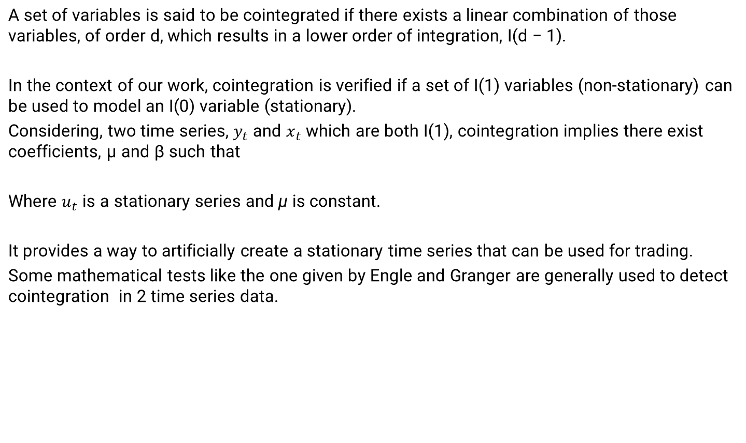

Cointegration
•

Slide 8
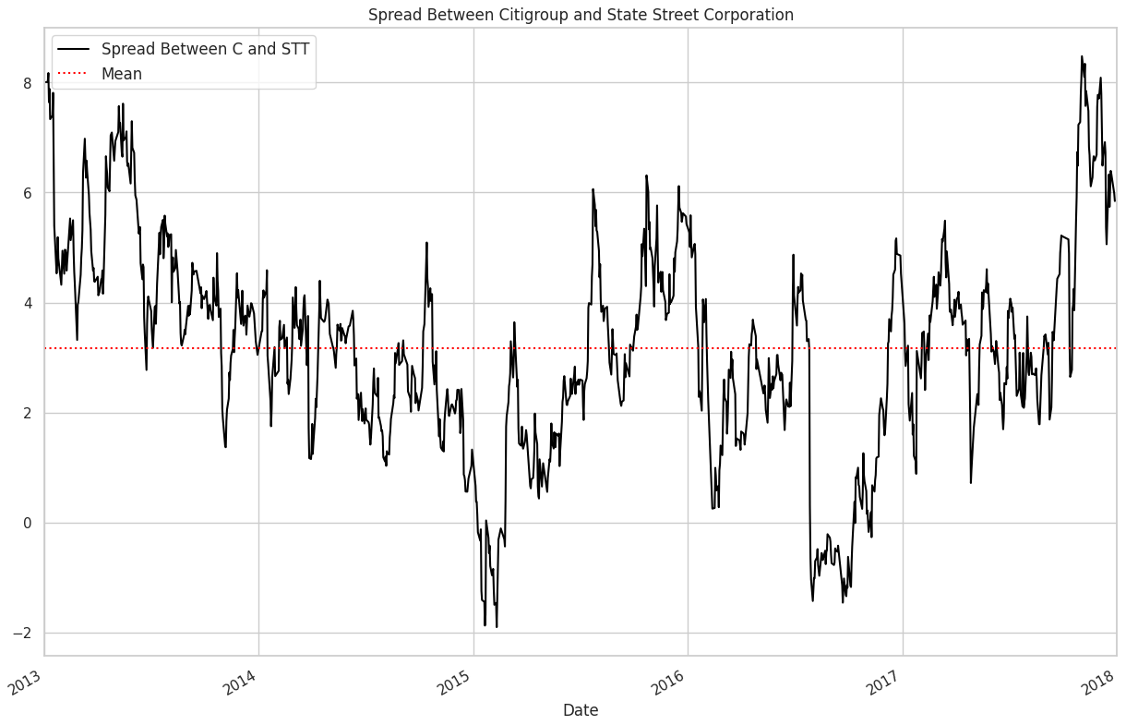
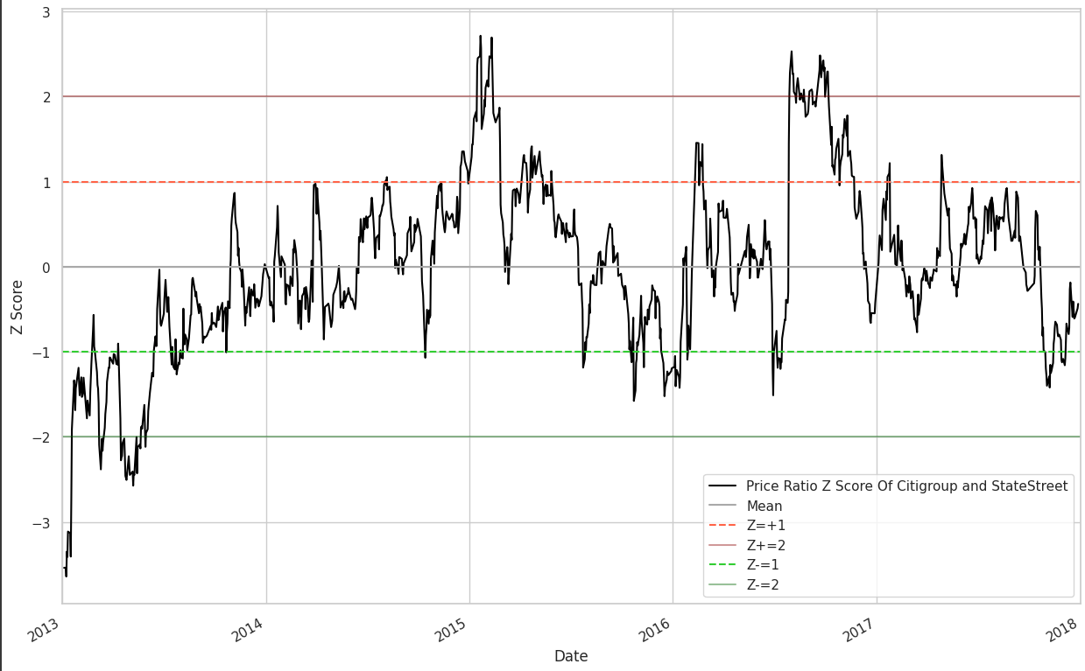
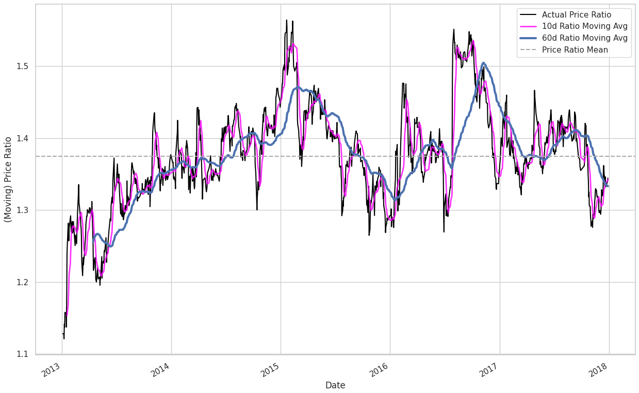
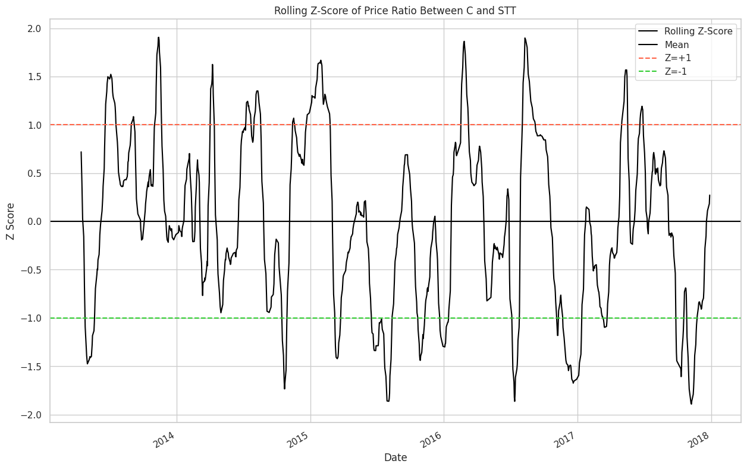
Some Visualization Plots

Slide 9
Backtesting Results
Total Profit (Net Profit): ₹ 379,343.52
This metric reflects the overall profit generated by the trading strategy after accounting for any transaction costs or fees associated with the trades.
Gross Profit: ₹ 402,698.71
This represents the total profit before factoring in any fees or expenses.
Net Profit (vs. Buy & Hold): ₹ 6,171.30 (Net Profit - Buy & Hold Return)
This value highlights the additional profit generated by the strategy compared to a simple buy-and-hold approach over the backtesting period. It essentially shows how much better your strategy performed compared to just holding the asset.
Sharpe Ratio: 14.6791
The Sharpe Ratio is a measure of risk-adjusted return. A higher Sharpe Ratio indicates better performance when considering both profitability and risk (volatility) involved in the strategy. A value of 14.6791 is quite high and suggests strong risk-adjusted returns.
Max Drawdown: -4.20%
This metric measures the largest peak-to-trough decline experienced by the portfolio during the backtesting period before reaching a new peak. A lower Max Drawdown is preferable as it indicates a smaller potential loss. Here, -4.20% signifies a relatively small maximum drawdown.
Total Closed Trades: 290
This represents the total number of trades executed by the strategy during the backtesting period.

Slide 10
Backtesting Results
Win Rate: 89.66%
The Win Rate reflects the percentage of trades that were profitable out of the total number of trades. A higher Win Rate suggests a more successful trading strategy, and 89.66% indicates a very high proportion of profitable trades.
Average Winning Trade: ₹ 15,488.41
This value represents the average profit earned on winning trades.
Average Losing Trade: ₹ -7,785.07
This metric shows the average loss incurred on losing trades.
Largest Winning Trade: ₹ 37,455.83
This signifies the single most profitable trade executed by the strategy during the backtesting period.
Largest Losing Trade: ₹ -12,008.40
This represents the single largest loss experienced on a trade.
Average Holding Duration: 56 (days/units as defined by strategy)
This metric reflects the average length of time a trade is held before being closed. Here, 56 represents the average holding duration in the units defined by your strategy (e.g., days, weeks, etc.).
Cumulative Return (%): 379.34%
This metric shows the total percentage return achieved by the strategy over the backtesting period.

Slide 11
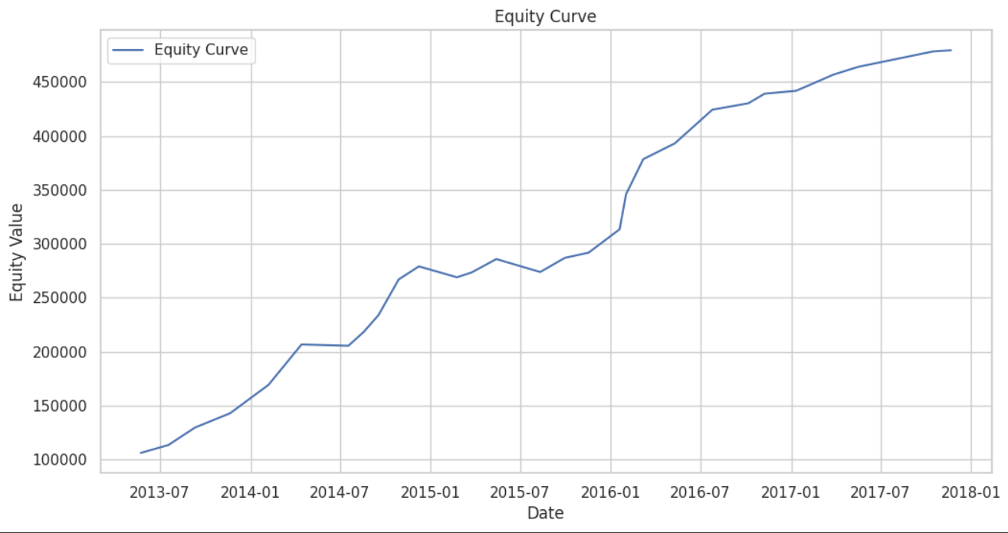
Equity Curve

Slide 12
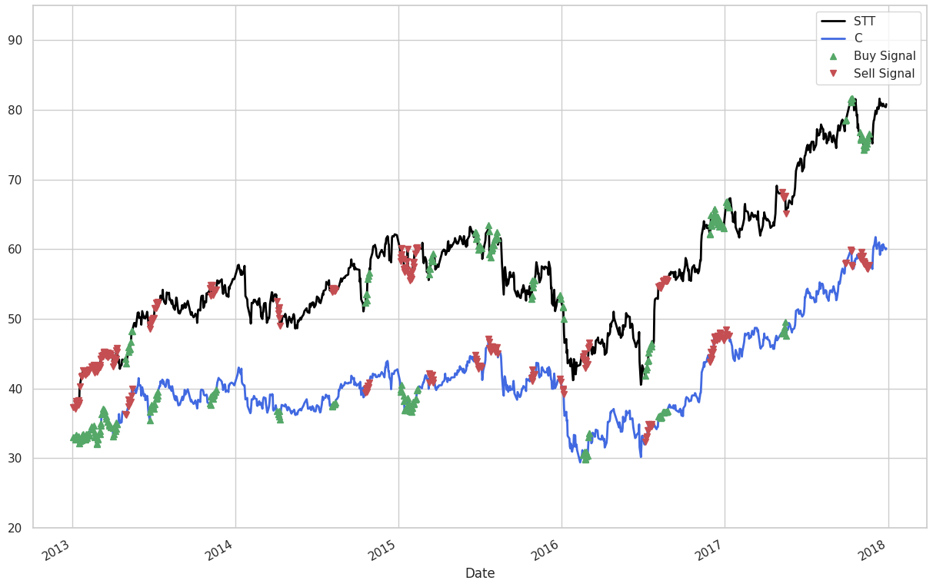
Buy- Sell Points

Slide 13
Code link
Code Link :
https://colab.research.google.com/drive/1N04cbpbhQzpCVWdP1GLb1ZM7rUGOPqUA#scrollTo=d3NuwUGTnxDg

Slide 14
Thanks

