Slide 1

Shubham Raj.

Slide 2

Built a Recommendation System for Electronic product section of an E-commerce site.
Performed EDA
Feature engineering to find the important features in the data set.
Divided he problem into 3 parts based on the user type ( New users, existing users and the product)

Slide 3
E-commerce Website can use this recommendation system to recommend their users better/relevant products.
The recommendation system can be used to compare different products base on ratings and help the user choose the right product.
It can help to recommend the user a bundle of similar products to save the user's time.
It can help the business organization to filter the products to achieve better sales and discard lower rated products.

Slide 4

In order to help the user to find out information about the product , recommendation systems where developed.
Recommender system creates a similarity between the user and items and exploits the similarity between user/item to make recommendations.
It can help the user to find the right product.
It can increase the user engagement. For example, there's 40% more click on the google news due to recommendation.
It helps the item providers to deliver the items to the right user.In Amazon , 35 % products get sold due to recommendation.
It helps to make the contents more personalized. In Netflix most of the rented movies are from recommendations.

Slide 5
The primary language used for the project is Python.
Library Used:
Numpy and pandas library for EDA.
Matplotlib and seaborn for data visualization,
Pearsonn correlation & K-nearest neighbor, cosine similarity for recommendation models.
Flask framework & HTML, bootstrap for frontend and deployement.

Slide 6
The recommendation system, I have designed below is based on the journey of a new customer from the time he/she lands on the business’s website for the first time to when he/she makes repeat purchases.
The recommendation system is designed in 3 parts based on the business context:
Recommendation system part I: Product pupularity based system targetted at new customers
Recommendation system part II: Model-based collaborative filtering system based on customer's purchase history and ratings provided by other users who bought items similar items
Recommendation system part III: When a business is setting up its e-commerce website for the first time withou any product rating
When a new customer without any previous purchase history visits the e-commerce website for the first time, he/she is recommended the most popular products sold on the company's website. Once, he/she makes a purchase, the recommendation system updates and recommends other products based on the purchase history and ratings provided by other users on the website. The latter part is done using collaborative filtering techniques.

Slide 7
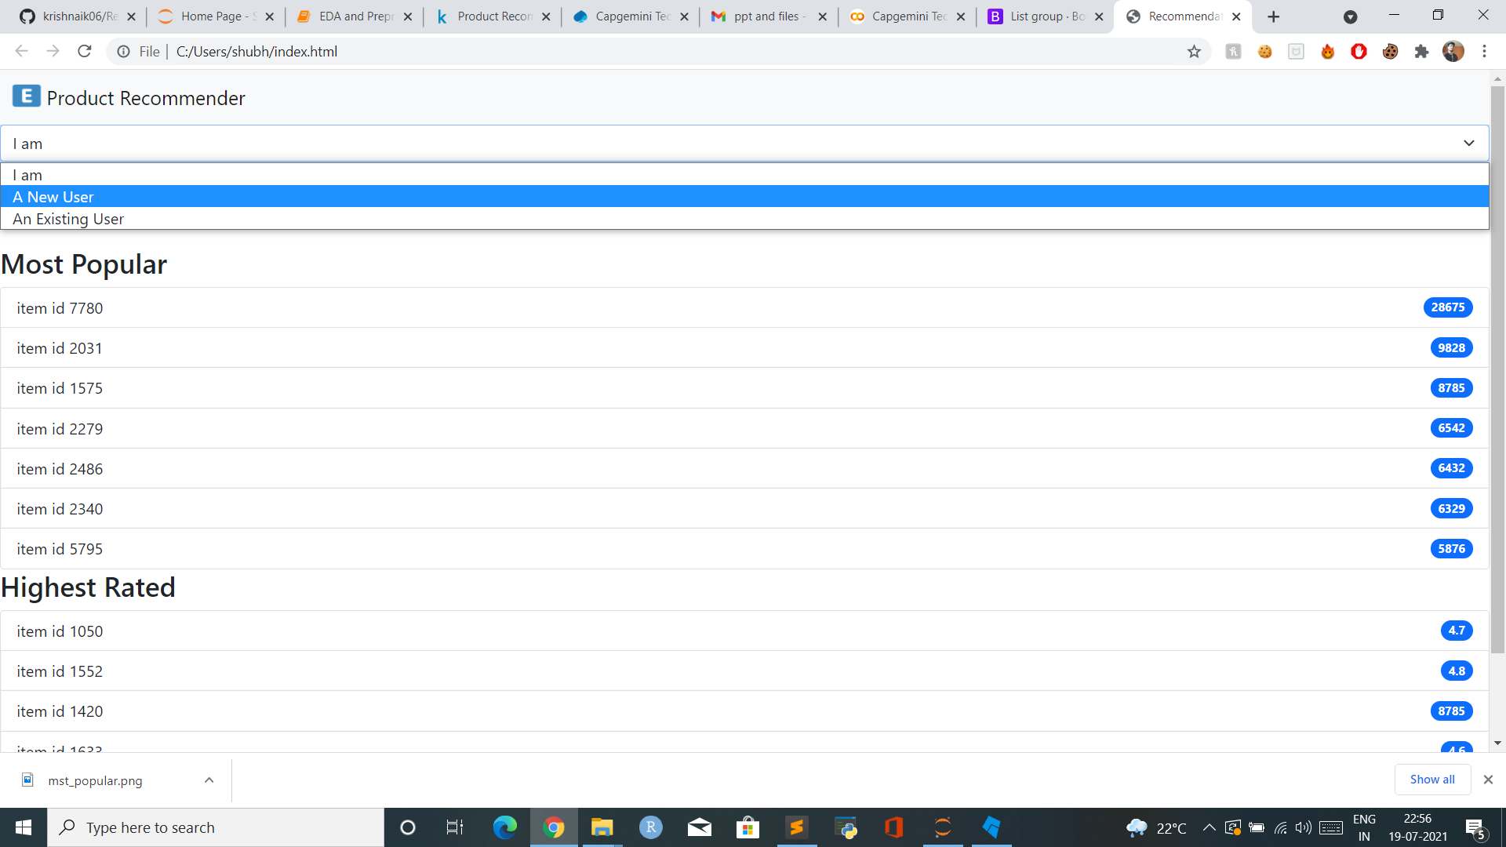
If the customer is new, 2 lists of recommended products appear on the screen – 1. Most Popular based on number of ratings
2. Highest rated based on the weighted average rating.

Slide 8
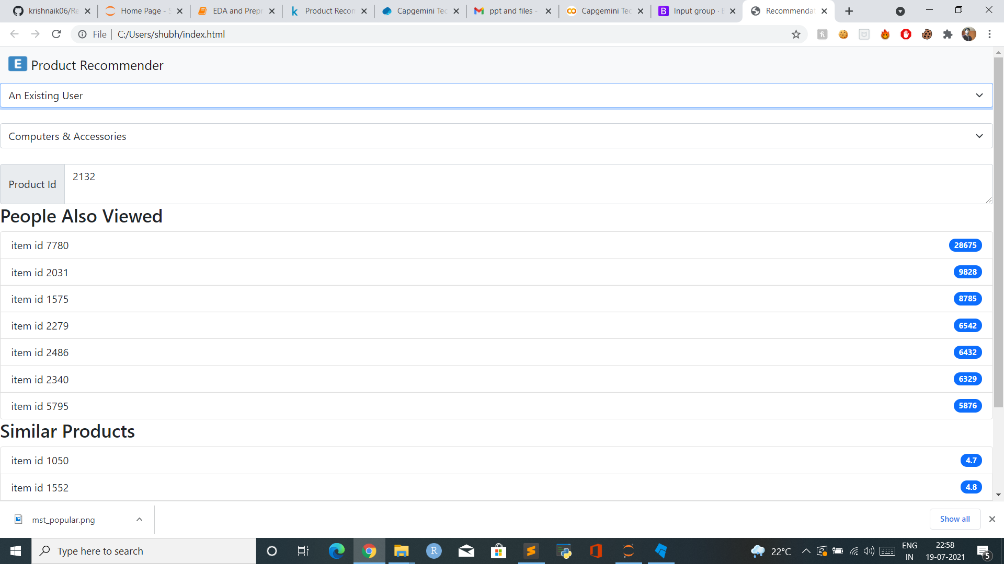
If the customer is an existing customer then 2 list of recommended products appear on the screen based on :
1. People also viewed( user-user similarity)
2. Similar Product. (item-item similarity)

Slide 9
Dataset size was too large for the correlation table. It could have been divided into subsets based on categories and ratings.
Product name could have helped for more clarifications.

Slide 10
Reviews can be added in the dataset along with rating so that NLP can be applied for better recommendations

Slide 11
THANK YOU

