Slide 1

BANGALORE INSTITUTE OF TECHNOLOGY
K.R ROAD. VV.PURAM. BANGALORE KARNATAKA‑560004
DEPT OF INFORMATION SCIENCE AND ENGINEERING
Apartment Management System
DBMS LABORATORY MINI PROJECT (18CSL58 )
UNDER THE GUIDANCE OF:
Mrs. S. Mercy
Assistant Professor
DEPT OF ISE , BIT, Bangalore - 04
Submitted by:
Shashwat Patwari : 1BI18IS048
Shubham V Kulkarni : 1BI18IS052

Slide 2
TABLE OF CONTENTS
INTRODUCTION
REQUIREMENTS SPECIFICATION
TABLES
ER DIAGRAM
RELATIONAL MAPPING
TRIGGERS USED
STORED PROCEDURE USED
SOME SQL QUERIES USED
CONCLUSION

Slide 3
INTRODUCTION
The main aim of Apartment Management Mini DBMS project is to rent apartments and get payments from respective tenants.
We aim to demonstrate the use of create, read, update and delete MySQL operations through this project.
The project starts by creating a Owner and by adding details of tenant buying apartment. The owner provides building & apartment details to their tenant with the start date of rent.
The tenants should pay their rents to the owner after every month completion.

Slide 4
REQUIREMENTS SPECIFICATION
HARDWARE REQUIREMENT
XAMPP software installs on a standard PC system. Minimum hardware requirements are as follows:
Processor- Pentium Dual-Core CPU and motherboard.
Installed Memory (RAM)-at least 1 GB or above.
System type -32-bit Operating System.
35 GB of hard disk space.
SOFTWARE REQUIREMENTS:
XAMPP for Windows
The distribution for windows 2000, 2003, XP, Vista, 7, 8 and 10 The version contains
Apache 2.4.9
MySQL 10.1.31 MariaDB
PHP 7.2.3 PhpMyAdmin4.7.9
Programming Language
PHP
MySQL
CSS

Slide 5
TABLES
OwnerTable:
OwnerID
OwnerUsername
OwnerFNam
OwnerLNam
OwnerPass
Owner Contact
OwnerAddress
Tenant Table:
TenantID
TenantUsername
TenantFName
TenantLName
TenantPass
Tenant Contact
Tenant Address
Payment Table:
PaymentId
Payment Date
ApartmentID
TenantID
FlatNum
PaidRent
Building Table:
BuildingID
OwnerID
Building Address
Building Name
Building Floors
Tenants
Apartment Table:
ApartmentId
FlatNumber
Building ID
TenantID
Rent
StartDate
Owe

Slide 6
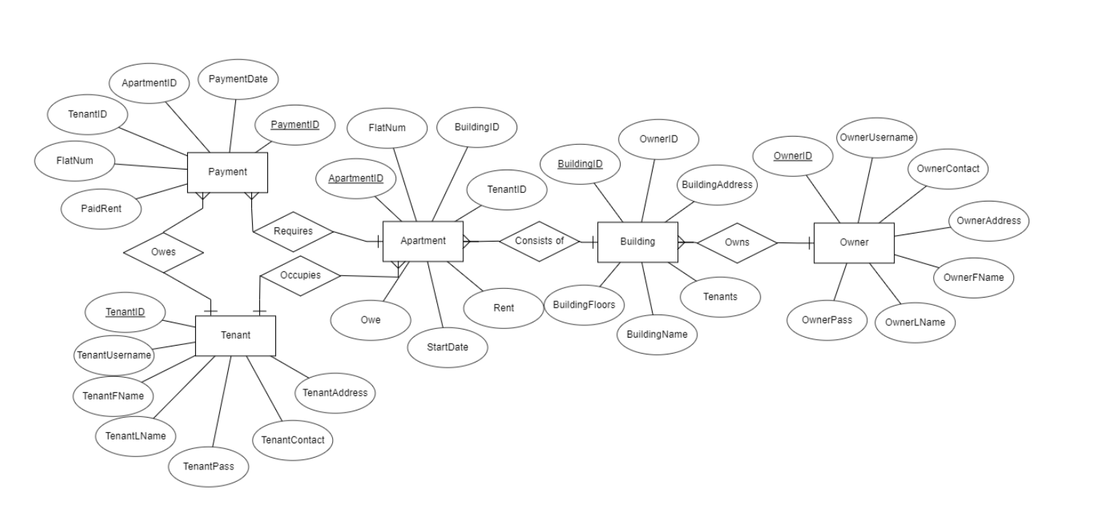
ER DIAGRAM

Slide 7
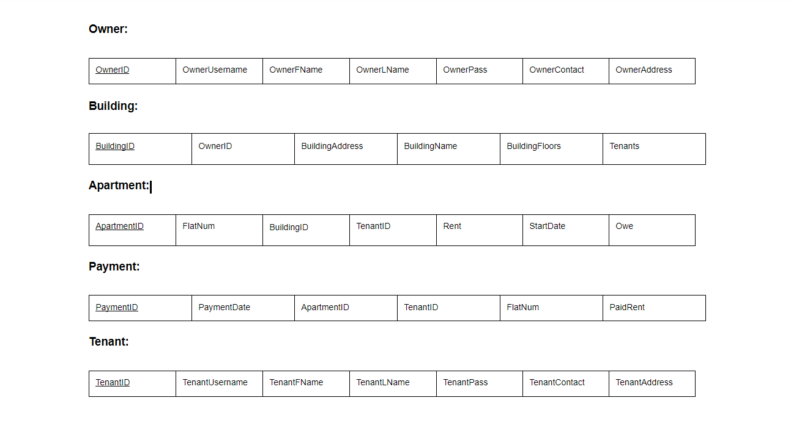
RELATIONAL MAPPING

Slide 8
Triggers Used
To increase and decrease number of tenants in the building:
CREATE DEFINER=`root`@`localhost` TRIGGER `tenantNum` AFTER INSERT ON `apartment` FOR EACH ROW UPDATE building SET building.Tenants = building.Tenants + 1 WHERE NEW.BuildingID = building.BuildingID;
CREATE DEFINER=`root`@`localhost` TRIGGER `tenantNumdecrease` AFTER DELETE ON `apartment` FOR EACH ROW UPDATE building SET building.Tenants = building.Tenants - 1 WHERE OLD.BuildingID = building.BuildingID;
To decrease owed amount after payment:
CREATE DEFINER=`root`@`localhost` TRIGGER `oweing` AFTER INSERT ON `payment` FOR EACH ROW UPDATE apartment SET apartment.Owe = apartment.Owe - NEW.PaidRent WHERE NEW.FlatNum = apartment.FlatNum AND NEW.ApartmentID = apartment.ApartmentID;

Slide 9
Stored Procedure Used:
To display all tenants and owed amount to a given input owner name:
CREATE DEFINER=`root`@`localhost` PROCEDURE `getDueTenants`(IN `namee` VARCHAR(20)) NOT DETERMINISTIC CONTAINS SQL SQL SECURITY DEFINER SELECT tenant.TenantFName,owner.OwnerFName,apartment.FlatNum,apartment.Rent,apartment.Owe FROM building,apartment,tenant,owner WHERE apartment.TenantID=tenant.TenantID AND apartment.BuildingID=building.BuildingID AND building.OwnerID=owner.OwnerID AND apartment.Owe>0 AND owner.OwnerUsername =namee;

Slide 10
Some Queries Used:
To select data from the building table:
SELECT * FROM `building`;
To get all payments due from tenants and their respective flats:
SELECT tenant.TenantFName,owner.OwnerFName,apartment.FlatNum,apartment.Rent,apartment.Owe FROM building,apartment,tenant,owner WHERE apartment.TenantID=tenant.TenantID AND apartment.BuildingID=building.BuildingID AND building.OwnerID=owner.OwnerID AND apartment.Owe>0
To check if owner name and password exists in database:
SELECT * FROM `owner` WHERE owner.OwnerUsername = '$ownername' AND owner.OwnerPass = '$ownerpass';

Slide 11
CONCLUSION
By doing this mini project apartment management system becomes easier and less tedious.
Separate modules for tenants ,owners, apartments and payments will be made to categorize each function of the system.
The apartment management system is flexible and easier to implement.
This project enables in smooth functionality and ensures each and every possible desires are fulfilled.

Slide 12
THANK YOU

