Slide 1

Loan Default Prediction: Using Classification Algorithms and Decision Trees
Welcome to our presentation on Loan Default Prediction using Classification Algorithms. We are a team of five students — Vidisha Goel, Saumya Gupta, Saumya Dubey, Sumedha Saxena and Shubham Kumar — from KIET Group of Institutions.
We'll walk you through how we used a Kaggle dataset to build predictive models using Decision Trees , along with data preprocessing and performance evaluation.

Slide 2
Problem Statement: Predicting Loan Default
Objective
Project Goals
Our primary objective is to develop a robust predictive model that can accurately determine whether a loan applicant is likely to default on their loan based on a set of input features. This early identification of high-risk applicants is crucial for financial institutions to mitigate potential losses and make informed lending decisions.
Build a classification model capable of predicting loan default.
Visualize the importance of various features in predicting loan default.

Slide 3
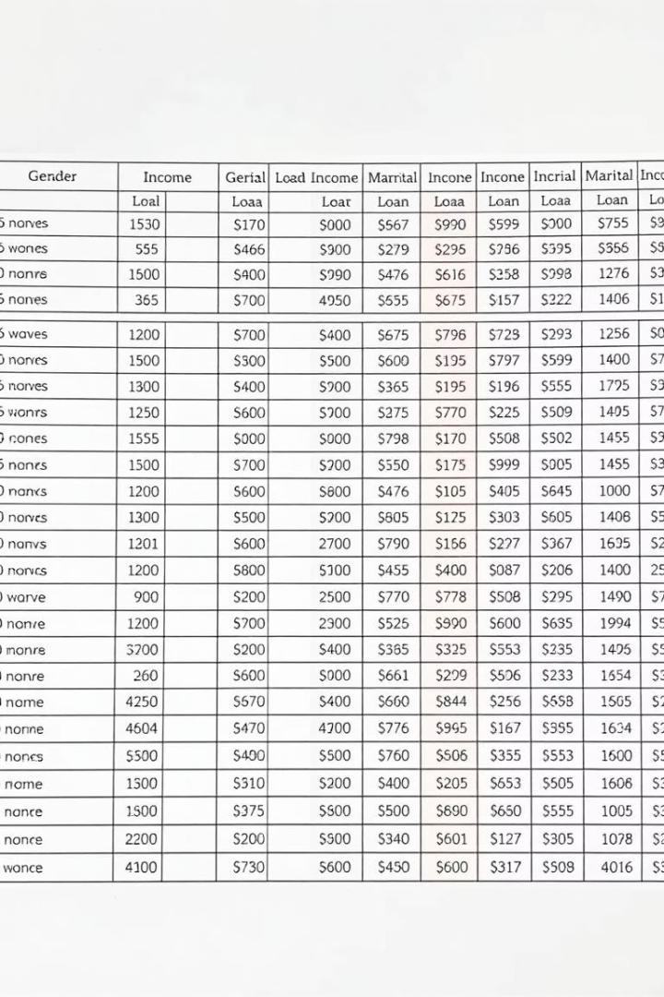
Dataset Overview: Loan Prediction Problem
Dataset File
train_u6lujuX_CVtuZ9i.csv
Number of Records
Approximately 614
Target Variable
Loan_Status (Y/N)
Key Features
Gender, Marital Status, Education, Self-Employed, Applicant Income, Coapplicant Income, Loan Amount, Loan Amount Term, Credit History, Property Area
The dataset is comprehensive, providing a wide array of demographic and financial information for each applicant. Understanding these features is critical, as they will serve as the foundation for our predictive models. The 'Loan_Status' column acts as our target variable, indicating whether the loan was approved ('Y') or rejected ('N'), which directly translates to our default prediction.

Slide 4
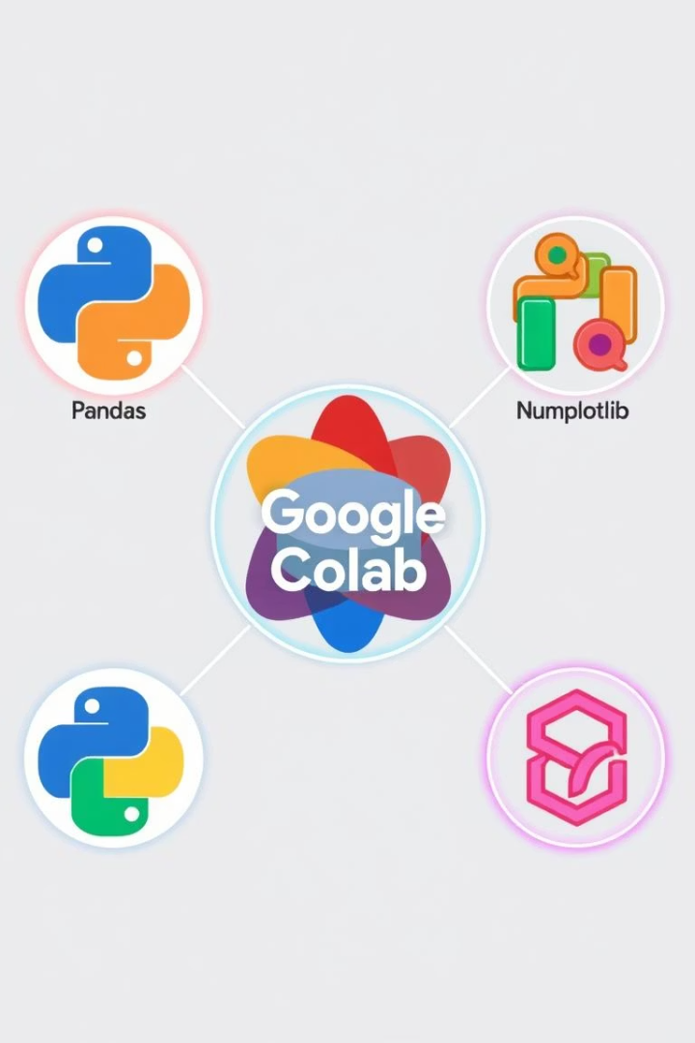




Tools and Libraries Utilized
Python
NumPy & Pandas
Matplotlib & Seaborn
The core programming language chosen for its extensive data science ecosystem and ease of use.
Essential libraries for efficient numerical operations and robust data manipulation and analysis.
Powerful tools for creating static, interactive, and animated visualizations in Python.
Scikit-learn
A comprehensive machine learning library providing various classification, regression, and clustering algorithms.
Our development environment was Google Colab, offering a cloud-based Jupyter notebook experience, which facilitated collaborative work and access to necessary computational resources for model training and evaluation.

Slide 5




Data Preprocessing: Preparing the Data for Modeling
Remove Loan_ID
The unique identifier 'Loan_ID' was removed as it does not contribute to the predictive power of the model.
Handle Missing Values
Categorical features: Imputed with the mode (most frequent value).
Numerical features: Imputed with the median to avoid skew from outliers.
Encode Categorical Features
All categorical features were converted into numerical representations using Label Encoding, making them suitable for machine learning algorithms.
Data Split
The dataset was partitioned into an 80% training set for model development and a 20% testing set for unbiased evaluation of model performance.
These preprocessing steps are crucial for ensuring the quality and usability of the data, which directly impacts the performance and reliability of the machine learning models. Clean and well-structured data is the foundation for accurate predictions.

Slide 6
Algorithm : Decision Tree Classifier
Model Description
Performance & Characteristics
A Decision Tree is a non-parametric supervised learning method used for classification and regression. It partitions the data into subsets based on feature values, forming a tree-like structure of decisions. Each internal node represents a test on a feature, each branch represents the outcome of the test, and each leaf node represents a class label.
Our Decision Tree model achieved an accuracy of approximately 70% on the test set. While this provides a reasonable baseline, it highlights certain trade-offs.
Pros: Highly interpretable, easy to understand and visualize, and requires little data preparation.
Cons: Prone to overfitting, especially with complex trees, and can be unstable due to small variations in data.
Model Used: DecisionTreeClassifier from Scikit-learn.

Slide 7
Conclusion & Future Directions
Key Achievements
Impact & Application
Future Enhancements
Successfully predicted loan approval outcomes using machine learning classification.
This project provides valuable insights for financial institutions, enabling them to make more accurate and informed lending decisions, thereby reducing financial risk and improving portfolio health.
Further improvements could involve exploring advanced ensemble methods like Gradient Boosting, experimenting with more sophisticated feature engineering techniques, or integrating real-time data streams for dynamic prediction capabilities.
Visualized the most important features influencing loan default predictions.
Implemented comprehensive data preprocessing techniques to handle missing values and encode features.
Thank you for your attention. I hope this presentation has provided a clear understanding of the loan default prediction process and the power of classification algorithms in this domain.

Slide 8
Thank you

