Slide 1



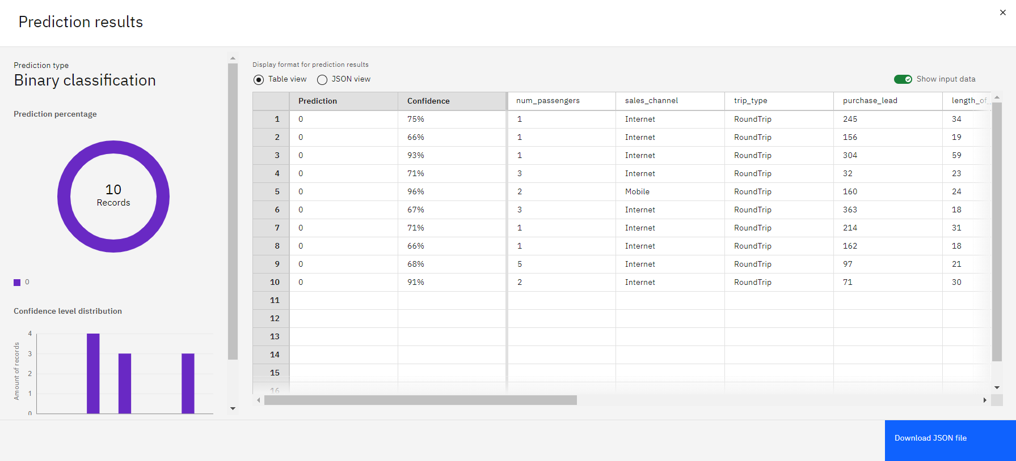
Predicting Holiday Purchase Intent in the Airline Industry
Program Feedback
Project Short Summary
The IBM SkillBuild Edunet program offered exceptional resources and training that greatly enhanced my skills in data science and machine learning. The structured learning path, hands-on projects, and real-world scenarios provided a comprehensive understanding of the latest technologies and best practices. The program's focus on practical applications, especially with tools like IBM Watson Studio, was invaluable for my professional growth.
The project aimed to predict customer booking behavior for a travel agency using IBM Watson Studio’s AutoAI. By leveraging advanced machine learning techniques and analyzing key features such as booking_origin and sales_channel, we developed a highly accurate predictive model. The solution not only improved marketing strategies but also optimized resource allocation. The use of AutoAI streamlined the process, allowing for efficient model training and deployment, and demonstrated the power of modern, code-free data science tools.
SHUBH SHARMA
sharma.shubh0401@gmail.com
University of Delhi
#skillsbuild

