Slide 1

Today
Building a Convolutional NN and image data preprocessing
In the upcoming week you will next learn the concepts that changed the whole course of Machine Learning.
Convolutional Neural Networks, these can detect almost anything from Images and are the most interesting concepts in Deep Learning.
A guide to convolution arithmetic for deep learning (HIGHLY Recommended)
AI4LE Week 4. Session 3

Slide 2
Today we will learn
Introduction to computer vision
Convolution Operation
Padding
Stride Convolution
Convolution on RGB
AI4LE Week 4. Session 3

Slide 3
What is computer vision
Computer Vision, often abbreviated as CV, is defined as a field of study that seeks to develop techniques to help computers “see” and understand the content of digital images such as photographs and videos
AI4LE Week 4. Session 3

Slide 4
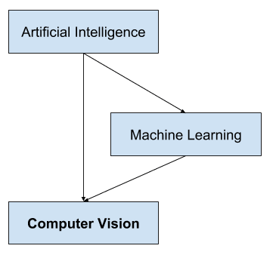
Computer vision
it is a multidisciplinary field
subfield of artificial intelligence and machine learning
involve the use of specialized methods and make use of general learning algorithms
AI4LE Week 4. Session 3

Slide 5
Computer vision - applications
Optical character recognition (OCR)
Machine inspection
Retail (e.g. automated checkouts)
3D model building (photogrammetry)
Medical imaging
Automotive safety
Match move (e.g. merging CGI with live actors in movies)
Motion capture (mocap)
Surveillance
Fingerprint recognition and biometrics
AI4LE Week 4. Session 3

Slide 6
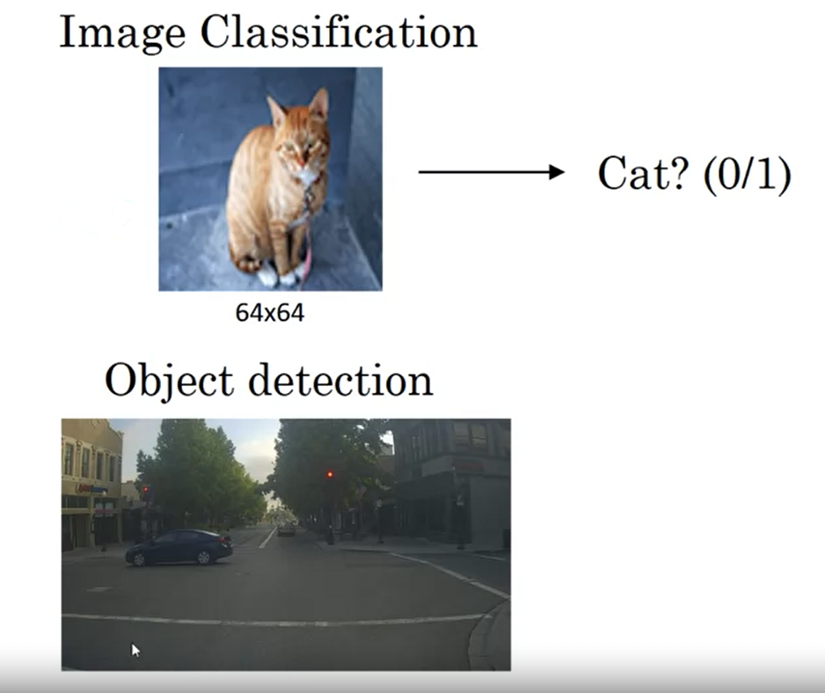
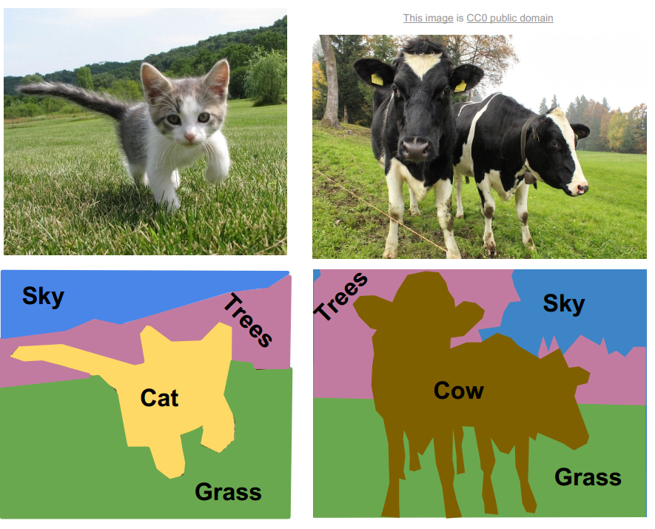
COMPUTER VISION
Image Segmentation
AI4LE Week 4. Session 3

Slide 7
What is convolution ?
In mathematics (in particular, functional analysis),
convolution is a mathematical operation on two functions (f and g)
that produces a third function that expresses how the shape of one is modified by the other
AI4LE Week 4. Session 3

Slide 8
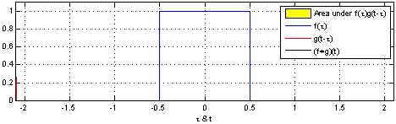
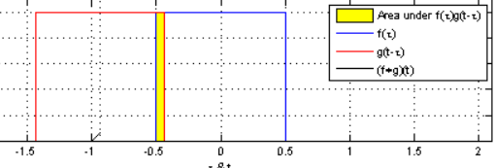
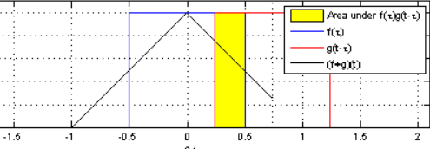
Example
AI4LE Week 4. Session 3

Slide 9
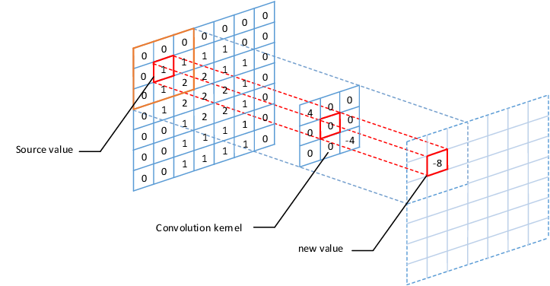
Example
AI4LE Week 4. Session 3

Slide 10
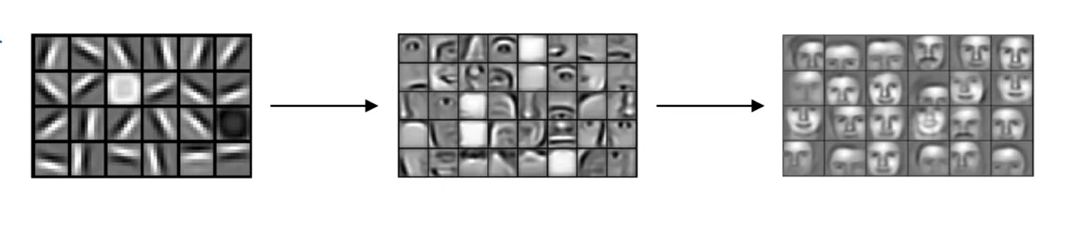
CONVOLUTION OPERATION
AI4LE Week 4. Session 3

Slide 11
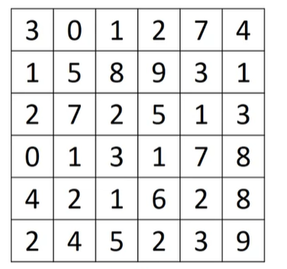
EDGE DETECTION using convolution
Convolution Operation
= 3*1 + 1*1 + 2*1 + 0*0 + 5*0 + 7*0 + 1*-1 + 8*-1 + 2*-1
= 3 + 1+ 2 - 1 - 8 - 2
= -5
-5 | -4 | 0 | 8
-10 | -2 | 2 | 3
0 | -2 | -4 | -7
-3 | -2 | -3 | -16
1 | 0 | -1
1 | 0 | -1
1 | 0 | -1
*
=
3x3 Filter
Output Image
6x6 Grayscale Image
AI4LE Week 4. Session 3

Slide 12
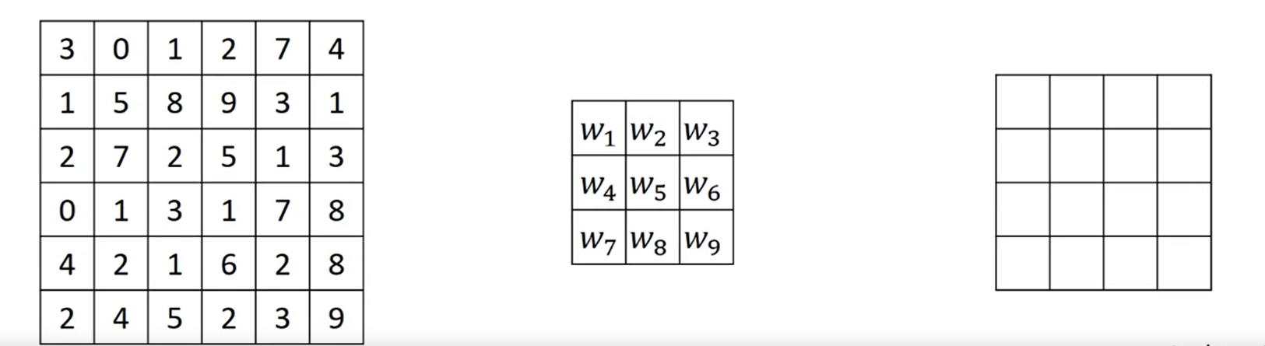
CONVOLUTION OPERATION
AI4LE Week 4. Session 3

Slide 13
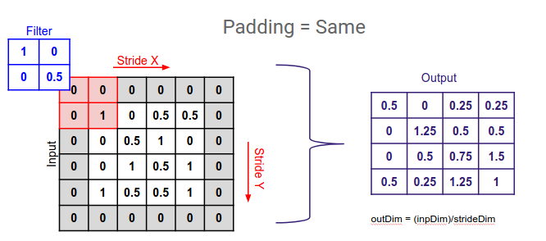
What is Padding in Machine Learning / convolution ?
Padding is a term relevant to convolutional neural networks
It refers to the amount of pixels added to an image when it is being processed by the kernel of a CNN
For example, if the padding in a CNN is set to zero, then every pixel value that is added will be of value zero
If, however, the zero padding is set to one, there will be a one pixel border added to the image with a pixel value of zero
It extends the area of an image in which a convolutional neural network processes.
AI4LE Week 4. Session 3

Slide 14
PADDING
n + 2*p – f + 1
AI4LE Week 4. Session 3

Slide 15
Code example
Types of Padding
There are three types of padding:
Same padding: input_shape=(28, 28, 1))), padding='same'))
Causal padding
Valid padding
Ref: https://github.com/christianversloot/machine-learning-articles/blob/main/what-is-padding-in-a-neural-network.md
AI4LE Week 4. Session 3

Slide 16
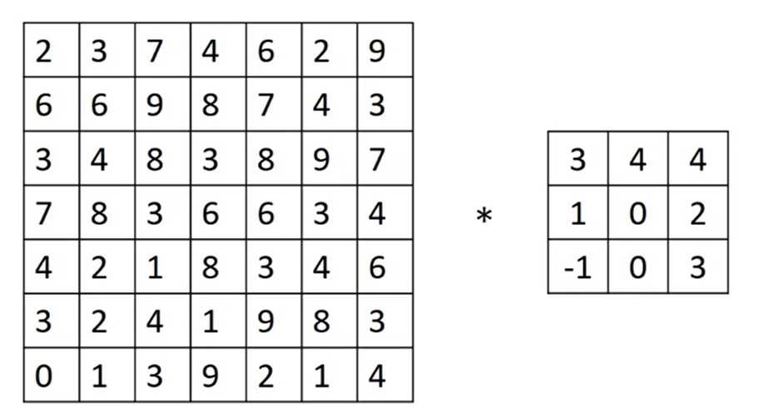
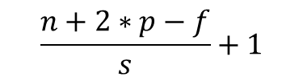
STRIDE CONVOLUTION
91 | 100 | 83
69 | 91 | 127
44 | 72 | 74
AI4LE Week 4. Session 3

Slide 17
Stride
Stride is the number of pixels shifts over the input matrix.
When the stride is 1 then we move the filters to 1 pixel at a time.
When the stride is 2 then we move the filters to 2 pixels at a time and so on.
Code example:
model.add(Conv2D(1, (3,3), strides=(2, 2), input_shape=(8, 8, 1)))
AI4LE Week 4. Session 3

Slide 18
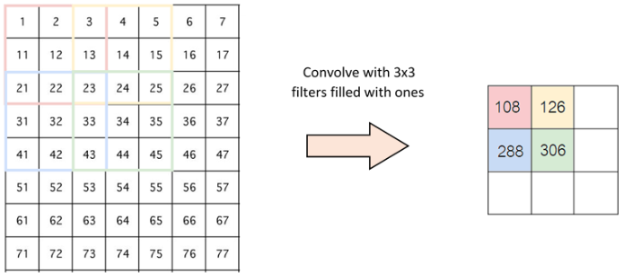
The below figure shows convolution would work with a stride of 2.
AI4LE Week 4. Session 3

Slide 19
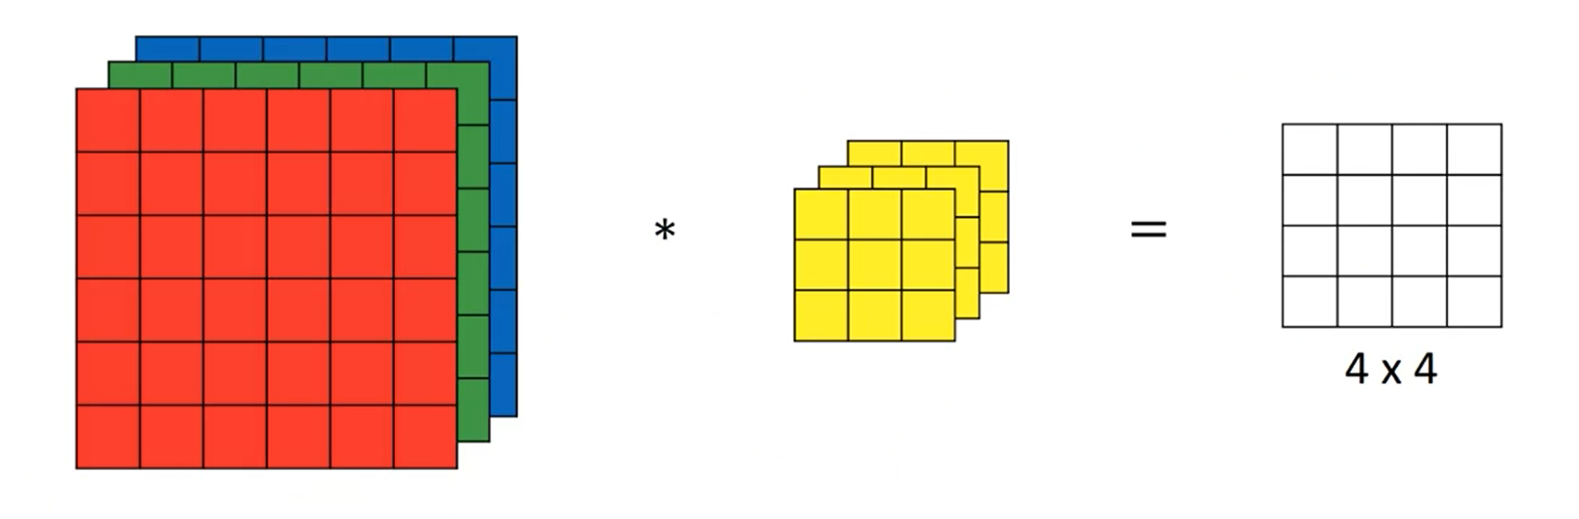
CONVOLUTION ON RGB
Ref: https://cs231n.github.io/convolutional-networks/#conv
AI4LE Week 4. Session 3

Slide 20
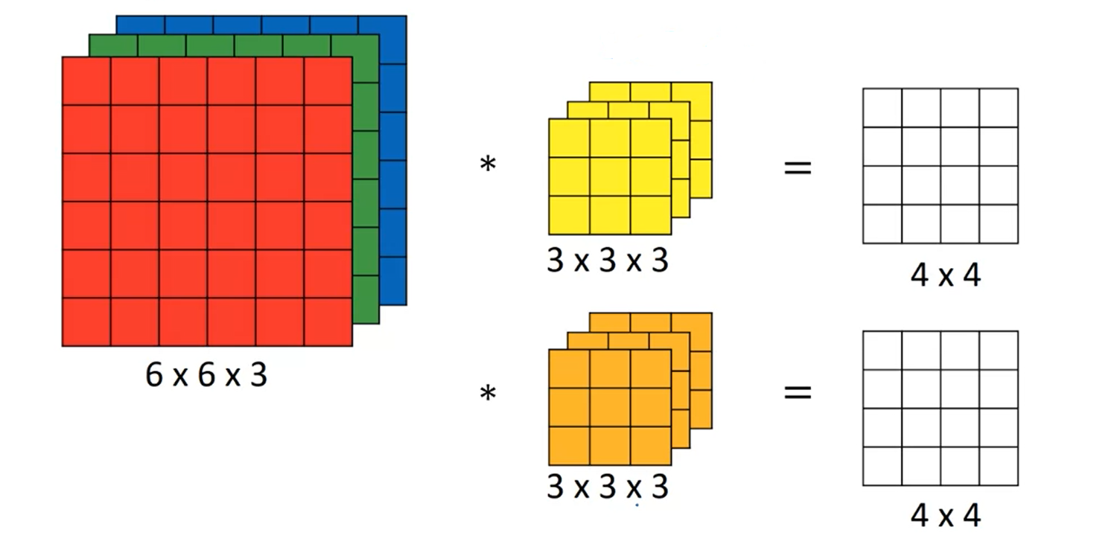
CONVOLUTION ON RGB
AI4LE Week 4. Session 3

Slide 21
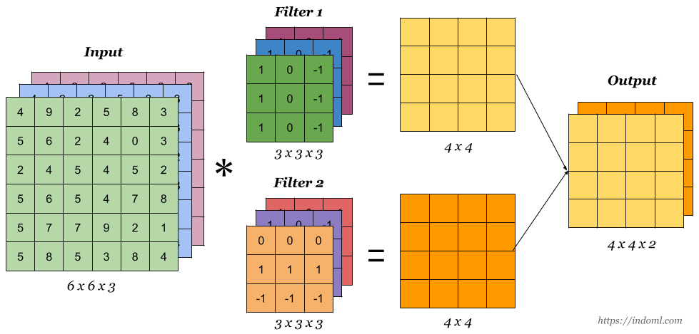
Example
AI4LE Week 4. Session 3

Slide 22
Next session -
Pooling
Dropout
Batch Normalisation
Data Augmentation
AI4LE Week 4. Session 3

Slide 23
Time to practice some questions!
Q-1 what do you understand by computer vision and is it same as deep neural network? Also,write some applications of CV.
Q-2 What is convolution in CV?
Q-3 What do you mean by the term Padding and Stride? Why do we use padding and stride in convolution of an image? Also write the equation for padding and stride to find dimensions of an output image.
AI4LE Week 4. Session 3

