Slide 1
RECAP
Topic Already Covered:
Computer Vision Introduction
Convolution Operation
Edge Detection
Pooling operations, Padding
State of the Art CNNs
Data Augmentations
Image Classification using tensorflow
Lunar Rock Segmentation Week 6. Session 1

Slide 2
This session -
Data Exploration
Labelme Installation
Data Annotation
Annotation to mask Conversion
IOU and related metrics
Lunar Rock Segmentation Week 6. Session 1

Slide 3
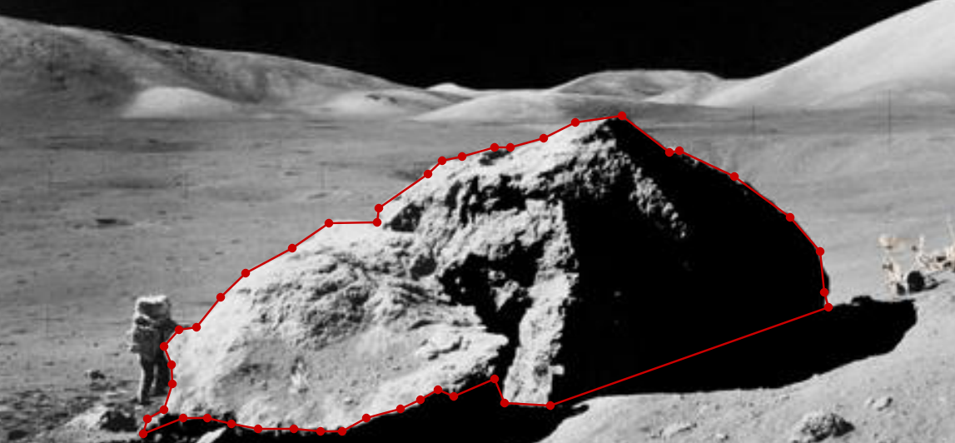

DATA ANNOTATION
Sample Annotation
Lunar Rock Segmentation Week 6. Session 1

Slide 4
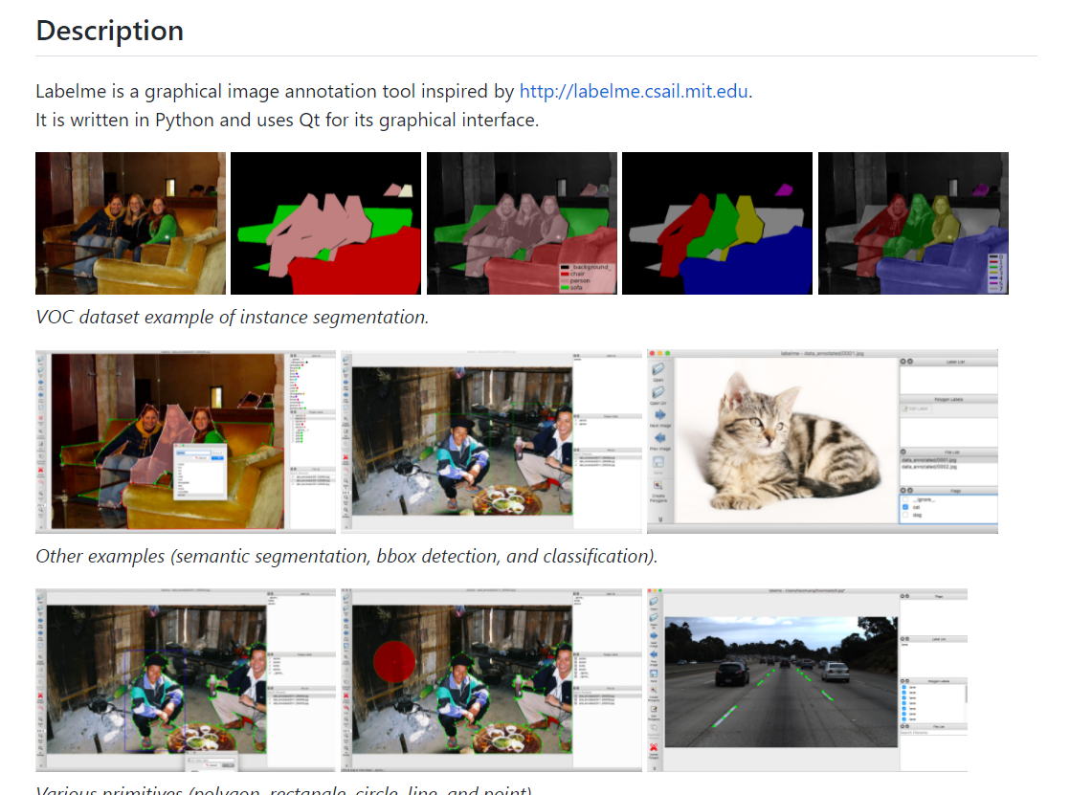
LABELME
https://github.com/wkentaro/labelme
Lunar Rock Segmentation Week 6. Session 1

Slide 5
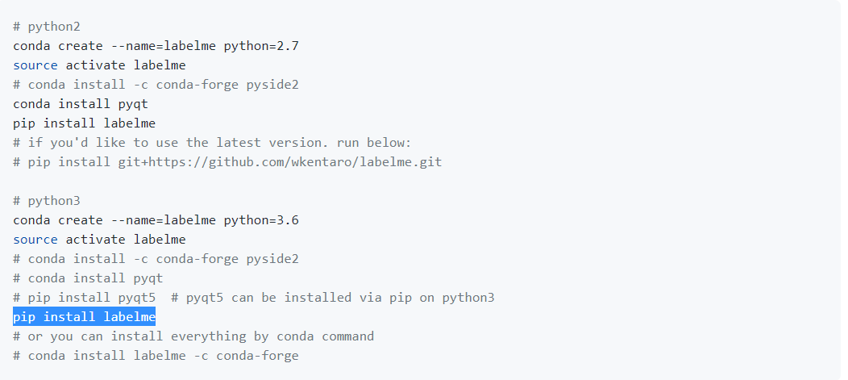
INSTALLATION
Lunar Rock Segmentation Week 6. Session 1

Slide 6
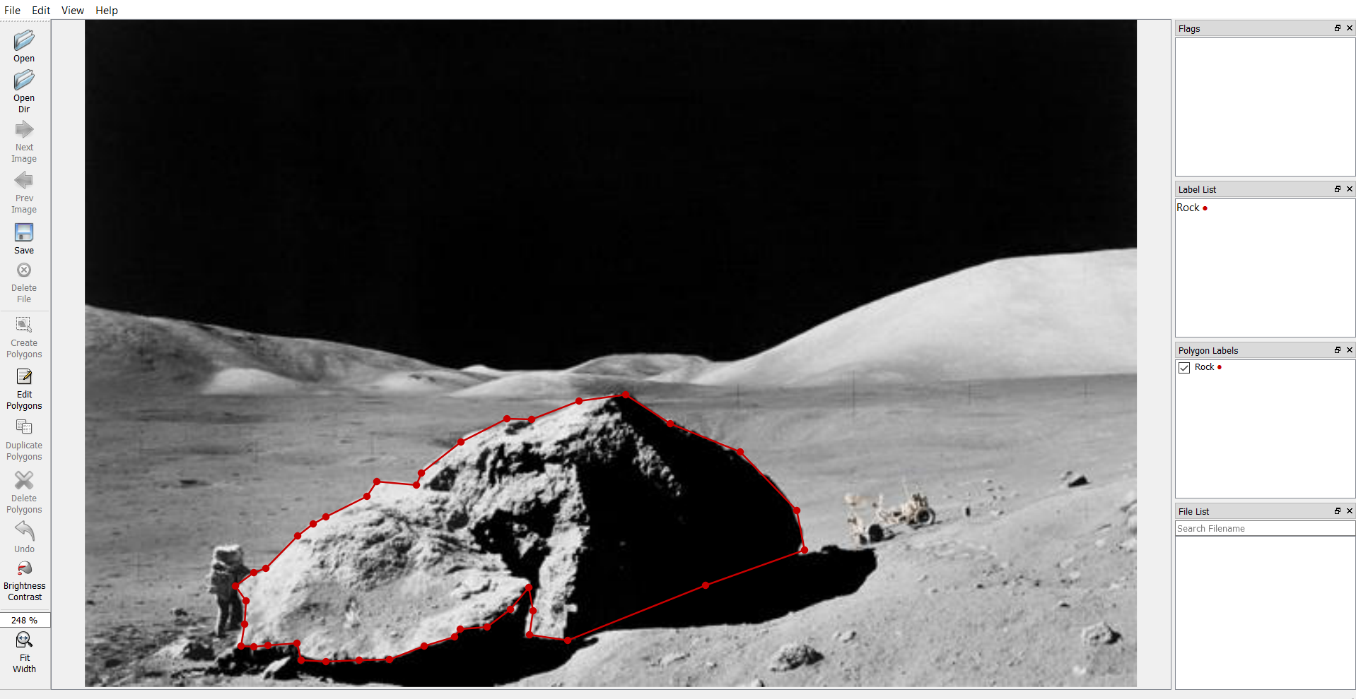
DEMONSTRATION
Lunar Rock Segmentation Week 6. Session 1

Slide 7
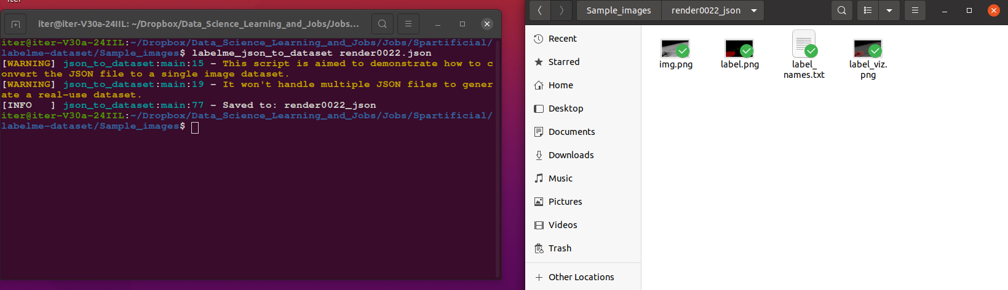
ANNOTATION TO MASK CONVERSION
Lunar Rock Segmentation Week 6. Session 1

Slide 8
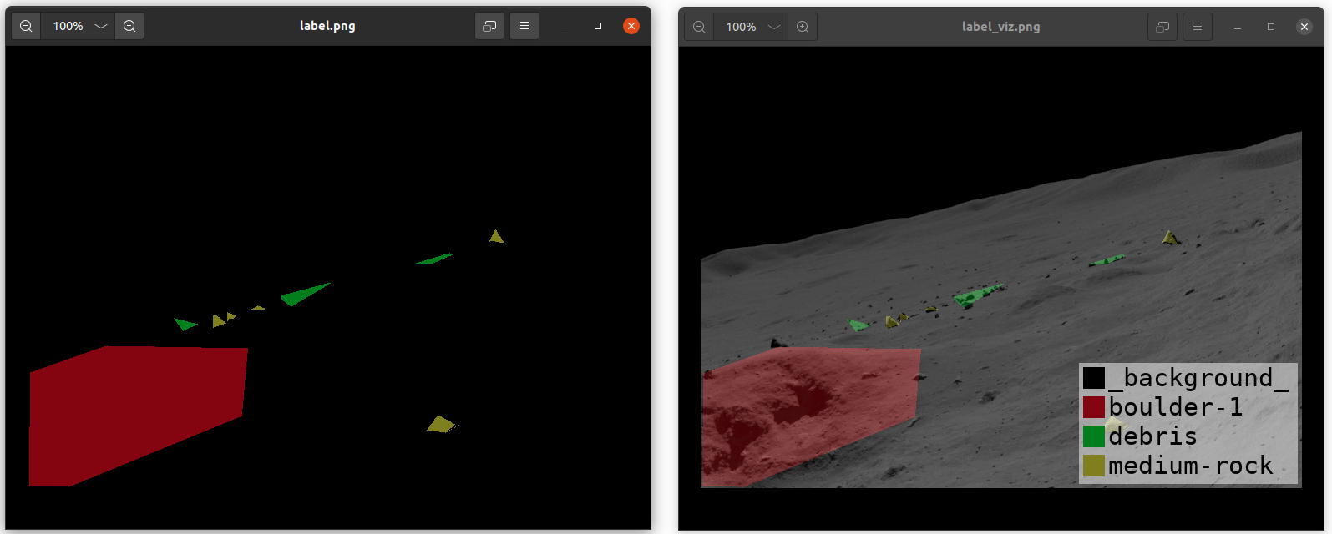
ANNOTATION TO MASK CONVERSION

Slide 9
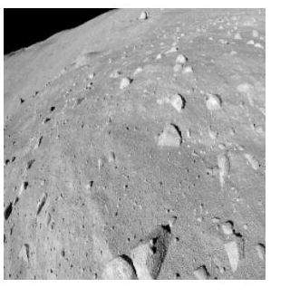
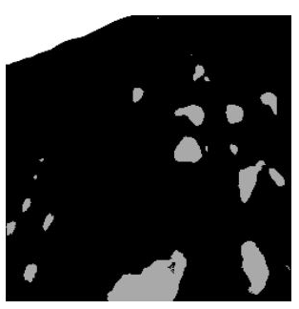
OUTPUT
Input Image
Output Image
Lunar Rock Segmentation Week 6. Session 1

