Slide 1

Git and GitHub
List of Contents:
What is Version Control Software?
Types of Version Control Software
What is Git and how it’s different from GitHub?
Sign up on GitHub, Installing and Configuring Git
Using Git via Commands: Git Clone, Commit, Push
Git Branch and Merge
AI4LE Week 8. Session 3

Slide 2
What is Version Control Software?
Version Control is basically how programmers and developers track their code changes.
It includes changes to code, websites or any piece of information that you store as part of your program.
We can save an initial version of our code in Git, then when we update our code, we can save it into Git again, and again, and again.
Throughout the course of the project, we get several versions of the project.
Version Control Software helps us in saving, accessing, and controlling these different versions.
We can look back or forward to understand all the changes we have made over time.
AI4LE Week 8. Session 3

Slide 3
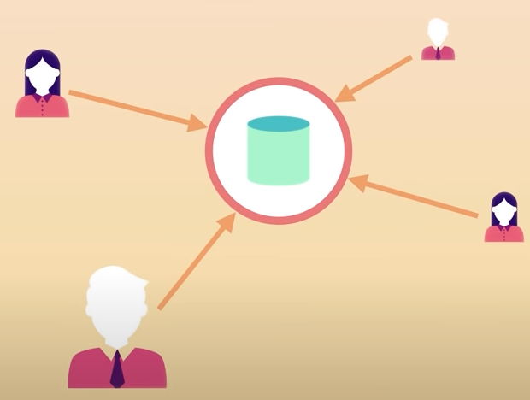
Types of Version Control Software
Fig: Centralized Version Control System
AI4LE Week 8. Session 3

Slide 4
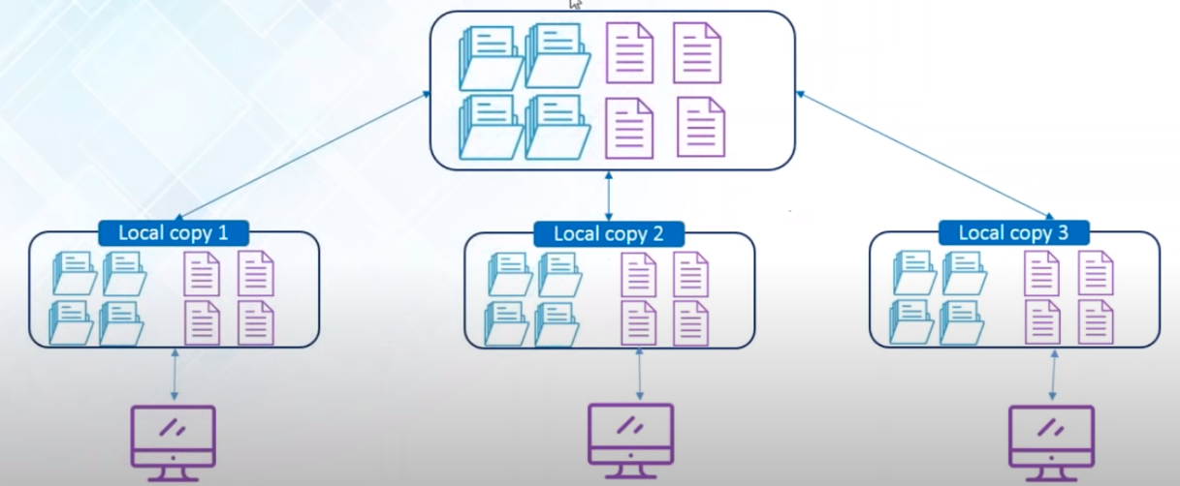
Types of Version Control Software
Fig: Distributed Version Control System
AI4LE Week 8. Session 3

Slide 5
What is Git?
Git is the most common free, distributed, open source version control system.
It tracks all our changes in a database called repository.
Repository is a space where we store any and all kinds of file associated with our project.
We can see our project history and see who has made what changes, and when.
If mistakes are discovered, we can revert to an earlier version of the project.
AI4LE Week 8. Session 3

Slide 6
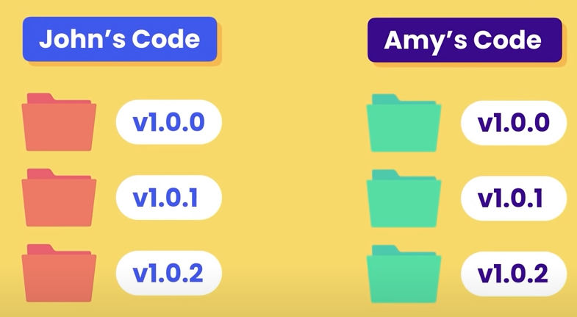
What is Git?
Without git, you’ll have to use emails and drives to keep separate versions and then manually merge the folders to get the final one.
AI4LE Week 8. Session 3

Slide 7
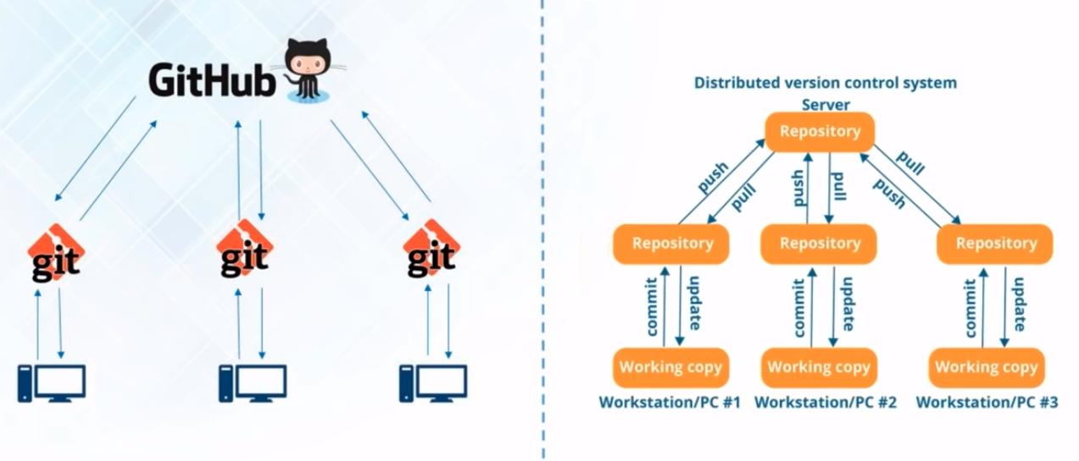
How is Git different from GitHub?
With Git, we can track our progress and work together.
GitHub is where we can store our project - its different versions.
GitHub is a code-hosting platform for version control collaboration - like Instagram for Developers!
AI4LE Week 8. Session 3

Slide 8
Sign up on GitHub, Installing and Configuring Git
Demo -> GitHub, creating first repo, readme.md file, new commits
Get the first repo on local machine
git -- version
If not installed already (Windows): https://www.atlassian.com/git/tutorials/install-git : GitBash
Set up a code editor: MS-VSCode (code.visualstudio.com), Sublime, Atom (atom.io)
Pull the repo to local machine!
AI4LE Week 8. Session 3

Slide 9
Sign Up on GitHub, Installing and Configuring Git
Open GitBash (as admin), and run:
git config --global user.name "AditiPanda"
git config --global user.email panda38aditi@gmail.com
git clone https://github.com/AditiPanda/demo-repo.git
Make sure you create a Personal Access Token with scope set to repo, and expiration set to never
AI4LE Week 8. Session 3

Slide 10
Using Git - Commands
To list out all files in your cloned repo:
ls -la
Make changes to your project - Add a python code file, change your readme
Now commit the latest changes to your github repo using git
First step to commit: run git status
Newly created files are untracked - add them! - git add . or git add name_of_newly_created_file
Run git status again to see a list of changes to be committed - Git comes up with this list!
AI4LE Week 8. Session 3

Slide 11
Git Branch and Merge
git branch
git checkout feature-readme-instructions
Do a git branch again, and a git checkout main again
In the new branch, modify readme file
Run git status, git add., git commit
After git checkout main, the changes are not visible in readme of main branch
Run git diff feature-readme-instructions to see differences
Run git merge feature-readme-instructions
AI4LE Week 8. Session 3

Slide 12
Git Branch and Merge
But now on doing a git push,it says fatalerror
Copy the command it shows: git push --set-upstream origin feature-readme-instructions
Go to GitHub, create a pull request, merge it with branch
AI4LE Week 8. Session 3

Slide 13
References
https://www.youtube.com/watch?v=8JJ101D3knE&ab_channel=ProgrammingwithMosh
https://www.youtube.com/watch?v=RGOj5yH7evk&ab_channel=freeCodeCamp.org
https://www.youtube.com/watch?v=xuB1Id2Wxak&ab_channel=edureka%21
https://www.youtube.com/watch?v=eeuNAIZoWRU&ab_channel=Simplilearn

