Slide 1
JAVA

Slide 2
What is Java
Java is a programming language and a platform. Java is a high level, robust, object-oriented and secure programming language.
Java was developed by Sun Microsystems (which is now the subsidiary of Oracle) in the year 1995. James Gosling is known as the father of Java.

Slide 3
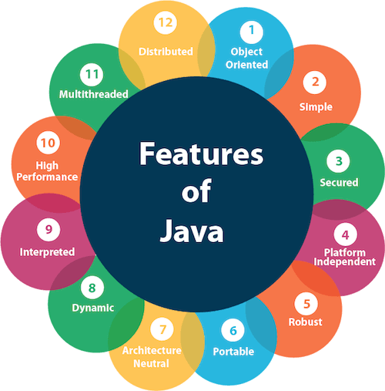
Features of Java

Slide 4
JDK,JRE and JVM
JVM (Java Virtual Machine) is an abstract machine. It is called a virtual machine because it doesn't physically exist. It is a specification that provides a runtime environment in which Java bytecode can be executed. It can also run those programs which are written in other languages and compiled to Java bytecode.
JRE is an acronym for Java Runtime Environment. It is also written as Java RTE. The Java Runtime Environment is a set of software tools which are used for developing Java applications. It is used to provide the runtime environment. It is the implementation of JVM. It physically exists. It contains a set of libraries + other files that JVM uses at runtime.
JDK is an acronym for Java Development Kit. The Java Development Kit (JDK) is a software development environment which is used to develop Java applications and applets. It physically exists. It contains JRE + development tools.

Slide 5
Data Types And Variables

Slide 6
What is Variables
A variable is a container which holds the value while the Java program is executed. A variable is assigned with a data type.
Variable is a name of memory location.

Slide 7
Types of Variables
There are three types of variables in Java:
1. Local variable - A variable declared inside the body of the method is called local variable. You can use this variable only within that method and the other methods in the class aren't even aware that the variable exists.A local variable cannot be defined with "static" keyword.
2. Instance variable - A variable declared inside the class but outside the body of the method, is called instance variable. It is not declared as static.It is called instance variable because its value is instance specific and is not shared among instances.
3. Static variable - A variable which is declared as static is called static variable. It cannot be local. You can create a single copy of static variable and share among all the instances of the class

Slide 8
Data Types
Data types specify the different sizes and values that can be stored in the variable. There are two types of data types in Java:
1. Primitive data types: The primitive data types include boolean, char, byte, short, int, long, float and double.
2. Non-primitive data types: The non-primitive data types include Classes, Interfaces, and Arrays.

Slide 9
Primitive Data Types
There are 8 types of primitive data types:
1. boolean data type
2. byte data type
3. char data type
4. short data type
5. int data type
6. long data type
7. float data type
8. double data type

Slide 10
Operators

Slide 11
What is Operators
Operator in Java is a symbol which is used to perform operations. For example: +, -, *, / etc.

Slide 12
Java Operator Precedence
Operator Type | Category | Precedence
Unary | postfix | expr++ expr--
 | prefix | ++expr --expr +expr -expr ~ !
Arithmetic | multiplicative | * / %
 | additive | + -
Shift | shift | << >> >>>
Relational | comparison | < > <= >= instanceof
 | equality | == !=
Bitwise | bitwise AND | &
 | bitwise exclusive OR | ^
 | bitwise inclusive OR | |
Logical | logical AND | &&
 | logical OR | ||
Ternary | ternary | ? :
Assignment | assignment | = += -= *= /= %= &= ^= |= <<= >>= >>>=

Slide 13
Conditional Statements

Slide 14
What is Conditional Statements
It means execute particular statement only when particular condition is satisfied. For Ex- Particular Citizens are eligible for voting only when their age is 18 or above so for that scenario, we can use condition statement to avoid all other citizens to vote.
In Java we have two types of condition statement- 1. if-else blocks
2. Switch-Case blocks.

Slide 15
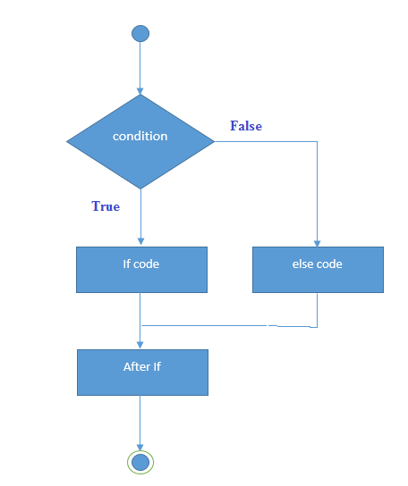
Java If –else
Java if statement checks if required condition is true or false. If it is true then running set of instructions otherwise pass the control to else blocks.

Slide 16
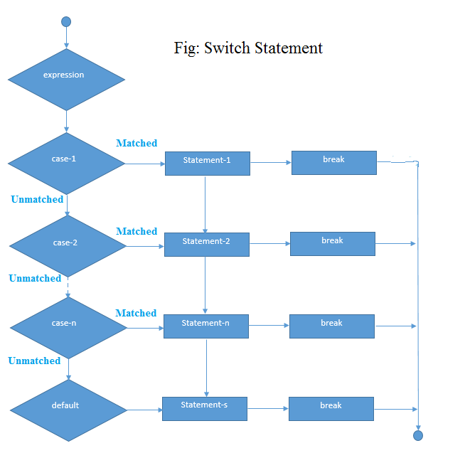
Switch-Case Statement
The Java switch statement executes one statement from multiple conditions. It is like if-else-if ladder statement. The switch statement works with byte, short, int, long, enum types, String and some wrapper types like Byte, Short, Int, and Long. Since Java 7, you can use strings in the switch statement.

Slide 17
Loops

Slide 18
What is Loops
In programming languages, loops are used to execute a set of instructions/functions repeatedly when some conditions become true. There are three types of loops in Java.
1. for loop
for(init;condition;incr/decr){
// code to be executed }
2. while loop
while(condition){
//code to be executed }
3. do-while loop
do{
//code to be executed
}while(condition);

Slide 19
Method

Slide 20
What is Method
In general, a method is a way to perform some task. Similarly, the method in Java is a collection of instructions that performs a specific task. It provides the reusability of code. We can also easily modify code using methods.

Slide 21
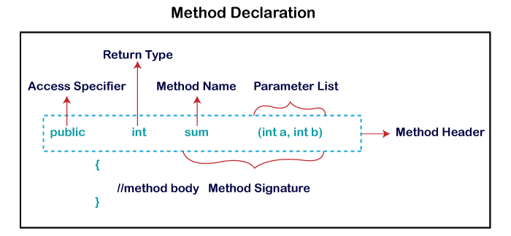
Method Declaration

Slide 22
OOPS Concepts

Slide 23
What is OOPS
Object-Oriented Programming is a paradigm that provides many concepts, such as inheritance, data binding, polymorphism, etc.
It simplifies software development and maintenance by providing some concepts:
1. Object
2. Class
3. Inheritance
4. Polymorphism
5. Abstraction
6. Encapsulation

Slide 24
Objects
An entity that has state and behavior is known as an object e.g., chair, bike, marker, pen, table, car, etc. It can be physical or logical (tangible and intangible).
An object has three characteristics:
1. State: represents the data (value) of an object.
2. Behavior: represents the behavior (functionality) of an object such as deposit, withdraw, etc.
3. Identity: An object identity is typically implemented via a unique ID. The value of the ID is not visible to the external user. However, it is used internally by the JVM to identify each object uniquely.
An object is an instance of a class.

Slide 25
CLASSES
A class is a group of objects which have common properties. It is a template or blueprint from which objects are created. It is a logical entity. It can't be physical.
A class in Java can contain:
Fields
Methods
Constructors
Blocks
Nested class and interface

Slide 26
Constructors

Slide 27
Constructors
A constructor is a block of codes (same as the method). It is called when an instance of the class is created. At the time of calling constructor, memory for the object is allocated in the memory.
Every time an object is created using the new() keyword, at least one constructor is called.
There are two rules defined for the constructor.
1. Constructor name must be the same as its class name
2. A Constructor must have no explicit return type
A Java constructor cannot be abstract, static, final, and synchronized
<class_name>(){
//Code
}

Slide 28
Types Of Constructors
There are two types of constructors -
Default constructor (no-arg constructor)
<class_name>(){
//Code
}
2. Parameterized constructor
<class_name>(some Parameters){
//Code
}

Slide 29
IIB
Instance Initializer block (IIB) is used to initialize the instance data member. It run each time when object of the class is created.
Suppose in our class we have three constructors and for all constructors we have some steps are same so instead of repeat it in each constructor we can declare that statements in IIB, so compiler copy content of IIB in the starting of each constructors.
There are mainly three rules for the instance initializer block. They are as follows:
1. The instance initializer block is created when instance of the class is created.
2. The instance initializer block is invoked after the parent class constructor is invoked (i.e. after super() constructor call).
3. The instance initializer block comes in the order in which they appear.

Slide 30
SIB
Static Instance Initializer block (SIB) is used to initialize the static data member.
When we use static keyword before IIB then it becomes SIB and SIB runs before main method and it runs once when program comes in active state.

Slide 31
Static & Non-Static

Slide 32
Static
Static is the keyword to make that member static.
1. Static means anything which is binding to class.
2. It is shared among all instance of that class.
3. We don’t need to create instance to access it.
4. Static member created when class is created by JVM so it means it comes into memory when program start.
Static can be variable ,method ,blocks and Nested class.

Slide 33
Non-Static
Non-static members which is binding to instance of that class.
It is different for all the instance.
It is allocated to memory when instance of class is created.
We need instance of class to access non-static member.

Slide 34
INHERITANCE

Slide 35
What is Inheritance
Inheritance in Java is a mechanism in which one object acquires all the properties and behaviors of a parent object. It is an important part of OOPs (Object Oriented programming system).
The idea behind inheritance in Java is that you can create new classes that are built upon existing classes. When you inherit from an existing class, you can reuse methods and fields of the parent class. Moreover, you can add new methods and fields in your current class also.
Inheritance represents the IS-A relationship which is also known as a parent-child relationship.

Slide 36
Important Terms of Inheritance
Class: A class is a group of objects which have common properties. It is a template or blueprint from which objects are created.
Sub Class/Child Class: Subclass is a class which inherits the other class. It is also called a derived class, extended class, or child class.
Super Class/Parent Class: Superclass is the class from where a subclass inherits the features. It is also called a base class or a parent class.
Reusability: As the name specifies, reusability is a mechanism which facilitates you to reuse the fields and methods of the existing class when you create a new class. You can use the same fields and methods already defined in the previous class.

Slide 37
Types of Inheritance
Single Inheritance -
When a class inherits another class, it is known as a single inheritance. In the example given below, Dog class inherits the Animal class, so there is the single inheritance.
class Animal{
void eat(){System.out.println("eating...");}
}
class Dog extends Animal{
void bark(){System.out.println("barking...");}
}

Slide 38
Types of Inheritance
Multilevel Inheritance -
When there is a chain of inheritance, it is known as multilevel inheritance. As you can see in the example given below, BabyDog class inherits the Dog class which again inherits the Animal class, so there is a multilevel inheritance.
class Animal{
void eat(){System.out.println("eating...");}
}
class Dog extends Animal{
void bark(){System.out.println("barking...");}
}
class BabyDog extends Dog{
void weep(){System.out.println("weeping...");}
}

Slide 39
Types of Inheritance
Hierarchical Inheritance -
When two or more classes inherits a single class, it is known as hierarchical inheritance. In the example given below, Dog and Cat classes inherits the Animal class, so there is hierarchical inheritance.
class Animal{
void eat(){System.out.println("eating...");}
}
class Dog extends Animal{
void bark(){System.out.println("barking...");}
}
class Cat extends Animal{
void meow(){System.out.println(“Meowing...");}
}

Slide 40
Types of Inheritance
Multiple Inheritance -
When one class inherits two or more classes, it is known as Multiple. Java doesnot support multiple inheritance.
Consider a scenario where A, B, and C are three classes. The C class inherits A and B classes. If A and B classes have the same method and you call it from child class object, there will be ambiguity to call the method of A or B class.
Since compile-time errors are better than runtime errors, Java renders compile-time error if you inherit 2 classes. So, whether you have same method or different, there will be compile time error.

Slide 41
PolyMorphism

Slide 42
What is PolyMorphism
Polymorphism means "many forms“.
There are two types of Polymorphism – 1. Compile-Time Polymorphism
Examples - OverLoading
2. Run-Time Polymorphism
Examples - OverRiding

Slide 43
OverLoading or Compile-Time Polymorphism
If a class has multiple methods having same name but different in method Signatures, it is known as Method Overloading.
Method Signatures means number of parameters or data types of parameters passing to any method.
Suppose you have to perform addition of the given numbers but there can be any number of arguments, if you write the method such as a(int,int) for two parameters, and b(int,int,int) for three parameters then it may be difficult for you as well as other programmers to understand the behavior of the method because its name differs.

Slide 44
Method Overloading is possible when return type is different
In java, method overloading is not possible by changing the return type of the method only because of ambiguity.

Slide 45
OverRiding

Slide 46
What is OverRiding
If subclass (child class) has the same method as declared in the parent class, it is known as method overriding in Java.
Usage of Java Method Overriding-:
Method overriding is used to provide the specific implementation of a method which is already provided by its superclass.
2. Method overriding is used for runtime polymorphism

Slide 47
How to Achieve OverRiding
The method must have the same name as in the parent class
The method must have the same parameter as in the parent class.
3. There must be an IS-A relationship (inheritance).

Slide 48
Covariant Return Type
The covariant return type specifies that the return type may vary in the same direction as the subclass.

Slide 49
Binding & Casting

Slide 50
What is Type-Casting
Type-Casting is a method or process that converts a data type into another data type in both ways manually and automatically. The automatic conversion is done by the compiler and manual conversion performed by the programmer.
There are two types of type casting:
Widening Type Casting - Converting a lower data type into a higher one is called widening type casting. It is also known as implicit conversion or casting down. It is done automatically. It is safe because there is no chance to lose data.
2. Narrowing Type Casting – Converting a higher data type into a lower one is called narrowing type casting. It is also known as explicit conversion or casting up. It is done manually by the programmer. If we do not perform casting then the compiler reports a compile-time error.

Slide 51
Examples of Casting
Casting can be done only if both condition is satisfied –
Both data types must be compatible with each other.
The target type must be larger than the source type.
byte -> short -> char -> int -> long -> float -> double
It is example of Widening Type Casting.
double -> float -> long -> int -> char -> short -> byte
It is example of Narrowing Type Casting.

Slide 52
Binding
Connecting a method call to a method body is called binding.
Types Of Binding –
Static Binding or Early Binding - The binding which can be resolved at compile time by compiler is known as static or early binding. The binding of static, private and final methods is compile-time. Why? The reason is that these method cannot be overridden and the type of the class is determined at the compile time.
Dynamic Binding or Late Binding - When compiler is not able to resolve the call/binding at compile time, such binding is known as Dynamic or late Binding. Method Overriding is a perfect example of dynamic binding. Both Parents and Child has same method and Type of Object is determined at the run-time.

Slide 53
Abstract Classes

Slide 54
What is Abstraction
Before learning Abstract class , first let’s understand Abstraction.
Abstraction is a process of hiding the implementation details and showing only functionality to the user.
Another way, it shows only essential things to the user and hides the internal details, for example, sending SMS where you type the text and send the message. You don't know the internal processing about the message delivery.
Abstraction lets you focus on what the object does instead of how it does it.
There are two ways to achieve abstraction in java
Abstract class (0 to 100%)
Interface (100%)

Slide 55
What is Abstract Classes
A class which is declared as abstract is known as an abstract class. It can have abstract and non-abstract methods. It needs to be extended and its method implemented. It cannot be instantiated.
Points to Remember -
An abstract class must be declared with an abstract keyword.
It can have abstract and non-abstract methods.
It cannot be instantiated.
It can have constructors and static methods also.
It can have final methods which will force the subclass not to change the body of the method.

Slide 56



Abstract Method
A method which is declared as abstract and does not have implementation is known as an abstract method.
abstract void methodA (); //no method body and abstract

Slide 57
Interface

Slide 58
What is Abstraction
Before learning Interface , first let’s rewind Abstraction.
Abstraction is a process of hiding the implementation details and showing only functionality to the user.
Another way, it shows only essential things to the user and hides the internal details, for example, sending SMS where you type the text and send the message. You don't know the internal processing about the message delivery.
Abstraction lets you focus on what the object does instead of how it does it.
There are two ways to achieve abstraction in java
Abstract class (0 to 100%)
Interface (100%)

Slide 59
What is Interface
Another way to achieve abstraction in Java, is with interfaces.
You can define Interface a 100% ‘Abstract Class’. It is type of class which is used to achieve 100% abstraction. It means It has only abstract method.
** Since Java 8, we can have default and static methods in an interface.
Points to Remember -
It is used to achieve abstraction.
By interface, we can support the functionality of multiple inheritance,means one class can implement multiple Interface at a time (which is not possible with classes).
It can be used to achieve loose coupling.
It can be declared same as we declare class just use keyword Interface in place of class.
interface printable { }

Slide 60
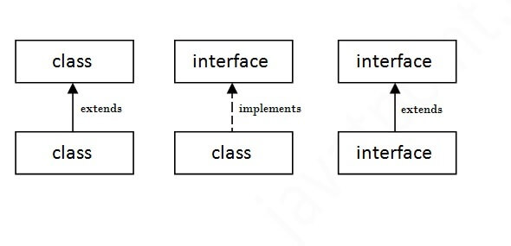
As shown in the figure given below, a class extends another class, an interface extends another interface, but a class implements an interface.

Slide 61
What is marker or tagged interface?
An interface which has no member is known as a marker or tagged interface, for example, Serializable, Cloneable, Remote, etc. They are used to provide some essential information to the JVM so that JVM may perform some useful operation.

Slide 62
Encapsulation

Slide 63
What is Encapsulation
Encapsulation in Java is a process of wrapping code and data together into a single unit, for example, a capsule which is mixed of several medicines.
We can create a fully encapsulated class in Java by making all the data members of the class private. Now we can use setter and getter methods to set and get the data in it.
The Java Bean class is the example of a fully encapsulated class.
It is the process of hiding information details and protecting data and behavior of the object.

Slide 64
Abstraction vs. Encapsulation
1. Encapsulation is more about "How" to achieve a functionality
2. Abstraction is more about "What" a class can do.
A simple example to understand this difference is mobile phone. Where the complex logic in the circuit board is encapsulated in a touch screen, and the interface is provided to abstract it out.

Slide 65
Advantages of Encapsulation
Encapsulation is binding the data with its related functionalities. Here functionalities mean "methods" and data means "variables“
So, we keep variable and methods in one place. That place is "class." Class is the base for encapsulation.
With Java Encapsulation, you can hide (restrict access) to critical data members in your code, which improves security.
As we discussed earlier, if a data member is declared "private", then it can only be accessed within the same class. No outside class can access data member (variable) of other class.
However, if you need to access these variables, you have to use public "getter" and "setter" methods.

Slide 66
Today’s Problem
Application to maintain Area of different geometrical shapes.
Application to maintain student record.

Slide 67
Packages

Slide 68
What is Packages
Package in Java is a mechanism to encapsulate a group of classes, sub packages and interfaces.
Why Packages or Usage of Packages –
Preventing naming conflicts.
Making searching/locating and usage of classes, interfaces, enumerations and annotations easier.
Providing controlled access.
Packages can be considered as data encapsulation

Slide 69
Package in java can be categorized in two form, built-in package and user-defined package.
There are many built-in packages such as java, lang, awt, javax, swing, net, io, util, sql etc.
If we want to declare my own packages then,
The package keyword is used to create a package in java.

Slide 70
How to access package
There are three ways to access the package from outside the package-:
import package.*; -
If you use package.* then all the classes and interfaces of this package will be accessible but not subpackages.
import package.classname; -
If you import package.classname then only declared class of this package will be accessible.
fully qualified name –
If you use fully qualified name then only declared class of this package will be accessible. Now there is no need to import. But you need to use fully qualified name every time when you are accessing the class or interface.
**It is generally used when two packages have same class name.

Slide 71
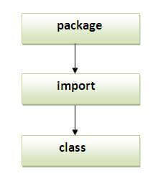
Important key points
Order of program should be as given in Image
Package inside the package is called the subpackage. It should be created to categorize the package further.
The static import feature of Java 5 facilitate the java programmer to access any static member of a class directly. There is no need to qualify it by the class name.

Slide 72
Objects

Slide 73
What is Objects class
The Object class is the parent class of all the classes in java by default. In other words, it is the topmost class of java.
The Object class is beneficial if you want to refer any object whose type you don't know. Notice that parent class reference variable can refer the child class object, know as upcasting.
Let's take an example, there is getObject() method that returns an object but it can be of any type like Employee ,Student etc , we can use Object class reference to refer that object.

Slide 74
Methods Of Object Classes
public final Class getClass()
public int hashCode()
public boolean equals(Object obj)
protected Object clone() throws CloneNotSupportedException
public String toString()
public final void notify()
public final void notifyAll()
public final void wait(long timeout)throws InterruptedException
public final void wait(long timeout,int nanos)throws InterruptedException
public final void wait()throws InterruptedException
protected void finalize()throws Throwable

Slide 75
Strings

Slide 76
What is String
In Java, String is basically an object that represents sequence of char values. An array of characters works same as Java string.
String s=“Java";
Java String class provides a lot of methods to perform operations on strings such as compare(), concat(), equals(), split(), length(), replace(), compareTo(), intern(), substring() etc.
The java.lang.String class implements Serializable, Comparable and CharSequence interfaces.
** String is Immutable Class, means you can’t change the string once it is created.

Slide 77
Methods Of String Classes
Length()
toUpperCase
toLowerCase
indexOf
charAt()
compareTo()
concat()
contains()
equals()
equalsIgnoreCase()
toCharArray()
indexOf()
intern()
isEmpty()
split()

Slide 78
What is String Builder or String Buffer
Java StringBuffer /StringBuilder class is used to create mutable (modifiable) string. The StringBuffer /StringBuilder class in java is same as String class except it is mutable i.e. it can be changed.
StringBuilder string = new StringBuilder(“Hello”);
StringBuffer string = new StringBuffer(“Hello”);
** A string that can be modified or changed is known as mutable string. StringBuffer and StringBuilder classes are used for creating mutable string..

Slide 79
Methods Of String Builder/String Buffer Classes
append()
insert(int offset, String s)
replace(int startIndex, int endIndex, String str)
delete(int startIndex, int endIndex)
reverse()
capacity()
ensureCapacity(int minimumCapacity)
charAt(int index)
length()
substring(int beginIndex)
substring(int beginIndex, int endIndex)

Slide 80
Difference between String Builder & String Buffer
No. | StringBuffer | StringBuilder
1) | StringBuffer is synchronized i.e. thread safe. It means two threads can't call the methods of StringBuffer simultaneously. | StringBuilder is non-synchronized i.e. not thread safe. It means two threads can call the methods of StringBuilder simultaneously.
2) | StringBuffer is less efficient than StringBuilder. | StringBuilder is more efficient than StringBuffer.

Slide 81
Difference between String & String Buffer
No. | String | StringBuffer
1) | String class is immutable. | StringBuffer class is mutable.
2) | String is slow and consumes more memory when you concat too many strings because every time it creates new instance. | StringBuffer is fast and consumes less memory when you cancat strings.
3) | String class overrides the equals() method of Object class. So you can compare the contents of two strings by equals() method. | StringBuffer class doesn't override the equals() method of Object class.

Slide 82
Wrappers

Slide 83
What is Wrapper classes
The wrapper class in Java provides the mechanism to convert primitive into object and object into primitive.
Since J2SE 5.0, autoboxing and unboxing feature convert primitives into objects and objects into primitives automatically. The automatic conversion of primitive into an object is known as autoboxing and vice-versa unboxing.
Integer integer = 5; // autoboxing
int a = integer // autounboxing

Slide 84
Use of Wrapper classes in Java
Change the value in Method: Java supports only call by value. So, if we pass a primitive value, it will not change the original value. But, if we convert the primitive value in an object, it will change the original value.
Serialization: We need to convert the objects into streams to perform the serialization. If we have a primitive value, we can convert it in objects through the wrapper classes.
Synchronization: Java synchronization works with objects in Multithreading.
java.util package: The java.util package provides the utility classes to deal with objects.
Collection Framework: Java collection framework works with objects only. All classes of the collection framework (ArrayList, LinkedList, Vector, HashSet, LinkedHashSet, TreeSet, PriorityQueue, ArrayDeque, etc.) deal with objects only.

Slide 85
Types Of Wrapper Class
Primitive Type | Wrapper class
boolean | Boolean
char | Character
byte | Byte
short | Short
int | Integer
long | Long
float | Float
double | Double

Slide 86
Auto-Boxing and Auto Unboxing
Auto-Boxing :-
The automatic conversion of primitive data type into its corresponding wrapper class is known as autoboxing, for example, byte to Byte, char to Character, int to Integer, long to Long, float to Float, boolean to Boolean, double to Double, and short to Short.
Auto-Unboxing :-
The automatic conversion of wrapper type into its corresponding primitive type is known as unboxing. It is the reverse process of autoboxing. Since Java 5, we do not need to use the intValue() method of wrapper classes to convert the wrapper type into primitives.

Slide 87
Arrays

Slide 88
What is Arrays
Normally, an array is a collection of similar type of elements which has contiguous memory location.
Java array is an object which contains elements of a similar data type. Additionally, The elements of an array are stored in a contiguous memory location. It is a data structure where we store similar elements. We can store only a fixed set of elements in a Java array.
Array in Java is index-based, the first element of the array is stored at the 0th index, 2nd element is stored on 1st index and so on.
In Java, array is an object of a dynamically generated class. Java array inherits the Object class, and implements the Serializable as well as Cloneable interfaces. We can store primitive values or objects in an array in Java. Like C/C++, we can also create single dimentional or multidimentional arrays in Java.

Slide 89
Advantages and DisAdvantages
Advantages
Code Optimization: It makes the code optimized, we can retrieve or sort the data efficiently.
Random access: We can get any data located at an index position.
Disadvantages
Size Limit: We can store only the fixed size of elements in the array. It doesn't grow its size at runtime. To solve this problem, collection framework is used in Java which grows automatically.

Slide 90
Types of Array
There are two types of array.
Single Dimensional Array
dataType[] arr;
dataType []arr;
dataType arr[];
Multidimensional Array
dataType[][] arrayRefVar;
dataType [][]arrayRefVar;
dataType arrayRefVar[][];
dataType []arrayRefVar[];

Slide 91
Exception Handling

Slide 92
What is Exception
Before learning Exception Handling, lets understand Why we need Exception Handling. Sometimes , we encounter some issue in runtime which terminate program instantly. That issues can be Error or Exception.
The Error indicates a problem that mainly occurs due to the lack of system resources and our application should not catch these types of problems.
Some of the examples of errors are system crash error and out of memory error.
Exceptions are the problems which can occur at runtime and compile time. It mainly occurs in the code written by the developers.
Exceptions are divided into two categories such as checked exceptions and unchecked exceptions.

Slide 93
Exception Handling in Java
The Exception Handling in Java is one of the powerful mechanism to handle the runtime unexected situations so that normal flow of the application can be maintained.
Exception Handling is a mechanism to handle runtime errors such as ClassNotFoundException, IOException, SQLException, RemoteException, etc.
Advantage of Exception –
The core advantage of exception handling is to maintain the normal flow of the application. An exception normally disrupts the normal flow of the application that is why we use exception handling.

Slide 94
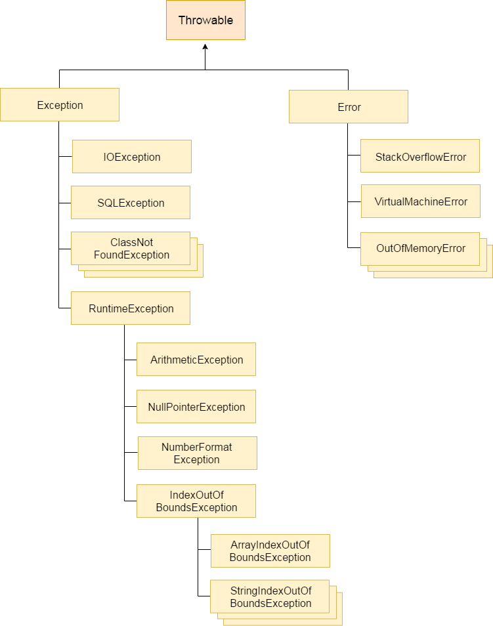
Hierarchy Of Exception

Slide 95
Types of Java Exceptions
There are three Exceptions –
Checked Exception-
The classes which directly inherit Throwable class except RuntimeException and Error are known as checked exceptions e.g. IOException, SQLException etc. Checked exceptions are checked at compile-time.
Unchecked Exception-
The classes which inherit RuntimeException are known as unchecked exceptions e.g. ArithmeticException, NullPointerException, ArrayIndexOutOfBoundsException etc. Unchecked exceptions are not checked at compile-time, but they are checked at runtime.
Error –
Error is irrecoverable e.g. OutOfMemoryError, VirtualMachineError, AssertionError etc.

Slide 96
Java Exception Keywords
Keyword | Description
try | The "try" keyword is used to specify a block where we should place exception code. The try block must be followed by either catch or finally. It means, we can't use try block alone.
catch | The "catch" block is used to handle the exception. It must be preceded by try block which means we can't use catch block alone. It can be followed by finally block later.
finally | The "finally" block is used to execute the important code of the program. It is executed whether an exception is handled or not.
throw | The "throw" keyword is used to throw an exception.
throws | The "throws" keyword is used to declare exceptions. It doesn't throw an exception. It specifies that there may occur an exception in the method. It is always used with method signature.

Slide 97
Multithreading

Slide 98
What is Multithreading
Multithreading in Java is a process of executing multiple threads simultaneously.
A thread is a lightweight sub-process, the smallest unit of processing. Multiprocessing and multithreading, both are used to achieve multitasking.
However, we use multithreading than multiprocessing because threads use a shared memory area. They don't allocate separate memory area so saves memory, and context-switching between the threads takes less time than process.
Java Multithreading is mostly used in games, animation, etc.

Slide 99
Advantages of Java Multithreading
1) It doesn't block the user because threads are independent and you can perform multiple operations at the same time.
2) You can perform many operations together, so it saves time.
3) Threads are independent, so it doesn't affect other threads if an exception occurs in a single thread.

Slide 100
What is Thread.
A thread is a lightweight subprocess, the smallest unit of processing. It is a separate path of execution.
Threads are independent. If there occurs exception in one thread, it doesn't affect other threads. It uses a shared memory area.
Life cycle of a Thread-:
New - The thread is in new state if you create an instance of Thread class but before the invocation of start() method.
Runnable- The thread is in runnable state after invocation of start() method, but the thread scheduler has not selected it to be the running thread.
Running - The thread is in running state if the thread scheduler has selected it.
Non-Runnable - This is the state when the thread is still alive but is currently not eligible to run.
Terminated - A thread is in terminated or dead state when its run() method exits.

Slide 101
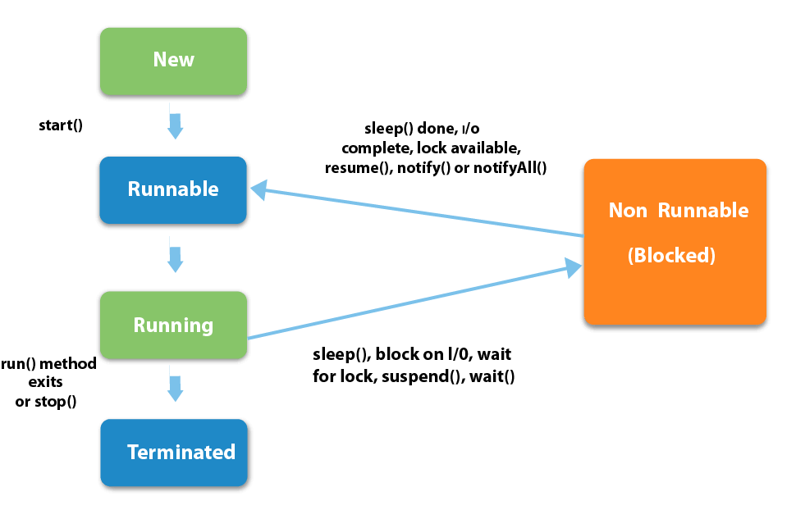
Thread Life Cycle

Slide 102
How to create Threads
There are two ways to create a thread:
By extending Thread class –
In this way, we are extending Thread class (Predefined Class). Thread class provide constructors and methods to create and perform operations on a thread.
By Implementing Runnable Interface –
The Runnable interface should be implemented by any class whose instances are intended to be executed by a thread. Runnable interface have only one method named run().
In both way, we need to override run() method. And call start method of Thread class.
start() method of Thread class is used to start a newly created thread. It performs following tasks:
A new thread starts(with new callstack).
The thread moves from New state to the Runnable state.
When the thread gets a chance to execute, its target run() method will run.

Slide 103
Thread Scheduler
Thread scheduler in java is the part of the JVM that decides which thread should run.
There is no guarantee that which runnable thread will be chosen to run by the thread scheduler.
Only one thread at a time can run in a single process.
The thread scheduler mainly uses preemptive or time slicing scheduling to schedule the threads.
Preemptive scheduling v/s Time slicing
Under preemptive scheduling, the highest priority task executes until it enters the waiting or dead states or a higher priority task comes into existence. Under time slicing, a task executes for a predefined slice of time and then reenters the pool of ready tasks. The scheduler then determines which task should execute next, based on priority and other factors.

Slide 104
Some key Points
Thread scheduler in java is the part of the JVM that decides which thread should run. There is no guarantee that which runnable thread will be chosen to run by the thread scheduler.
Under preemptive scheduling, the highest priority task executes until it enters the waiting or dead states or a higher priority task comes into existence. Under time slicing, a task executes for a predefined slice of time and then reenters the pool of ready tasks. The scheduler then determines which task should execute next, based on priority and other factors.
The sleep() method of Thread class is used to sleep a thread for the specified amount of time.
After starting a thread, it can never be started again. If we does so, an IllegalThreadStateException is thrown.
Invoking the run() method from main thread, the run() method goes onto the current call stack rather than at the beginning of a new call stack.
The join() method waits for a thread to die. In other words, it causes the currently running threads to stop executing until the thread it joins with completes its task.

Slide 105
Some key Points
The Thread class provides methods to change and get the name of a thread. By default, each thread has a name i.e. thread-0, thread-1 and so on.
The currentThread() method returns a reference of currently executing thread.
Each thread have a priority. Priorities are represented by a number between 1 and 10. In most cases, thread schedular schedules the threads according to their priority.
Daemon thread in java is a service provider thread that provides services to the user thread. Its life depend on the mercy of user threads i.e. when all the user threads dies, JVM terminates this thread automatically.
The shutdown hook can be used to perform cleanup resource or save the state when JVM shuts down normally or abruptly. Performing clean resource means closing log file, sending some alerts or something else. So if you want to execute some code before JVM shuts down, use shutdown hook.
Java provides a convenient way to group multiple threads in a single object. In such way, we can suspend, resume or interrupt group of threads by a single method call.
ThreadGroup tg1 = new ThreadGroup("Group A");
Thread t1 = new Thread(tg1,new MyRunnable(),"one");

Slide 106
Collections

Slide 107
What is Collections
The Collection in Java is a framework that provides an architecture to store and manipulate the group of objects.
Java Collections can achieve all the operations that you perform on a data such as searching, sorting, insertion, manipulation, and deletion.
Java Collection means a single unit of objects. Java Collection framework provides many interfaces (Set, List, Queue, Deque) and classes (ArrayList, Vector, LinkedList, PriorityQueue, HashSet, LinkedHashSet, TreeSet).
The Collection framework represents a unified architecture for storing and manipulating a group of objects. It has:
Interfaces and its implementations, i.e., classes
Algorithm

Slide 108
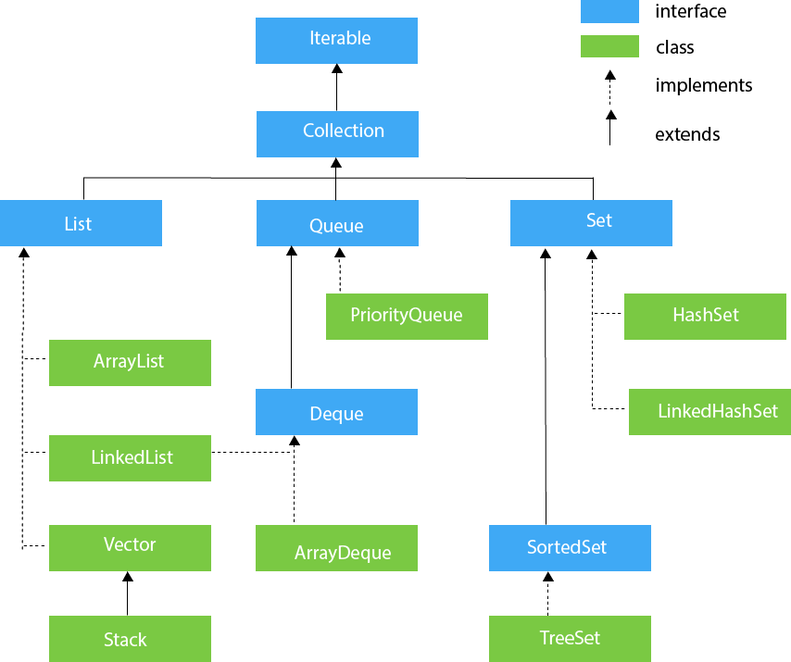
Hierarchy of Collection Framework

Slide 109
Java Iterator
The Java Iterator interface represents an object capable of iterating through a collection of Java objects, one object at a time. The Iterator interface is one of the oldest mechanisms in Java for iterating collections of objects.
To use a Java Iterator you will have to obtain an Iterator instance from the collection of objects you want to iterate over. The obtained Iterator keeps track of the elements in the underlying collection to make sure you iterate through all of them.
Some collections do not allow you to modify the collection while you are iterating it via an Iterator. In that case you will get a ConcurrentModificationException the next time you call the Iterator next() method.
The Java Iterable interface represents a collection of objects which is iterable - meaning which can be iterated. This means, that a class that implements the Java Iterable interface can have its elements iterated. You can iterate the objects of a Java Iterable in three ways: Via the , by obtaining a Java Iterator from the Iterable, or by calling the Java Iterable forEach() method.

Slide 110
Java Generic Collections
The Java Generics features were added to the Java language from Java 5. Generics add a way to specify concrete types to general purpose classes and methods that operated on Object before.
Note: Java generics can be used with other classes than the collection classes, but it is easiest to show the basics of Java generics using collections.
Example - : The List interface represents a list of Object instances. This means that we could put any object into a List. Because any object could be added, you would also have to cast any objects obtained from these objects. Very often you only use a single type with a collection. For instance, you only keep String's or something else in the collection, and not mixed types. With the Java Generics features you can set the type of the collection to limit what kind of objects can be inserted into the collection. Additionally, you don't have to cast the values you obtain from the collection.
List<String> strings = new ArrayList<String>();

Slide 111
LIST

Slide 112
What is LIST
The Java List interface, java.util.List, represents an ordered sequence of objects. The elements contained in a Java List can be inserted, accessed, iterated and removed according to the order in which they appear internally in the Java List. The ordering of the elements is why this data structure is called a List.
Each element in a Java List has an index. The first element in the List has index 0, the second element has index 1 etc. The index means "how many elements away from the beginning of the list". The first element is thus 0 elements away from the beginning of the list - because it is at the beginning of the list.
You can add any Java object to a List. If the List is not typed, using Java Generics, then you can even mix objects of different types (classes) in the same List. Mixing objects of different types in the same List is not often done in practice.

Slide 113
ArrayList
Java ArrayList class uses a dynamic array for storing the elements. It is like an array, but there is no size limit. We can add or remove elements anytime. So, it is much more flexible than the traditional array. It is found in the java.util package. It is like the Vector in C++.
The ArrayList in Java can have the duplicate elements also. It implements the List interface so we can use all the methods of List interface here. The ArrayList maintains the insertion order internally.
It inherits the AbstractList class and implements List interface.
The important points about Java ArrayList class are:
Java ArrayList class can contain duplicate elements.
Java ArrayList class maintains insertion order.
Java ArrayList class is non synchronized.
Java ArrayList allows random access because array works at the index basis.
In ArrayList, manipulation is little bit slower than the LinkedList in Java because a lot of shifting needs to occur if any element is removed from the array list.

Slide 114
Declaration of ArrayList - :
public class ArrayList<E> extends AbstractList<E> implements List<E>, RandomAccess, Cloneable, Serializable
Java Non-generic Vs. Generic Collection –
In a generic collection, we specify the type in angular braces. Now ArrayList is forced to have the only specified type of objects in it. If you try to add another type of object, it gives compile time error.
ArrayList list=new ArrayList(); //creating old non-generic arraylist
ArrayList<String> list=new ArrayList<String>();//creating new generic arraylist

Slide 115
Java LinkedList class
Java LinkedList class uses a doubly linked list to store the elements. It provides a linked-list data structure. It inherits the AbstractList class and implements List and Deque interfaces.
The important points about Java LinkedList are:
Java LinkedList class can contain duplicate elements.
Java LinkedList class maintains insertion order.
Java LinkedList class is non synchronized.
In Java LinkedList class, manipulation is fast because no shifting needs to occur.
Java LinkedList class can be used as a list, stack or queue.
LinkedList class declaration -:
public class LinkedList<E> extends AbstractSequentialList<E> implements List<E>, Deque<E>, Cloneable, Serializable

Slide 116
ArrayList V/S LinkedList
ArrayList and LinkedList both implements List interface and maintains insertion order. Both are non synchronized classes.
ArrayList | LinkedList
1) ArrayList internally uses a dynamic array to store the elements. | LinkedList internally uses a doubly linked list to store the elements.
2) Manipulation with ArrayList is slow because it internally uses an array. If any element is removed from the array, all the bits are shifted in memory. | Manipulation with LinkedList is faster than ArrayList because it uses a doubly linked list, so no bit shifting is required in memory.
3) An ArrayList class can act as a list only because it implements List only. | LinkedList class can act as a list and queue both because it implements List and Deque interfaces.
4) ArrayList is better for storing and accessing data. | LinkedList is better for manipulating data.

Slide 117
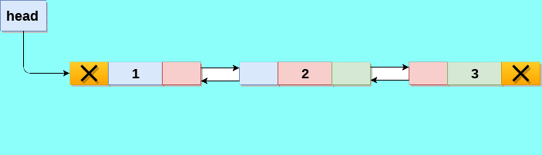
Doubly Linked List

Slide 118
SET

Slide 119
What is HashSet
Java HashSet class is used to create a collection that uses a hash table for storage. It inherits the AbstractSet class and implements Set interface.
The important points about Java HashSet class are:
HashSet stores the elements by using a mechanism called hashing.
HashSet contains unique elements only.
HashSet allows null value.
HashSet class is non synchronized.
HashSet doesn't maintain the insertion order. Here, elements are inserted on the basis of their hashcode.
HashSet is the best approach for search operations.
The initial default capacity of HashSet is 16, and the load factor is 0.75.
** A list can contain duplicate elements whereas Set contains unique elements only.

Slide 120
LinkedHashSet
Java LinkedHashSet class is a Hashtable and Linked list implementation of the set interface. It inherits HashSet class and implements Set interface.
The LinkedHashSet class extends HashSet class which implements Set interface. The Set interface inherits Collection and Iterable interfaces in hierarchical order.
The important points about Java LinkedHashSet class are:
Java LinkedHashSet class contains unique elements only like HashSet.
Java LinkedHashSet class provides all optional set operation and permits null elements.
Java LinkedHashSet class is non synchronized.
Java LinkedHashSet class maintains insertion order.

Slide 121
TreeSet
Java TreeSet class implements the Set interface that uses a tree for storage. It inherits AbstractSet class and implements the NavigableSet interface. The objects of the TreeSet class are stored in ascending order.
The important points about Java TreeSet class are:
Java TreeSet class contains unique elements only like HashSet.
Java TreeSet class access and retrieval times are quiet fast.
Java TreeSet class doesn't allow null element.
Java TreeSet class is non synchronized.
Java TreeSet class maintains ascending order.

Slide 122
MAP

Slide 123
What is MAP
A map contains values on the basis of key, i.e. key and value pair. Each key and value pair is known as an entry. A Map contains unique keys.
A Map is useful if you have to search, update or delete elements on the basis of a key.
There are two interfaces for implementing Map in java: Map and SortedMap, and three classes: HashMap, LinkedHashMap, and TreeMap.
A Map doesn't allow duplicate keys, but you can have duplicate values. HashMap and LinkedHashMap allow null keys and values, but TreeMap doesn't allow any null key or value.
A Map can't be traversed, so you need to convert it into Set using keySet() or entrySet() method.
Entry is the subinterface of Map. So we will be accessed it by Map.Entry name. It returns a collection-view of the map, whose elements are of this class. It provides methods to get key and value.

Slide 124
HashMap
Java HashMap class implements the Map interface which allows us to store key and value pair, where keys should be unique. If you try to insert the duplicate key, it will replace the element of the corresponding key. It is easy to perform operations using the key index like updation, deletion, etc. HashMap class is found in the java.util package.
HashMap in Java is like the legacy Hashtable class, but it is not synchronized. It allows us to store the null elements as well, but there should be only one null key. Since Java 5, it is denoted as HashMap<K,V>, where K stands for key and V for value. It inherits the AbstractMap class and implements the Map interface.
Points to remember
Java HashMap contains values based on the key.
Java HashMap contains only unique keys.
Java HashMap may have one null key and multiple null values.
Java HashMap is non synchronized.
Java HashMap maintains no order.
The initial default capacity of Java HashMap class is 16 with a load factor of 0.75.

Slide 125
Declaration of HashMap –
public class HashMap<K,V> extends AbstractMap<K,V> implements Map<K,V>, Cloneable, Serializable
HashMap class Parameters –
K: It is the type of keys maintained by this map.
V: It is the type of mapped values.

Slide 126
Working of HashMap
Before this, first learn Hashing. It is the process of converting an object into an integer value. The integer value helps in indexing and faster searches.
equals(): It checks the equality of two objects. It compares the Key, whether they are equal or not. It is a method of the Object class. It can be overridden. If you override the equals() method, then it is mandatory to override the hashCode() method.
hashCode(): This is the method of the object class. It returns the memory reference of the object in integer form. The value received from the method is used as the bucket number. The bucket number is the address of the element inside the map. Hash code of null Key is 0.
Buckets: Array of the node is called buckets. Each node has a data structure like a LinkedList. More than one node can share the same bucket. It may be different in capacity.

Slide 127
Working of HashMap
Steps to store elements in HashMap –
First, we check the key object is null. If the key is null, the value is stored in hashTable[0] position. Because hashcode for null is always 0.
Then on next step, a hash value is calculated using the key’s hash code by calling its hashCode() method. This hash value is used to calculate the index in the array for storing Entry object.
Now indexFor(hash, table.length) function is called to calculate exact index position for storing the Entry object.
If two objects have same hashcode function and key are not equal, then we can use linkedlist in this case.
When an Entry object needs to be stored in particular index, HashMap checks whether there is already an entry?? If there is no entry already present, the entry object is stored in this location. If there is already an object sitting on calculated index, its next attribute is checked. If it is null, and current entry object becomes next node in linkedlist. If next variable is not null, procedure is followed until next is evaluated as null.

Slide 128
LinkedHashMap
Java LinkedHashMap class is Hashtable and Linked list implementation of the Map interface, with predictable iteration order. It inherits HashMap class and implements the Map interface.
Points to remember -
Java LinkedHashMap contains values based on the key.
Java LinkedHashMap contains unique elements.
Java LinkedHashMap may have one null key and multiple null values.
Java LinkedHashMap is non synchronized.
Java LinkedHashMap maintains insertion order.
The initial default capacity of Java HashMap class is 16 with a load factor of 0.75.

Slide 129
TreeMap
Java TreeMap class is a red-black tree based implementation. It provides an efficient means of storing key-value pairs in sorted order.
The important points about Java TreeMap class are:
Java TreeMap contains values based on the key. It implements the NavigableMap interface and extends AbstractMap class.
Java TreeMap contains only unique elements.
Java TreeMap cannot have a null key but can have multiple null values.
Java TreeMap is non synchronized.
Java TreeMap maintains ascending order.

Slide 130
JAVA 8 FEATURES

Slide 131
Java 8 Features
Java 8 provides following features for Java Programming:-
Lambda expressions
Method references
Functional interfaces
Stream API
Default methods
Static Method
Optional class
Collectors class

Slide 132
Lambda Expressions
Lambda expression is a new and important feature of Java which was included in Java SE 8. It provides a clear and concise way to represent one method interface using an expression. It is very useful in collection library. It helps to iterate, filter and extract data from collection.
The Lambda expression is used to provide the implementation of an interface which has functional interface. It saves a lot of code. In case of lambda expression, we don't need to define the method again for providing the implementation. Here, we just write the implementation code.
Java lambda expression is treated as a function, so compiler does not create .class file.
Lambda expression provides implementation of functional interface. An interface which has only one abstract method is called functional interface. Java provides an anotation @FunctionalInterface, which is used to declare an interface as functional interface.
(argument-list) -> {body}

Slide 133
Java Method References
Java provides a new feature called method reference in Java 8. Method reference is used to refer method of functional interface. It is compact and easy form of lambda expression. Each time when you are using lambda expression to just referring a method, you can replace your lambda expression with method reference.
There are following types of method references in java:
1. Reference to a static method.
2. Reference to an instance method.
3. Reference to a constructor.

Slide 134
New Features in Interfaces in Java 8
We have following features add in interface in Java 8 – 1. Functional Interface – If any interface has only one abstract method then it is called functional interface. We can annotate @FunctionalInterface to declare functional interface.
2. Default Method – Before Java8 , Interface has only abstract method but Java8 introduce facility to add default method in Interface. Default keyword is used to declare any method as default inside interface and it must have implementation or method body.
3. Static Method – Similarly like default method , we can also add static method in interface with help of static keyword.

Slide 135
Optional Class
Java introduced a new class Optional in jdk8. It is a public final class and used to deal with NullPointerException in Java application.
Important Method of Optional Class –
empty() – which returns empty optional object. Of(T value) – which return Optional Object with specified non null value.
OfNullable(T value) – which return Optional with value if value is not null otherwise return empty Optional object.
Get() – If Optional has value it return value otherwise throws NoSuchElementException.
isPresent() – It returns true if optional object is not empty and return false if optional object is empty.

Slide 136
Stream Api
Java provides a new additional package in Java 8 called java.util.stream. This package consists of classes, interfaces and enum to allows functional-style operations on the elements. You can use stream by importing java.util.stream package.
The important points about Stream Api are:
Stream does not store elements. It simply conveys elements from a source such as a data structure, an array, or an I/O channel, through a pipeline of computational operations.
Stream is functional in nature. Operations performed on a stream does not modify it's source. For example, filtering a Stream obtained from a collection produces a new Stream without the filtered elements, rather than removing elements from the source collection.
Stream is lazy and evaluates code only when required.
The elements of a stream are only visited once during the life of a stream. Like an Iterator, a new stream must be generated to revisit the same elements of the source.
You can use stream to filter, collect, print, and convert from one data structure to other

Slide 137
Stream Api
Of(array)
Boolean allMatch
Boolean anyMatch
Collect
Count
Distinct
findAny
findFirst
forEach
Limit
Filter
toArray
Map
sorted
max
min

