Slide 1
JAVA

Slide 2
What is Java
Java is a programming language and a platform. Java is a high level, robust, object-oriented and secure programming language.
Java was developed by Sun Microsystems (which is now the subsidiary of Oracle) in the year 1995. James Gosling is known as the father of Java.

Slide 3
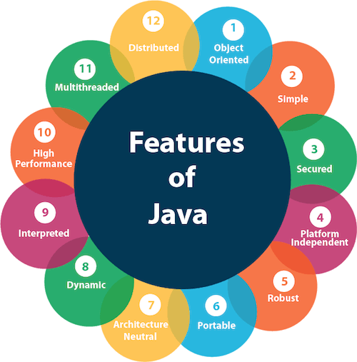
Features of Java

Slide 4
JDK,JRE and JVM
JVM (Java Virtual Machine) is an abstract machine. It is called a virtual machine because it doesn't physically exist. It is a specification that provides a runtime environment in which Java bytecode can be executed. It can also run those programs which are written in other languages and compiled to Java bytecode.
JRE is an acronym for Java Runtime Environment. It is also written as Java RTE. The Java Runtime Environment is a set of software tools which are used for developing Java applications. It is used to provide the runtime environment. It is the implementation of JVM. It physically exists. It contains a set of libraries + other files that JVM uses at runtime.
JDK is an acronym for Java Development Kit. The Java Development Kit (JDK) is a software development environment which is used to develop Java applications and applets. It physically exists. It contains JRE + development tools.

Slide 5
Data Types And Variables

Slide 6
What is Variables
A variable is a container which holds the value while the Java program is executed. A variable is assigned with a data type.
Variable is a name of memory location.

Slide 7
Types of Variables
There are three types of variables in Java:
1. Local variable - A variable declared inside the body of the method is called local variable. You can use this variable only within that method and the other methods in the class aren't even aware that the variable exists.A local variable cannot be defined with "static" keyword.
2. Instance variable - A variable declared inside the class but outside the body of the method, is called instance variable. It is not declared as static.It is called instance variable because its value is instance specific and is not shared among instances.
3. Static variable - A variable which is declared as static is called static variable. It cannot be local. You can create a single copy of static variable and share among all the instances of the class

Slide 8
Data Types
Data types specify the different sizes and values that can be stored in the variable. There are two types of data types in Java:
1. Primitive data types: The primitive data types include boolean, char, byte, short, int, long, float and double.
2. Non-primitive data types: The non-primitive data types include Classes, Interfaces, and Arrays.

Slide 9
Primitive Data Types
There are 8 types of primitive data types:
1. boolean data type
2. byte data type
3. char data type
4. short data type
5. int data type
6. long data type
7. float data type
8. double data type

Slide 10
Operators

Slide 11
What is Operators
Operator in Java is a symbol which is used to perform operations. For example: +, -, *, / etc.

Slide 12
Java Operator Precedence
Operator Type | Category | Precedence
Unary | postfix | expr++ expr--
 | prefix | ++expr --expr +expr -expr ~ !
Arithmetic | multiplicative | * / %
 | additive | + -
Shift | shift | << >> >>>
Relational | comparison | < > <= >= instanceof
 | equality | == !=
Bitwise | bitwise AND | &
 | bitwise exclusive OR | ^
 | bitwise inclusive OR | |
Logical | logical AND | &&
 | logical OR | ||
Ternary | ternary | ? :
Assignment | assignment | = += -= *= /= %= &= ^= |= <<= >>= >>>=

Slide 13
Conditional Statements

Slide 14
What is Conditional Statements
It means execute particular statement only when particular condition is satisfied. For Ex- Particular Citizens are eligible for voting only when their age is 18 or above so for that scenario, we can use condition statement to avoid all other citizens to vote.
In Java we have two types of condition statement- 1. if-else blocks
2. Switch-Case blocks.

Slide 15
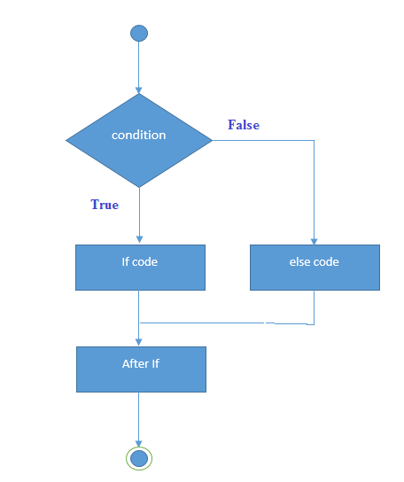
Java If –else
Java if statement checks if required condition is true or false. If it is true then running set of instructions otherwise pass the control to else blocks.

Slide 16
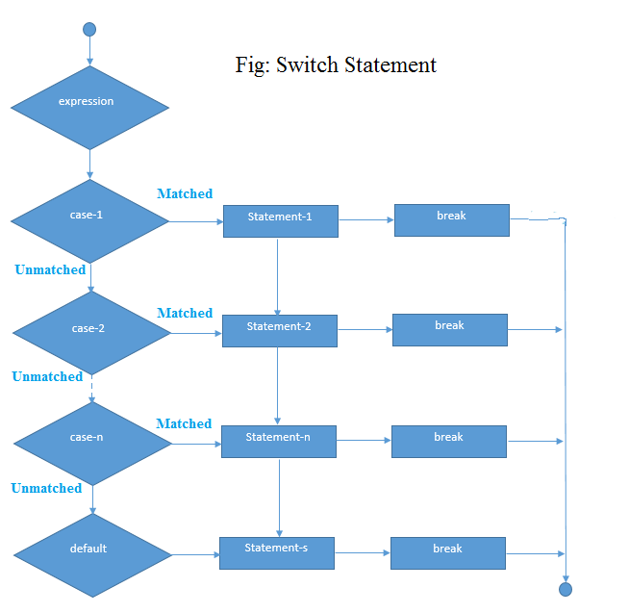
Switch-Case Statement
The Java switch statement executes one statement from multiple conditions. It is like if-else-if ladder statement. The switch statement works with byte, short, int, long, enum types, String and some wrapper types like Byte, Short, Int, and Long. Since Java 7, you can use strings in the switch statement.

Slide 17
Loops

Slide 18
What is Loops
In programming languages, loops are used to execute a set of instructions/functions repeatedly when some conditions become true. There are three types of loops in Java.
1. for loop
for(init;condition;incr/decr){
// code to be executed }
2. while loop
while(condition){
//code to be executed }
3. do-while loop
do{
//code to be executed
}while(condition);

Slide 19
Method

Slide 20
What is Method
In general, a method is a way to perform some task. Similarly, the method in Java is a collection of instructions that performs a specific task. It provides the reusability of code. We can also easily modify code using methods.

Slide 21
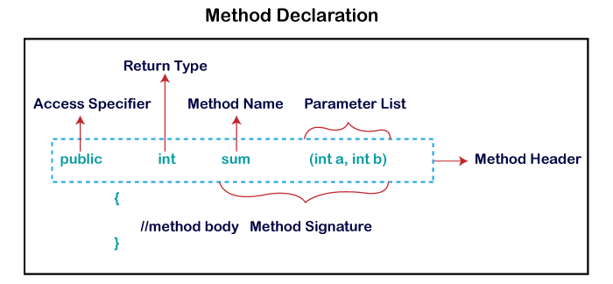
Method Declaration

Slide 22
OOPS Concepts

Slide 23
What is OOPS
Object-Oriented Programming is a paradigm that provides many concepts, such as inheritance, data binding, polymorphism, etc.
It simplifies software development and maintenance by providing some concepts:
1. Object
2. Class
3. Inheritance
4. Polymorphism
5. Abstraction
6. Encapsulation

Slide 24
Objects
An entity that has state and behavior is known as an object e.g., chair, bike, marker, pen, table, car, etc. It can be physical or logical (tangible and intangible).
An object has three characteristics:
1. State: represents the data (value) of an object.
2. Behavior: represents the behavior (functionality) of an object such as deposit, withdraw, etc.
3. Identity: An object identity is typically implemented via a unique ID. The value of the ID is not visible to the external user. However, it is used internally by the JVM to identify each object uniquely.
An object is an instance of a class.

Slide 25
CLASSES
A class is a group of objects which have common properties. It is a template or blueprint from which objects are created. It is a logical entity. It can't be physical.
A class in Java can contain:
Fields
Methods
Constructors
Blocks
Nested class and interface

Slide 26
Constructors

Slide 27
Constructors
A constructor is a block of codes (same as the method). It is called when an instance of the class is created. At the time of calling constructor, memory for the object is allocated in the memory.
Every time an object is created using the new() keyword, at least one constructor is called.
There are two rules defined for the constructor.
1. Constructor name must be the same as its class name
2. A Constructor must have no explicit return type
A Java constructor cannot be abstract, static, final, and synchronized
<class_name>(){
//Code
}

Slide 28
Types Of Constructors
There are two types of constructors -
Default constructor (no-arg constructor)
<class_name>(){
//Code
}
2. Parameterized constructor
<class_name>(some Parameters){
//Code
}

Slide 29
IIB
Instance Initializer block (IIB) is used to initialize the instance data member. It run each time when object of the class is created.
Suppose in our class we have three constructors and for all constructors we have some steps are same so instead of repeat it in each constructor we can declare that statements in IIB, so compiler copy content of IIB in the starting of each constructors.
There are mainly three rules for the instance initializer block. They are as follows:
1. The instance initializer block is created when instance of the class is created.
2. The instance initializer block is invoked after the parent class constructor is invoked (i.e. after super() constructor call).
3. The instance initializer block comes in the order in which they appear.

Slide 30
SIB
Static Instance Initializer block (SIB) is used to initialize the static data member.
When we use static keyword before IIB then it becomes SIB and SIB runs before main method and it runs once when program comes in active state.

Slide 31
Static & Non-Static

Slide 32
Static
Static is the keyword to make that member static.
1. Static means anything which is binding to class.
2. It is shared among all instance of that class.
3. We don’t need to create instance to access it.
4. Static member created when class is created by JVM so it means it comes into memory when program start.
Static can be variable ,method ,blocks and Nested class.

Slide 33
Non-Static
Non-static members which is binding to instance of that class.
It is different for all the instance.
It is allocated to memory when instance of class is created.
We need instance of class to access non-static member.

Slide 34
INHERITANCE

Slide 35
What is Inheritance
Inheritance in Java is a mechanism in which one object acquires all the properties and behaviors of a parent object. It is an important part of OOPs (Object Oriented programming system).
The idea behind inheritance in Java is that you can create new classes that are built upon existing classes. When you inherit from an existing class, you can reuse methods and fields of the parent class. Moreover, you can add new methods and fields in your current class also.
Inheritance represents the IS-A relationship which is also known as a parent-child relationship.

Slide 36
Important Terms of Inheritance
Class: A class is a group of objects which have common properties. It is a template or blueprint from which objects are created.
Sub Class/Child Class: Subclass is a class which inherits the other class. It is also called a derived class, extended class, or child class.
Super Class/Parent Class: Superclass is the class from where a subclass inherits the features. It is also called a base class or a parent class.
Reusability: As the name specifies, reusability is a mechanism which facilitates you to reuse the fields and methods of the existing class when you create a new class. You can use the same fields and methods already defined in the previous class.

Slide 37
Types of Inheritance
Single Inheritance -
When a class inherits another class, it is known as a single inheritance. In the example given below, Dog class inherits the Animal class, so there is the single inheritance.
class Animal{
void eat(){System.out.println("eating...");}
}
class Dog extends Animal{
void bark(){System.out.println("barking...");}
}

Slide 38
Types of Inheritance
Multilevel Inheritance -
When there is a chain of inheritance, it is known as multilevel inheritance. As you can see in the example given below, BabyDog class inherits the Dog class which again inherits the Animal class, so there is a multilevel inheritance.
class Animal{
void eat(){System.out.println("eating...");}
}
class Dog extends Animal{
void bark(){System.out.println("barking...");}
}
class BabyDog extends Dog{
void weep(){System.out.println("weeping...");}
}

Slide 39
Types of Inheritance
Hierarchical Inheritance -
When two or more classes inherits a single class, it is known as hierarchical inheritance. In the example given below, Dog and Cat classes inherits the Animal class, so there is hierarchical inheritance.
class Animal{
void eat(){System.out.println("eating...");}
}
class Dog extends Animal{
void bark(){System.out.println("barking...");}
}
class Cat extends Animal{
void meow(){System.out.println(“Meowing...");}
}

Slide 40
Types of Inheritance
Multiple Inheritance -
When one class inherits two or more classes, it is known as Multiple. Java doesnot support multiple inheritance.
Consider a scenario where A, B, and C are three classes. The C class inherits A and B classes. If A and B classes have the same method and you call it from child class object, there will be ambiguity to call the method of A or B class.
Since compile-time errors are better than runtime errors, Java renders compile-time error if you inherit 2 classes. So, whether you have same method or different, there will be compile time error.

Slide 41
PolyMorphism

Slide 42
What is PolyMorphism
Polymorphism means "many forms“.
There are two types of Polymorphism – 1. Compile-Time Polymorphism
Examples - OverLoading
2. Run-Time Polymorphism
Examples - OverRiding

Slide 43
OverLoading or Compile-Time Polymorphism
If a class has multiple methods having same name but different in method Signatures, it is known as Method Overloading.
Method Signatures means number of parameters or data types of parameters passing to any method.
Suppose you have to perform addition of the given numbers but there can be any number of arguments, if you write the method such as a(int,int) for two parameters, and b(int,int,int) for three parameters then it may be difficult for you as well as other programmers to understand the behavior of the method because its name differs.

Slide 44
Method Overloading is possible when return type is different
In java, method overloading is not possible by changing the return type of the method only because of ambiguity.

Slide 45
OverRiding

Slide 46
What is OverRiding
If subclass (child class) has the same method as declared in the parent class, it is known as method overriding in Java.
Usage of Java Method Overriding-:
Method overriding is used to provide the specific implementation of a method which is already provided by its superclass.
2. Method overriding is used for runtime polymorphism

Slide 47
How to Achieve OverRiding
The method must have the same name as in the parent class
The method must have the same parameter as in the parent class.
3. There must be an IS-A relationship (inheritance).

Slide 48
Covariant Return Type
The covariant return type specifies that the return type may vary in the same direction as the subclass.

Slide 49
Binding & Casting

Slide 50
What is Type-Casting
Type-Casting is a method or process that converts a data type into another data type in both ways manually and automatically. The automatic conversion is done by the compiler and manual conversion performed by the programmer.
There are two types of type casting:
Widening Type Casting - Converting a lower data type into a higher one is called widening type casting. It is also known as implicit conversion or casting down. It is done automatically. It is safe because there is no chance to lose data.
2. Narrowing Type Casting – Converting a higher data type into a lower one is called narrowing type casting. It is also known as explicit conversion or casting up. It is done manually by the programmer. If we do not perform casting then the compiler reports a compile-time error.

Slide 51
Examples of Casting
Casting can be done only if both condition is satisfied –
Both data types must be compatible with each other.
The target type must be larger than the source type.
byte -> short -> char -> int -> long -> float -> double
It is example of Widening Type Casting.
double -> float -> long -> int -> char -> short -> byte
It is example of Narrowing Type Casting.

Slide 52
Binding
Connecting a method call to a method body is called binding.
Types Of Binding –
Static Binding or Early Binding - The binding which can be resolved at compile time by compiler is known as static or early binding. The binding of static, private and final methods is compile-time. Why? The reason is that these method cannot be overridden and the type of the class is determined at the compile time.
Dynamic Binding or Late Binding - When compiler is not able to resolve the call/binding at compile time, such binding is known as Dynamic or late Binding. Method Overriding is a perfect example of dynamic binding. Both Parents and Child has same method and Type of Object is determined at the run-time.

Slide 53
Abstract Classes

Slide 54
What is Abstraction
Before learning Abstract class , first let’s understand Abstraction.
Abstraction is a process of hiding the implementation details and showing only functionality to the user.
Another way, it shows only essential things to the user and hides the internal details, for example, sending SMS where you type the text and send the message. You don't know the internal processing about the message delivery.
Abstraction lets you focus on what the object does instead of how it does it.
There are two ways to achieve abstraction in java
Abstract class (0 to 100%)
Interface (100%)

Slide 55
What is Abstract Classes
A class which is declared as abstract is known as an abstract class. It can have abstract and non-abstract methods. It needs to be extended and its method implemented. It cannot be instantiated.
Points to Remember -
An abstract class must be declared with an abstract keyword.
It can have abstract and non-abstract methods.
It cannot be instantiated.
It can have constructors and static methods also.
It can have final methods which will force the subclass not to change the body of the method.

Slide 56



Abstract Method
A method which is declared as abstract and does not have implementation is known as an abstract method.
abstract void methodA (); //no method body and abstract

Slide 57
Interface

Slide 58
What is Abstraction
Before learning Interface , first let’s rewind Abstraction.
Abstraction is a process of hiding the implementation details and showing only functionality to the user.
Another way, it shows only essential things to the user and hides the internal details, for example, sending SMS where you type the text and send the message. You don't know the internal processing about the message delivery.
Abstraction lets you focus on what the object does instead of how it does it.
There are two ways to achieve abstraction in java
Abstract class (0 to 100%)
Interface (100%)

Slide 59
What is Interface
Another way to achieve abstraction in Java, is with interfaces.
You can define Interface a 100% ‘Abstract Class’. It is type of class which is used to achieve 100% abstraction. It means It has only abstract method.
** Since Java 8, we can have default and static methods in an interface.
Points to Remember -
It is used to achieve abstraction.
By interface, we can support the functionality of multiple inheritance,means one class can implement multiple Interface at a time (which is not possible with classes).
It can be used to achieve loose coupling.
It can be declared same as we declare class just use keyword Interface in place of class.
interface printable { }

Slide 60
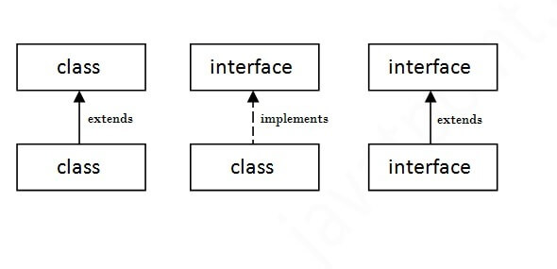
As shown in the figure given below, a class extends another class, an interface extends another interface, but a class implements an interface.

Slide 61
What is marker or tagged interface?
An interface which has no member is known as a marker or tagged interface, for example, Serializable, Cloneable, Remote, etc. They are used to provide some essential information to the JVM so that JVM may perform some useful operation.

Slide 62
Encapsulation

Slide 63
What is Encapsulation
Encapsulation in Java is a process of wrapping code and data together into a single unit, for example, a capsule which is mixed of several medicines.
We can create a fully encapsulated class in Java by making all the data members of the class private. Now we can use setter and getter methods to set and get the data in it.
The Java Bean class is the example of a fully encapsulated class.
It is the process of hiding information details and protecting data and behavior of the object.

Slide 64
Abstraction vs. Encapsulation
1. Encapsulation is more about "How" to achieve a functionality
2. Abstraction is more about "What" a class can do.
A simple example to understand this difference is mobile phone. Where the complex logic in the circuit board is encapsulated in a touch screen, and the interface is provided to abstract it out.

Slide 65
Advantages of Encapsulation
Encapsulation is binding the data with its related functionalities. Here functionalities mean "methods" and data means "variables“
So, we keep variable and methods in one place. That place is "class." Class is the base for encapsulation.
With Java Encapsulation, you can hide (restrict access) to critical data members in your code, which improves security.
As we discussed earlier, if a data member is declared "private", then it can only be accessed within the same class. No outside class can access data member (variable) of other class.
However, if you need to access these variables, you have to use public "getter" and "setter" methods.

Slide 66
Today’s Problem
Application to maintain Area of different geometrical shapes.
Application to maintain student record.

Slide 67
Packages

Slide 68
What is Packages
Package in Java is a mechanism to encapsulate a group of classes, sub packages and interfaces.
Why Packages or Usage of Packages –
Preventing naming conflicts.
Making searching/locating and usage of classes, interfaces, enumerations and annotations easier.
Providing controlled access.
Packages can be considered as data encapsulation

Slide 69
Package in java can be categorized in two form, built-in package and user-defined package.
There are many built-in packages such as java, lang, awt, javax, swing, net, io, util, sql etc.
If we want to declare my own packages then,
The package keyword is used to create a package in java.

Slide 70
How to access package
There are three ways to access the package from outside the package-:
import package.*; -
If you use package.* then all the classes and interfaces of this package will be accessible but not subpackages.
import package.classname; -
If you import package.classname then only declared class of this package will be accessible.
fully qualified name –
If you use fully qualified name then only declared class of this package will be accessible. Now there is no need to import. But you need to use fully qualified name every time when you are accessing the class or interface.
**It is generally used when two packages have same class name.

Slide 71
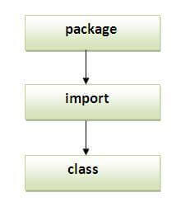
Important key points
Order of program should be as given in Image
Package inside the package is called the subpackage. It should be created to categorize the package further.
The static import feature of Java 5 facilitate the java programmer to access any static member of a class directly. There is no need to qualify it by the class name.

