Slide 1
Test Driven Development (TDD)
Prepared by:
Pappu Rout

Slide 2
Analogy
“Code without tests is bad code. It doesn’t matter how well written it is; it doesn’t matter how pretty or object-oriented or well-encapsulated it is. With tests, we can change the behaviour of our code quickly and verifiably. Without them, we really don’t know if our code is getting better or worse.”
– said by (Michael Feathers)

Slide 3
Agenda
Understand TDD and Best Practice
TDD Steps
Process Document
TDD
Benefits
Hands on
Assignments
Mockito
Hands on
Assignments

Slide 4
Test Driven Development (TDD)
Test-driven development (TDD) is an approach to development which combines test-first development where you
write a test before you write just enough production code to fulfil that test and refactoring.
This technique is heavily emphasized by those using Agile development methodologies
The result of using this practice is a comprehensive suite of unit tests that can be run at any time to provide feedback that the software is still working.

Slide 5
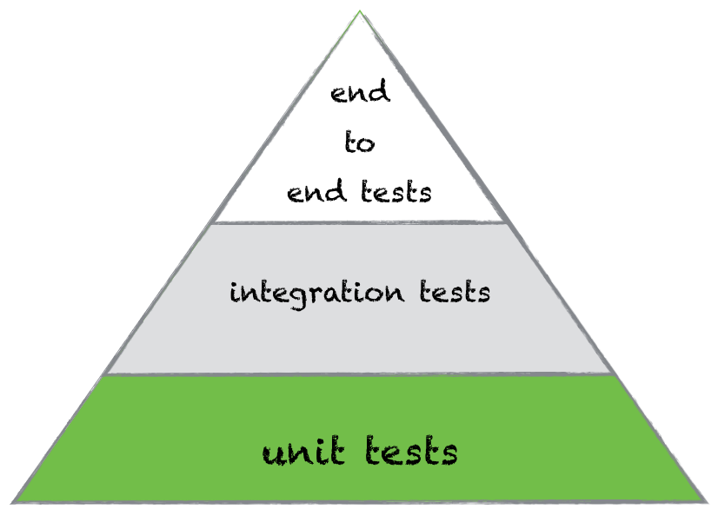
Test Driven Development (TDD)
Place of unit tests in TDD
Unit tests are the smallest elements in the test automation pyramid, TDD is based on them. With help of unit tests we can check business logic of any class.

Slide 6
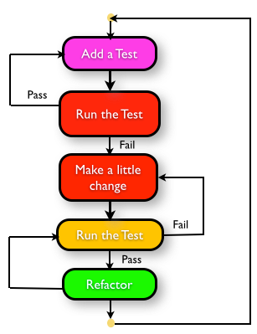
Test Driven Development Steps

Slide 7
Process Document
Understand the requirements of the story, work item, or feature that you are working on.
Red: Create a test and make it fail.
a. Imagine how the new code should be called and write the test as if the code already existed. You will not get IntelliSense because the new method does not yet exist.
b. Create the new production code stub. Write just enough code so that it compiles.
c. Run the test. It should fail. This is a calibration measure to ensure that your test is calling the correct code and that the code is not working by accident. This is a meaningful failure, and you expect it to fail.
3. Green: Make the test pass by any means necessary.
a. Write the production code to make the test pass. Keep it simple.
b. Some advocate the hard-coding of the expected return value first to verify that the test correctly detects success. This varies from practitioner to practitioner.

Slide 8
Process Document
c. If you've written the code so that the test passes as intended, you are finished. You do not have to write more code speculatively. The test is the objective definition of "done." The phrase "You Ain't Gonna Need It" (YAGNI) is often used to veto unnecessary work. If new functionality is still needed, then another test is needed. Make this one test pass and continue.
d. When the test passes, you might want to run all tests up to this point to build confidence that everything else is still working
4. Refactor: Change the code to remove duplication in your project and to improve the design while ensuring that all tests still pass.
a. Remove duplication caused by the addition of the new functionality.
b. Make design changes to improve the overall solution.
c. After each refactoring, rerun all the tests to ensure that they all still pass.
5. Repeat the cycle. Each cycle should be very short, and a typical hour should contain many Red/Green/Refactor cycles

Slide 9
TDD - Benefits
The suite of unit tests provides constant feedback that each component is still working.
• The unit tests act as documentation that cannot go out-of-date, unlike separate documentation, which can and frequently does.
• When the test passes and the production code is refactored to remove duplication, it is clear that the code is finished, and the developer can move on to a new test.
• Test-driven development forces critical analysis and design because the developer cannot create the production code without truly understanding what the desired result should be and how to test it.
• The software tends to be better designed, that is, loosely coupled and easily maintainable, because the developer is free to make design decisions and refactor at any time with confidence that the software is still working. This confidence is gained by running the tests. The need for a design pattern may emerge, and the code can be changed at that time.

Slide 10
TDD - Benefits
The test suite acts as a regression safety net on bugs: If a bug is found, the developer should create a test to reveal the bug and then modify the production code so that the bug goes away and all other tests still pass. On each successive test run, all previous bug fixes are verified.
• Reduced debugging time!

Slide 11
Prime Factor using TDD
Try not to read ahead.
Do one task at a time. The trick is to learn to work incrementally.

Slide 12
FizzBuzz Kata
Problem Statement
  “Fizz” if number is divisible by 3
  “Buzz” if number is divisible by 5
  “FizzBuzz” if number is divisible by 3 and 5 both
  The number, otherwise

Slide 13
Assignment Kata : Word Counter kata
A method that, given a delimited string, returns a collection of all the unique words in it and the count of how many times they occurred. Start off with a space between words, but later other delimiters will be added.
Example input
  “boom, bang, boom”
Output
  boom – 2
  bang - 1

Slide 14
Assignment Kata : Password Verification kata
Create a password verification class called “PasswordVerifier”
Add the below verifications to the master function called “verify”
  Password should be larger than 8 characters
  Password should not be null
  Password should have at least one upper case letter
  Password should have at least one lower case letter
  Password should have at least one number
Each one of these should throw an exception with a different message of your choice
  Add feature: password is ok if at least three of the previous conditions is true
  Add feature: password is never ok if item 1.4 is not true

Slide 15
String Calculator using TDD
Try not to read ahead.
Do one task at a time. The trick is to learn to work incrementally.
Make sure you only test for correct inputs. there is no need to test for invalid inputs for this kata

Slide 16
String Calculator
Problem Statement - String Calculator
1. Create a simple String calculator
  1. The method can take 0, 1 or 2 numbers, and will return their sum (for an empty string it will return 0) for example “” or “1” or “1,2”
  2. Start with the simplest test case of an empty string and move to 1 and two numbers
  3. Remember to solve things as simply as possible so that you force yourself to write tests you did not think about.
  4. Remember to refactor after each passing test
2. Allow the Add method to handle an unknown amount of numbers
example : 1,2,3,4,5
3. Allow the Add method to handle new lines between numbers (instead of commas).
1. the following input is ok: “1\n2,3” (will equal 6)
2. the following input is NOT ok: “1,\n” (not need to prove it - just clarifying)

Slide 17
String Calculator
4. Support different delimiters
1.to change a delimiter, the beginning of the string will contain a separate line that looks like this:
//[delimiter]\n[numbers…]” for example “//;\n1;2” should return three where the
default delimiter is ‘;’ .
2.the first line is optional. all existing scenarios should still be supported
5. Calling Add with a negative number will throw an exception “negatives not allowed” - and the negative that was passed. If there are multiple negatives, show all of them in the exception Message
Hint:
@Rule
public ExpectedException exception = ExpectedException.none();
6. Numbers bigger than 1000 should be ignored, so adding 2 + 1001 = 2
7. Add Logging Abilities to your new String Calculator (to an ILogger.Write()) interface.
Every time you call Add(), the sum result will be logged to the logger.

Slide 18
References
http://codingdojo.org/TestDrivenDevelopment/

Slide 19
Thank you!

