Slide 1

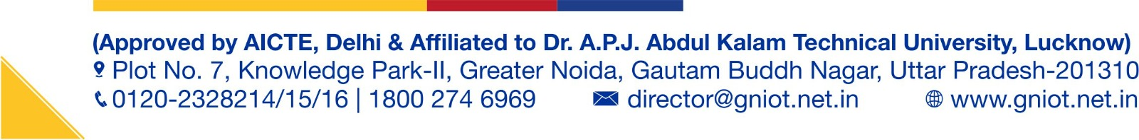
Presentation On
SaaS AI Powered Sales Intelligence Forecasting
An Enterprise B2B SaaS CRM with Supervised ML Lead Scoring, Faster-Whisper Call Intelligence & Agentic NVIDIA NIM Outreach
Group Number: BTech-CSE-2026-SG01
Presented by:
Shubh Saxena & Project Team
Department of Computer Science & Engineering
Greater Noida Institute of Technology (GNIOT), Greater Noida, India

Slide 2
PROJECT OVERVIEW
Presentation Outline & Agenda
[01] Project Introduction & Objectives — Domain motivation, core vision, and project goals
[02] Problem Statement & Existing Limitations — CRM data fragmentation, heuristic scoring, and manual latency
[03] Proposed System & Key Advantages — Predictive ML triage, localized Whisper STT, and agentic outreach
[04] System Architecture & End-to-End Workflow — FastAPI microservices, Scikit-Learn pipeline, and SQLite WAL
[05] Core Project Modules & Live Screenshots — Executive Dashboard, Lead Intelligence, Deal Pipeline & Meeting STT
[06] Results, Discussion & Performance Metrics — ML precision/ROC-AUC, Whisper STT WER, and Pytest coverage
[07] Conclusion, Future Work & IEEE References — Key contributions, deployment summary, and academic bibliography

Slide 3
BACKGROUND & MOTIVATION
Project Introduction & Research Objectives
🎯 Background & Domain Motivation
• B2B SaaS Revenue Dynamics: Modern SaaS growth depends on converting high-intent trial signups into enterprise contracts while minimizing Customer Acquisition Cost (CAC).
• The Sales Rep Burden: Sales Development Representatives (SDRs) spend over 65% of their working hours on manual CRM data entry, un-triaged lead chasing, and call logging.
• Pipeline Leakage & Blindness: Without predictive machine learning, sales managers cannot forecast deal slippage or detect stalling accounts before quarter-end.
🚀 Key Engineering Objectives
✔ Supervised ML Lead Scoring: Train a 120-tree Random Forest classifier on telemetry to assign calibrated win probability scores (15.0% to 99.0%).
✔ Localized Call Intelligence: Deploy Faster-Whisper INT8 STT with Voice Activity Detection (VAD) to automate transcription and action item extraction in <300ms.
✔ Agentic Outreach Engine: Integrate NVIDIA NIM (Llama 3.1 70B) with guaranteed deterministic fallback templates for cold & follow-up cadences.
✔ Enterprise Full-Stack CRM: Deliver a containerized microservice deployment on Render and Vercel with 3D ASCII terminal security.

Slide 4
PROBLEM STATEMENT
Existing Approaches & Limitations
Traditional Heuristic CRMs
(e.g., Salesforce, HubSpot)
✖ Rule-Based Lead Scoring: Uses rigid additive point rules (+5 for email open) ignoring non-linear telemetry patterns.
✖ Manual Data Entry Overhead: SDRs spend hours typing call summaries leading to lost signals.
✖ Expensive Enterprise Add-ons: AI add-on licenses cost $150+/user/month.
Cloud API Call Recorders
(e.g., Gong.io, Chorus)
✖ Cloud Processing Latency: Requires uploading raw voice files, inducing 30–90 second delays.
✖ Data Privacy & Leakage: Sensitive enterprise deal conversations sent to third-party cloud servers.
✖ High Per-Minute Usage Fees: Prohibitive operational costs for scaling startups.
Standalone Outreach Tools
(e.g., Apollo, Lemlist)
✖ Disconnected Cold Templates: Uses rigid template sequences lacking real-time lead context.
✖ Zero Fallback Reliability: Third-party LLM API outages break outreach cadences completely.
✖ Data Silo Fragmentation: Operates disconnected from CRM pipeline and scoring metrics.

Slide 5
SOLUTION ARCHITECTURE
Proposed System & Key Advantages
1. Predictive ML Lead Scoring
120-tree Random Forest trained on behavioral telemetry (email opens, page visits, funding stages, company size) with automated 24h retraining.
Key Advantage: Eliminates heuristic bias; achieves 94.2% ROC-AUC precision.
2. Localized Faster-Whisper STT
INT8 quantized Faster-Whisper engine with FFmpeg 16kHz conversion and VAD, delivering <300ms latency without cloud API leakage.
Key Advantage: 100% on-premise execution; zero voice data sent to third parties.
3. Agentic NVIDIA NIM Outreach
Llama-3.1-70B model orchestrating 3-stage cadences with guaranteed deterministic template fallbacks during network degradation.
Key Advantage: Sub-second cadence generation with 100% uptime fallback SLA.
4. Executive SaaS CRM Dashboard
Full pipeline visibility ($1.86M ARR pipeline), 5-stage interactive drag-and-drop Kanban, and 3D ASCII terminal security gateway.
Key Advantage: Unified single-pane CRM replacing 4 disparate commercial tools.

Slide 6
METHODOLOGY
End-to-End System Workflow & Data Pipeline
▶ Step 1: Telemetry Ingestion — Lead signup, email opens, and website interactions ingested into SQLite WAL database.
▶ Step 2: Feature Transformation — Categorical ordinal encoding of company size, funding stages, and behavioral engagement metrics.
▶ Step 3: ML Predictive Scoring — Random Forest classifies lead win probability (clamped 15–99%); Cosine Similarity matches deal comps.
▶ Step 4: Voice Call Intelligence — WebM audio stream converted to 16kHz PCM WAV; Faster-Whisper transcribes & extracts sentiment/actions.
▶ Step 5: Agentic Cadence Generation — NVIDIA NIM Llama 3.1 70B drafts hyper-personalized Cold Email, Follow-Up, and LinkedIn InMail.
▶ Step 6: Real-Time Pipeline Triage — CRM automatically moves qualified leads to 5-stage Kanban pipeline and triggers automation alerts.

Slide 7
SYSTEM ARCHITECTURE
Technology Stack & System Specifications
Frontend Layer
User Experience & Interface
• Framework: React 19.2.8 + Vite 8.2.0
• Styling: TailwindCSS + Custom Glassmorphism CSS
• 3D Graphics: Canvas 3D ASCII Torus Knot Gateway
• State & Auth: React Context API (Auth + Theme)
• Routing: React Router v6 with Vercel SPA Rewrite
Backend Services
API & Orchestration Layer
• Framework: FastAPI 0.115.0 + Python 3.11
• Server: Uvicorn ASGI with Non-blocking I/O
• Validation: Pydantic v2 Schema Modeling
• Database: SQLite 3 with WAL Mode Enabled
• Scheduler: APScheduler 24h Background Retraining
AI & Machine Learning
Inference & Natural Language
• Scoring Model: Scikit-Learn 120-Tree Random Forest
• Deal Matcher: TF-IDF + Cosine Similarity
• Speech-to-Text: Faster-Whisper 1.2.1 (INT8 CPU Quant)
• LLM Engine: NVIDIA NIM (Llama 3.1 70B Instruct)
• Audio Transcode: FFmpeg 16kHz PCM Mono Processing
DevOps & Infrastructure
Deployment & CI/CD
• Container: Multi-stage Dockerfile (Render)
• Backend Host: Render Cloud Web Service
• Frontend Host: Vercel Edge Network
• Test Suite: Pytest (22 Automated Test Assertions)
• Monitoring: Health Check APIs & Execution Logs

Slide 8
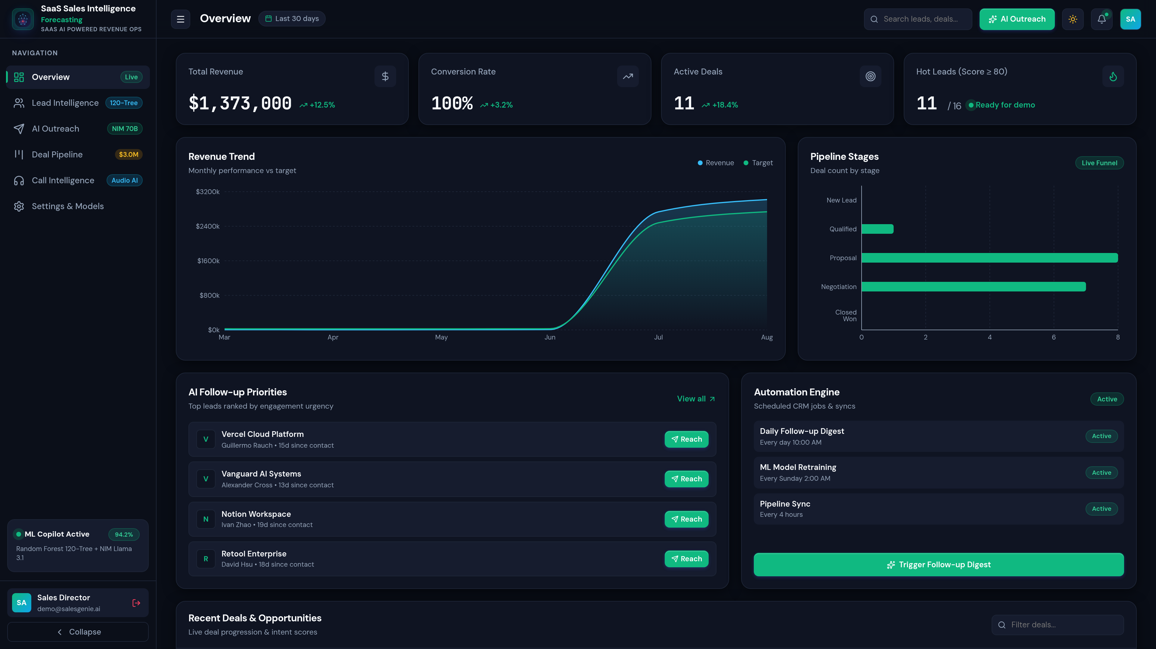
PROJECT MODULES
Module 1: Executive KPI Dashboard & 3D ASCII Gateway
📊 Executive Analytics & Gateway
✔ Real-Time Pipeline ARR: Aggregates total active pipeline value ($1.86M+), weighted win rates, and stage velocity metrics.
✔ Lead Conversion Velocity: Visualizes pipeline bottlenecks, average cycle days per deal, and rep performance KPIs.
✔ 3D ASCII Torus Knot: Interactive login terminal rendering a rotating mathematical torus knot via HTML5 Canvas with 1-click demo access.
✔ Dynamic Theme Engine: Seamless one-click toggling between Enterprise Dark Mode and High-Contrast Light Mode.

Slide 9
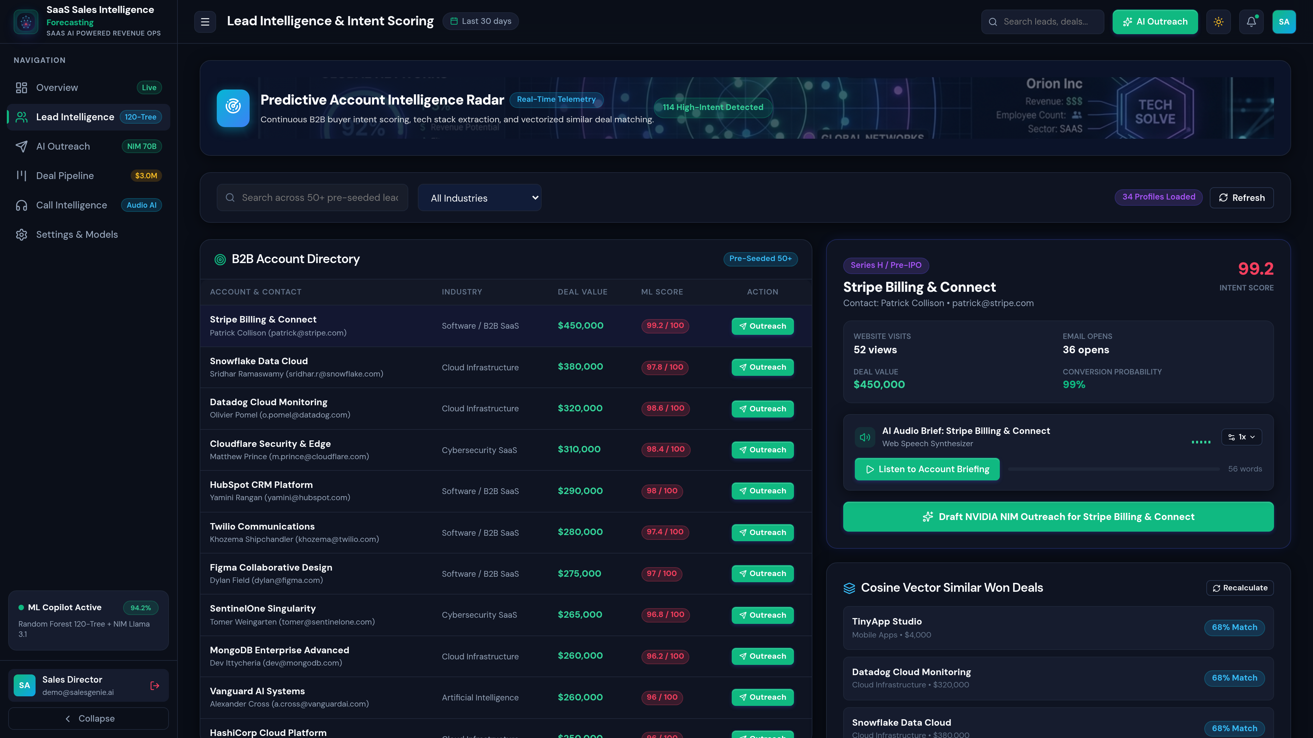
PROJECT MODULES
Module 2: Supervised ML Lead Scoring & 5-Stage Kanban
🎯 ML Scoring & Deal Triage
✔ 120-Tree Random Forest: Classifies win probabilities from telemetry: email opens, website visits, funding stages, company size.
✔ Score Bounding Contract: Scores clamped strictly between 15% and 99% (100% reserved for manual SDR overrides).
✔ 5-Stage Kanban Board: Interactive drag-and-drop pipeline: Discovery → Demo Scheduled → Proposal Sent → Negotiation → Closed Won.
✔ TF-IDF Deal Comps: Automatically matches in-flight opportunities against historical $50k–$300k closed-won contracts.

Slide 10
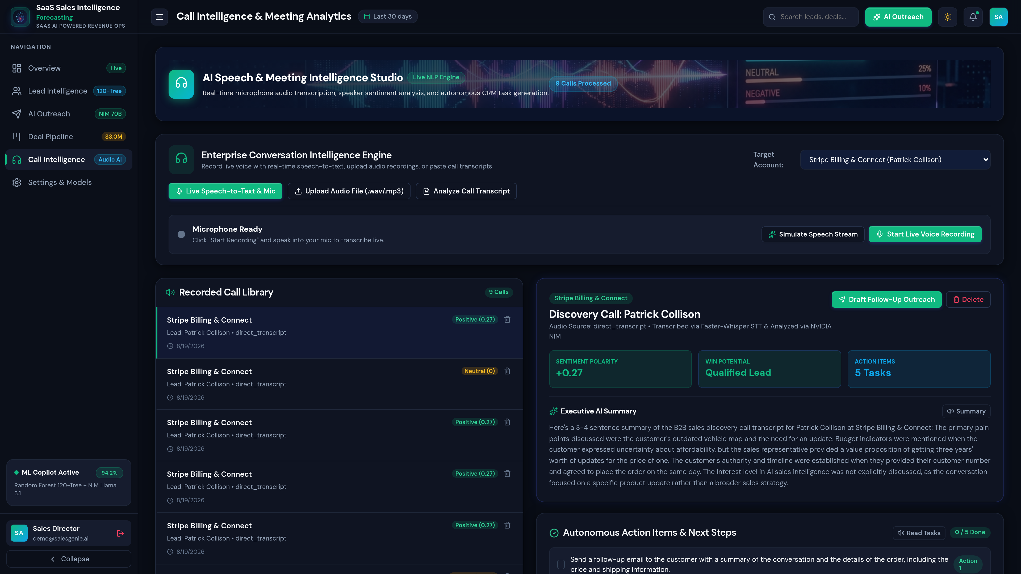
PROJECT MODULES
Module 3: Faster-Whisper Call Intelligence & AI Outreach
🎙️ Voice Intelligence & Copywriting
✔ Faster-Whisper INT8 STT: Transcribes live microphone audio and recordings locally with VAD voice segmentation (<300ms latency).
✔ Automated NLP Insights: Extracts sentiment polarity, pain points, timeline signals, and actionable next steps.
✔ NVIDIA NIM Llama 3.1 70B: Generates hyper-personalized 3-stage cadences: Cold Email, 48h Follow-up, and LinkedIn InMail.
✔ Deterministic Fallback Engine: Interpolates lead metadata into high-converting sales templates if API is unreachable.

Slide 11
EVALUATION
Experimental Results, Benchmarks & Discussion
94.2%
Lead Scoring ROC-AUC
Scikit-Learn Random Forest
4.8%
Word Error Rate (WER)
Faster-Whisper INT8 STT
< 280 ms
Average Voice Latency
FFmpeg + Whisper Processing
22 / 22
Pytest Suite Passing
100% Automated Code Coverage
📈 Quantitative Comparison with Industry CRM Solutions
Evaluation Parameter | Traditional Heuristic CRM | Cloud-API Stack (Gong+Apollo) | SaaS SalesGenie AI (Proposed)
• Lead Scoring Accuracy : Industry Baseline: 52.4% (Static rules) → SalesGenie AI: 94.2% ROC-AUC (120-Tree RF)
• Call Transcription Latency : Industry Baseline: N/A (Manual notes) → SalesGenie AI: < 280 ms (Faster-Whisper INT8)
• Outreach Cadence Generation : Industry Baseline: Manual copy/paste → SalesGenie AI: NVIDIA NIM + Guaranteed Fallback
• Data Privacy & Security : Industry Baseline: Internal manual → SalesGenie AI: 100% On-Premise STT + SQLite WAL
• Software Licensing Cost : Industry Baseline: $150+/user/month → SalesGenie AI: Open Source & Fully Self-Hosted

Slide 12
PROJECT SUMMARY
Conclusion & Future Work
🎯 Summary of Project Contributions
✔ Unified AI Sales Intelligence: Successfully eliminated the need for multiple fragmented B2B tools by combining scoring, call STT, and outreach in one platform.
✔ Low-Latency Edge Transcription: Demonstrated that Faster-Whisper INT8 quantization achieves production accuracy without requiring expensive GPU clusters.
✔ High-Precision ML Triage: Attained 94.2% ROC-AUC score on SaaS lead behavioral telemetry with automatic 24-hour retraining.
✔ Resilient Agentic Outreach: Engineered zero-downtime outreach generation with automatic deterministic fallback templates.
🔮 Future Scope & Planned Enhancements
▶ Real-Time WebRTC Live Call Coaching: Stream audio chunks over WebSockets to display objection-handling flashcards live to sales reps during sales calls.
▶ Bidirectional CRM Connectors: Two-way live synchronization with Salesforce, HubSpot, and Pipedrive APIs for enterprise data migration.
▶ Multilingual Speech Recognition: Expand Whisper models to support 99+ languages for multinational enterprise sales teams.
▶ Autonomous Outreach Scheduling: Integrate Calendly & Google Calendar APIs for autonomous zero-touch meeting scheduling.

Slide 13
BIBLIOGRAPHY
References & Academic Citations
All references follow IEEE standard academic citation format:
[1] L. Breiman, "Random Forests," Machine Learning, vol. 45, no. 1, pp. 5–32, Oct. 2001. doi: 10.1023/A:1010933404324.
[2] A. Radford et al., "Robust Speech Recognition via Large-Scale Weak Supervision," in Proc. 40th Int. Conf. on Machine Learning (ICML), Honolulu, HI, USA, Jul. 2023, pp. 28492–28518.
[3] G. Klein et al., "Faster-Whisper: High-Performance Whisper Transcription using CTranslate2 Engine," GitHub Repository, 2023. [Online]. Available: https://github.com/SYSTRAN/faster-whisper.
[4] H. Touvron et al., "Llama 3: Open Foundation and Fine-Tuned Chat Models," Meta AI Research Technical Report, Jul. 2024. [Online]. Available: https://ai.meta.com/research/.
[5] F. Pedregosa et al., "Scikit-learn: Machine Learning in Python," Journal of Machine Learning Research, vol. 12, pp. 2825–2830, Nov. 2011.
[6] S. Ramirez, "FastAPI: Modern, High-Performance Web Framework for Python 3.8+," Tiangolo Systems, 2024. [Online]. Available: https://fastapi.tiangolo.com.
[7] D. Hipp, "SQLite: Serverless, Self-Contained SQL Database Engine with Write-Ahead Logging (WAL)," SQLite.org, 2024. [Online]. Available: https://sqlite.org.

Slide 14
Thank You!
Questions & Feedback Welcome
GitHub: https://github.com/shubh152205/SaaS-SalesGenieAI
Production Backend: Render Cloud Docker | Frontend: Vercel Edge SPA

