Slide 1

Hisaab Kitaab
OSTPL MINI-PROJECT

Slide 2
Our Team
Shubh Gangar
Harshit Jain
1911013
1911017

Slide 3
Introduction
In today's expensive world, one has to maintain his/her expense to know about their saving depending upon their income and their expenditure. One also needs to track down where he/she spends more money so as to cut down his/her expense and save more for the future.

Slide 4

Problem Definition
At the end of the month we start to have money crisis.
Lack of proper planning of our income.
Person has to keep a log in a diary or in a computer.
All the calculations needs to be done by the user.
Overload to rely on the daily entry of the expenditure.

Slide 5
Why Expense Tracker
Tracking Your Expenses Can Reveal Spending Issues
It Helps You Stick to Your Budget
It Helps You Meet Your Financial Objectives

Slide 6
Scope Of Project
01
03
05
02
04
06
Storing a Record
Search Record
Check Current Balance
Your daily expense be it a debit or credit gets stored in the database.
You can search a particular transaction by its date, type or the opposite party.
You can check your current balance after a transaction.
View Your Records
Delete Record
View Your Expenses
You can view your transactions and their dates.
You can delete a particular record.
A pie chart displaying your previous and the current month expenses.

Slide 7
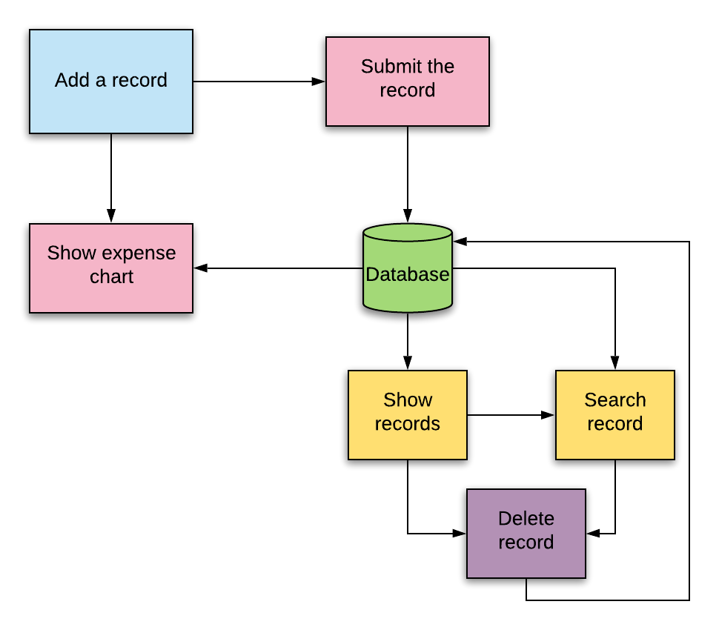

Slide 8
Packages Used
Tkinter
Datetime
Matplotlib
Calendar
Pillow
TkCalendar
Sqlite3

Slide 9
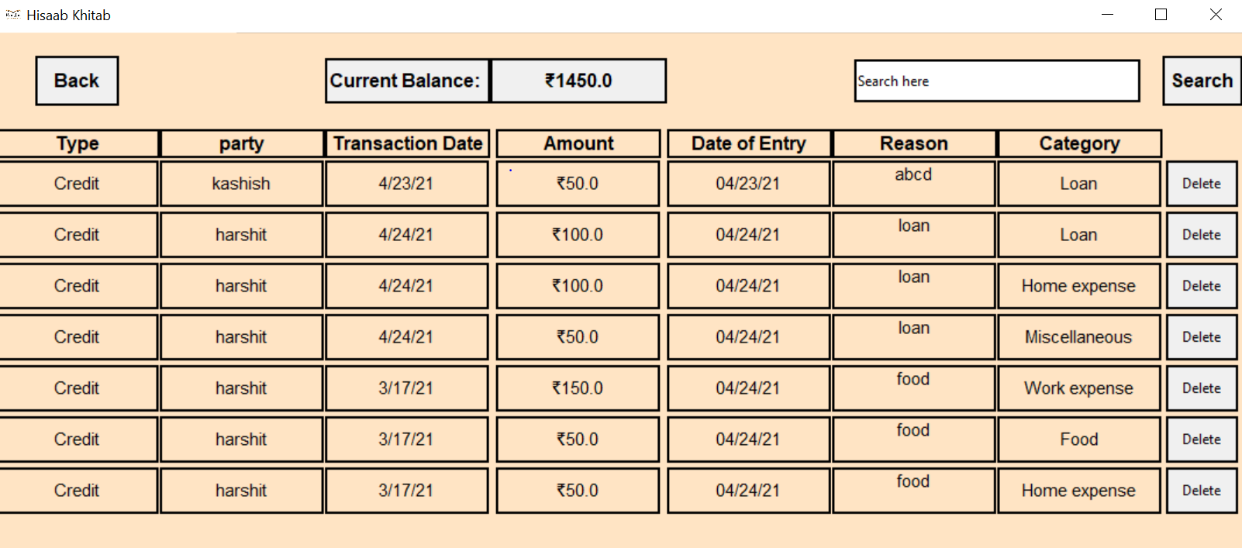
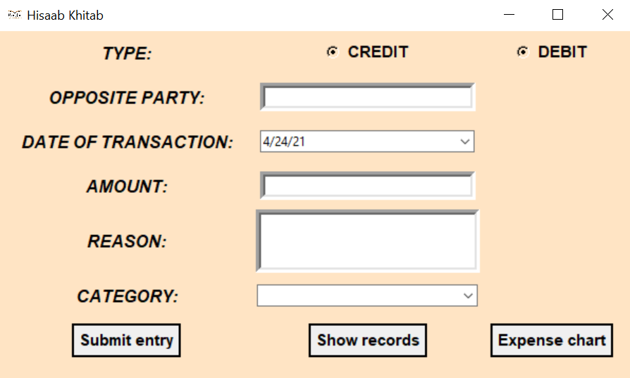
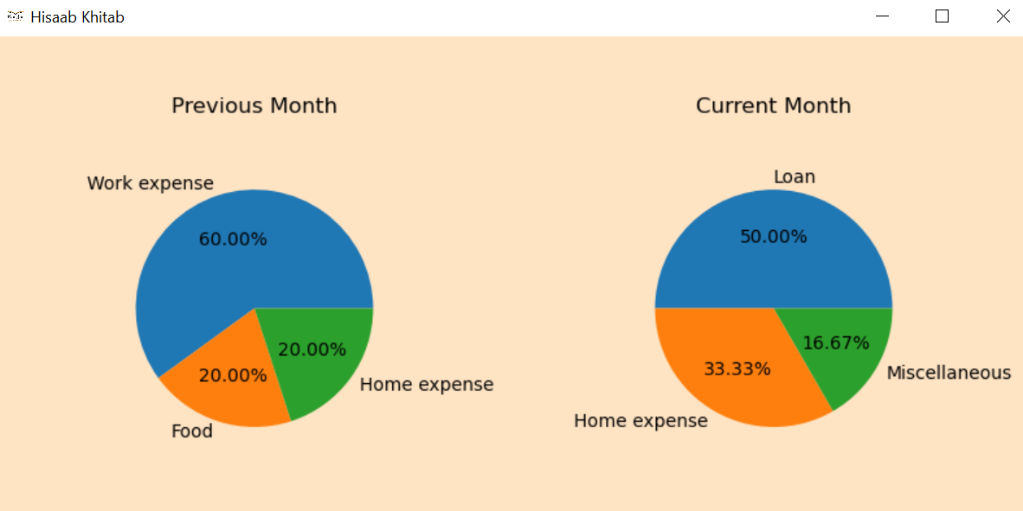
Sneak Peek

Slide 10
Conclusion
Hence we believe that our application will help people to keep track of their expenses and will assist them to improve their budget.
This project also helped us to understand tkinter and various other python packages and how to use them.

Slide 11
THANK YOU!
Github Link: https://github.com/shubh1605/TKinterProject

