Slide 1
Relation Extraction
Manas Joshi
2015ME10108
Shubham Singla
2015ME10383
Notes:
Good Morning everyone, I am Shubham and this is my friend Manas. We are working on project of relation extraction from biochemical research papers. So, Let’s see what the actual problem statement is,

Slide 2
Problem Statement
Generate reference data (structured content) from published research articles (unstructured content)
Create database for different entity types
To infer about the characteristics of a microbe such as
Aerobic
Anaerobic
Notes:
The problem statement that we are going to solve is to generate structured content from published research articles. Basically, what is meant by this structured content is to find various attributes of our interest such as substrates, environment in which microbe appears. Apart from this, we have created a database for all the entity types such as microbes, property of microbe, substrate etc and use this database to infer about the characteristics of microbes. The inference that we need to make is whether a particular type of microbe is found in aerobic conditions or anaerobic.

Slide 3
Approach
Corpus
Identify entities of interest
Identify and extract relations
Inference
Proposed Model
Corpus - Pre-defined set of documents provided by ExxonMobil subject matter experts
Entities include pseudomonas, deep sea, quinoline, aeruginosa etc.
Relations include such as pseudomonas found in ground water, aeroguinosa acts on quinoline etc.
Inference part mainly focuses on characterising whether a bacteria is found in aerobic conditions or not
Notes:
To tackle this task of identifying the useful relations, we have divided the task into sub tasks. First of all, we need to have corpus which is basically pre-defined set of documents provided by ExxonMobil subject matter experts. After that, we need to identify the entities which are of interest to us such as …. Further, after identifying the entities and their types, we need to develop some kind of model to extract relevant relations between them such as ….and then infer from these relations whether a bacteria is aerobic or anaerobic.

Slide 4
Entity types of Interest
Microbes (Pseudomonas, desulfohalobium)
Environment (deep sea, groundwater, landfills)
Substrate (benzoyl, butane, nitrite, nitrate)
Nutrient (Tryptone Soy Broth, ammonium)
Process (fermentation, incineration, PCR)
Enzyme (oxygenase, manganese peroxidase)
Property (aerobic, anaerobic, carcinogenic)
Notes:
Going through a some articles from corpus and problem statement we decided that the entities and their types that are of interest to us include the list stated in the slides such as microbes, environment such as deep sea or ground water, substrates that act with the help of microbes and nutrient, different reactions and processes such as fermentation, incineration to name a few and so on.

Slide 5
Entity Collection
Manual annotation, listing and refining
Online resources:
NCBI (List of Microbes)
PubMed (List of Research papers)
PubChem (List of Substrates)
Springer (List of Research papers)
Science Direct (List of Research papers)
Notes:
We need to manually annotate the documents and prepare list corresponding to each entity and further refine them to produce as much as accuracy as possible to the best of our knowledge. Although, some online resources such as NCBI, PubChem etc are used for obtaining the list of microbes or substrates. But manual annotation was necessary to include all such entities and identify them according to their type.

Slide 6
Annotation
Pattern matching from text
Annotate as entity type
Hydrocarbon as substrate
Pseudomonas as microbe
Identifying and separating adjectives for each entity type
Aliphatic hydrocarbon
Methanogenic sediments
Remove stop words from the adjective list
Various
significant
Visualize and verify using brat
Notes:
For annotating the different entities and their corresponding types, we did pattern matching from the manually

Slide 7
Relations
Extract specific kinds of stated entity-entity relations such as:
Found In <Microbe, Environment> | Pseudomonas found in groundwater
Of_m <Property, Microbe> | Aerobic nature Of Pseudomonas
Act On <Microbe, Substrate> | Pseudomonas act on benzene
Carried On_m <Process, Microbe> | Infiltration carried on_m Pseudomonas
Produce <Microbe, Enzyme> | Pseudomonas produce carboxylase
Carried On_s <Process, Substrate> | Biodegradation carried on_s benzene
Occurs In <Process, Environment> | Oil degradation occurs in deep sea
Inhibit <Enzyme, Process> | Lignin peroxidase inhibit oxygenation

Slide 8
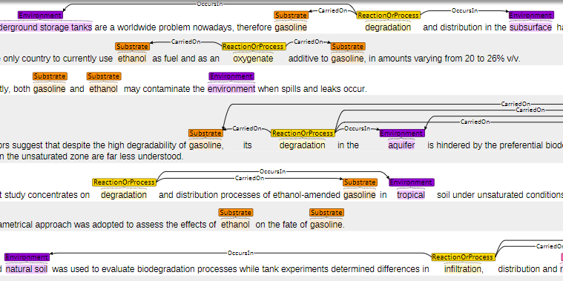

Slide 9
Relation Extraction
Requires a dictionary of entities and relation terms, or well-defined rules for identifying them
Model 1 – Co-Occurrence
Relation made according to entities available in a single sentence
Model2 – Bag of words
Classification model using probability of words present in between
two entities
Notes:
For relation extraction
We decided to use the

Slide 10
Model 1 – Co-Occurrence
Annotate entities and their types in each sentence
Annotate pseudomonas in entity whose entity type is defined as microbe
Specified relation entities present or not
Make a relation between such entities
Relations such as Pseudomonas is found in groundwater where found in relation is made between entity types, microbes and environment

Slide 11
Results
Number of Test Documents = 6
Number of relations = 426
Relation Type | Precision(Number of relations)
Found In <Microbe, Environment> | 0.167 ( 6)
Of_m <Property, Microbe> | NA
Act On <Microbe, Substrate> | NA
Carried On_m <Process, Microbe> | 0.2(15)
Produce <Microbe, Enzyme> | NA
Carried On_s <Process, Substrate> | 37.91(211)
Occurs In <Process, Environment> | 34.46(201)
Inhibit <Enzyme, Process> | NA

Slide 12
Model 2 - Bag of Words
Training Data
Label Co-occurrence data as 0 or 1
For every true/false relation - train model by calculating
the probability of each word
Cross Validation Data
Find the threshold from the trained data for each relation
Test Data
Test model on new articles or test data
Calculate F-Score and compare with other models

Slide 13
Future Work
Try new models for relation extraction:
Use POS(part-of-speech) tags and path in dependency trees as features for a multi class classifier
Inference:
Make a classifier to infer characteristics of microbe e.g. – aerobic or anaerobic

Slide 14
Analyze Sentence Structure
Create rules

Slide 15
Create Vocabulary

Slide 16
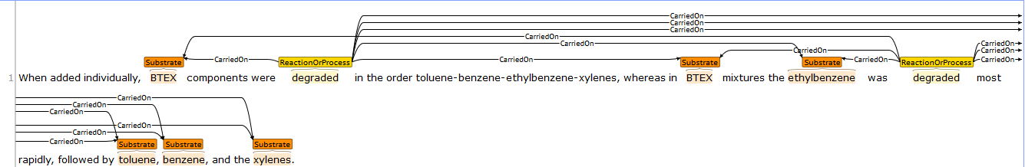
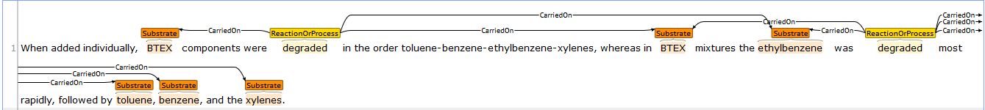
After correction using dependency parsing

Slide 17
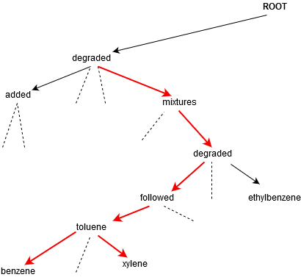

Slide 18
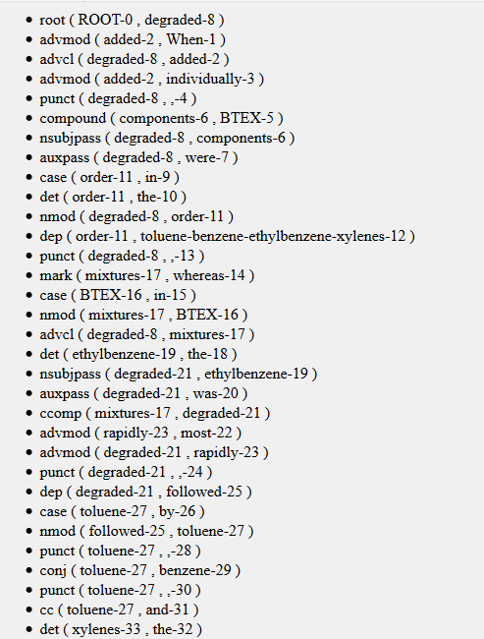

Slide 19
Thank You

